Slide 1
Stock Report
Summary

Slide 2
TSLA: 2018-11-05 to 2018-11-26

Slide 3
Summary
TSLA closed down at 325.83 dollars per share on 2018-11-26.
High: 337.5
Low: 325.55
Close: 325.83
Notes:
Data were analyzed using these packages:
tidyquant
quantmod
tidyverse

Slide 4
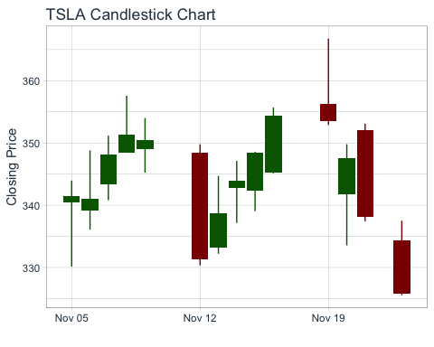
Price History
Stock prices for TSLA

Slide 5
TSLA last week
date | open | high | low | close
2018-11-14 | 342.70 | 347.11 | 337.15 | 344.00
2018-11-15 | 342.33 | 348.58 | 339.04 | 348.44
2018-11-16 | 345.19 | 355.70 | 345.12 | 354.31
2018-11-19 | 356.34 | 366.75 | 352.88 | 353.47
2018-11-20 | 341.75 | 349.80 | 333.55 | 347.49
2018-11-21 | 352.00 | 353.10 | 337.40 | 338.19
2018-11-23 | 334.35 | 337.50 | 325.55 | 325.83

Slide 6
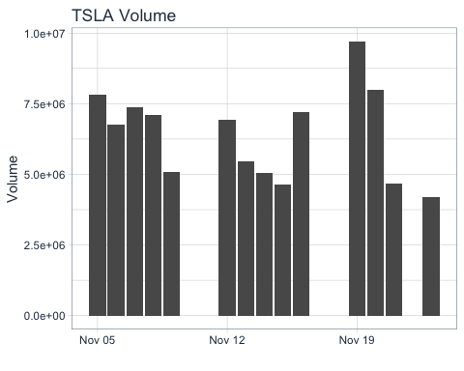
Volume
TSLA trading volume was 4,202,600 shares on 2018-11-26. Average trading volume over this time period was 6,430,229 shares.
Trading volume for TSLA

