Slide 1
Customer Tracker Report

Slide 2
Overview
Data were compared from pre and post periods by week. This report shows pecentage change by:
Total (segment)
Total (group)
Week (period)

Slide 3
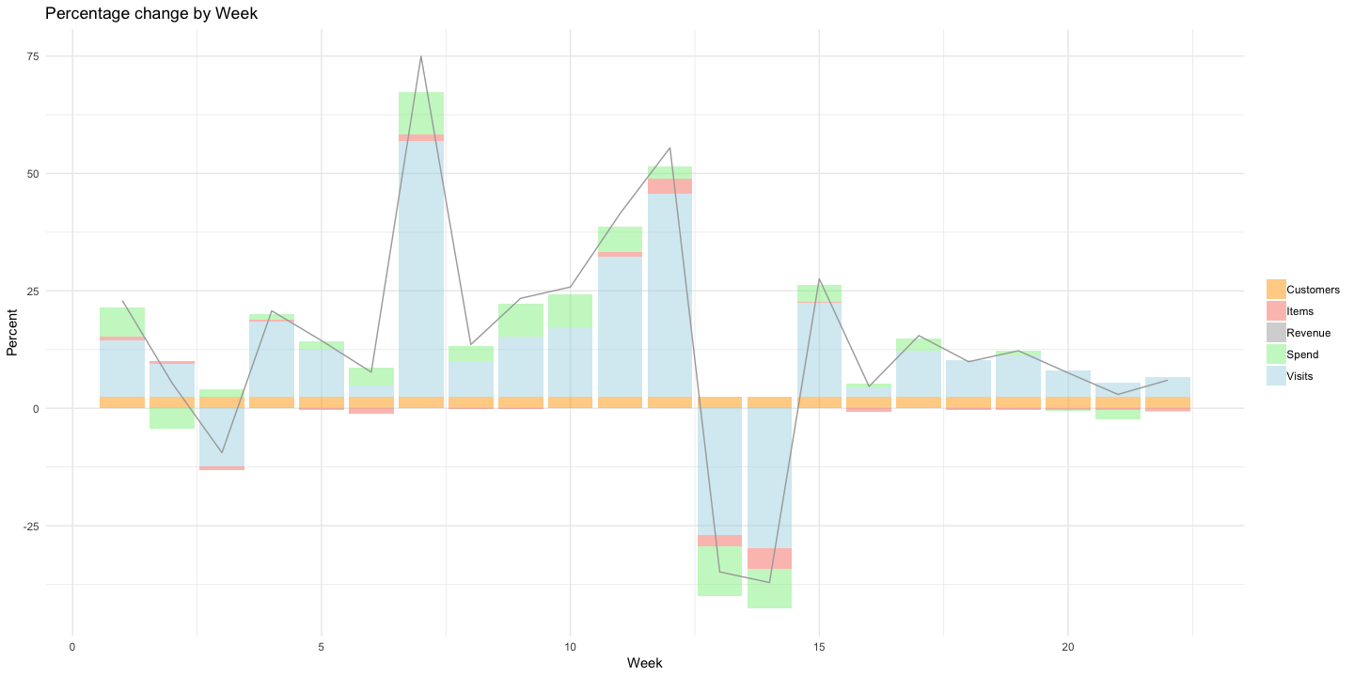
Results

Slide 4
Detail
Week | Revenue | Customers | Visits | Items | Spend
1 | 22.9% | 2.4% | 12.1% | 0.8% | 6.3%
2 | 5.4% | 2.4% | 7.1% | 0.5% | -4.4%
3 | -9.5% | 2.4% | -12.4% | -0.7% | 1.7%
4 | 20.7% | 2.4% | 16.0% | 0.4% | 1.2%
5 | 14.4% | 2.4% | 10.0% | -0.3% | 1.9%
6 | 7.7% | 2.4% | 2.4% | -1.1% | 3.9%
7 | 74.9% | 2.4% | 54.5% | 1.4% | 9.1%
8 | 13.6% | 2.4% | 7.6% | -0.2% | 3.3%
9 | 23.4% | 2.4% | 12.9% | -0.1% | 6.9%
10 | 25.8% | 2.4% | 14.6% | -0.0% | 7.2%
11 | 41.5% | 2.4% | 30.0% | 1.0% | 5.3%
12 | 55.5% | 2.4% | 43.2% | 3.3% | 2.7%

Slide 5
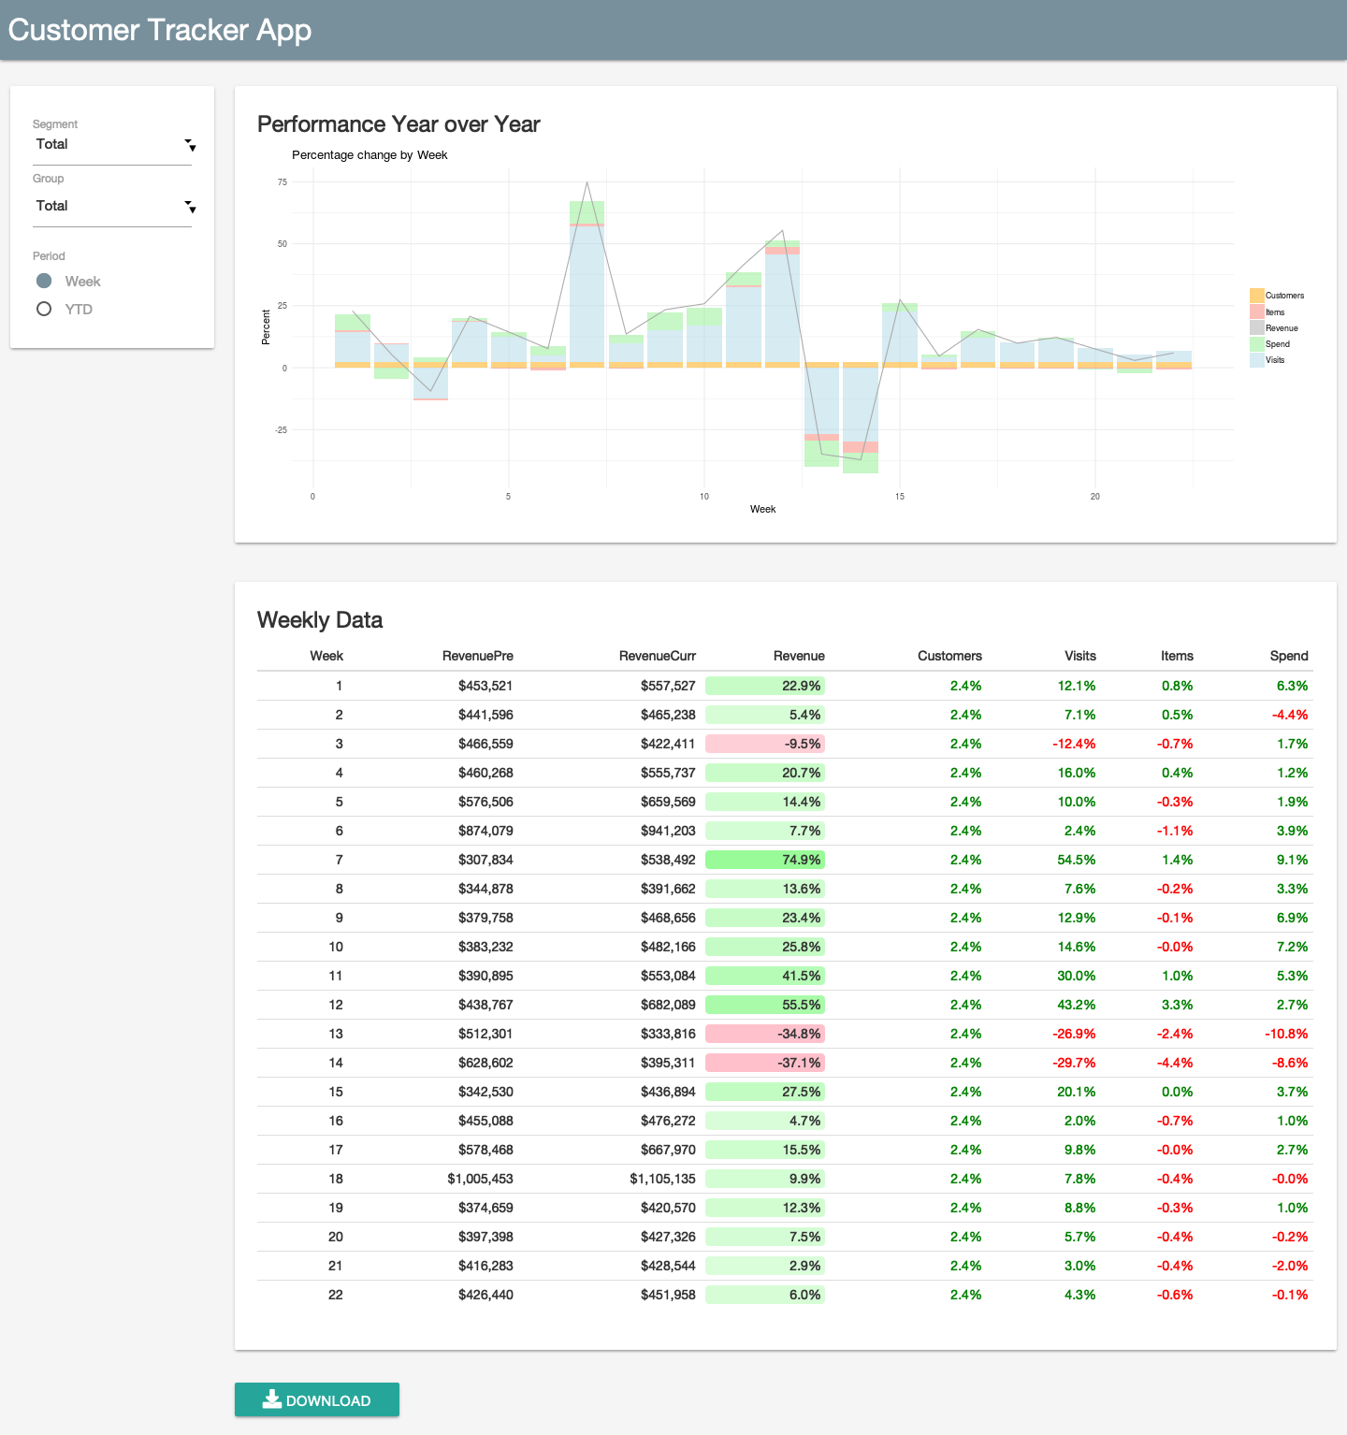
Shiny App
This report is for:
Segment: Total
Group: Total
Use the Shiny app to explore explore other segments and groups.
Click image to open app.
Notes:
Click on the image to open the Shiny app in RStudio Connect. Or visit online at http://colorado.rstudio.com/rsc/content/1120/.

