Slide 1
Shiny and PowerPoint
How to include a Shiny app in your presentation

Slide 2
Overview
What if you want to include a Shiny application in your PowerPoint presentation? With the webshot package, you can embed a screenshot of a Shiny application that links viewers to a live application hosted on RStudio Connect, Shiny Server, or Shinyapps.io.

Slide 3
Requirements
Install the webshots package and phantomjs.
install.packages("webshot") webshot::install_phantomjs()

Slide 4
Using
Use knitr::include_app('<URL>') to include a Shiny application in your presentation. The render process will automatically take a screenshot of your Shiny app and link the image to your hosted app.
knitr::include_app('https://gallery.shinyapps.io/goog-trend-index/')

Slide 5
Useful chunk options
You can use knitr options to control the webshot experience.
Specify image width
fig.width=15
Cache your screenshots
cache=TRUE
Wait for the image to load before taking a screenshot
screenshot.opts=list(delay=5)
Add an image caption
fig.cap="Click Image to Open App"

Slide 6
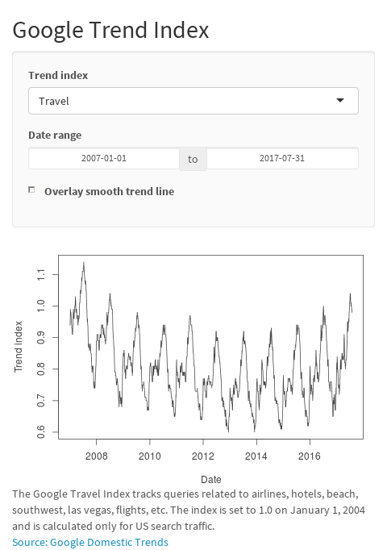
Include a Shiny App in PowerPoint
Click image to open

