Slide 1
Stock Report

Slide 2
TSLA: 2018-07-25 to 2018-08-15

Slide 3
Summary
TSLA closed down at 347.64 dollars per share on 2018-08-15.
High: 359.2
Low: 347.1
Close: 347.64
Notes:
Data were analyzed using these packages:
tidyquant
quantmod
tidyverse

Slide 4
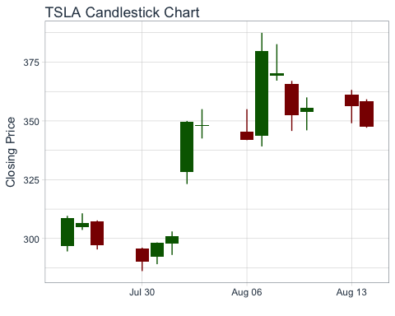
Price History
Stock prices for TSLA

Slide 5
TSLA last week
date | open | high | low | close
2018-08-06 | 345.46 | 354.98 | 341.82 | 341.99
2018-08-07 | 343.84 | 387.46 | 339.15 | 379.57
2018-08-08 | 369.09 | 382.64 | 367.12 | 370.34
2018-08-09 | 365.55 | 367.01 | 345.73 | 352.45
2018-08-10 | 354.00 | 360.00 | 346.00 | 355.49
2018-08-13 | 361.13 | 363.19 | 349.02 | 356.41
2018-08-14 | 358.45 | 359.20 | 347.10 | 347.64

Slide 6
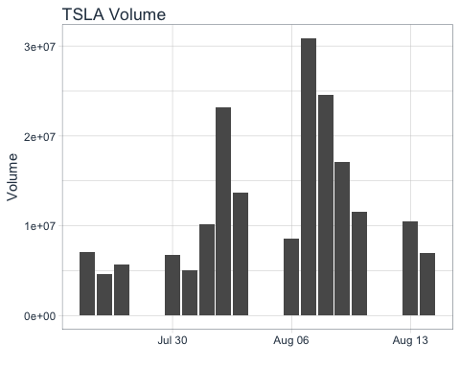
Volume
TSLA trading volume was 6,986,400 shares on 2018-08-15. Average trading volume over this time period was 12,426,980 shares.
Trading volume for TSLA

