Slide 1
R Code Chunks

Slide 2
Syntax Highlighting
library(dplyr) nycflights13::flights %>% select(carrier, arr_time) %>% filter(!is.na(arr_time)) %>% group_by(carrier) %>% summarize(average = mean(arr_time)) %>% arrange(average)

Slide 3
knitr::kable(mtcars)
Sepal.Length | Sepal.Width | Petal.Length | Petal.Width | Species
5.1 | 3.5 | 1.4 | 0.2 | setosa
4.9 | 3.0 | 1.4 | 0.2 | setosa
4.7 | 3.2 | 1.3 | 0.2 | setosa
4.6 | 3.1 | 1.5 | 0.2 | setosa
5.0 | 3.6 | 1.4 | 0.2 | setosa
5.4 | 3.9 | 1.7 | 0.4 | setosa

Slide 4
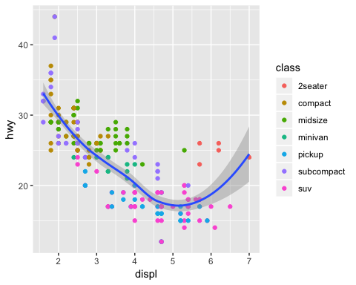
ggplot(mpg, ...)
Highway miles per gallon vs engine displacement

Slide 5
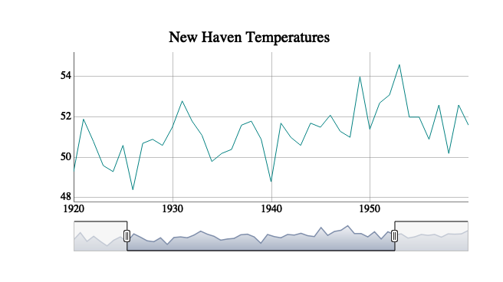
dygraph(nhtemp, ...)
Screenshot of interactive dygraph

