Slide 1
PowerPoint Templates

Slide 2
Defining a Template
Any template included with a recent install of Microsoft PowerPoint (either with .pptx or .potx extension) should work, as will most templates derived from these.

Slide 3
Template Contents
The specific requirement is that the template should contain the following four layouts as its first four layouts:
Title. Defined in the YAML header.
Section header. Break the presentation into sections. These slides have a section header but no content.
Title and content. Presentation content.
Two Content. Presentation content in two columns.
All templates included with a recent version of MS PowerPoint will fit these criteria. (You can click on Layout under the Home menu to check.)

Slide 4
Modyify the default template
You can also modify the default reference.pptx: first run
pandoc --print-default-data-file reference.pptx > custom-reference.pptx
Then modify custom-reference.pptx in MS PowerPoint (pandoc will use the first four layout slides, as mentioned above).

Slide 5
Example Section Header

Slide 6
Example Title and Content with Speaker Notes
Data science is an exciting discipline that allows you to turn raw data into understanding, insight, and knowledge. The goal of “R for Data Science” is to help you learn the most important tools in R that will allow you to do data science.
Notes:
Data science toolchain:
Access
Understand
Communicate

Slide 7
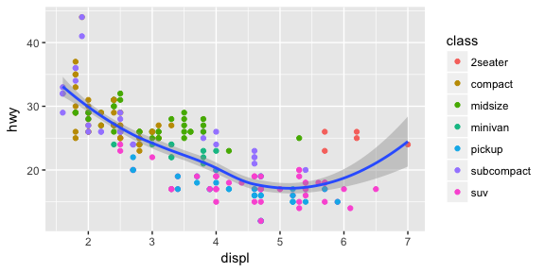
Example Title and Content
Highway miles per gallon vs engine displacement

Slide 8
Example Two Content
First you must import your data into R. This typically means that you take data stored in a file, database, or web API, and load it into a data frame in R. If you can’t get your data into R, you can’t do data science on it!
Once you have tidy data, a common first step is to transform it. Transformation includes narrowing in on observations of interest (like all people in one city, or all data from the last year), creating new variables that are functions of existing variables (like computing velocity from speed and time), and calculating a set of summary statistics (like counts or means).

Slide 9
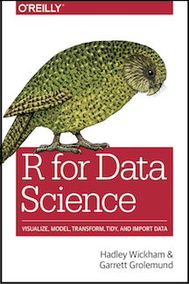
Example Two Content
Click to open
R for Data Science

