Slide 1
X-Series
赫杰辉

Slide 2
What is X-Series
A set of light weight framework/tools
With Graphic UI
Easy to use
Easy to integrate
Easy to test
Solving the problem of large scale software development
Communication
Documentation
Learning curve

Slide 3
What developers really want
你不知道你不知道
The Challenge
The Root Cause
The Need
The Answer
The Next

Slide 4
The Challenge
Big company development syndrome
Document Maze
It is hard to keep document up-to-date
Document misses the implementation detail
“Show me the code” – with bugs
Source Code Hell
Big class, big method, big trouble
Huge nested if-else trees
Hard coded component composition
No development tool
Most tools are doing administration instead of development
The build system, CI, Source control, homegrown processes, etc.
More administration tool, more tough life
They are slow down your development pace
Stay calm with new tools/framework/standard/language
Is it really something new? Is it just solve existing problem which is already solved in an existing way?
Do we even realize it? Even we do, can we make a change?
Shut up and enjoy?

Slide 5
The Root Cause
Development is Translation
Requirement → Design → Code
Where there is translation there is misunderstanding
There are detail enhance/lose between abstraction levels
Requirement Translation
I am sure PM or business users don’t understand code
I am not sure if developers understand business requirement
Design Translation
Class diagram limitation
It shows relationship between entities instead of how work is done [wrong answer]
Sequence diagram limitation
Only show particular execution path and can not handle branch or loop well
These diagrams are still documents need to be translated

Slide 6
The Need
Development does not ONLY mean writing code
We need right answer for right question
Sadly, we answer all questions with one answer
We need something everyone understand without translation
Visualize high level system model
Behavior
Decision
State
Work on mode instead of code
It is not code generation, the model should always stay same in different stage
GUI Editor
Model file
Runtime

Slide 7
The Answer
Xross unit
Depict high level logic flow focus on how to do
Service level
Xross Decision tree
Model complex decision making
Module level
Xross state
Organize business workflow by do what
Domain level
Xeda
SEDA model
Runnable Instance level

Slide 8
Xross Unit
Xross unit editor is flexible system builder
Build system using flow diagram
Within eclipse in WYSIWYG way.
Provide rich components
processor, converter, validator, locator
Provide rich structures
chain, if-else, branch, while, do while loop, decorator, adapter
Edit naturally
Drag drop and unit combination – E.g. Validator + Unit = if/else structure
And configurable
Properties to be specified at application or unit level
Still want to see code? Double click!!!
Check out the default implementation or
Provide your own component or structure

Slide 9
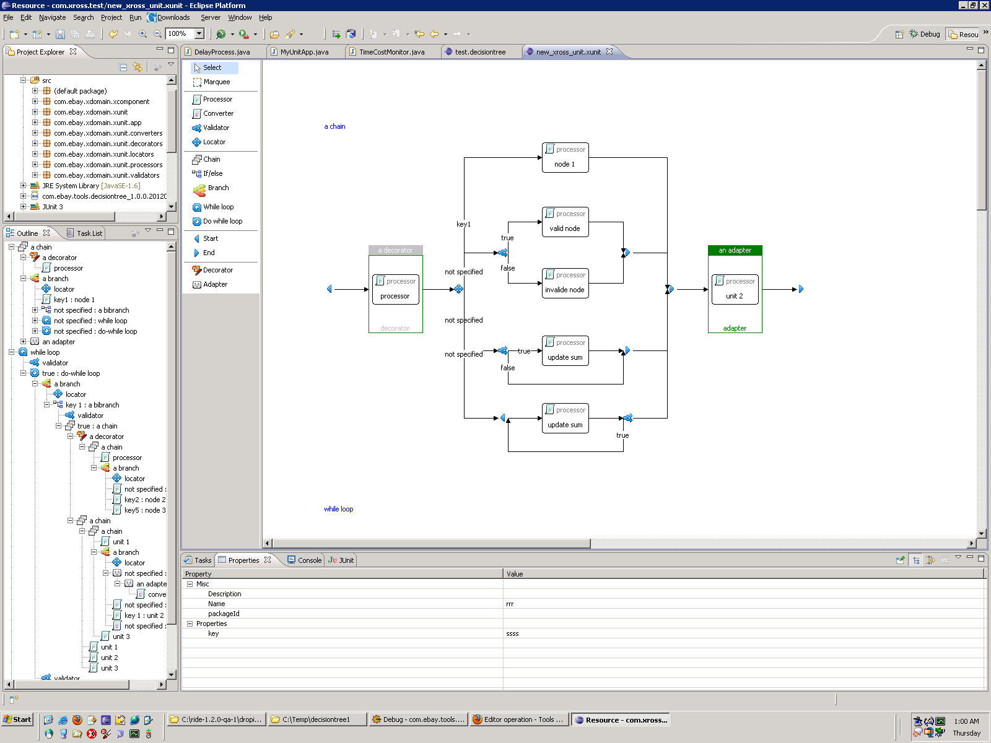
Xross Unit

Slide 10
More about Xross Unit I
It is not another spring
Spring: construct system from structure perspective
Xunit: handle request from behavior perspective
It is not a workflow
Workflow do task/path management during multiple round of req/resp between multiple roles
Xunit manages path for one req/resp
It is not a visual programming language
Visual programming language interprets and produces code
Xunit compose behavior and structural unit at business level
Workflow
Xunit
Spring
Visual Language

Slide 11
More about Xross Unit II
Why using unit to do what code also can do
Because size matters, guess what you do with the following
“Hello World”
A web service
A small web app
A site at a size of taobao, ebay, ctrip
Why not using existing command framework
Because they all lack insight into there “unit” -- command
Servlet – Command at URL level
JEE: Session Bean, Entity Bean, Message Bean – Command at bean id level
Although there are many small commands which are just at a size of one page
There are also few but important one which is of “monster” size

Slide 12
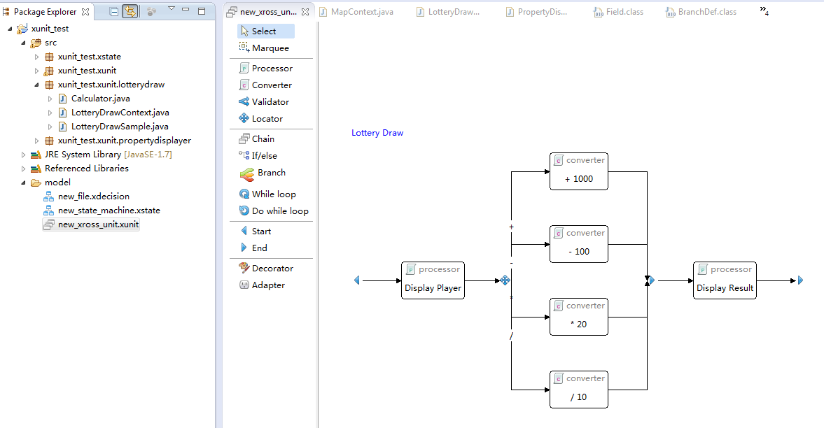
Xunit Sample
Create diagram
You can keep polishing and discuss with PM, PD, QA

Slide 13
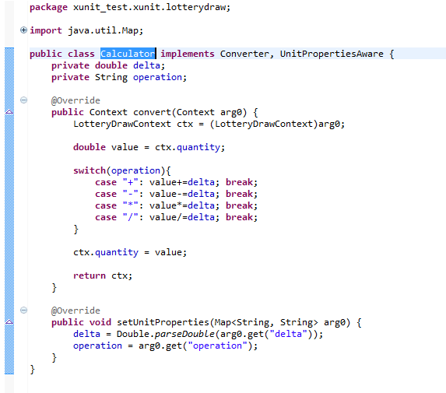
Xunit Sample
Create unit

Slide 14
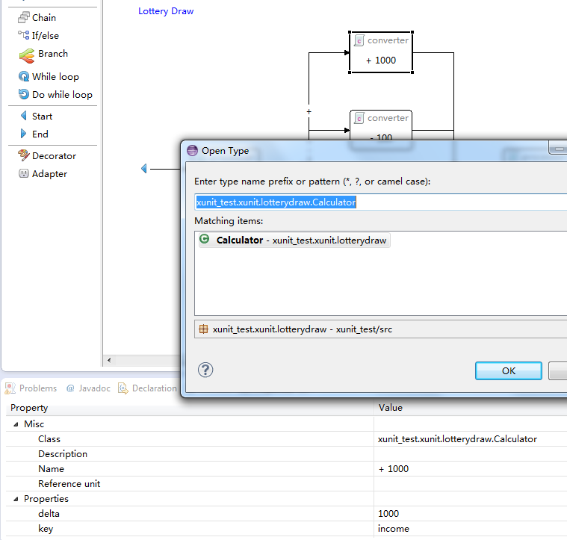
Xunit Sample
Assign class and set properties

Slide 15
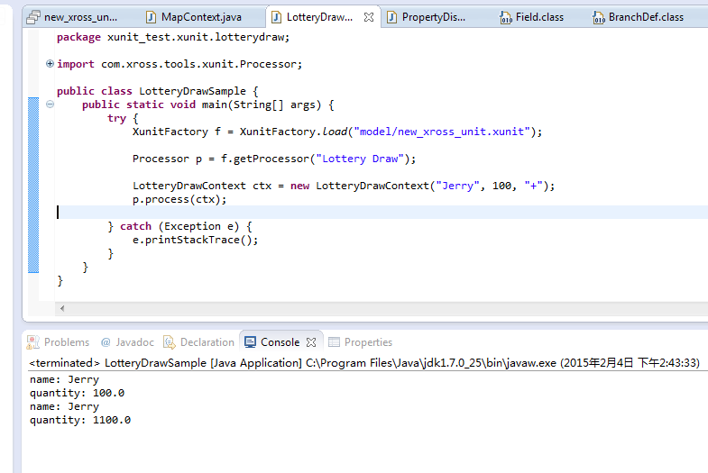
Xunit Sample
Check it out

Slide 16
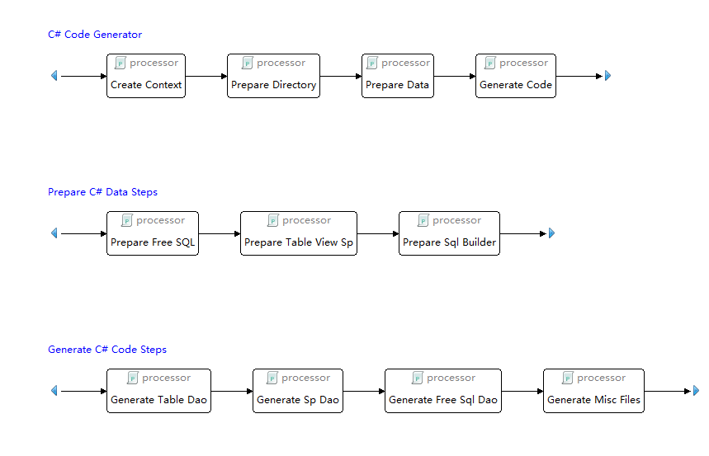
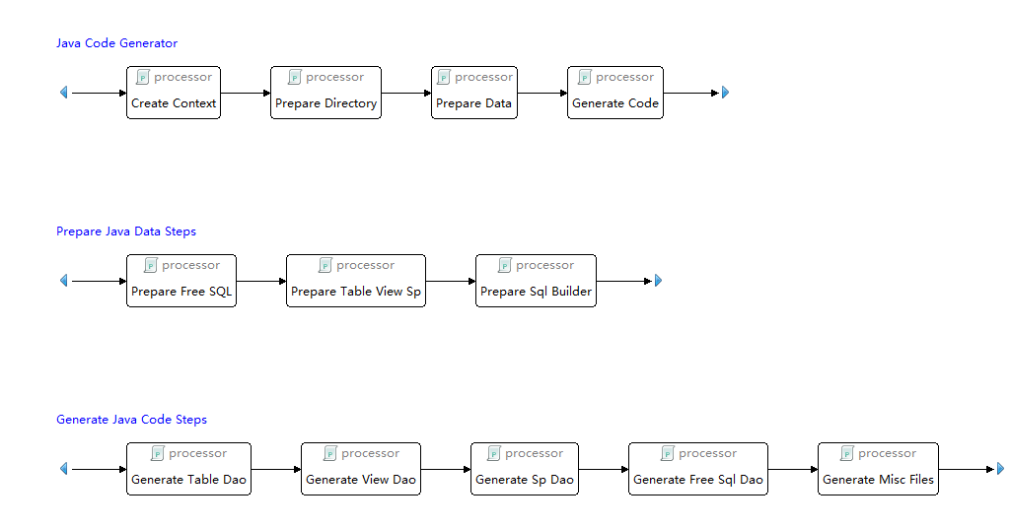
Xunit is field tested

Slide 17
Decision tree
What is decision tree
A common tool used in business intelligence domain
To represent complex decision making path in a tree model
Decision Tree Editor enables developer
Create decision tree
Within eclipse in WYSIWYG way
Verify model correctness with generated unit test
Cover all paths that a decision can be reached
Benefit
Pure model, no code.
Can be reused
Replace you if/else, tremendously deduce code

Slide 18
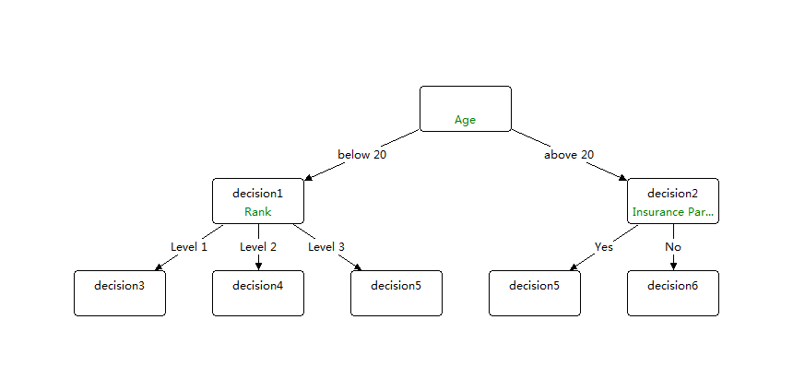
Decision tree

Slide 19
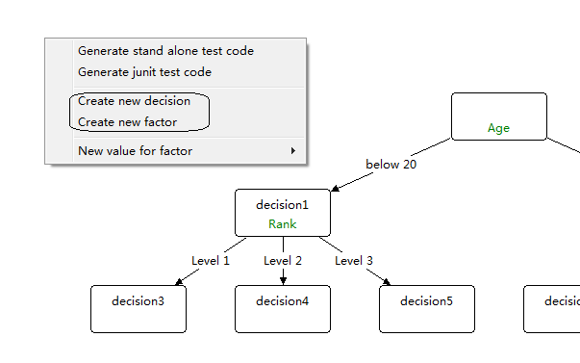
Decision tree
Specify Factors
Variable that has several value
Specify Decision
Key that identifies particular decision result

Slide 20
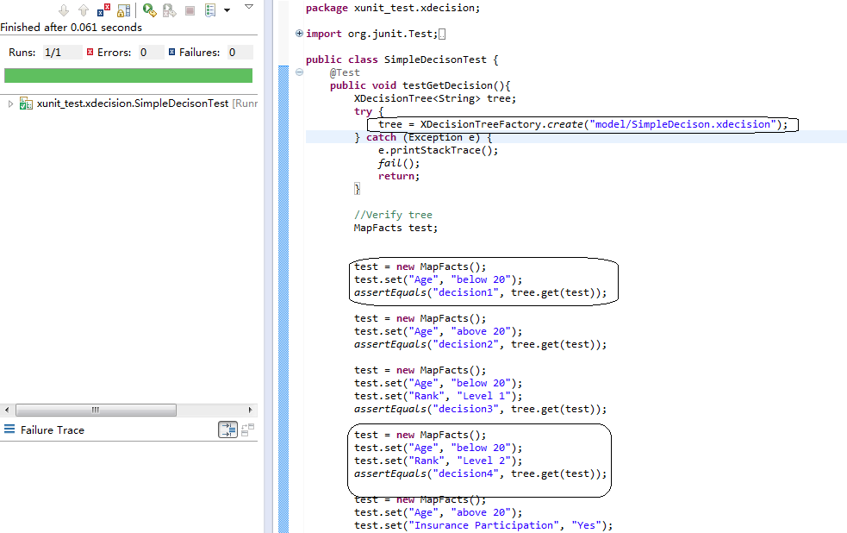
Decision Tree

Slide 21
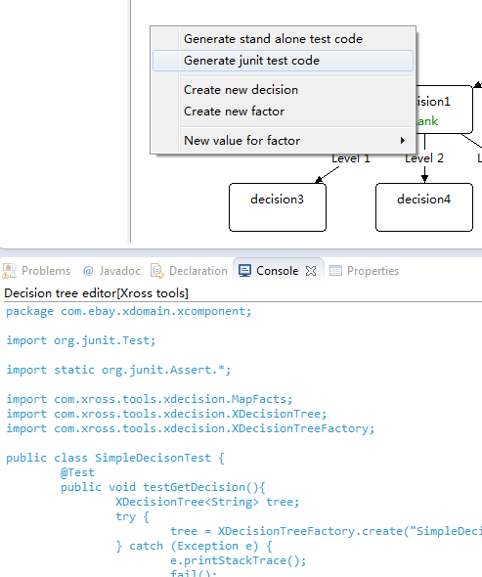
Generate Unit Test
To verify model
Show how to use

Slide 22
Xross State
A state machine editor that allow developer create state machine to represent state change
Like decision tree, it cares only the state machine model.
No couple with client code
The model file can be parsed by runtime to trigger state transition

Slide 23
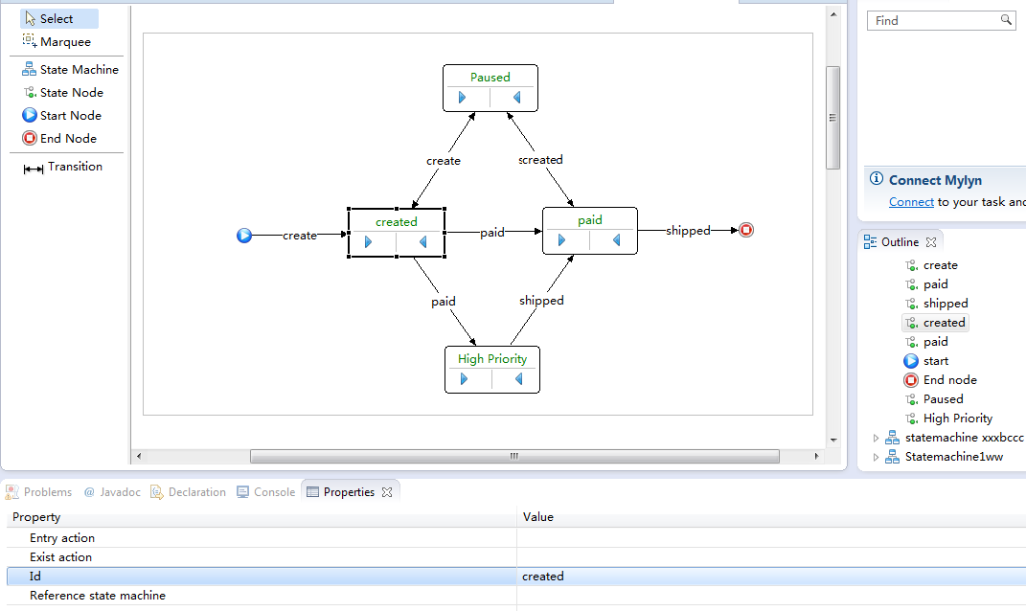
Xross State

Slide 24
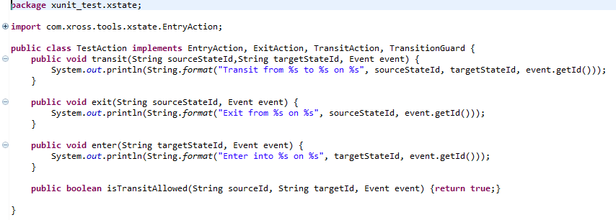
Xross State
Actions on transition
EntryAction
ExitAction
TransitionAction
Validator for transition
TransitionGuard

Slide 25
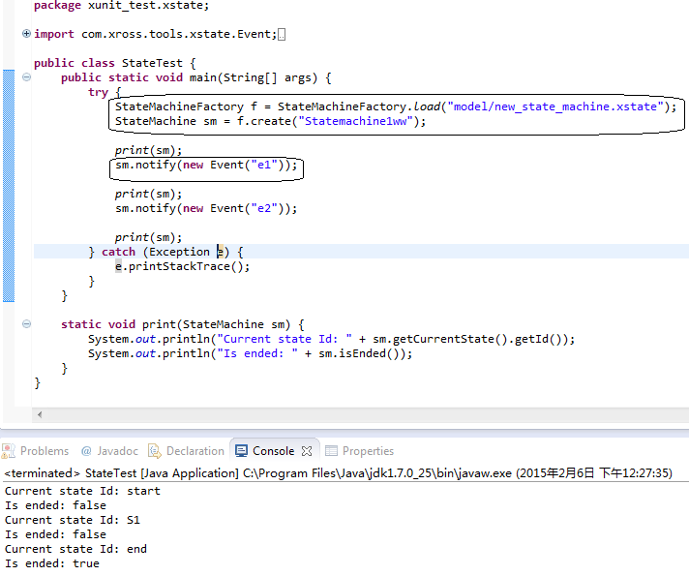
Xross State

Slide 26
X series resource
Codebase
https://github.com/hejiehui/xUnit
https://github.com/hejiehui/xDecision
https://github.com/hejiehui/xState
Sample
https://github.com/hejiehui/xross-tools-installer/blob/master/com.xross.tools.xunit.feature/installer/xunit_test.zip
All-in-one Installer
https://github.com/hejiehui/xross-tools-installer/blob/master/com.xross.tools.xunit.feature/installer/xrossTools.zip

Slide 27
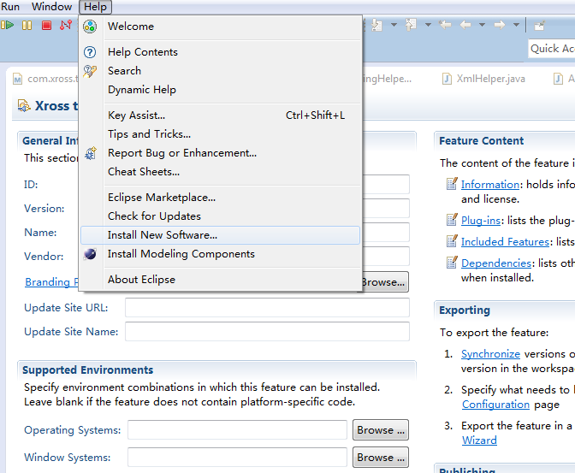
Install X series
First download installer zip

Slide 28
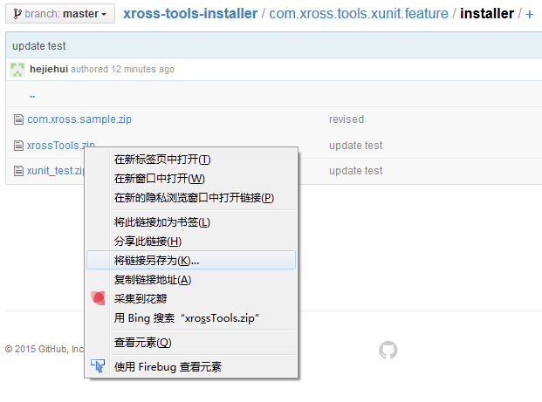
Install X series

Slide 29
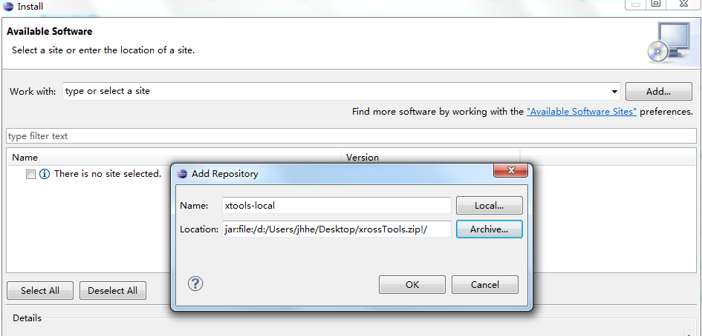
Install X series

Slide 30
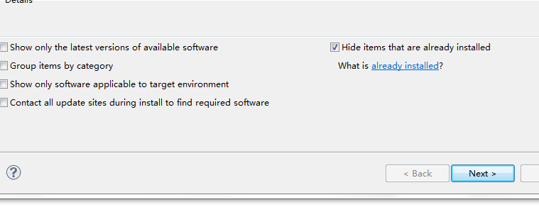
Install X Series
In case you have installed GEF, you can uncheck the following

Slide 31
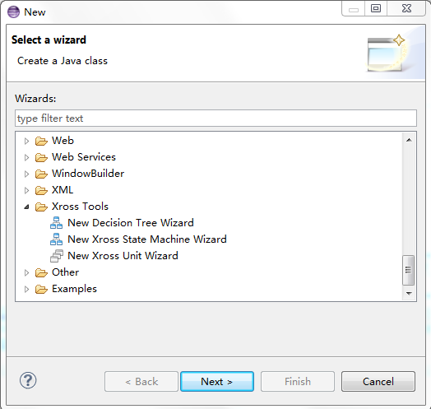
Install X Series
New…Xross Tools

Slide 32

The Next
XEDA
SEDA/Microservice implementation
Service transition
Managing/Monitoring

Slide 33
Q&A
问题比答案更重要

