Slide 1
Franklin Templeton Web Platform Team Testing 101 Information Sharing 18/01/2018
By Anthony M^{c}Kale Wizard without Portfolio

Slide 2
Overview
Testing Overview
General Testing Theory
Testing 101
Web Platform Recap
Redux “Jest” Testing
Aurelia View Model “Karma / Jasmine” Testing
Profit…

Slide 3
1) Testing Overview
Why test code… ? Testing …
… helps flesh out requirements (especially edge cases)
… helps ensure code works as expected
… helps ensure regression hasn’t happened
… prevents regression in the future
… helps aid future understanding (e.g. provides example usage code)

Slide 4
1) General Testing Theory
Test General Use cases
Test Edge Cases
Test the Complexity (if statements, for loops etc “-/+ 1” errors are easily created yet easily testable)
Delete unreliable tests (often tests can develop race time conditions, delete and rewrite these tests)
Monitor / Review Code Coverage
Let Code Coverage direct testing

Slide 5
1) General Testing Theory
Unit Tests are better than Blackbox* Tests
Blackbox* Tests are better than Sanity Tests
Sanity Tests are better than no tests at all
Blackbox* also has named similar variants Snapshot / Smoke tests

Slide 6
1) General Testing Theory
http://www.developertesting.com/archives/month200705/20070504-000425.html
https://martinfowler.com/bliki/TestCoverage.html

Slide 7
1) Testing 101 Basic Terms
Assertion – single condition check
Test – single function asserting one or more conditions * this can be a integration / unit or other type of test
Test Suite –a group of related Test
Test Runner – a program that runs a Test Suite
Jasmine – name of a popular Javascript Test Runner

Slide 8
1) Testing 101 Basic Constructs
Mock – object/class pretending to be a working class, will often return canned (or stubbed) data * aka a Time object to allow test to be any time
Stub – dumb object pretending to be real data/class/object
Fixture – pre-canned data pretending to be real data, aka http response / io response * typically stored in separate file
Spy / Proxy – magic setter / getter wrapping object/class to return analytics on function calls / usage
Sinion.js – name of a popular mocking/spying library

Slide 9
1) Testing 101 Basic Code Coverage
Code Coverage – Percentage of code ran in tests
Instrumentation – Process of wrapping each line of code with analytics to calculate code coverage
Instanbul – name of the most popular javascript code instrumenter

Slide 10
1) Testing 101 Javascript Testing
Nothing set in stone aka Junit
you create your own testing : Random Test Runner Library + Random Assertions Library +
Random Mocking/Spying/Stubbing Library +
Random Code Coverage Library

Slide 11
1) Testing 101 Javascript Testing
Jest
* All below running in pure node
Test Runner = Jasmine
Assertions = Jest inbuilt + Jasmine inbuilt
Mocking/Spying/Stubbing = Jest inbuilt + Jasmine inbuilt + sinon.js
Code Coverage = Jest Reporter + Instanbul

Slide 12
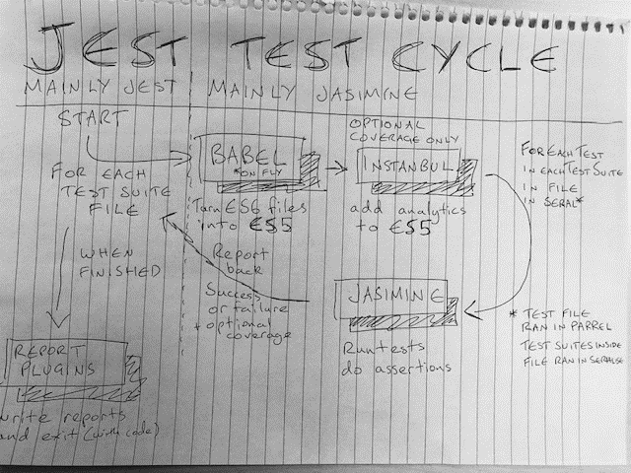
1) Testing 101 Javascript Testing
.

Slide 13
1) Testing 101 Javascript Testing
Jest
* All below running in pure node
Great at pure node unit testing
Bad at browser testing * uses poor man’s browser mock called jsdom can explain details separately for those interested
Normally Fast* * normally unfortunately McAfee breaks babel cache forcing mass on-fly transpiling so actually super slow on corporate machines
Fast-ish on CI though ☺

Slide 14
1) Testing 101 Javascript Testing
Karma + Jasmine
* Karma running in pure node, creates web server, and runs Jasmine in real browser
Web Server = Express + Chrome headless * or any other non-headless for debugging
Test Runner = Jasmine
Assertions = Jasmine inbuilt
Mocking/Spying/Stubbing = Jasmine inbuilt + sinon.js
Code Coverage = Karma Reporter + Instanbul

Slide 15
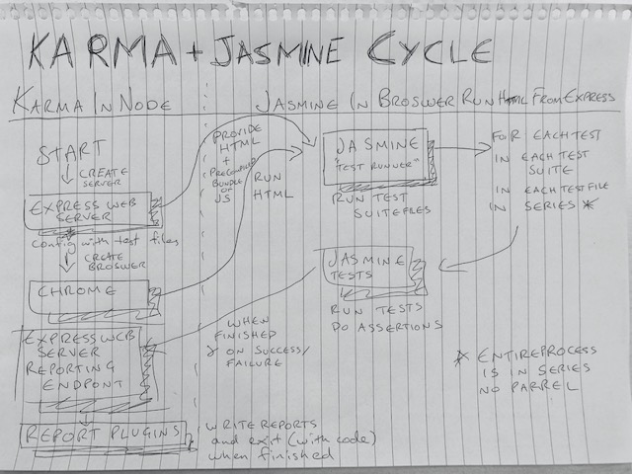
1) Testing 101 Javascript Testing
.

Slide 16
1) Testing 101 Javascript Testing
Karma + Jasmine
* Karma running in pure node, creates web server, and runs Jasmine in real browser
Great at browser testing * can be used to catching browser bugs because it’s a real browser!
Great at basic component integration testing
Typically Slow at Unit testing* * actually x100 faster than JEST due to McAfee breaking in fun and exciting ways we use a pre-compiled bundle rather than Babel on the fly
Can’t run on our CI though ☺ As no browsers installed * pure node browsers like phantom.js do not like Aurelia * can discus offline why no browsers installed / aurelia vs phantom.js

Slide 17
1) Testing 101 Javascript Testing
Common Jasmine Functions
Assertion – single condition check
Test – single function asserting one or more conditions * this can be a integration / unit or other type of test
Test Suite –a group of related Test

Slide 18
1) Testing 101 Javascript Testing
Common Jasmine Functions
Assertion – expect expect(OUTPUT).ASSERTION_FUNCTION(EXPECTED_OUTPUT) examples :
https://jasmine.github.io/2.0/introduction
expect(true).toBe(true);
expect(false).not.toBe(true); // SUGAR EXAMPLE
var message = "foo bar baz";
expect(message).toMatch(/bar/);
expect(message).toMatch("bar");
expect(message).not.toMatch(/quux/);
expect(foo).toEqual(1);
expect(true).toEqual(true);

Slide 19
1) Testing 101 Javascript Testing
Common Jasmine Functions
Test – it * sync / async (determined by presence of argument / polymorph function) Examples:
https://jasmine.github.io/2.0/introduction
it("should work for objects", function() {
var foo = { a: 12, b: 34 };
var bar = { a: 12, b: 34 };
expect(foo).toEqual(bar);
});

Slide 20
1) Testing 101 Javascript Testing
Common Jasmine Functions
Test – it * sync / async (determined by presence of argument / polymorph function) Examples:
https://jasmine.github.io/2.0/introduction
it("should support async expectations", function(done) {
value++;
expect(value).toBeGreaterThan(0);
done(); // Could be in micro or macro
});

Slide 21
1) Testing 101 Javascript Testing
Common Jasmine Functions
Test Suite –a group of related Test
https://jasmine.github.io/2.0/introduction
describe("The 'toBe' matcher compares with ===", function() { var foo; beforeEach(function() { foo = 0; foo += 1; }); afterEach(function() { foo = 0; }); it("and has a positive case", function() { expect(true).toBe(true); }); it("and can have a negative case", function() { expect(false).not.toBe(true); }); });

Slide 22
Intermission
Tea
Cake
Questions ?
Points:
Javascript Testing has had a hard life * It’s a war zone, and changing all the time
Jest is great* for unit testing
Karma is great* for component testing
* Normally discounting environmental issues!

Slide 23
Overview
Testing Overview
General Testing Theory
Testing 101
Web Platform Recap
Redux “Jest” Testing
Aurelia View Model “Karma / Jasmine” Testing
Profit…

Slide 24
2) Web Platform Recap
Our web platform app, are a series of self bootstrapping Web Components They are built using : - The frontend of the Aurelia Framework - The Global Data State framework Redux - Following a M - MV – V Pattern (Model -> View Model -> View)
xxx

Slide 25
3) Web Platform Recap
Aurelia Framework (View and View Model)
Redux Framework (Model)
Model – View Model – View Pattern Redux Model -> Aureila View Model -> Aurelia View

Slide 26
3) “Jest” Testing : Redux Recap
Redux Framework (Model Code)
Redux is a framework for storing global state in our Web-Platform app It contains all the rest calls, configurations, and parsed data It is made up of Actions, States, Stores, and Reducers https://redux.js.org/

Slide 27
3) “Jest” Testing : Redux Recap
State
Dumb object full of serialisable data (e.g. no Maps or Functions, just JSON-ible data)
Store
Current State, wrapped around a Event Dispatcher which has Actions added
Action
Event to be fired on a Store, contains TYPE
Reducer
Event handler set in Store, which responds to specific Action TYPEs, and immutably edits the current State and returns it

Slide 28
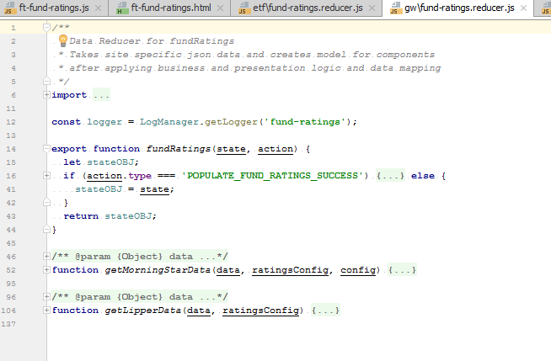
3) “Jest” Testing : Example Reducer
components/products/overview/ft-fund-ratings/gw-etf/lib/gw/fund-ratings.reducer.js

Slide 29
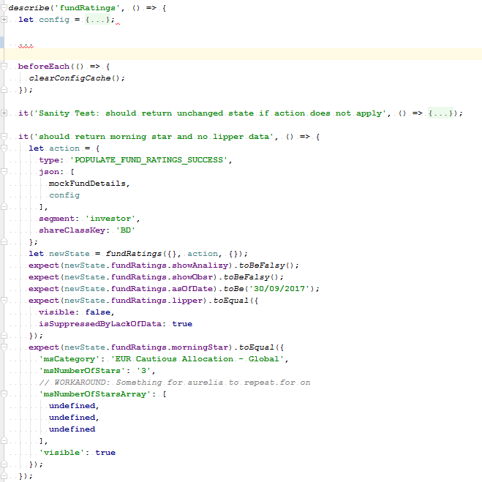
3) “Jest” Testing : Example JEST Test
components/products/overview/ft-fund-ratings/gw-etf/lib/gw/fund-ratings.spec.js

Slide 30
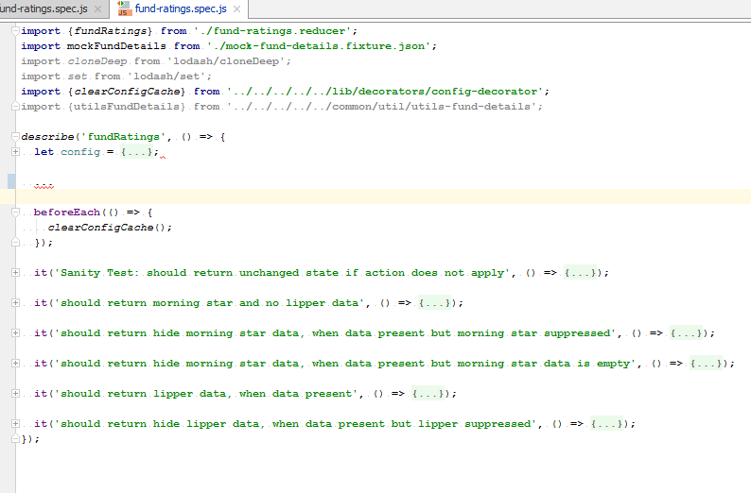
3) “Jest” Testing : Example JEST Test
components/products/overview/ft-fund-ratings/gw-etf/lib/gw/fund-ratings.spec.js

Slide 31
3) “Jest” Testing : Example JEST Test
Sanity Tests
Simple tests, tests the obvious and simple error cases
Snapshot Tests
Simple black box input / output tests, similar to an integration test, comes out the box with jest
Unit Tests
Directed simple input / output test, should be no more than 4-5 assertions, and input should be highly tailored

Slide 32
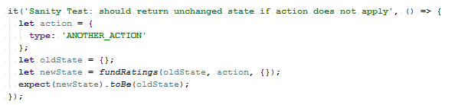
3) “Jest” Testing : Sanity Tests
tests the obvious or simple error cases - Simple / Small
Quick
Only prevents simple errors

Slide 33
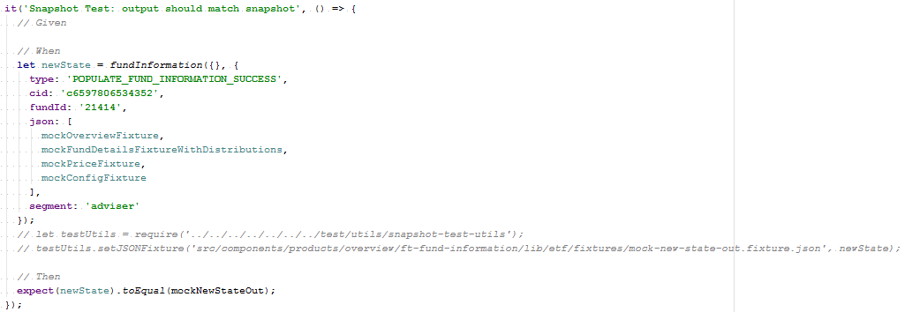
3) “Jest” Testing : Snapshot Tests
tests the full input / output of a function - Simple
Quick to Create
Easy to maintain
Blackbox / Monolithic, doesn’t say much

Slide 34
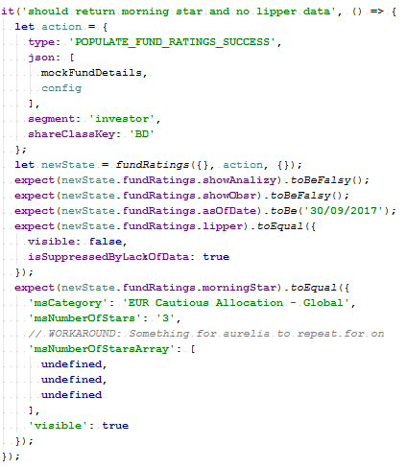
3) “Jest” Testing : Unit Tests
tests the full input / output of a function - Tests Fine Detail
Tests Edge Cases
Directs Bug Fixing
Quick to run
Slow to write
Hard to maintain

Slide 35
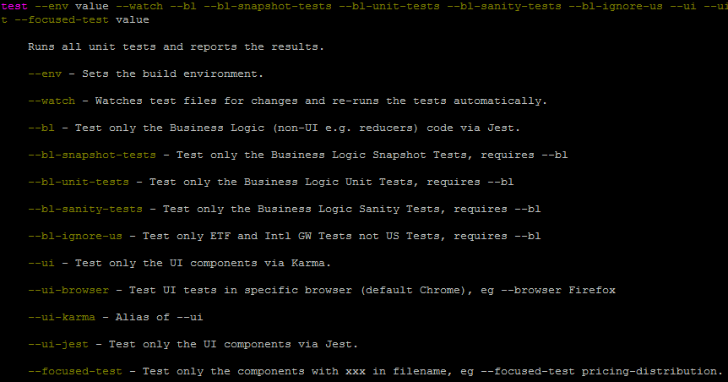
3) “Jest” Testing : How to run
Just runs JEST tests
au test --bl au test --bl --focused-test <class>

Slide 36
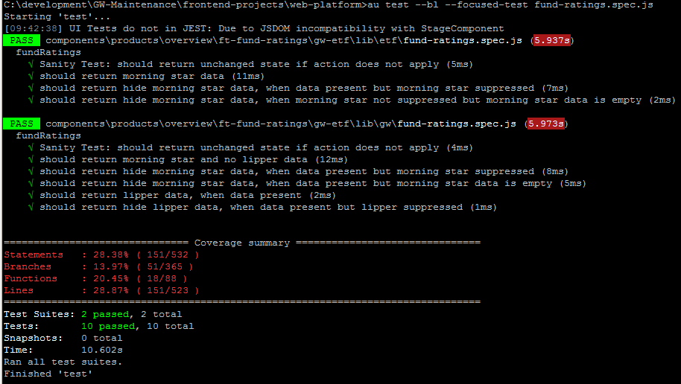
3) “Jest” Testing : Worked Example
GW-Maintenance\frontend-projects\web-platform\src\components\products\overview\ft-fund-ratings\gw-etf\lib\gw\fund-ratings.spec.js

Slide 37
Intermission
Tea
Cake
Questions ?
Points:
Jest is great* for unit testing * Normally, discounting environmental issues!
Jest snapshots are super quick * when not abused or randomly updated on fail
Jest unit tests are super powerful * when not disabled!

Slide 38
4) Web Platform Recap
Aurelia Framework (View and View Model)
Redux Framework (Model)
Model – View Model – View Pattern Redux Model -> Aureila View Model -> Aurelia View

Slide 39
4) “Karma / Jasmine” Testing: Aurelia Recap
Aurelia Framework is a modern web framework - Successor to Angular 1 (after Angular 2 jumped the shark)
Simple to use
Modular
Supports Web Components
https://www.webcomponents.org/
http://aurelia.io/docs/

Slide 40
4) “Karma / Jasmine” Testing: Aurelia Recap
We’re using Aurelia Components, composed of: - View (Templated HTML) - View Model (ES6 View Model Class)
- Value Converters We sparingly use these - Testing
http://aurelia.io/docs/fundamentals/components#creating-a-component
http://aurelia.io/docs/templating
http://aurelia.io/docs/binding
http://aurelia.io/docs/testing

Slide 41
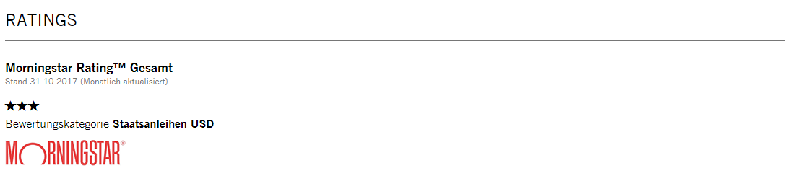
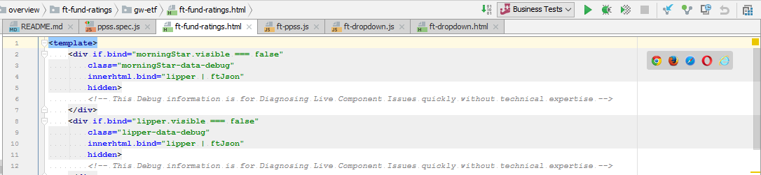
4) “Karma / Jasmine” Testing: Aurelia Example
xxx
view-source:xxx

Slide 42
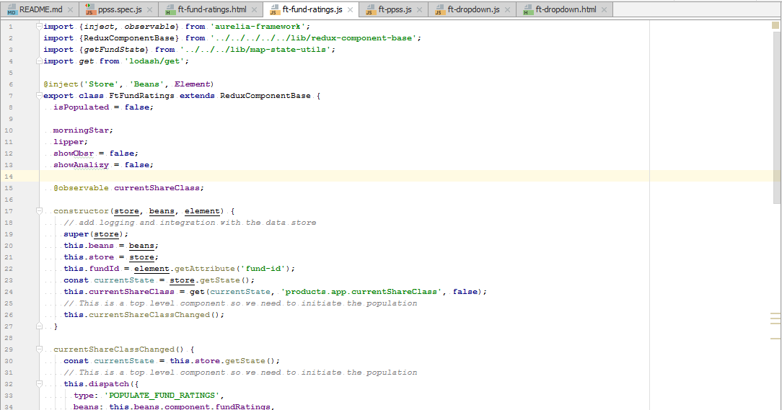
4) “Karma / Jasmine” Testing: Aurelia View Model Example
xxx

Slide 43
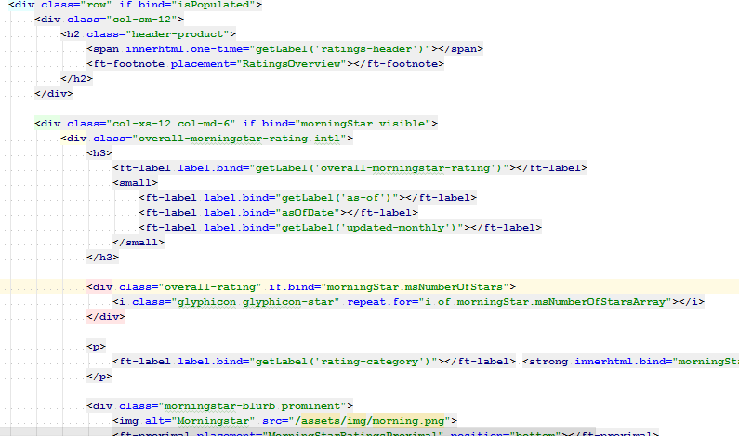
4) “Karma / Jasmine” Testing: Aurelia View Example

Slide 44
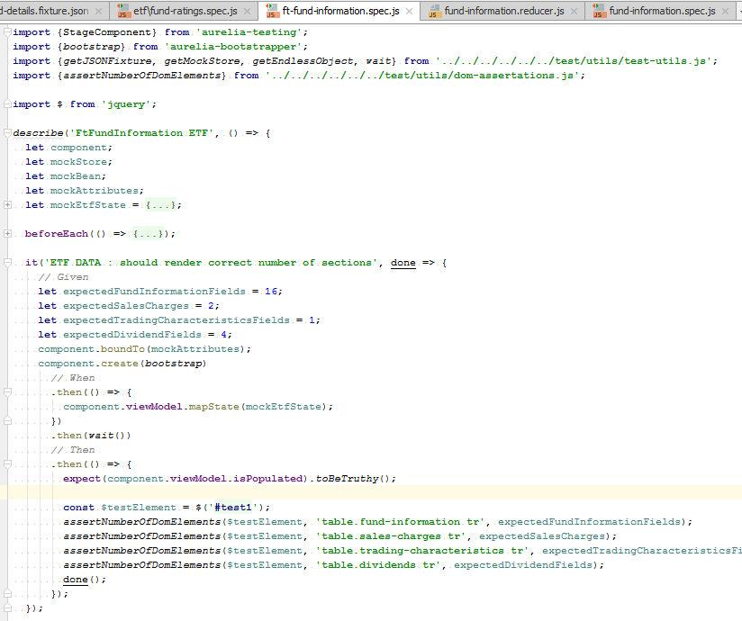
4) “Karma / Jasmine” Testing: Aurelia Test Example
GW-Maintenance\frontend-projects\web-platform\src\components\products\overview\ft-fund-information\etf\ft-fund-information.spec.js

Slide 45
4) “Karma / Jasmine” Testing: Aurelia Test Types
Sanity Tests
Simple obvious tests (majority of our UI tests unfortunately)
Unit Tests (Dom Assertion)
Simple black box input / output tests, does input render correct HTML
Unit Tests (Dom manipulation)
Directed simple UI interaction test, should be few actions, no more than 4-5 assertions, and input should be highly tailored

Slide 46
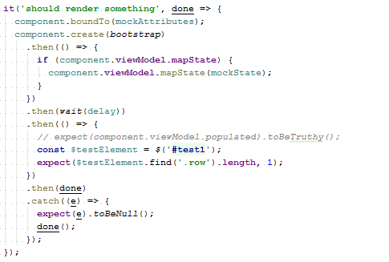
4) “Karma / Jasmine” Testing: Aurelia Sanity Testing
- Simple / Small
Quick
Only prevents simple errors

Slide 47
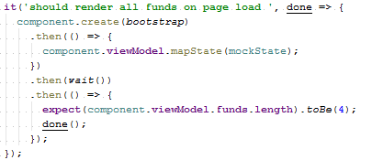
4) “Karma / Jasmine” Testing: Unit Test (Dom Assertion)
- Tests Fine Detail
Tests Edge Cases
Directs Bug Fixing
Slow to write
Hard to maintain
HTML / UI Tests are Brittle

Slide 48
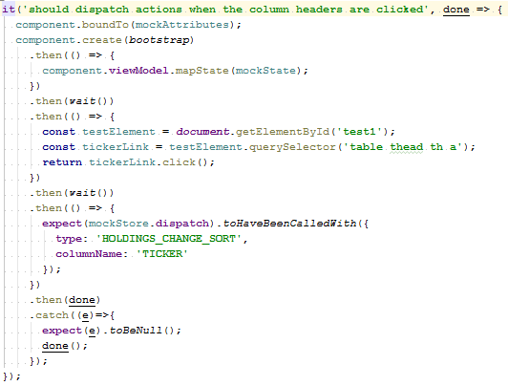
4) “Karma / Jasmine” Testing: Unit Test (Dom Manipulation)
- Tests Fine Detail
Tests Edge Cases
Directs Bug Fixing
Slow to write
Hard to maintain
UI Interaction code often Complex
UI Interaction Tests are very Brittle

Slide 49
4) “Karma / Jasmine” Testing: How to run
Just runs JEST tests
au test --ui (optional --watch) au test --ui --focused-test <class>

Slide 50
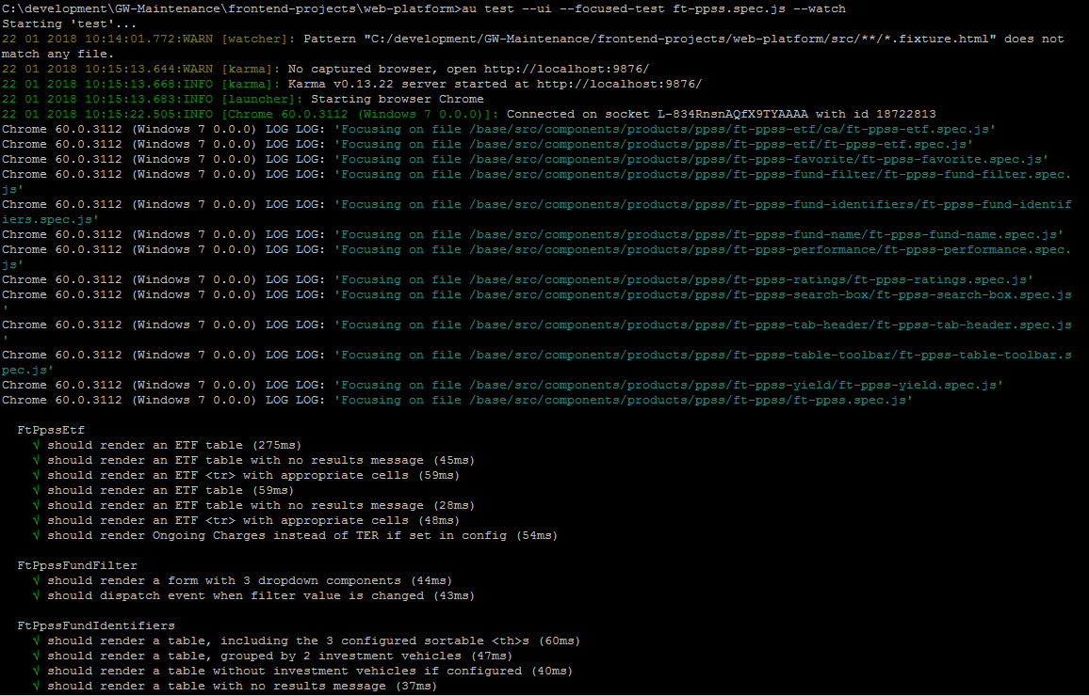
4) “Karma / Jasmine” Testing: Worked example
C:\development\GW-Maintenance\frontend-projects\web-platform\src\components\products\ppss\ft-ppss\ft-ppss.spec.js

Slide 51
Intermission
Tea
Cake
Questions ?
Points:
Karma is great* for browser testing * Normally, discounting CI issues!
Karma / Jasmine can more than current * browser bug testing / simple integration testing
Don’t use for complex Integration / Behavioural Testing * Cucumber / Selenium, see protractor tests, no covering in this introduction

Slide 52

6) Questions ?
I’ve been Anthony M^{c}Kale “Wizard without Portfolio” Fixer-Upper of Broken things, and creator of time-constrained workable Fudges for 15 years. Email : anthony@zapper.hodgers.com

