Slide 1


Sky Talk
Friday Training Hour “Git Exercises”
Anthony McKale
Principal Software Engineer
06/05/2022

Slide 2
Preface
Heroes vs Villains

Slide 3
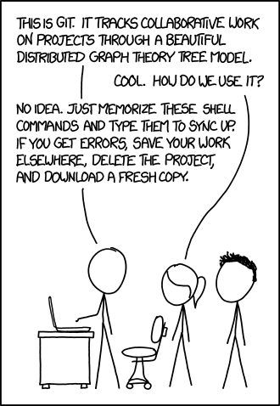
GIT USAGE
HERO
https://xkcd.com/1597/

Slide 4
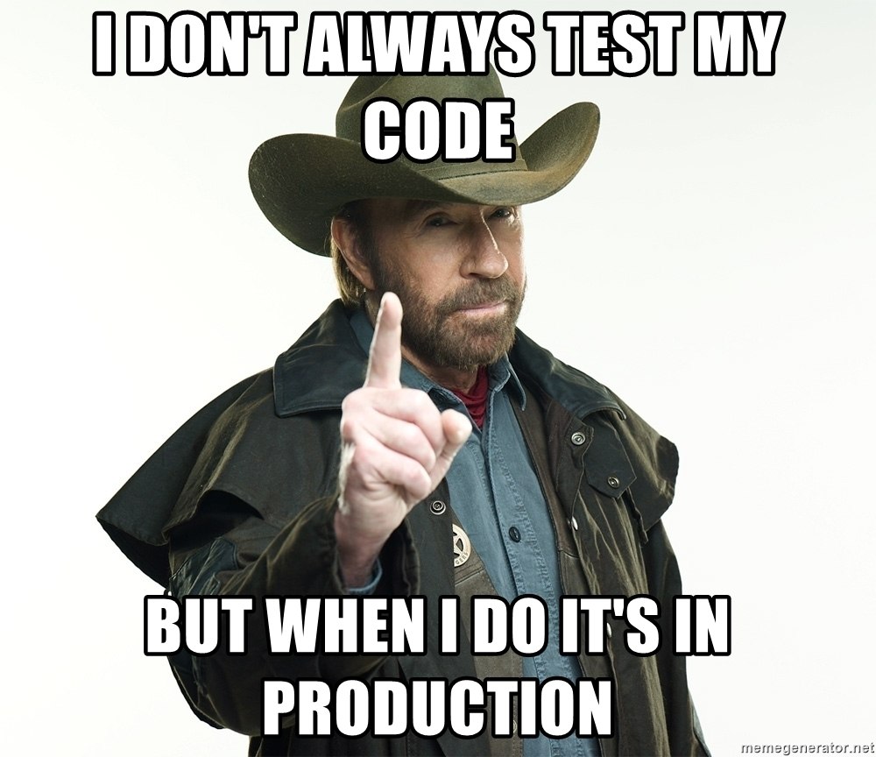
GIT FLOW: HERO

Slide 5
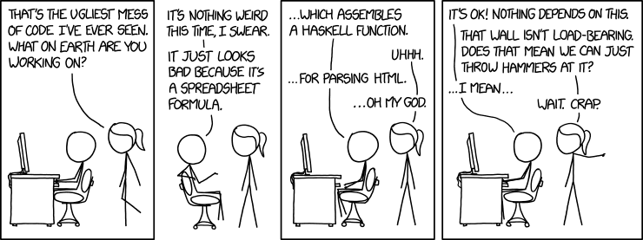
GIT Tooling HERO
https://www.explainxkcd.com/wiki/index.php/1926:_Bad_Code

Slide 6
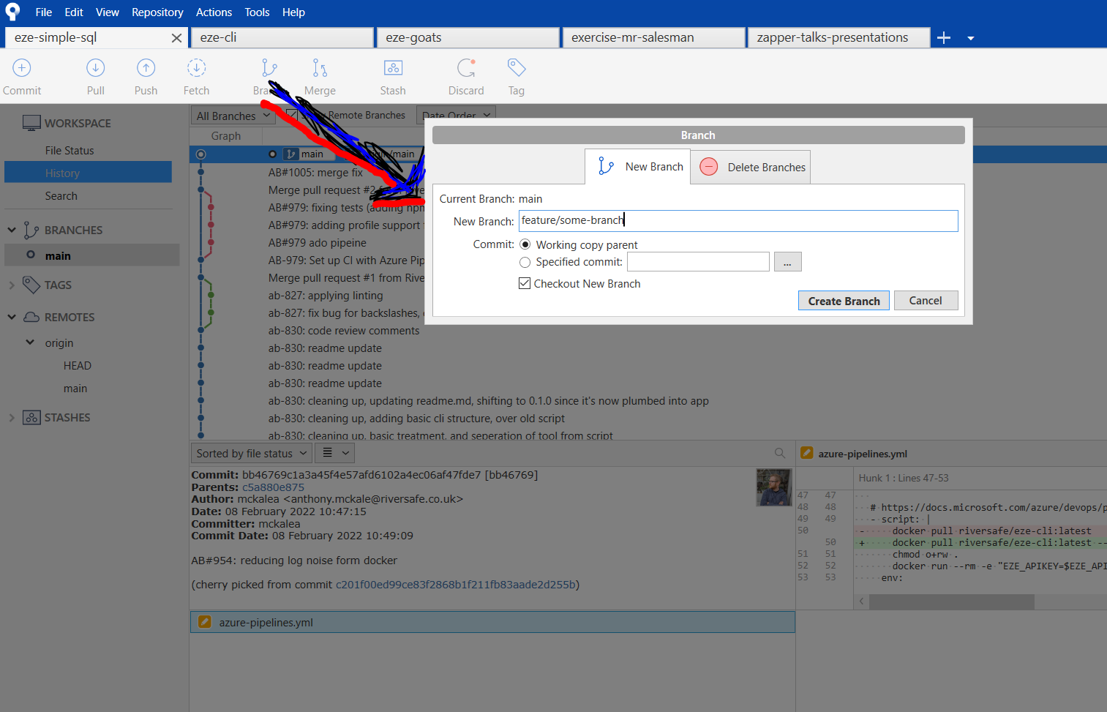
GIT: Tooling
Villian’s use git tooling aka SourceTree

Slide 7
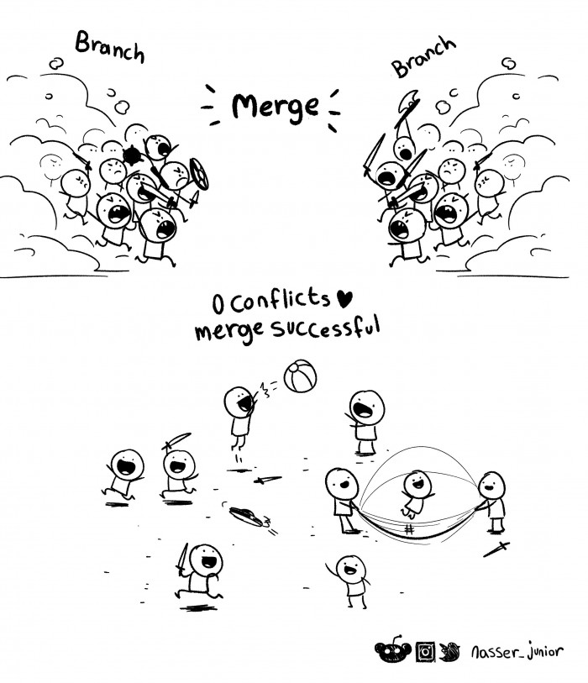
GIT:
Exercise
Merge
Conflict
https://devhumor.com/media/merge

Slide 8
Agenda
GIT Exercises
Exercise 1
Exercise 2
Exercise 3
Exercise 4

Slide 9
GIT Exercises
4 Challenge Merges: Develop -> Main
when develop and main have changes Feature -> Develop
when develop has changes
Forked Child Feature -> Develop
when develop has changes from a Parent Feature
Lint Hell Develop
when developer does woods man ship without telling the team

Slide 10

GIT Exercises
Develop -> Main
when develop and main have changes
TASK:
merge develop into master
.

Slide 11

GIT Exercises
Feature -> Develop
when develop has changes
TASK:
merge feature into develop

Slide 12
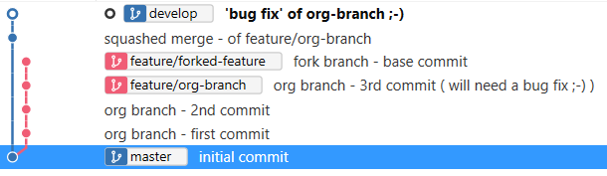
GIT Exercises
Forked Child Feature -> Develop
when develop has changes from a Parent Feature
TASK:
merge forked feature branch into develop (without breaking bug fix already in develop)

Slide 13

GIT Exercises
Lint Hell Develop
when developer does woods man ship without telling the team
TASK:
merge feature into develop (after someone made a bunch of pointless changes to whitespace)

Slide 14
GIT: Exercise
Challenge is to merge all 4 situation in a sensible way
Local GIT Repos available online here as a zip
https://github.com/Anthony-Mckale/talks-presentations/blob/master/2022/2022-04-29-exercise-git-training.zip

Slide 15
Questions
I’ve been Anthony “Zapper” M^{c}Kale
Hopefully I’ve Educated, Informed, and even Entertained Good Testing is Good Security is Good software

Slide 16
Thank you

