Slide 1
Friday Training Hour
Friday Training Hour:
Bug Hunting
“How to investigate bugs”
Anthony McKale
AI CoE Principal Software Engineer 05/06/2020

Slide 2
BUGS
FOR INTERNAL USE ONLY
Table of Contents
Types of Bug
When Bugs Occur
Bug Physiology
How to Fix Bugs Schedule of Events
How to Fix Bugs Stages
Will be aimed at the developer knowledge level
Information classiﬁcation: Public

Slide 3
Types of Bug
FOR INTERNAL USE ONLY
Compilation Bugs
Runtime Bugs
Logic Bugs
Racetime Bugs
Integration Bugs
Requirements Bugs
Information classiﬁcation: Public

Slide 4
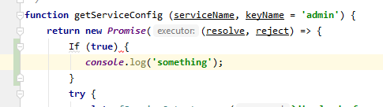
Types of Bug: Compilation Bugs*
FOR INTERNAL USE ONLY
These are linting and syntax errors
- Should be caught by code review and unit testing
- Shouldn’t happen on prod * but can if dev/test/prod have different interpreter or library version
* In interpreted languages I mean linting/syntax
Information classiﬁcation: Public

Slide 5
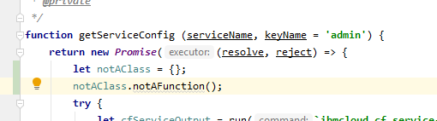
Types of Bug: Runtime Bugs
FOR INTERNAL USE ONLY
These are Errors that occur at runtime
- Should be caught by code review and unit testing
- Can happen on production but should be caught and reported in alerting
Information classiﬁcation: Public

Slide 6
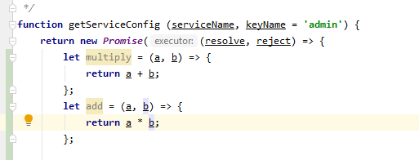
Types of Bug: Logic Bugs
FOR INTERNAL USE ONLY
These are Errors that occur in code, where the code isn’t doing what’s expected
- Should be caught by code review and unit testing
- Can happen on production but should be caught and reported by users / business
Information classiﬁcation: Public

Slide 7
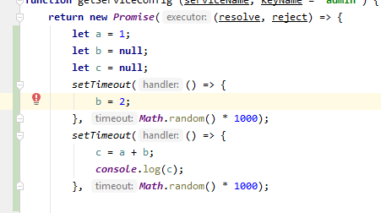
Types of Bug: Race time Bugs
FOR INTERNAL USE ONLY
These are Errors that occur in runtime with typically async code, where the code isn’t handling the async nature of the code or a 3rd party
Should be caught by code review and unit testing
- Can happen on production but should be caught and reported by users / business, sometimes alerting if a runtime error occurs
- Hard to debug as they are intermittent by nature
Information classiﬁcation: Public

Slide 8
Types of Bug: Integration Bugs
FOR INTERNAL USE ONLY
These are Errors that occur where the code isn’t handling a 3rd party correctly
Should be caught by code review and integration testing
- Can happen on production but should be caught and reported by users / business, sometimes alerting if a runtime error occurs
Hard to prod issues find in dev/test if not representative of prod
Hard to find in unit tests as they have assumptions about 3rd parties when properly mocked
Information classiﬁcation: Public

Slide 9
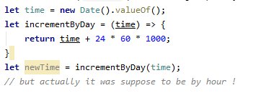
Types of Bug: Requirements Bugs
FOR INTERNAL USE ONLY
These are Errors that occur when the code is working correctly but not doing the correct thing
Should be caught by code review or business testing
- Important that release items are retested before release in a test environment
- Due normally to poor communication or misunderstandings between people
Information classiﬁcation: Public

Slide 10
Types of Bug: Overview
FOR INTERNAL USE ONLY
Bugs are hard
identify bug behaviour to discover type of bug
Type of bug will determine root cause
Type of bug will fix for bug
Type of bug will aid retrospective to prevent future types of that bug
Information classiﬁcation: Public

Slide 11
Questions ?
FOR INTERNAL USE ONLY
Information classiﬁcation: Public

Slide 12
When Bugs Occur
These are the common times bugs occur
During Local Development > Local Runtime
Non-Prod Environments during DEV/QA Integration > After Continuous Integration on Dev Box > After QA Release on Test Box
After Prod Release on Prod Box
Also unexpectedly
Long after Prod Release on Prod Box
After 3rd Party Change on Prod Box

Slide 13
When Bugs Occur: During Local Development
Local Runtime errors are:
Common in local
Rare in dev/test/prod
Normally due to inconsistent environments or developer error

Slide 14
When Bugs Occur: Non-Prod Environments
Normal Errors in Non-Prod are a normal and common thing
Common in dev
Rare in test
Should be picked up by unit tests, business testing
* How normal / common will impact your productivity ☺

Slide 15
When Bugs Occur: Non-Prod Box
Prevention:
Pairing / Peer Code Reviews
Write unit tests to test new code
Business Testing new features in business review
Test out existing features in testing QA environment *
Carry out regular automatic system e2e testing in dev
* Called regression testing

Slide 16
When Bugs Occur: After Prod Release on Prod Box
These are called regression bugs, and are very high priority
Should be caught by business checkout
Test scripts should help caught these
Service impacting bugs should be immediately hotfixed
Minor or Non Service impacting bugs should be put onto the next sprint’s backlog

Slide 17
When Bugs Occur: After Prod Release on Prod Box
Prevention:
Do Code Freeze before production release, to aid code stability
Beta and A/B testing can help testing out code with sub set of users before main release
Release out of hours to reduce outage/risks
Carry out system e2e testing
Test new features in testing environment
Test out existing features in testing environment *
* Called regression testing

Slide 18
When Bugs Occur: Long after Prod Release on Prod Box
These are called production bugs, and are high priority
These often are low priority (or they would have been found sooner)
Should be put in backlog for prioritisation and fixing

Slide 19
When Bugs Occur: Long after Prod Release on Prod Box
Prevention:
Test new features in testing environment before releases
Test out existing features in testing environment * before releases
Have mature error reporting mechanism to catch issues early
* Called regression testing

Slide 20
When Bugs Occur: After 3rd Party Change on Prod Box
These are 3rd Party / Vendor production bugs, and are high priority
These often not caught until production
Should be immediately hot fixed, as often cause immediate and ongoing outage

Slide 21
When Bugs Occur: After 3rd Party Change on Prod Box
Prevention:
Contact 3rd parties vendors and obtain release / upgrade schedule
Carry out regular automatic system e2e testing
Hook out dev to dev, test to test for 3rd parties to catch bugs early*
* Can come with it’s own challeneg dealing with others often broken environments

Slide 22
When Bugs Occur: Cliffnotes
Prod Release Bugs are just non caught Dev/Test Bugs
Prod Release Bugs are a nightmare, avoid at all costs
Only Prod bugs “matter”*
Keep good vendor contact to prevent Integration issues
Regression Test to prevent going backwards
Feature Test to ensure going forwards
Most* bugs happen after releases
* “matter” Dev/Test only matter to your productivity ☺
* Most up until working on Live Persion and IBMCloud…

Slide 23
Bug Psychology
FOR INTERNAL USE ONLY
Serious Production Bug are actually hard to deal with.
Information classiﬁcation: Public

Slide 24
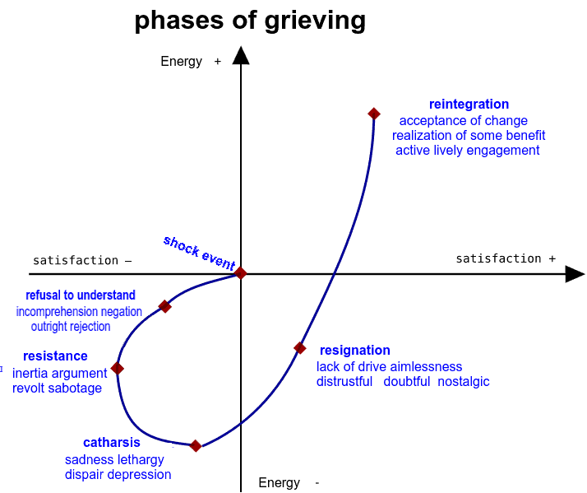
Bug Psychology
FOR INTERNAL USE ONLY
Apon finding a Bug, it can actually emerge as a Grief response
Information classiﬁcation: Public

Slide 25
Bug Psychology
FOR INTERNAL USE ONLY
Serious Production Bug are actually hard to deal with.
It’s important to not turtle up, or get overwhelmed at a team or personal mistake
2 basic rules to help you deal with the stress of bugs
Information classiﬁcation: Public

Slide 26
Bug Psychology
FOR INTERNAL USE ONLY
2 basic rules to help you deal with the stress of bugs
Rule 1: DON’T PANIC * * maybe grab a towel
Information classiﬁcation: Public

Slide 27
Bug Psychology
FOR INTERNAL USE ONLY
2 basic rules to help you deal with the stress of bugs
Rule 1: DON’T PANIC * * maybe grab a towel
Rule 2: Communication & Honesty - Report Issues immediately - Don’t Hide / Ignore Issues - Don’t dismiss Error Reports (always reply to reports)
Information classiﬁcation: Public

Slide 28
How to Fix Bugs Schedule of Events
FOR INTERNAL USE ONLY
Steps to fixing bugs:
- NON-PROD/INCIDENT SCHEDULE OF EVENTS
- PROD INCIDENT SCHEDULE OF EVENTS
- REAL PROD INCIDENT SCHEDULE OF EVENTS
Information classiﬁcation: Public

Slide 29
How to Fix Bugs: NON-PROD/INCIDENT
FOR INTERNAL USE ONLY
NON-PROD/INCIDENT SCHEDULE OF EVENTS
Steps:
Discovery
Reproduce in Dev/Local
Fix* in Dev/Local
Profit
* Fix includes verification of fix by business / testers
Information classiﬁcation: Public

Slide 30
How to Fix Bugs: PROD INCIDENT
FOR INTERNAL USE ONLY
PROD INCIDENT SCHEDULE OF EVENTS
Steps:
Discovery
Reproduce in Dev/Local
Fix in Dev/Local
Reproduce in Test
Fix In Test
Paperwork…
Reproduce in Prod
Fix in Prod
Profit
Information classiﬁcation: Public

Slide 31
How to Fix Bugs: REAL PROD INCIDENT
FOR INTERNAL USE ONLY
REAL PROD INCIDENT
Steps:
Discovery
Reproduce in Dev/Local
Having everyone and their boss emailing / phone you
Fix in Dev/Local
Having everyone and their boss emailing / phone you
Reproduce in Test
Having everyone and their boss emailing / phone you
Fix In Test
Having everyone and their boss emailing / phone you
Paperwork…
Having everyone and their boss emailing / phone you
Reproduce in Prod
Having everyone and their boss emailing / phone you
Fix in Prod
Having everyone and their boss emailing / phone you
Profit
Having everyone and their boss emailing / phone you
Information classiﬁcation: Public

Slide 32
How to Fix Bugs: Overview
FOR INTERNAL USE ONLY
Cliffnotes:
Prod bugs are much much worse than dev bugs
Comms must be clear and Efficient (otherwise the cost of updated and comms will delay fixes)
Responsibly of the leadership in the team to protect the support engineers (Get help comms are becoming a problem / getting overwhelmed)
Information classiﬁcation: Public

Slide 33
How to Fix Bugs: Overview
FOR INTERNAL USE ONLY
See this page for our comms email templates
https://confluence.dts.fm.rbsgrp.net/pages/viewpage.action?pageId=476848373
Make sure outages are centrally recorded
https://confluence.dts.fm.rbsgrp.net/display/DESDATA/Outages+Log
Information classiﬁcation: Public

Slide 34
How to Fix Bugs Stages
FOR INTERNAL USE ONLY
Steps:
Discovery
Reproduce
Fix*
Information classiﬁcation: Public

Slide 35
How to Fix Bugs: Discovery
FOR INTERNAL USE ONLY
Discovery happens through many means:
Customer reports
System Testing
Developer Testing
Business Checkout
System Alerts
Remember the rules when handling Discovery
Information classiﬁcation: Public

Slide 36
How to Fix Bugs : Discovery
FOR INTERNAL USE ONLY
Rule 1: DON’T PANIC
Rule 2: Communication & Honest Report Issues immediately
Information classiﬁcation: Public

Slide 37
How to Fix Bugs: Discovery
FOR INTERNAL USE ONLY
Discovery should result in:
Communications
Tracking
Audit Trail
(for prod) email to management email to stakeholder snow or jira incident
Issue on outage page
Information classiﬁcation: Public

Slide 38
How to Fix Bugs: Reproduce
FOR INTERNAL USE ONLY
From https://sites.google.com/site/yacoset/Home/how-to-fix-bugs-step-by-step
EASY STUFF
Step 1: Enter the bug in your case tracking system
Step 2: Google the error message
Information classiﬁcation: Public

Slide 39
How to Fix Bugs: Reproduce
FOR INTERNAL USE ONLY
CODE STUFF
Step 3: Identify the immediate line of code where the bug occurs
Step 4: Identify the line of code where the bug actually occurs
Step 5: Identify the species of bug
Step 6: Use the process of elimination
Step 7: Log everything and analyze the logs
Information classiﬁcation: Public

Slide 40
How to Fix Bugs: Reproduce
FOR INTERNAL USE ONLY
EXTERNAL STUFF
Step 8: Eliminate the hardware, 3rd party vendor Step 8: Eliminate the hardware or platform as a cause
Step 9: Look at the correlations
Step 10: Bring-in outside help or platform as a cause
Step 9: Look at the correlations
Information classiﬁcation: Public

Slide 41
How to Fix Bugs: Reproduce
FOR INTERNAL USE ONLY
LASTLY … GET HELP
Step 10: Bring-in outside help
Aka another colleague / my good self / or Craig
Information classiﬁcation: Public

Slide 42
How to Fix Bugs: Fix
FOR INTERNAL USE ONLY
GOING TO BE HONEST
I’VE RAN OUT OF TIME, PROBABLY MASSIVELY OVER TIME
ALSO THE BUG IS THE SAME AS THE CODE
THAT’S THE EASY PART ☺
https://sites.google.com/site/yacoset/Home/how-to-fix-bugs-step-by-step
Information classiﬁcation: Public

Slide 43
Questions ?
FOR INTERNAL USE ONLY
Information classiﬁcation: Public

Slide 44
Questions ?
FOR INTERNAL USE ONLY
I’ve been Anthony M^{c}Kale “Wizard without Portfolio” Fixer-Upper of Broken things, and creator of time-constrained workable Fudges for 15 years. Email : anthony@zapper.hodgers.com
Information classiﬁcation: Public

Slide 45
FOR INTERNAL USE ONLY
Thank you
Information classiﬁcation: Public

