Slide 1


Academy
Cloud 101
Anthony McKale
Principal Software Engineer

Slide 2
Agenda
- History
- Cloudable Things
- Cloudable Things: details
- Cloudable Terms
- Dora (not the explorer)

Slide 3
CLOUD HISTORY

Slide 4
History: BEFORE
Developers:
Plan Project
Buy Infrastructure
Build Infrastructure
Build Code
Put Code on Infrastructure

Slide 5
History: AFTER
Developers:
Plan Project
Buy Infrastructure
Build Infrastructure
Build Code
Put Code on Infrastructure
Paid for Infrastructure Monthly

Slide 6
History: Practice
Same stuff, different day

Slide 7
History:
45 – The Great Alan Turing (and others) built the first general purpose computer and won WW2*
50s – Advent of Super and Office computers (size of buildings and rooms)
80s – Advent of Personal Mini/Micro-computers (size of desks and briefcases)
90s – Advent of Nano-computers including a Mobile phone… (size of your palm and smaller)
* Historical details may be fictionalised / simplified

Slide 8
History:
2000s – Advent of Serverless-computers Where the computers exist in thin-air and microwaves, and computing power can be extracted directly from the internet

Slide 9
History:
2000s – Advent of Serverless-computers Where the computers exist in thin-air and microwaves, and computing power can be extracted directly from the internet Where huge super/office computing is setup in cold remote places, connected to the internet These can be accessed directly from the internet (for a cost)

Slide 10
History: Serverless/Cloud
1990s – Sales force sold software as a service (SAAS) aka runs on our servers not yours, for a price
late 1990s – Big Tech joins in
Google/Microsoft start selling SAAS solutions
2000s – Random Internet Shop joins the party
Amazon created AWS / EC2, based off their
own internal software to run their website

Slide 11
History: Serverless/Cloud
1990s – Sales force sold software as a service (SAAS) aka runs on our servers not yours, for a price
late 1990s – Big Tech joins in
Google/Microsoft start selling SAAS solutions
2000s – Random Internet Shop joins the party
Amazon created AWS / EC2, based off their
own internal software to run their website

Slide 12
Amazon Profits 2022
Percentage by Department ?

Slide 13

Amazon Profits 2022
https://www.insiderintelligence.com/insights/amazon-revenue/

Slide 14
Amazon Profits 2022
Percentage by Department
$17 billion (13%)

Slide 15
History
Questions ?

Slide 16
Cloudable Things

Slide 17
Serverless vs Server-ed
ALL SERVERLESS IS ON SERVERS AND HARDWARE Serverless / Cloud is a provisioning approach
Not Magic

Slide 18
Serverless vs Server-ed
Non-Serverless =
Actual servers / software
owned and maintained by yourself or 3rd Party
Serverless =
Actual servers / software
Details someone else’s problem

Slide 19
Typical Server Things
6 big things servers do….
Audience participation: Name 6 big things servers do

Slide 20
Typical Server Things
Compute: Running programs
Data: Databases, and File Storage
Identity Authentications / Authorisation
Communication / Service Glue (Queues / Notifications / Email / Events)
Logs / Analytics
Networking: firewalls, vpns, gateways, dns, routers

Slide 21
Cloudable Things
Lets go into detail, shall we ?

Slide 22
Cloudable Things
Compute: Running programs
Data: Databases, and File Storage
Identity Authentications / Authorisation
Communication / Service Glue (Queues / Notifications / Email / Events)
Logs / Analytics
Networking: firewalls, vpns, gateways, dns, routers

Slide 23
Cloudable Things: Compute
Compute:
Running programs, before cloud required: Physical server (+ maintenance)
Operating System (+ maintenance)
Software to Run
Scale Case:
Networking Fun + more servers

Slide 24
Cloudable Things: Compute
Compute:
Running programs, after cloud
Two main types:
Code in a long lived VM often called EC2, Azure Compute…
Code in Short lived Container often called a Lambda function, Azure Function…

Slide 25
Cloudable Things: Compute
Compute:
Running programs in Code in a long lived VM,
after cloud
Physical server (+ maintenance)
Operating System Image (+ docker upgrades)
Software to Run
Scale Case:
Pay more

Slide 26
Cloudable Things: Compute
Compute:
Running programs in Code in Short lived Container,
after cloud
Physical server (+ maintenance)
Operating System Image (+ docker upgrades)
Software to Run
Scale Case:
Pay more

Slide 27
Cloudable Things: Compute
Compute Question ?, onto data
Two main types:
Code in a long lived VM often called EC2, Azure Compute…
Code in Short lived Container often called a Lambda function, Azure Function…

Slide 28
Cloudable Things: data
Data: Storing data
Before cloud required: Physical server (+ maintenance)
Operating System (+ maintenance)
Software to Run
Scale Case:
Networking Fun + more servers

Slide 29
Cloudable Things: data
Compute:
Storing data, after cloud
Two main types:
Indexed Data in Database often called RDS…
Blob Data in Long term Store often called a S3…

Slide 30
Cloudable Things: data
Data: Storing data in Indexed Data in Database,
after cloud
Physical server (+ maintenance)
Operating System (+ maintenance)
Software to Run Software to manage / populate
Scale Case:
Pay more

Slide 31
Cloudable Things: data
Data: Blob Data in Long term Store,
after cloud
Physical server (+ maintenance)
Operating System (+ maintenance)
Software to Run Web portal to populate
Scale Case:
Pay more

Slide 32
Cloudable Things: data
Data Question ?, onto identity
Two main types:
Indexed Data in Database often called RDS…
Blob Data in Long term Store often called a S3…

Slide 33
Cloudable Things: identity
Data: Authentications / Authorisation
Before cloud required: Physical server (+ maintenance)
Operating System (+ maintenance)
Software to Run
Scale Case:
Networking Fun + more servers

Slide 34
Cloudable Things: identity
Data: Authentications / Authorisation, after cloud
Physical server (+ maintenance)
Operating System (+ maintenance)
Software to Run Software to manage / populate
Scale Case:
Pay more

Slide 35
Cloudable Things: identity
Identity Question ?, got the pattern ? So quick Comms, Logs, Networking

Slide 36
Cloudable Things: comms
Communication / Service Glue (Queues / Notifications / Email / Events)
Before cloud required: Physical server (+ maintenance)
Operating System (+ maintenance)
Software to Run
Scale Case:
Networking Fun + more servers

Slide 37
Cloudable Things: comms
Communication: Service Glue (Queues / Notifications / Email / Events) after cloud Physical server (+ maintenance)
Operating System (+ maintenance)
Software to Run Software to manage / populate
Scale Case:
Pay more

Slide 38
Cloudable Things: logs
Logs / Analytics
Before cloud required: Physical server (+ maintenance)
Operating System (+ maintenance)
Software to Run
Scale Case:
Networking Fun + more servers

Slide 39
Cloudable Things: logs
Logs / Analytics
After cloud required: Physical server (+ maintenance)
Operating System (+ maintenance)
Software to Run Software to manage / populate
Scale Case:
Pay more

Slide 40
Cloudable Things: Networking
Networking: firewalls, vpns, gateways, dns, routers
Before cloud required: Expensive Physical hardware (+ maintenance)
Operating System (+ maintenance)
Scale Case:
Networking Fun + more servers

Slide 41
Cloudable Things: Networking
Networking: firewalls, vpns, gateways, dns, routers
After cloud required: Expensive Physical hardware (+ maintenance)
Operating System (+ maintenance) Software to manage / populate
Scale Case:
Pay more

Slide 42
Cloudable Things
Questions ?

Slide 43
Cloudable Terms

Slide 44
Cloudable Terms
You’ll hear these alot:
SaaS
PaaS
IaaS https://aws.amazon.com/what-is-cloud-computing/

Slide 45
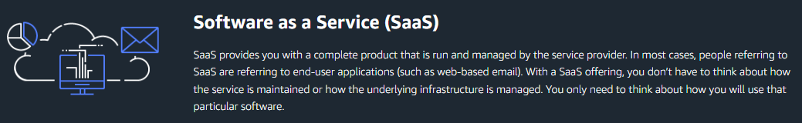
Cloudable Terms
SaaS
a.k.a hosted 3rd party software
https://en.wikipedia.org/wiki/Software_as_a_service

Slide 46
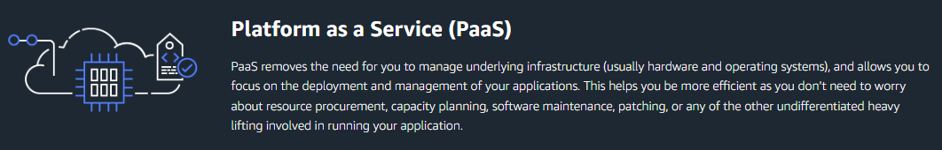
Cloudable Terms
PaaS
a.k.a hosted custom own software
https://en.wikipedia.org/wiki/Platform_as_a_service

Slide 47
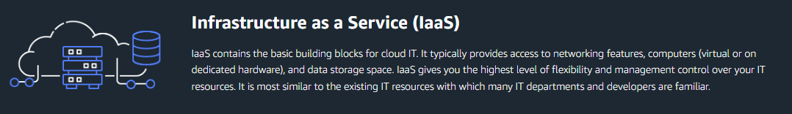
Cloudable Terms
IaaS
a.k.a hosted custom data-center
https://en.wikipedia.org/wiki/Infrastructure_as_a_service

Slide 48
Cloudable Terms
Questions ?
SaaS = Hosted 3rd Party Software
PaaS = Hosted Own Software
IaaS = Hosted Data-Centre https://aws.amazon.com/what-is-cloud-computing/

Slide 49
DORA a.k.a Best Practice

Slide 50

DORA
D ev O ps R esearch A ssessment
program
https://www.devops-research.com/research.html

Slide 51
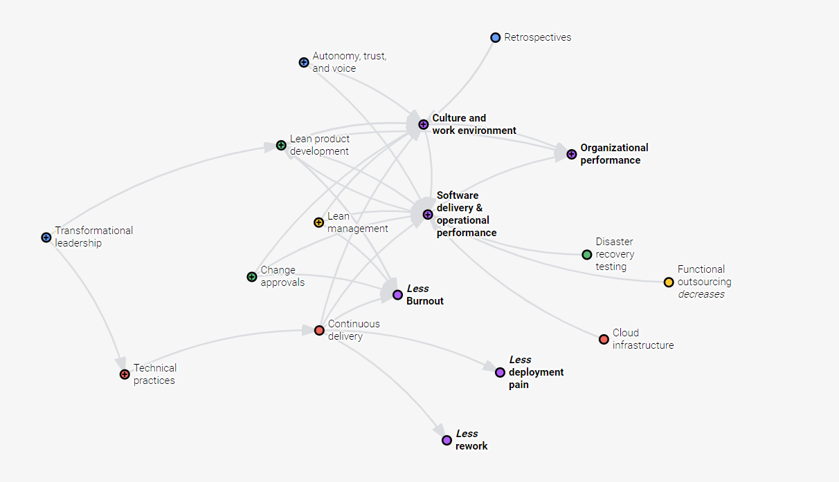
DORA
Best Practice via research

Slide 52
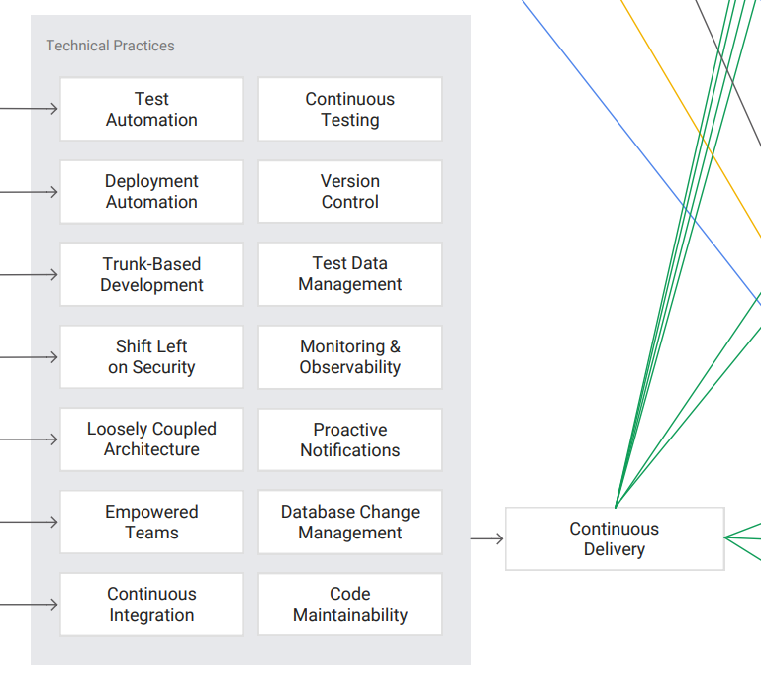
DORA
Devops Best Practice (for devops)

Slide 53
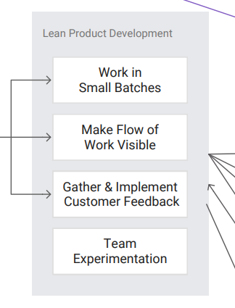
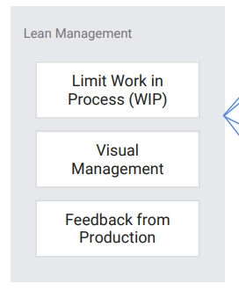
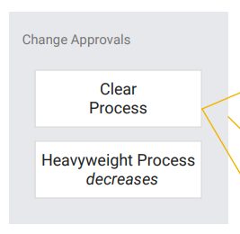
DORA
Devops Best Practice (for teamwork / tickets)

Slide 54
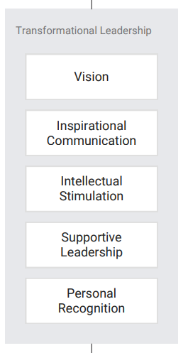
DORA
Devops Best Practice (for managers / ops)

Slide 55
DORA
Devops Best Practice (for team leadership)

Slide 56
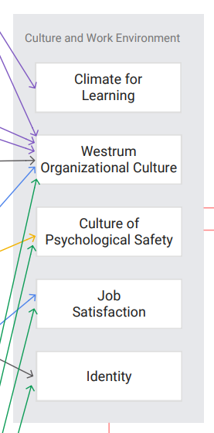
DORA
Devops Best Practice (for team culture)

Slide 57
DORA
Best Practice via research

Slide 58
DORA
This is just a teaser,
we’ll cover DORA in more detail later

Slide 59
Questions
I’ve been Anthony “Zapper” M^{c}Kale
Hopefully I’ve Educated, Informed, and even Entertained Good Testing is Good Security is Good software

Slide 60
Thank you

