Slide 1


Academy
AWS Cloud 101
Anthony McKale
Principal Software Engineer

Slide 2
Agenda
- History
- Overview: IaaS of the PaaS of the SaaS
- AWS Services
- AWS Services and IAM…

Slide 3
History

Slide 4
AWS History (Truncated)
2000 – Creation of Amazon
2004 – Amazon launches SaaS / PaaS / IaaS solutions for all internal Infrastructure
2005 – Trials with selected partners
2006 – Start of the Storm of Services…

Slide 5
AWS History (Truncated)
2006 –
Simple Storage Service (S3) launched globally
Simple Queue Service (SQS) launched globally
Elastic Compute Cloud (EC2) launched globally
2007 –
SimpleDB launched (today superseded by DynamoDB)

Slide 6
AWS History (Truncated)
2006 –
Simple Storage Service (S3) launched globally
Simple Queue Service (SQS) launched globally
Elastic Compute Cloud (EC2) launched globally
2007 –
SimpleDB launched (today superseded by DynamoDB)

Slide 7
AWS History (Truncated)
2008-2009 – Launch of IaaS solutions
Elastic Ips
Cloud Front (basically DNS servers)
Virtual Private Cloud (VPC)
more

Slide 8
AWS History (Truncated)
2010
AWS Cloudformation IaC launched foundation of all Infrastructure as Code in AWS we’ll cover these later…
2011
Simple Notification Service (SNS) augmented with Simple Email Service (SES) a full enterprise level email solution

Slide 9
AWS History (Truncated)
2012
AWS Marketplace launched now the modern AWS is born
2012-Today
World domination
Billions in Profits
Hundreds of new services

Slide 10
AWS History (Truncated)
Questions?
https://en.wikipedia.org/wiki/Timeline_of_Amazon_Web_Services

Slide 11
IaaS of the PaaS of the SaaS

Slide 12
IaaS of the PaaS of the SaaS
SaaS = Hosted 3rd Party Software
PaaS = Hosted Own Software
IaaS = Hosted Data-Centre https://aws.amazon.com/what-is-cloud-computing/

Slide 13
IaaS of the PaaS of the SaaS
Each Cloud/AWS Service will be a mixture of these
Example Simple Storage Service (S3)
IaaS elements | PaaS elements | SaaS elements
none | Can be used as a file system, in Platforms created in | Pretty Website to access/upload files

Slide 14
AWS Services

Slide 15
AWS Service: Areas
Compute: Running programs
Data: Databases, and File Storage
Identity Authentications / Authorisation
Communication / Service Glue (Queues / Notifications / Email / Events)
Logs / Analytics
Networking: firewalls, vpns, gateways, dns, routers

Slide 16
AWS Service : Compute
Running programs
Two main types:
Code in a long lived VM often called EC2, Azure Compute…
Code in Short lived Container often called a Lambda function, Azure Function…

Slide 17
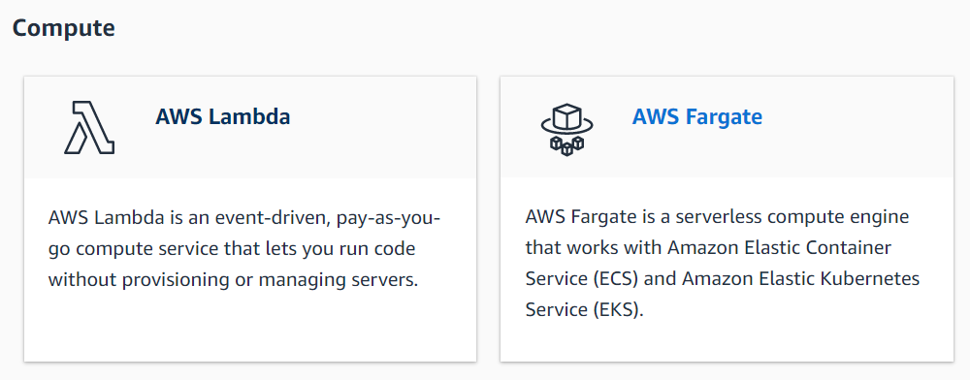
AWS Service: Compute (Serverless)

Slide 18
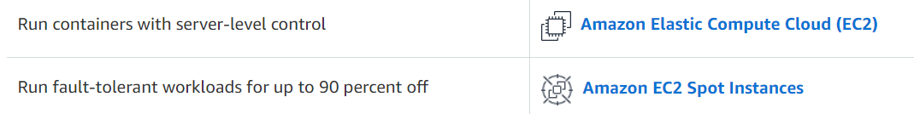
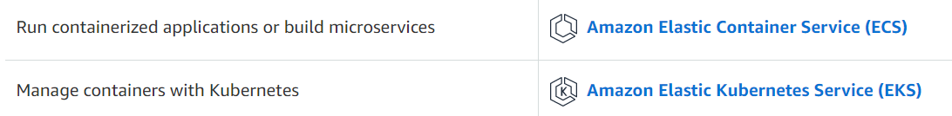
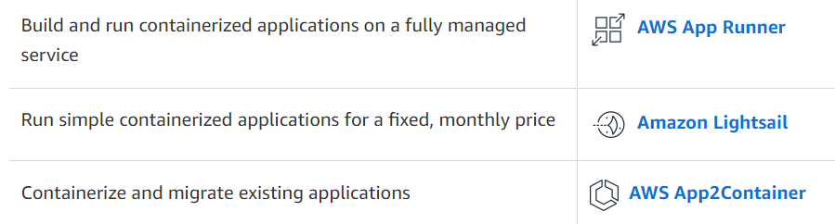
AWS Service: Compute (Server-ed + Support)

Slide 19
AWS Service: Compute Cover
We’ll be concentrating on:
Lambda Functions
Elastic Compute Cloud (EC2)
ECS (aka AWS DockerHub) + EKS (aka AWS Kubernetes)

Slide 20
AWS Service: data
Storing data
Two main types:
Indexed Data in Database often called RDS…
Blob Data in Long term Store often called a S3…

Slide 21
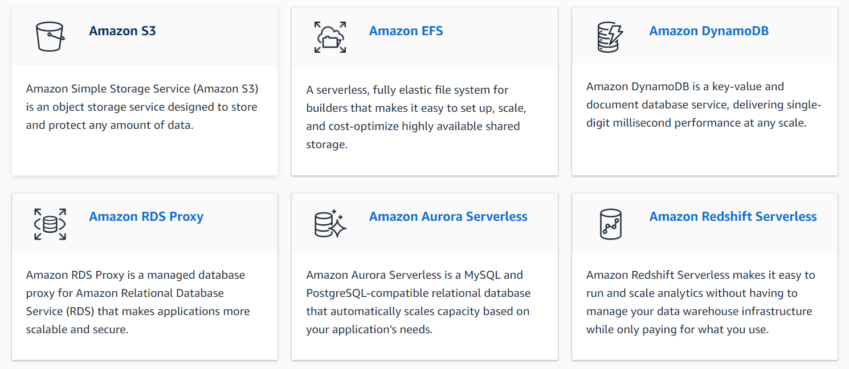
AWS Service: Data
and more …

Slide 22
AWS Service: Data Cover
We’ll be concentrating on:
Simple Storage Service (S3)
Relational Database Service (RDS)

Slide 23
AWS Service : identity
Authentications / Authorisation
Who is at the door
What are they allowed to ask for Two we’re concentrating on:

Slide 24
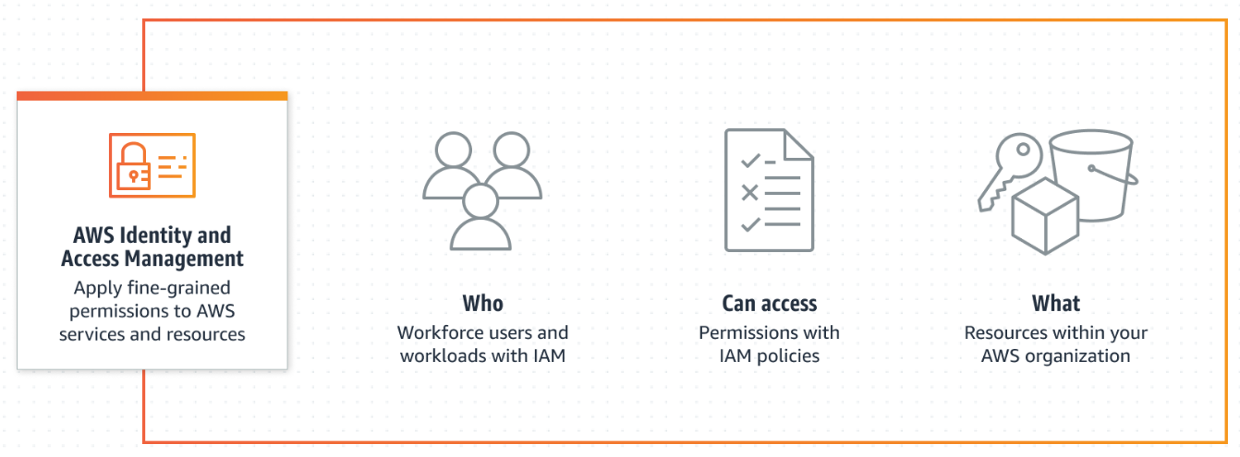
AWS Service: Identity
AWS Identity and Access Management (IAM) : User/Service to Service inside AWS
https://aws.amazon.com/iam

Slide 25
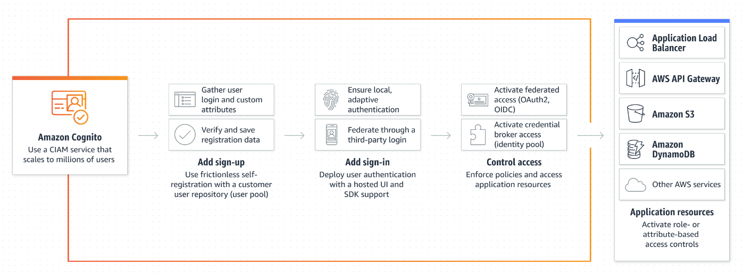
AWS Service: Identity
AWS Cognito : User logins into AWS Deployed Application
https://aws.amazon.com/cognito/

Slide 26
AWS Service: Identity
We’ll be concentrating on:
AWS IAM
AWS Cognito
Last three things in brief

Slide 27
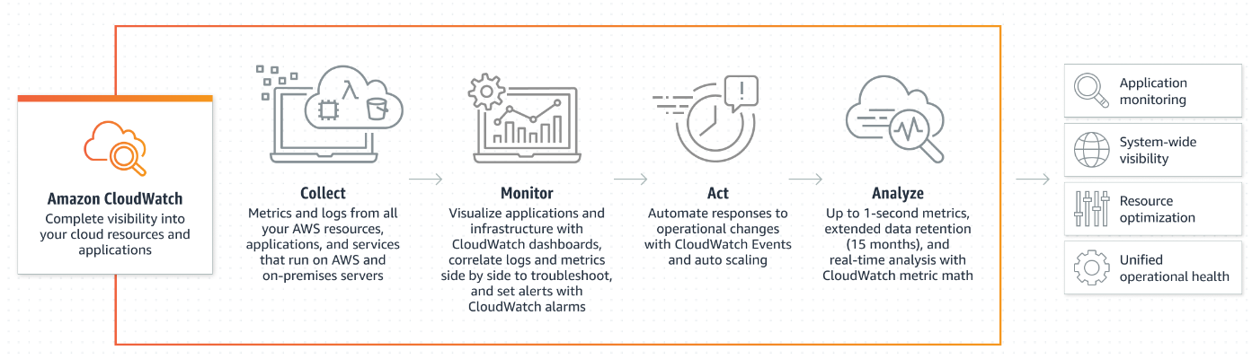
AWS Service: Logs
AWS Cloudwatch : All the logs for all AWS Services / Applications
https://aws.amazon.com/cloudwatch/

Slide 28
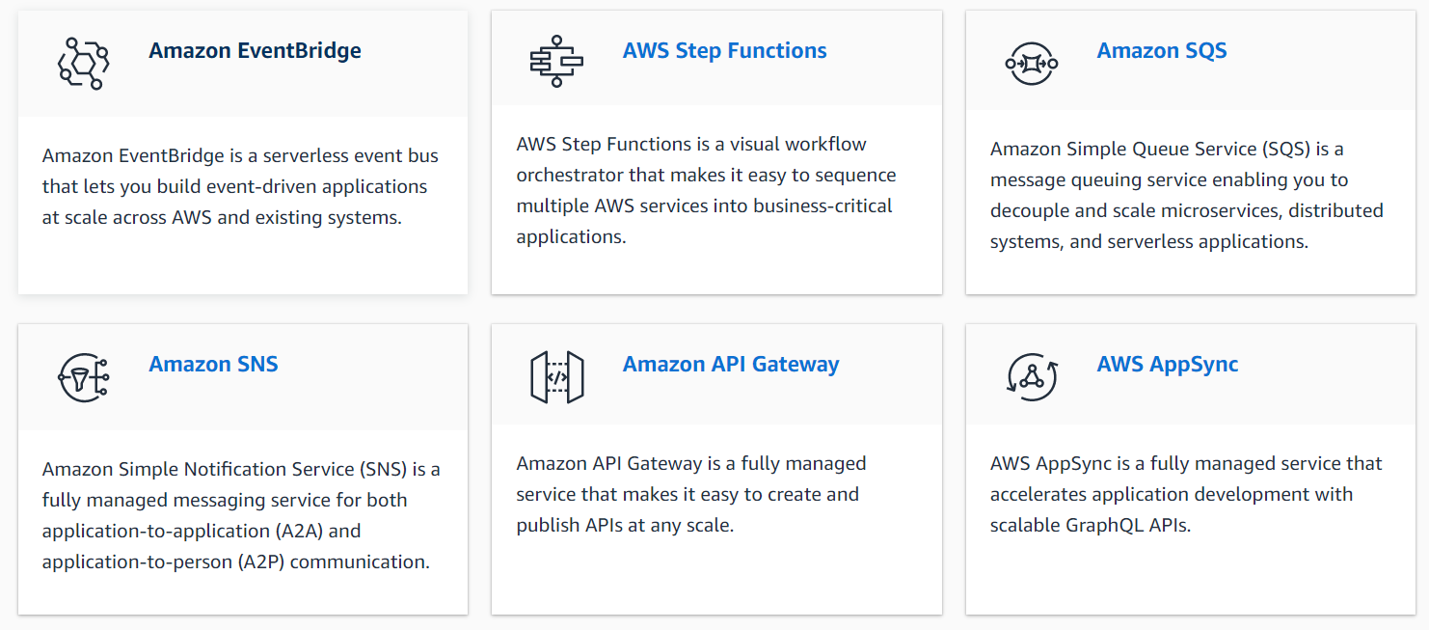
AWS Service: Glue
https://aws.amazon.com/serverless/

Slide 29
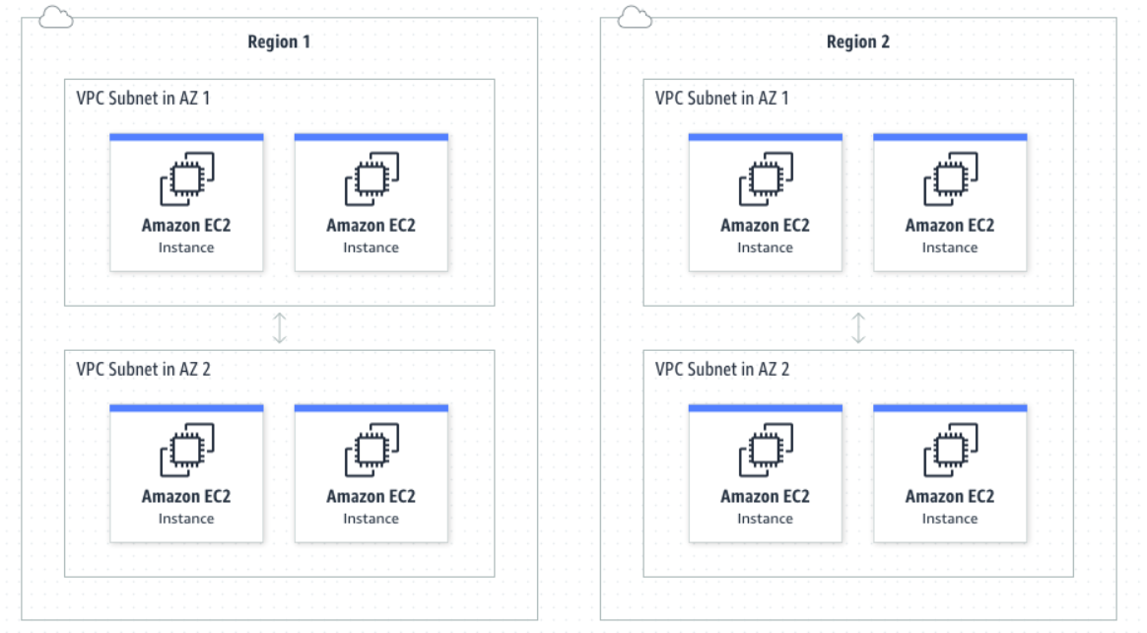
AWS Service: Infrastructure
Virtual Private Cloud (VPC) : AWS Services / Applications protected off the public internet
https://aws.amazon.com/vpc/

Slide 30
AWS Service: Infrastructure
Virtual Private Cloud (VPC) are really hard
so we’ll just be touching the surface aka more theory than practice
https://aws.amazon.com/vpc/

Slide 31
AWS Services
Sure that seemed like a lot Questions ?
Onto todays actual learning AWS CLI
AWS IAM
AWS Logs

Slide 32
AWS CLI

Slide 33
AWS CLI
Git has a cli
Docker has a cli AWS has a cli

Slide 34
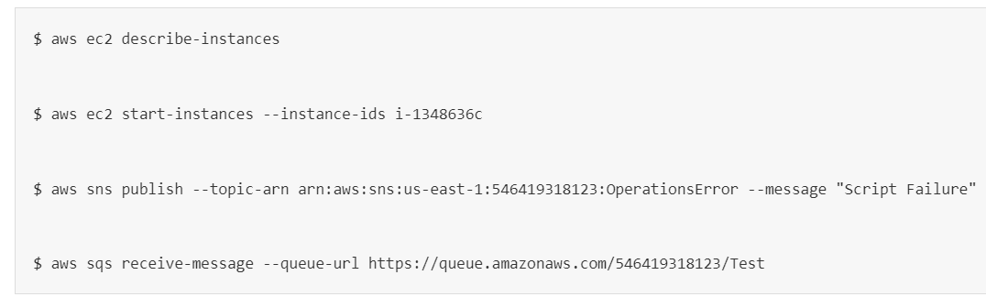
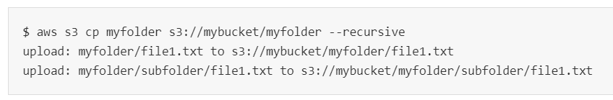
AWS CLI
Same stuff different day Except each of those hundreds of AWS services Have a sub command

Slide 35
AWS CLI
How to install https://docs.aws.amazon.com/cli/latest/userguide/getting-started-install.html
How to use
https://docs.aws.amazon.com/cli/latest/userguide/cli-chap-using.html
Reference
https://docs.aws.amazon.com/cli/latest/reference/

Slide 36
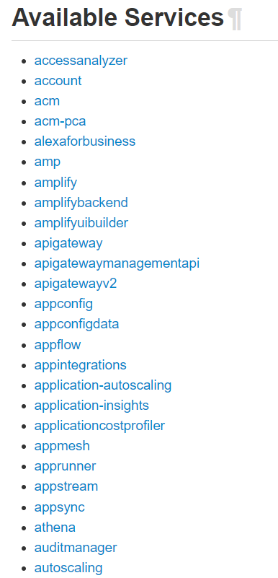
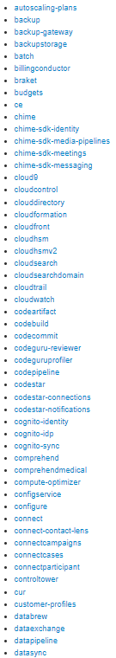
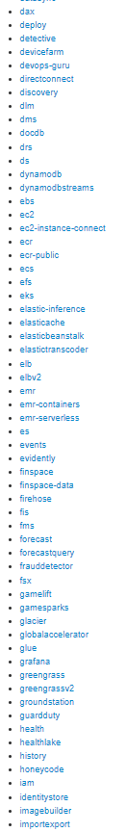
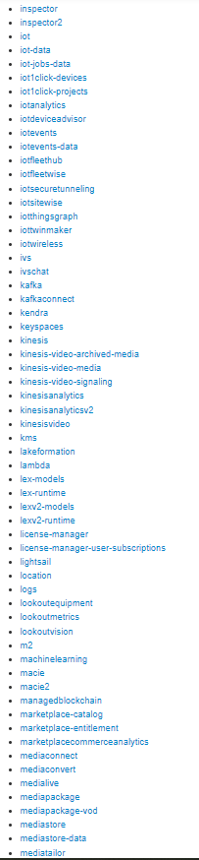
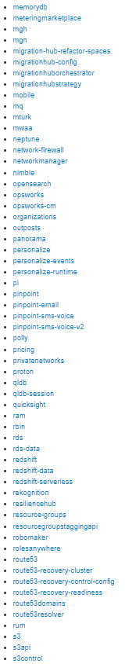
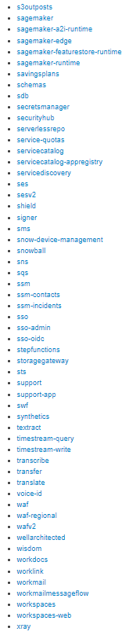
AWS CLI
Remember it’s big, you don’t need to know it all

Slide 37
AWS CLI
Questions ?

Slide 38
AWS IAM: my first service

Slide 39
AWS IAM
AWS Identity and Access Management (IAM) : User/Service to Service inside AWS
https://aws.amazon.com/iam

Slide 40
AWS IAM
IAM is the heart of AWS
Controls what users can do (All AWS console users are a IAM user)
Controls what Services can do (All AWS Services are a IAM user)
Controls what Applications can do (All AWS Applications are a IAM user)
https://aws.amazon.com/iam

Slide 41
AWS IAM
Two schools of storing authorisations Role based access (RBAC)
Users -> Role -> List of Permissions
Access Control List access (ACL)
Users -> List of Permissions
https://aws.amazon.com/iam

Slide 42
AWS IAM
Role based access (RBAC) typically preferred over Access Control List access (ACL)
RBAC is easier to maintain, and has a lower chance of user error when setting permissions
ACL can give finer access permissions, and is better at setting individual user permissions or controlling low level data access
https://aws.amazon.com/iam

Slide 43
AWS IAM
ABAC attribute based access control is also possible
This is where user attributes aka member of “backdoor-project”
Can be used to allow allow to say aka all S3s / EC2s prefixed “backdoor-”
https://aws.amazon.com/iam

Slide 44
AWS IAM
In AWS all approaches can be used together Ps: Permissions can be allow and denied as well
https://aws.amazon.com/iam

Slide 45
AWS IAM (AWS Terms)
TERM
IAM Resources | Any services/part that could have a permission applied to it
IAM Action | A permission of a service/part
IAM Identities | Holders of permissions, all Entities and Principals can have sub identities | Any thing that can have action added to it
IAM Entities | User/Role used to identity a user or application Subgroup of Identities only the one’s Principals can have | aka user “amckale” is idenitying as the Entity “Admin” role Use “Admin” role to determine actions allowed
Principals | Actual User or Application doing something
https://aws.amazon.com/iam

Slide 46

AWS IAM (AWS Terms)
Principal
TERM
IAM User | Long term Principal for user/app doing something | Two Flavours: Console or CLI user
Role | Short term Principal for Services doing something
User Group | Holders of policies, upto 10 assign to user
Policy | Lists of Actions | Normally a JSON blob
Action | Permission
ARN | Global name of any Resource | Aka amckale user is arn:aws:iam::466847355032:user/amckale
https://aws.amazon.com/iam

Slide 47
AWS IAM
DEMO on AWS IAM Console
https://aws.amazon.com/iam

Slide 48
AWS IAM
Questions ?
https://aws.amazon.com/iam

Slide 49
Questions
I’ve been Anthony “Zapper” M^{c}Kale
Hopefully I’ve Educated, Informed, and even Entertained Good Testing is Good Security is Good software

Slide 50
Thank you

