Slide 1


Academy
AWS Authentication 101
Anthony McKale
Principal Software Engineer

Slide 2
Agenda
- Overview - AAA Systems
- Federated Identity
- Access Delegation Standards
- Tokens (JWT) inbrief
- OAuth Indepth - AWS Cognito inbrief

Slide 3
Overview

Slide 4

Overview
<a-team sound track>
https://youtu.be/UAO2JBjRRBk

Slide 5
Overview
<a-team sound track in background> Authentication: Who are you ? Authorisation: What are you allowed to do ? Audit: Who did what ?
https://en.wikipedia.org/wiki/Authentication https://en.wikipedia.org/wiki/Authorization https://en.wikipedia.org/wiki/Audit

Slide 6
Overview: Authentication History
Ancient Times – Seals of Office or Family 1800s – Biometrics such as Fingerprints / Written-Signature
1930s – One time password 1950s – Computer password 1970s – Hashed password 1970s – Public-Private Key pair Cryptographic
2010s – Multi-factor (based off Device Hardware Cryptography)

Slide 7
Overview
Questions ?

Slide 8
AAA

Slide 9
AAA
Authentication: Who are you ? Authorisation: What are you allowed to do ? Audit: Who did what ?
https://en.wikipedia.org/wiki/Authentication https://en.wikipedia.org/wiki/Authorization https://en.wikipedia.org/wiki/Audit

Slide 10
AAA: AWS Cloud
Authentication: IAM / Cognito Authorisation: IAM (via role/user permissions) Cognito (via Cognito usergroup, IAM role permissions) Audit:
Cloudwatch Cloudtrail

Slide 11
AAA: NSA Bestpractice Guide
Centralised: Use Centralised AAA Servers
AAA over Local: All Services, and User Devices use AAA auth ( local only for off-line / break-glass disaster recovery )
Principal of Least Privilege: give minimum authorizations required to do job (including Admins, break-glass root passwords !)
Limit authentication attempts
https://media.defense.gov/2022/Jun/15/2003018261/-1/-1/0/CTR_NSA_NETWORK_INFRASTRUCTURE_SECURITY_GUIDE_20220615.PDF

Slide 12
AAA: Centralised Servers in Cloud ?
How to get :
Multi-Cloud Service Users ?
Local Devices ? Applications ? 3rd Party SAAS ? All using same user/password AAA, with central auditing, central authorisation

Slide 13
AAA: Identity Management / AD
Normally it’s Microsoft Active Directory Other solutions exist Systems implement federated (think delegated) AAA via protocols Common protocols: SAML, Oauth, Kerberos https://en.wikipedia.org/wiki/Active_Directory

Slide 14
AAA
Questions ?
Onto Federated Identity

Slide 15
Federated Identity

Slide 16
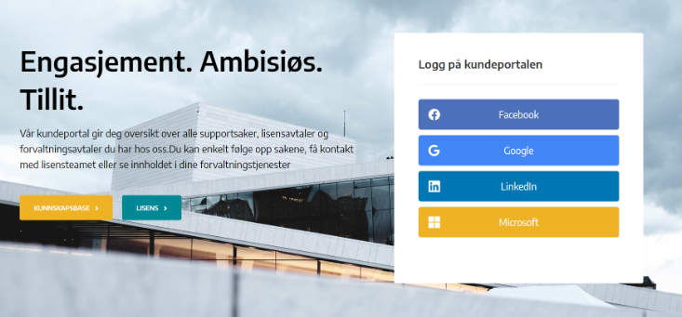
Federated Identity
Familiar ?

Slide 17
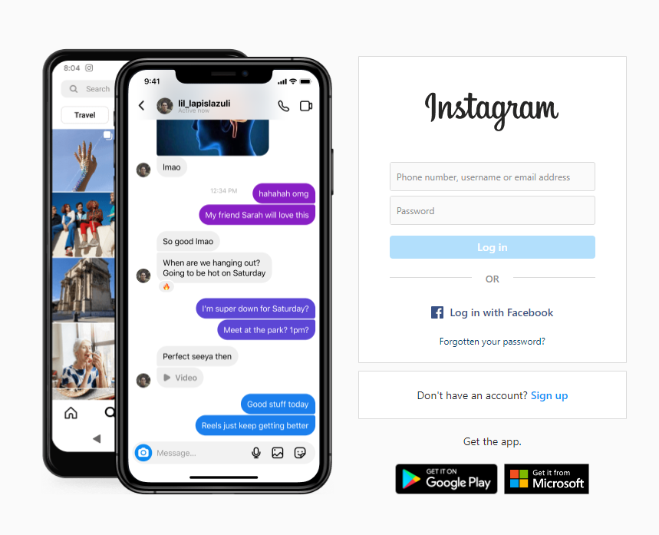
Federated Identity
Familiar ?

Slide 18
Federated Identity
Examples of Federated Identity The Authenication of a entity is being delegated to a 3rd Party Often used in a corporation environment to centralise control access and sometimes Authorisation, and very occasionally Auditing

Slide 19
Federated Identity: Why?
Audience Question ?

Slide 20
Federated Identity: Why?
Easier to maintain only remove leavers once only add new user once same team can grant/remove access
Better visibility
common db/dashboards for auditing
Better security best practice controls equality applied

Slide 21
Federated Identity vs SSO
Often connected but different thing SSO = Single Sign-on, aka login once, logged in everywhere Federated Identity = Way to login
This uses logged in computer’s credentials to automatically log into other systems
Complex topic: Basically it’s a log into a system, and other systems automatically know who you are Often implemented via cookies, reverse proxy servers, etc

Slide 22
Federated Identity vs SSO
Often you initially sign into the first system with Federated Identity Then SSO (Single Sign-on) mechanisms allow other systems to be automatically used without more authenication

Slide 23
Federated Identity
Questions ?

Slide 24
Access Delegation Standards: OAuth / SAML

Slide 25
Access Delegation Standards
Why ?

Slide 26
Access Delegation Standards
Why ? What’s wrong with Password Sharing ?

Slide 27
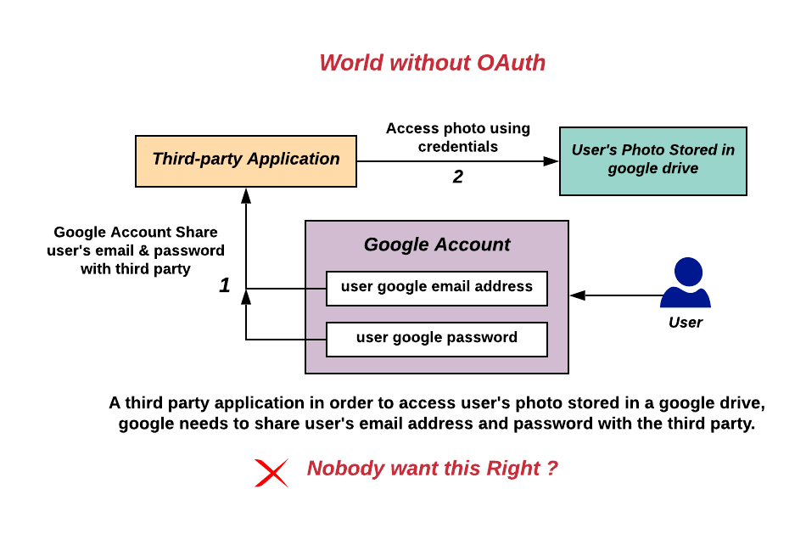
Access Delegation Standards
. https://en.wikipedia.org/wiki/OAuth#/media/File:Without-oauth.png

Slide 28
Access Delegation Standards
How ? https://developer.okta.com/blog/2017/06/21/what-the-heck-is-oauth

Slide 29
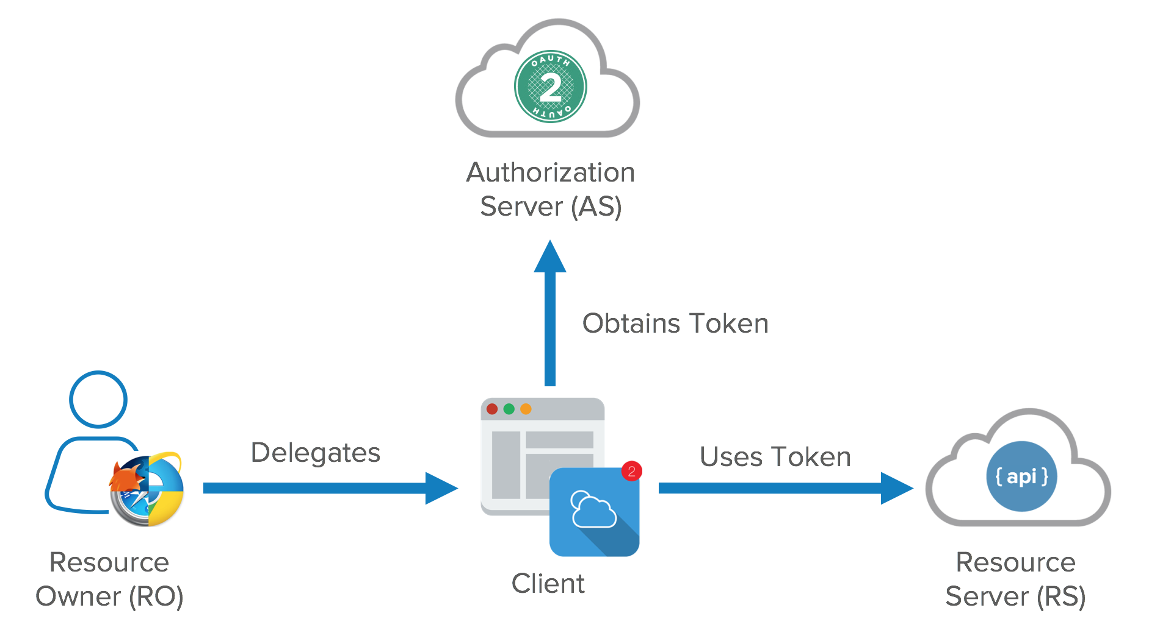
Access Delegation Standards
How ? https://developer.okta.com/blog/2017/06/21/what-the-heck-is-oauth

Slide 30
Access Delegation Standards
You’re probably seen these standards in action - Go to bank app to approve this Transaction - Use this QR code to Login to Facebook
- Login via Google ID

Slide 31
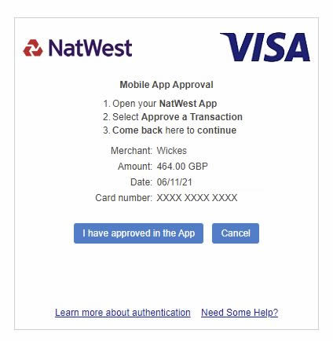
Access Delegation Standards
You’re probably seen these standards in action

Slide 32
Access Delegation Standards
Oauth: since 2006s been securing the web (non-corporate defacto standard, created by big tech / IETF) SAML: since 2001s secured corporate America (XML based, created by OASIS)

Slide 33
Tokens Inbrief

Slide 34
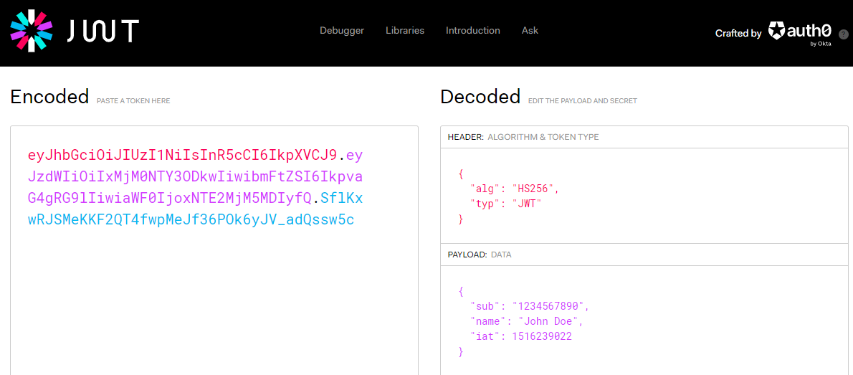
Token Standards
JWT: json web token https://jwt.io/

Slide 35
Token Qualities
Short lived JWT has a built in expiry
Has Metadata JWT has Headers + Payload (just like HTTP)
Verified Payload JWT has signature hash
Payload is NOT encrypted by default (or standard) JWT has optional encrypted payloads

Slide 36
Token Standards
Other token standards exist https://en.wikipedia.org/wiki/Access_token

Slide 37
OAuth Indepth

Slide 38
OAuth in Depth
OAuth has flows (aka ways to authentication) Authorization Code Flow Implicit Flow Client Credentials Flow Device Flow Resource Owner Password Flow https://auth0.com/

Slide 39
OAuth in Depth
Authorization Code Flow Implicit Flow Client Credentials Flow Device Flow Resource Owner Password Flow https://auth0.com/

Slide 40
OAuth: Authorisation Code Flow
Login via Authentication Server (with Authorization App) Before: - App is signed up and Authorisation in Auth Server
- User is setup in Authenication Server Auth process:
- App sends User to Auth Server
- Users authorizes Login - Auth Server gives Token to App (basically) https://auth0.com/docs/get-started/authentication-and-authorization-flow/authorization-code-flow

Slide 41
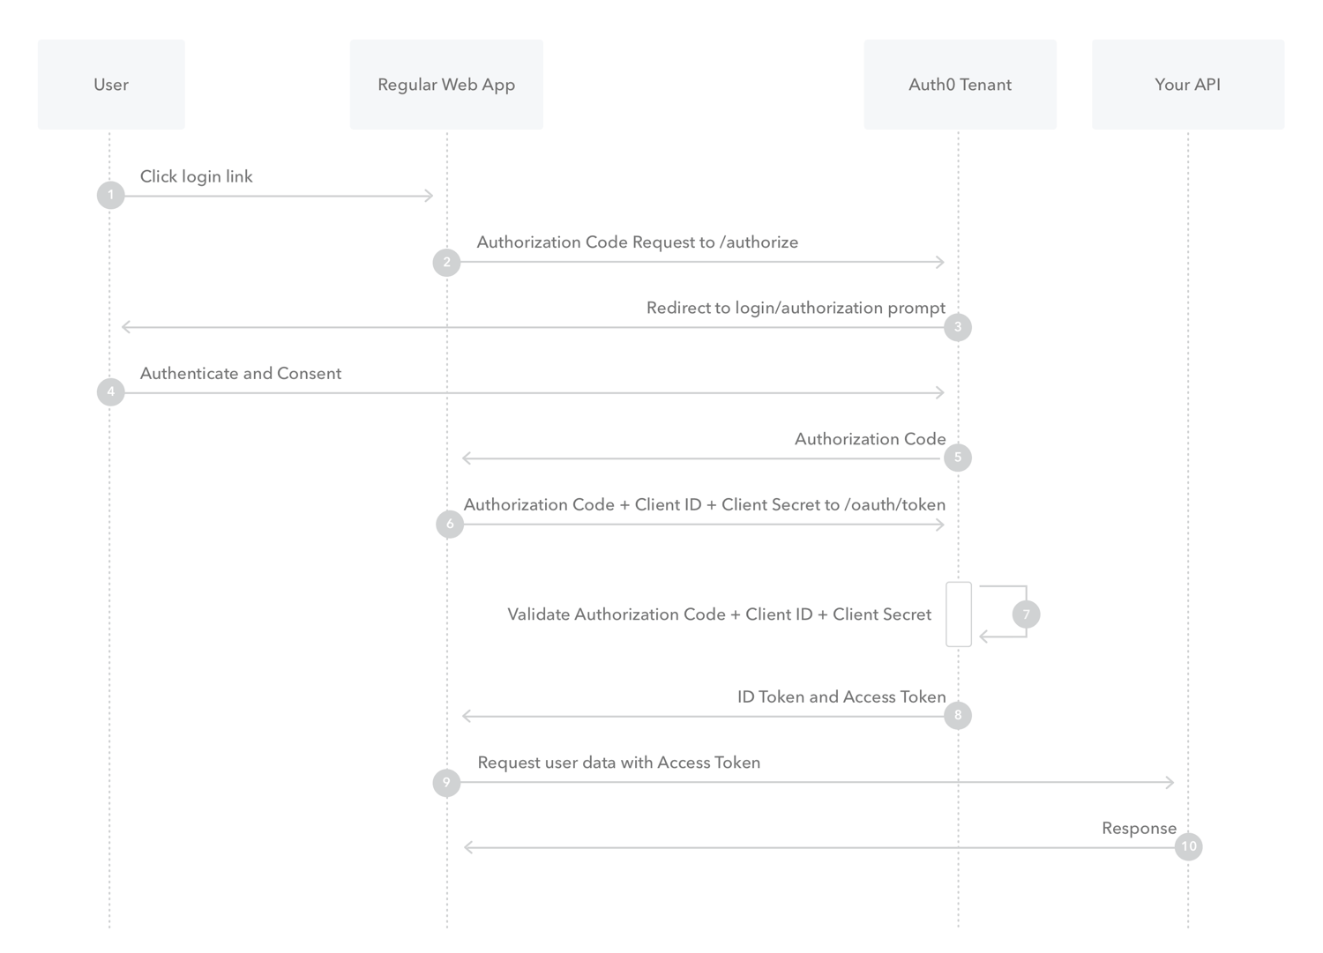
OAuth: Authorisation Code Flow

Slide 42
OAuth in Depth
Authorization Code Flow Implicit Flow Client Credentials Flow Device Flow Resource Owner Password Flow https://auth0.com/

Slide 43
OAuth: Implicit Flow
Login via Authentication Server (no App required) Before: - User is setup in Authenication Server Auth process:
- App sends User to Auth Server
- Users authorizes Login - Auth Server gives Token to App (basically) https://auth0.com/docs/get-started/authentication-and-authorization-flow/implicit-flow-with-form-post

Slide 44
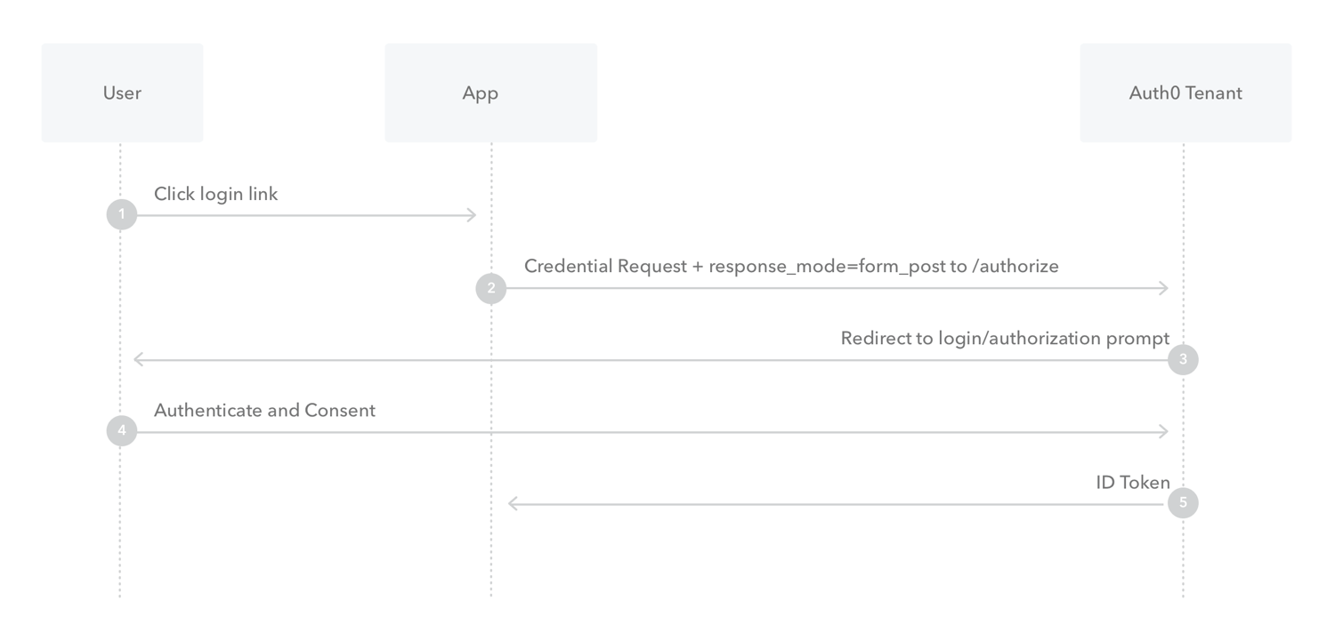
OAuth: Implicit Flow
.

Slide 45
OAuth: Implicit Flow COMMENTS
Implicit flow is not recommended due to Replay attacks
aka the send to a auth server could be repeated, returned or controlled (say in an controlled iframe)
Unlike Authorisation Code Flow, where the app actually needs to talk to the Auth server to get a usable token
The return is usable straight away

Slide 46
OAuth in Depth
Authorization Code Flow Implicit Flow Client Credentials Flow Device Flow Resource Owner Password Flow https://auth0.com/

Slide 47
OAuth: Credentials Flow
Password login (for machine to machine) Before: - App has user/pass to Auth Server (sorry…. client id + client secret) Auth process:
- App id/secret logs into Auth Server - Auth Server gives Token to App (basically) https://auth0.com/docs/get-started/authentication-and-authorization-flow/client-credentials-flow

Slide 48
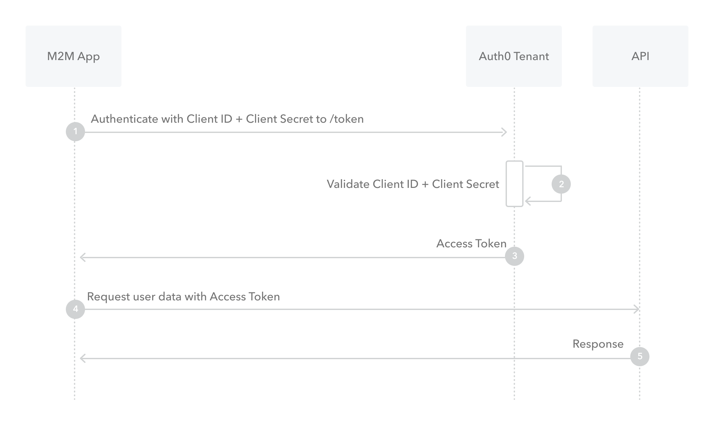
OAuth: Credentials Flow
.

Slide 49
OAuth: Credentials Flow COMMENTS
For machine to machine only
Basically, machines need passwords to login

Slide 50
OAuth in Depth
Authorization Code Flow Implicit Flow Client Credentials Flow Device Flow Resource Owner Password Flow https://auth0.com/

Slide 51
OAuth: Device Flow
3rd Device login (for logging into inputless device like TV) Before: - User has 2th Device, aka Mobile / Laptop
- App authorization with Auth Server Auth process:
- 1st User Device go to App
- App gives url or QR code for User’s 2nd Device
- Users logs in using 2nd Device - Auth Server gives Token to App - 1st Device is now Logged in https://auth0.com/docs/get-started/authentication-and-authorization-flow/device-authorization-flow

Slide 52
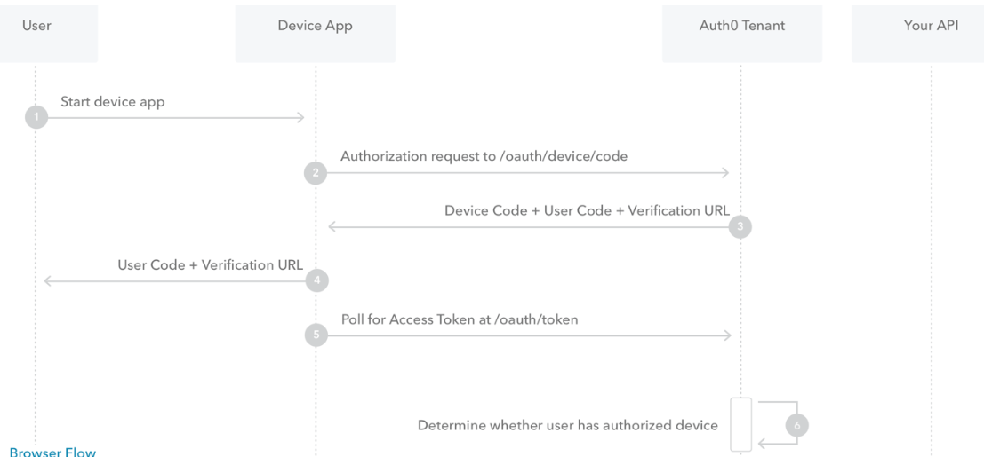
OAuth: Device Flow (part 1)
.

Slide 53
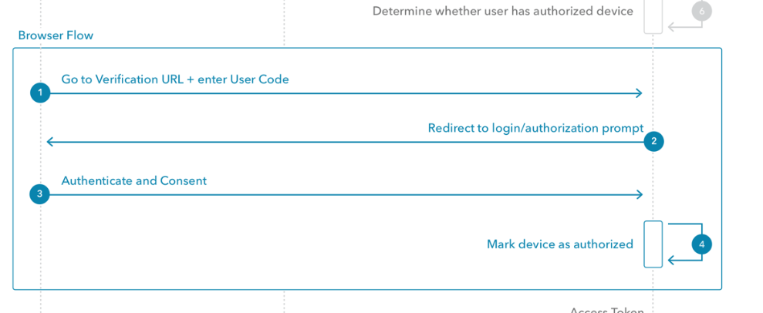
OAuth: Device Flow (part 2)
.

Slide 54
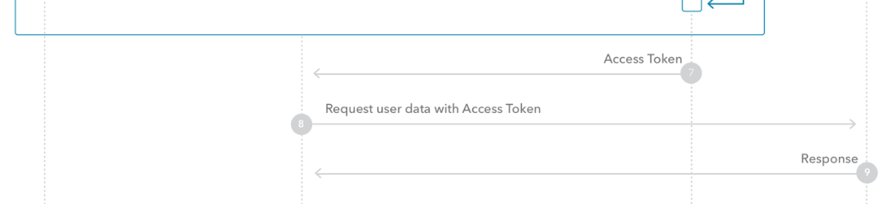
OAuth: Device Flow (part 3)
.

Slide 55
OAuth: Device Flow COMMENTS
For machine to machine only
Basically, machines need passwords to login

Slide 56
OAuth in Depth
Authorization Code Flow Implicit Flow Client Credentials Flow Device Flow Resource Owner Password Flow https://auth0.com/

Slide 57
OAuth: Resource Owner Password Flow
Before: - User is setup in Authenication Server Auth process:
- User gives credentials to App….
- App logins User into Auth Server - Auth Server gives Token to App
https://auth0.com/docs/get-started/authentication-and-authorization-flow/resource-owner-password-flow

Slide 58
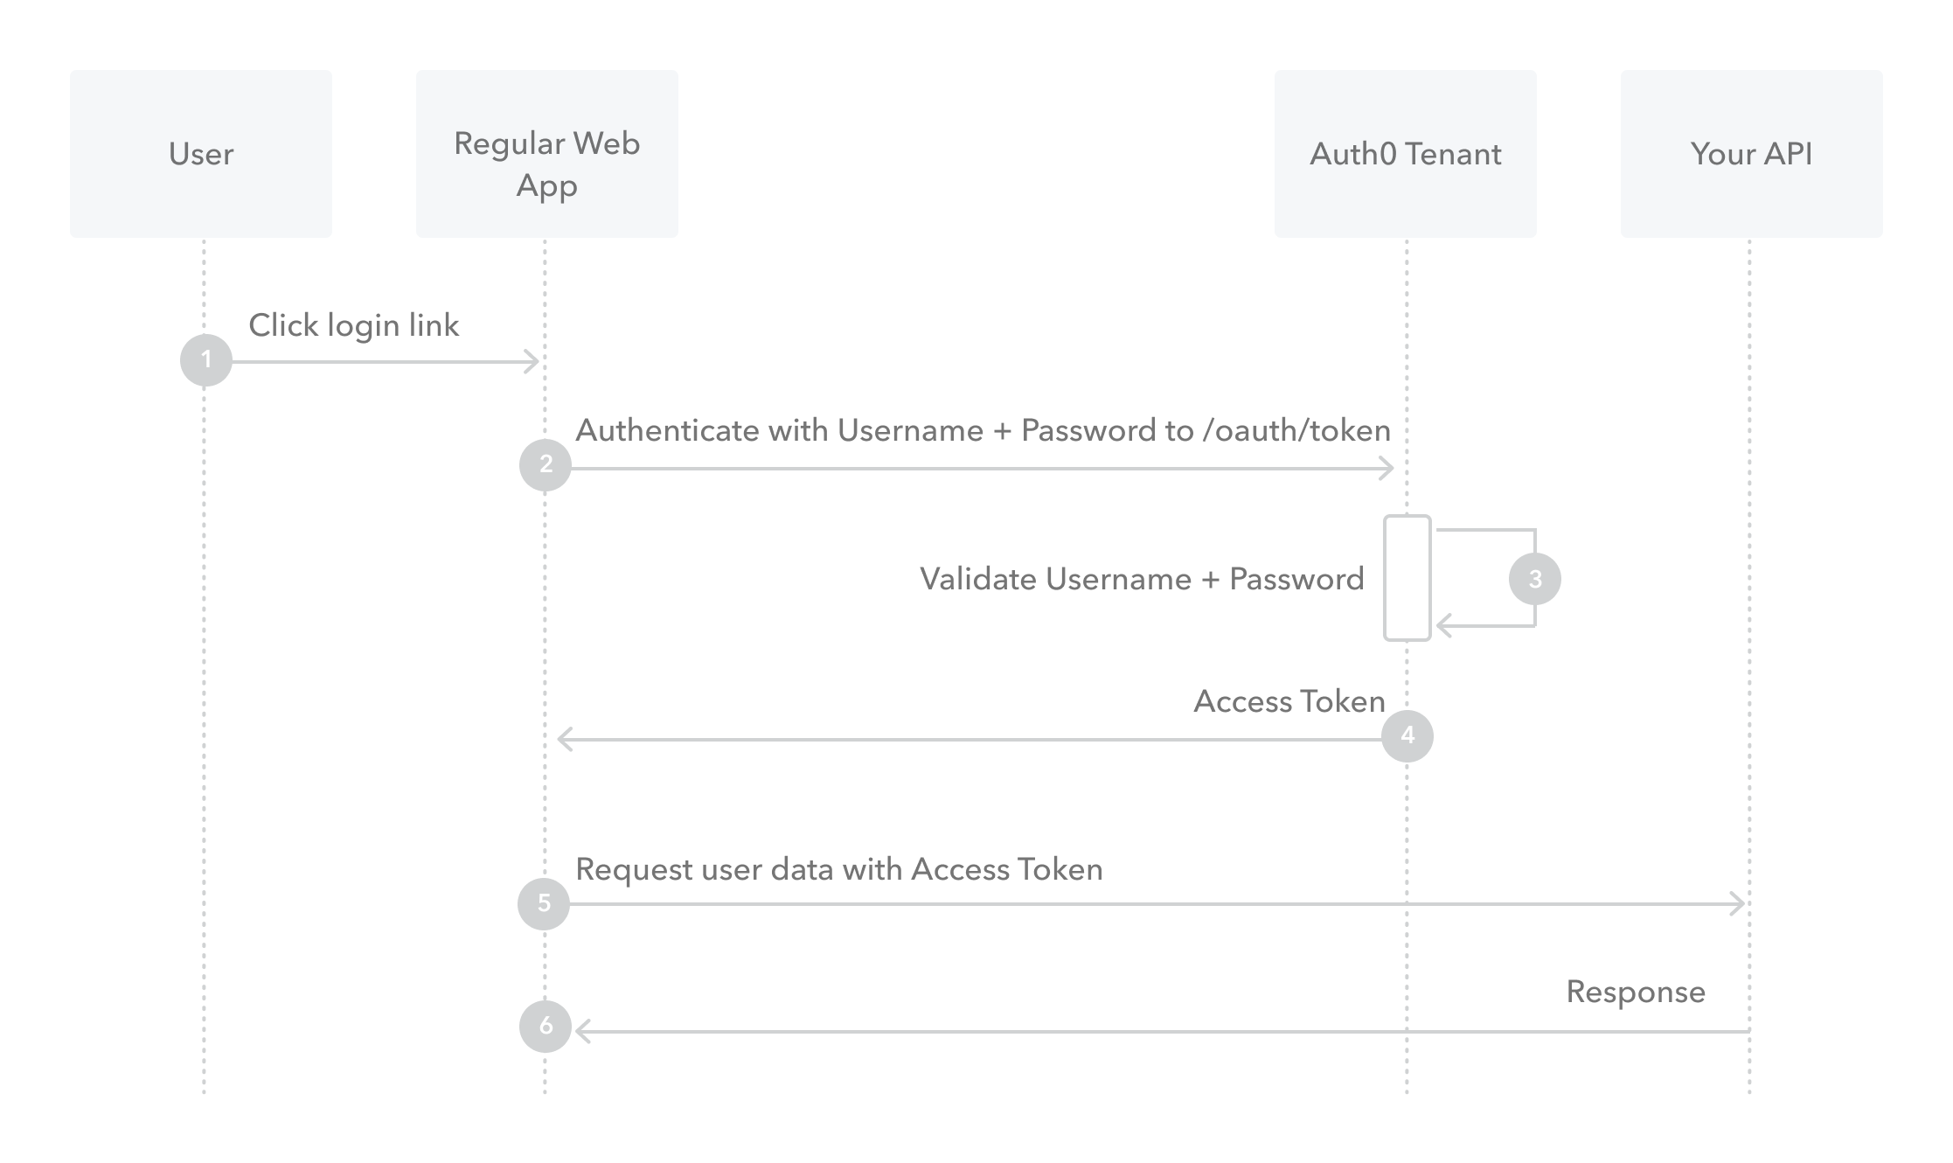
OAuth: Resource Owner Password Flow
.

Slide 59
OAuth: Resource Owner Password Flow COMMENTS
Not Recommended
Users giving the app your username and password!

Slide 60
Cognito

Slide 61
Cognito
Cognito is just an OAuth server
It does the previously mentioned things, it can even federate to other OAuth and SAML servers Using “client credentials flow” to daisy chain https://docs.aws.amazon.com/cognito/latest/developerguide/cognito-user-pools-app-integration.html

Slide 62
Questions
I’ve been Anthony “Zapper” M^{c}Kale
Hopefully I’ve Educated, Informed, and even Entertained Good Testing is Good Security is Good software

Slide 63
Thank you

