Slide 1
Friday Training Hour “Basics of Jira”
DES AI / ML Centre of Excellence
Anthony McKale Tech Lead

Slide 2
Agile Primer

Slide 3
Agile Primer
Value is represented in agile as units of work
In Agile we break down large value items
Into smaller, easier to achieve units of work
We give a status to each unit of work (e.g. Backlog, Ready, In Progress, Complete)

Slide 4
Agile Primer
The units of work are then tackled (one by one, one at a time)
Each of these units of work are moved in status
(As they are started and completed)
Time moves on we complete all the units of work
Those large value items are completed

Slide 5
Agile Primer
Profit… or more accurately value creation

Slide 6
Agile Primer
Profit… or more accurately value creation
Ps
The status of the unit of work is called a “status”

Slide 7
Agile Primer
Profit… or more accurately value creation
Ps
The status of the unit of work is called a “status”
The unit of work is called a “Task / Bug Ticket”

Slide 8
Agile Primer
Profit… or more accurately value creation
Ps
The status of the unit of work is called a “status”
The unit of work is called a “Task / Bug Ticket”
The larger value item is a “Epic Ticket”

Slide 9
Agile Primer
Profit… or more accurately value creation
Ps
The status of the unit of work is called a “status”
The unit of work is called a “Task / Bug Ticket”
The larger value item is a “Epic Ticket”
The place where tickets progress is displayed is called a “Board”

Slide 10
Agile Primer
And …
The world’s best “Board” Software is called “JIRA”

Slide 11
The Basics of Jira
“The Basics of Jira” Table of Contents
Jira Tickets
Jira Markup
Jira Search / JQL
Jira Workflow
Jira Boards

Slide 12
Intermission
Tea
Cake
Questions ?
Points:
- Subdivided work helps manage large tasks
Agile Boards are amazing
Jira is an amazing online Agile Board

Slide 13
Jira Tickets

Slide 14
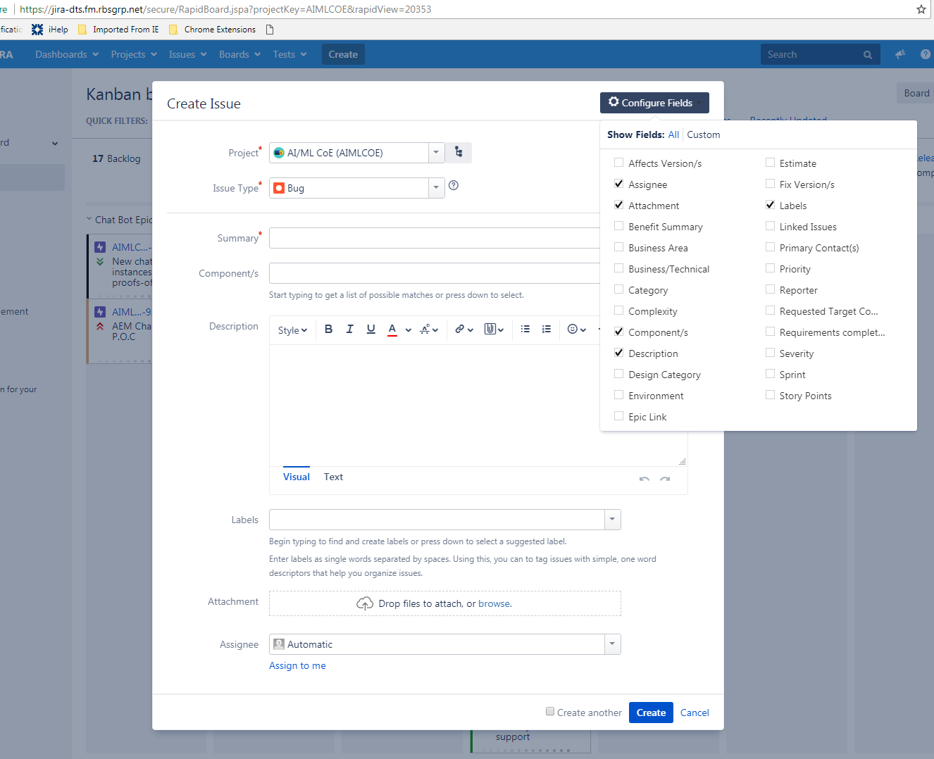
Jira Tickets
Jira Tickets are normally completely customisable Unfortunately there are locked down here in RBS
Hence please ignore surplus fields

Slide 15
Jira Tickets
Important Fields
5 of 25

Slide 16
Jira Tickets
Jira Tickets has properties, main ones are:
Type: Epic / Task / Bug
Summary: Human Short name
Component : Which board (we’re ‘Chatbot’)
Description : Human Details
Assignee : Who’s working on it

Slide 17
Jira Tickets
Plus “status”
Status : aka Ticket Progress, always starts as “Open” (Determined by workflows which are explained later)

Slide 18
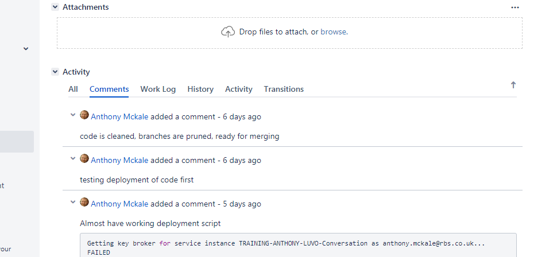
Jira Tickets
Jira Comments

Slide 19
Jira Tickets
Jira Comments, these should be added when:
Status change aka testing of work now complete
Progress happens aka work on WebUI for Chatbot is completed
Feedback related happens aka unblocked with access granted

Slide 20
Jira Wiki markup

Slide 21
Jira Wiki markup
Jira Comments + Description Field support wiki markup
This adds rich content, such as :
- Tables
Code blocks
Images

Slide 22
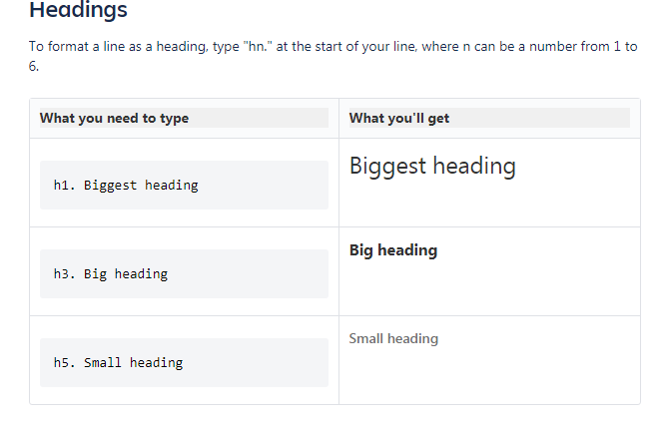
Jira Wiki markup

Slide 23
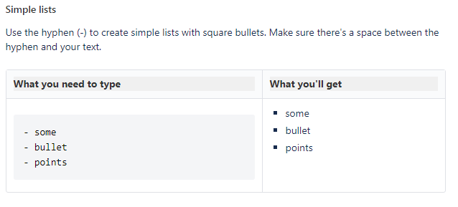
Jira Wiki markup

Slide 24
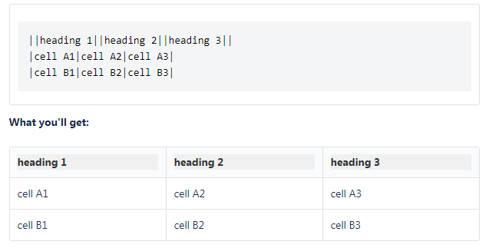
Jira Wiki markup
Tables

Slide 25
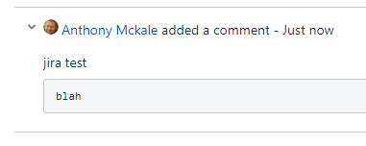
Jira Wiki markup
Code
{code} blah {code}

Slide 26
Jira Wiki markup
More Details
https://confluence.atlassian.com/doc/confluence-wiki-markup-251003035.html

Slide 27
Jira Search aka JQL

Slide 28
Jira Search aka JQL
JQL is just like SQL for those Database buffs
For everyone else think programmable filters + Pretty GUI which creates JQL
https://jira-dts.fm.rbsgrp.net/issues/?jql=
Aka “find me all ticket with status ‘Open’”
JQL is “status=Open”
Aka “find me all ticket assigned to Anthony”
JQL is “assignee=mckalea” where mckalea is my username

Slide 29
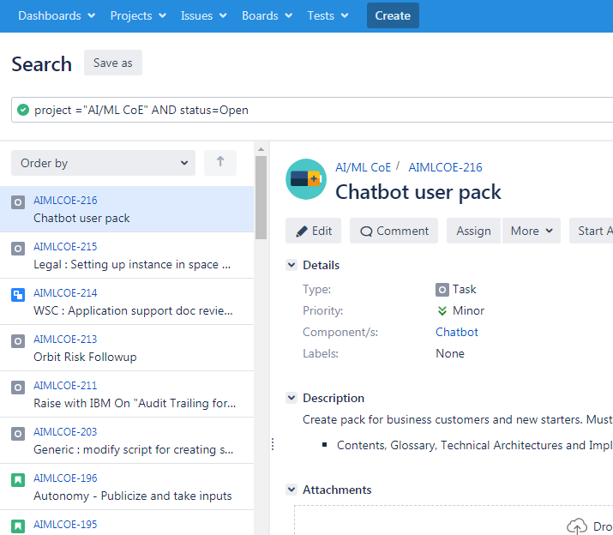
Jira Search aka JQL
Example:
https://jira-dts.fm.rbsgrp.net/issues/?jql=project%20%3D"AI%2FML%20CoE"%20AND%20status%3DOpen
Tips: https://confluence.atlassian.com/jirasoftwareserver0712/advanced-searching-959315322.html https://confluence.atlassian.com/jiracore/blog/2015/07/search-jira-like-a-boss-with-jql https://confluence.atlassian.com/jirasoftwarecloud/advanced-searching-764478330.html https://www.atlassian.com/blog/jira-software/jql-the-most-flexible-way-to-search-jira-14

Slide 30
Jira Workflow

Slide 31
Jira Workflow
Jira Workflow
Determines what Statuses are available aka Backlog / Ready for Work / Blocked / In Progress… etc
Determines ticket status flow to another aka Backlog -> Ready for Work
Completely customisable in JIRA * Normally but locked down here in RBS
Each Status maps to a Column in Kanban Board

Slide 32
Jira Workflow
Ideal Kanban Jira Ticket Workflow
WORK COMPLETE
WORK IN PROGRESS
TEST IN PROGRESS
BLOCKED
TEST COMPLETE
READY
BACKLOG
CLOSED

Slide 33
Jira Workflow
REMOVED

Slide 34
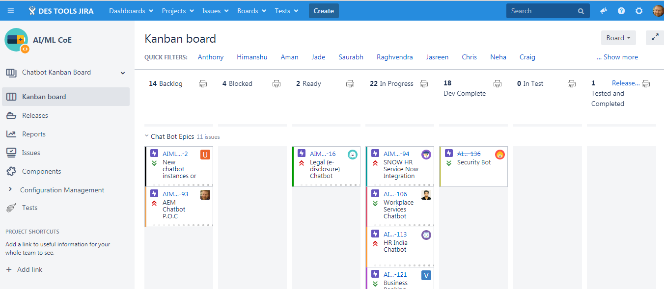
Jira Board

Slide 35
Jira Board
Agile board are where team can see :
Work ready to be worked on
Work in progress
Work that is completed* *within the “sprint/cycle”
Work that is blocked

Slide 36
Jira Board
Aka :
What needs done
What is being done
What has been done
What is blocked

Slide 37
Jira Board
Features to help this
Tickets (Epic / Task / Bug)
Columns
Swim Lanes
Filters
Component ?

Slide 38
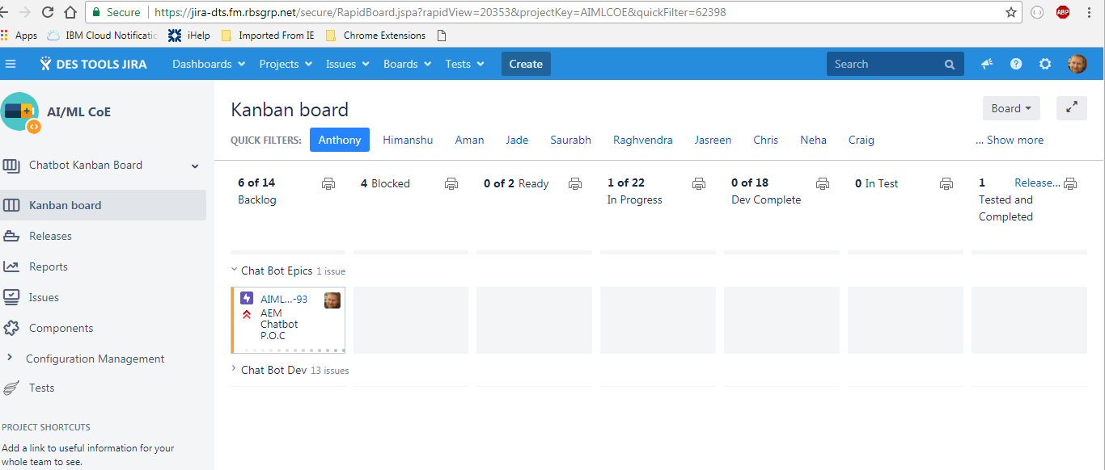
Jira Board
TICKETS REPRESENT WORK

Slide 39
Jira Board
COLUMNS REPRESENT PROGRESS
PROGRESS

Slide 40
Jira Board
EPIC TASKS
TASKS AND BUGS
SWIMLANES REPRESENT DIVISION OF WORK
(ANY SPLIT YOU DECIDE)

Slide 41
Jira Board
FILTERS REPRESENT JQL QUERY OF WORK ON BOARD
(CAN BE ANY JQL YOU DECIDE)
FILTERS SET UP

Slide 42
Jira Board
KANBAN BOARD
ALL TICKETS WITH
COMPONENT = “Chatbot”
COMPONENTS REPRESENT WHICH BOARD IN OUR PROJECT A TICKET IS ON
*CAN BE ANY JQL AND ANY FIELD
BUT WE CHOSE COMPONENT FIELD FOR THIS

Slide 43
Intermission
Tea
Cake
Questions ?
Points:
Workflows are a compromise
Tickets have too many fields
Testing is good for quality (please remember to do this step)

Slide 44

Questions ?
I’ve been Anthony M^{c}Kale “Wizard without Portfolio” Fixer-Upper of Broken things, and creator of time-constrained workable Fudges for 15 years. Email : anthony@zapper.hodgers.com

