Slide 1
Friday Training Hour “Basics of Git”
DES AI / ML Centre of Excellence
Anthony McKale Tech Lead

Slide 2
Git Primer

Slide 3
Git Primer
Git History
Born in the early 00s, by Legend Linus Torvalds
Based on proprietary BitKeeper
Used originally on the Linux kernal

Slide 4
Git Primer
What is Git
Git is a Code Repo
Repo maintains every change to the code base (called a commit)
Repo maintains codebase versions (called branches)
Repo maintains fixed versions of the codebase (called tags)

Slide 5
Git Primer
Git is Distributed (aka your local git is a server)
SVN / CVS are central (only the main SVN is a server)
Git is installed locally and that is a Code Repo
Git is typically installed remotely, that is also a Code Repo
These Repos can talk to one another
You can work offline locally

Slide 6
Git Primer
Git Terminology
You clone remote repos to create local repos
You commit file system changes to your local repo
You pull remote changes to local repo
You push local changes to remote repo

Slide 7
The Basics of Jira
“The Basics of Jira” Table of Contents
History / Primer
Git Architecture
Git: How to setup
Gitlab / Github
Git Cli
Git Branch + Source Tree
Git Merge + Source
Fast look at Git Flow (will not be in depth !)

Slide 8
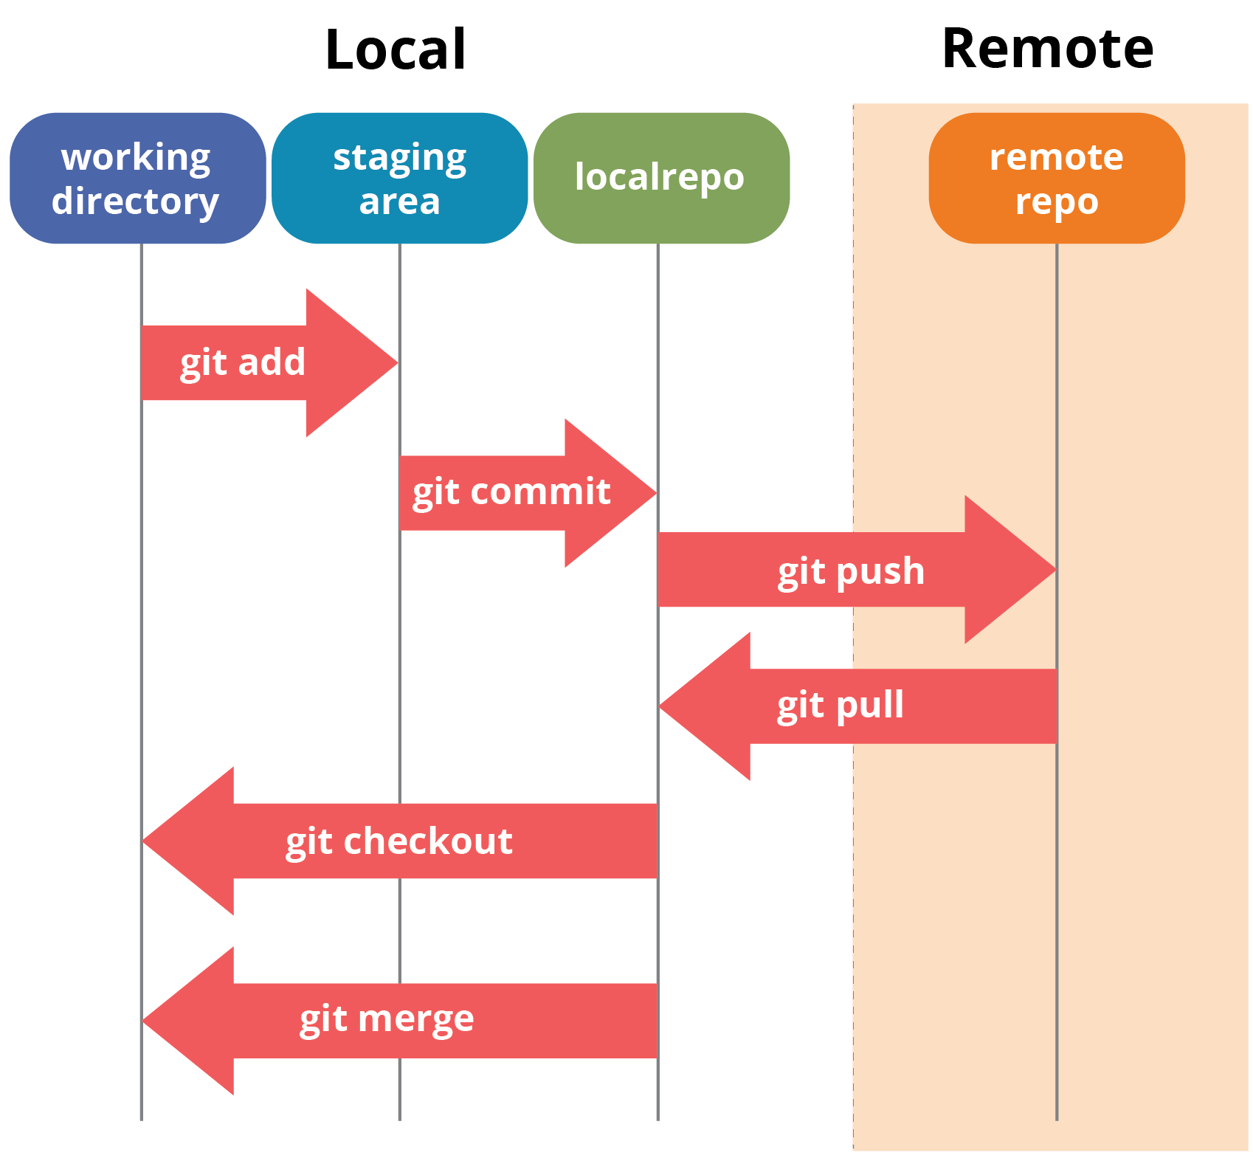
Git Architecture from https://www.edureka.co/blog/git-tutorial/

Slide 9
Git: How to setup
Install Git Portable (not rbs self service version!) https://git-scm.com/download/win
https://github.com/git-for-windows/git/releases/download/v2.21.0.windows.1/PortableGit-2.21.0-64-bit.7z.exe
Generate SSH Keys
https://git.ng.bluemix.net/help/ssh/README#generating-a-new-ssh-key-pair
Add SSH Keys to Gitlab
https://git.ng.bluemix.net/profile/keys

Slide 10
Git: How to setup
REMOVED

Slide 11
Git: Cli
Common commands git add FILENAME git commit –m "MESSAGE“ git pull git push git branch LOTS OF OPTIONS git merge LOTS OF OPTIONS

Slide 12
Git: Source Tree
Common Tasks : merging / branching use Source Tree
These are super hard on commandline

Slide 13
Git: Source Tree
Common Tasks : merging / branching use Source Tree
These are super hard on commandline
Don’t be a hero
There a app for that

Slide 14
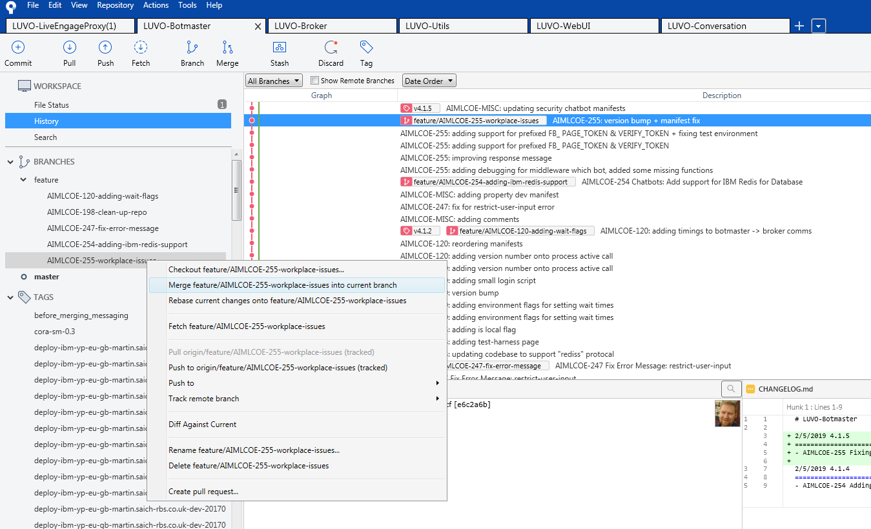
Git: Source Tree

Slide 15
Work Example
- Create repo - Clone repo - Commit change - Branch repo - commit change - merge repo - profit

Slide 16
Git Lab / Git Hub
These are external Git Repo hosting
Gitlab is open source
Github is commercial

Slide 17
Git ignore
You don’t want to store all files
.gitignore is a list at your git root of files not to store https://git-scm.com/docs/gitignore

Slide 18
Git keep
You can’t keep empty folders in git
By convention a empty .gitkeep file is put into empty folders to store them in git

Slide 19
Git Flow
Git Flow is a process of commiting / pulling / pushing to repos
Git Flow keeps the repos tidy
Git Flow stops branch soup

Slide 20
Git Flow
Git Flow Branches
develop – what is developed and finished
master – what is deployed on live
feature/XXX – normal ticket work which are work-inprogress
hotfix/xxx – emergency fixes to master
(tag) release-x.x.x – released versions of code
(tag is just a fixed branch you can’t change*)

Slide 21
Git Flow
Git Flow Basicsdevelop – what is developed and finished
https://www.atlassian.com/git/tutorials/comparing-workflows#gitflow-workflow
Will draw on board

Slide 22
Intermission
Tea
Cake
Questions ?
Points:
- Defenestrate old git repos

Slide 23
Further Information
Links
Git https://en.wikipedia.org/wiki/Git
Git Flow Descriptions
https://www.atlassian.com/git/tutorials/comparing-workflows#gitflow-workflow
https://datasift.github.io/gitflow/IntroducingGitFlow.html
Best Git Branch Management Software https://www.sourcetreeapp.com/
Installing Git on VCSe instructions https://confluence.dts.fm.rbsgrp.net/display/DESDATA/Developer+Machine+Setup#DeveloperMachineSetup-InstallGitStuff(Git/GitBash%22PortableVersion%22/SourceTreebranchviewer)

Slide 24

Questions ?
I’ve been Anthony M^{c}Kale “Wizard without Portfolio” Fixer-Upper of Broken things, and creator of time-constrained workable Fudges for 15 years. Email : anthony@zapper.hodgers.com

