Slide 1


Academy
Anatomy and Psychology of
Bug Hunting
Anthony McKale
Principal Software Engineer

Slide 2
Table of Contents
FOR INTERNAL USE ONLY
Bugs?
Bug Physiology
Types of Bugs
When Bugs Occur
Bug Finder Warning: Audience Participation!
Information classiﬁcation: Public

Slide 3
Basically what are bugs

Slide 4
Bugs
Audience participation Question ? What are bugs
https://en.wikipedia.org/wiki/Bug_(engineering)

Slide 5
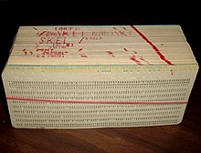
Real Bugs
Used to be paper eating Insects That hid and ate the data storing paper
Note *: the term has competing origin stories, I was told this personally by someone of the punch-card era
https://en.wikipedia.org/wiki/Bug_(engineering)
https://en.wikipedia.org/wiki/Computer_programming_in_the_punched_card_era

Slide 6
Software Bugs
Bugs are: - Coding Mistakes
Misinterpreted requirements
Poorly Interacting systems
Etc
https://en.wikipedia.org/wiki/Software_bug

Slide 7
Neu Bugs
Audience participation Question ? When are bugs not a bug
https://en.wikipedia.org/wiki/Bug_(engineering)

Slide 8
Neu Bugs
Audience participation Question ? When are bugs not a bug
https://en.wikipedia.org/wiki/Bug_(engineering)

Slide 9

Neu Bugs
When a bug is a feature “It’s not a bug, it’s a feature”
https://en.wikipedia.org/wiki/Bug_(engineering)

Slide 10
Bug Psychology

Slide 11
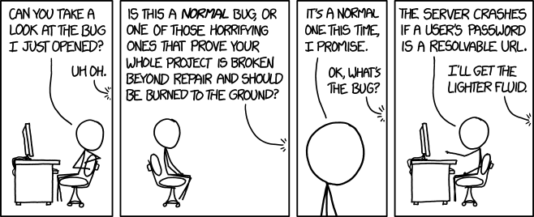
Production bugs are scary
FOR INTERNAL USE ONLY
. From xkcd
Information classiﬁcation: Public

Slide 12
Example
FOR INTERNAL USE ONLY
Steps of what can happen when serious bugs are found
Information classiﬁcation: Public

Slide 13
Bug Psychology: PROD INCIDENT EXAMPLE
FOR INTERNAL USE ONLY
Steps:
Discovery
Reproduce in Dev/Local
Fix in Dev/Local
Reproduce in Test
Fix In Test
Paperwork…
Reproduce in Prod
Fix in Prod
Information classiﬁcation: Public

Slide 14
Bug Psychology: REAL PROD INCIDENT
FOR INTERNAL USE ONLY
Discovery
Reproduce in Dev/Local
Having everyone and their boss emailing / phone you
Fix in Dev/Local
Having everyone and their boss emailing / phone you
Reproduce in Test
Having everyone and their boss emailing / phone you
Fix In Test
Having everyone and their boss emailing / phone you
Paperwork…
Having everyone and their boss emailing / phone you
Reproduce in Prod
Having everyone and their boss emailing / phone you
Fix in Prod
Having everyone and their boss emailing / phone you
Profit
Having everyone and their boss emailing / phone you
Steps:

Slide 15

Bug Psychology: REAL PROD INCIDENT
FOR INTERNAL USE ONLY
Steps in Music Form
.

Slide 16
Bug Psychology
FOR INTERNAL USE ONLY
Serious Bug produce a classic 5 stage grief response
Denial : it’s not that bad
Anger : why the hell did xx not check this
Bargaining : maybe if we do xxx no one with notice
Depression : were all getting fired
Acceptance : tell management we have a problem
https://www.washington.edu/counseling/2020/06/08/the-stages-of-grief-accepting-the-unacceptable/

Slide 17
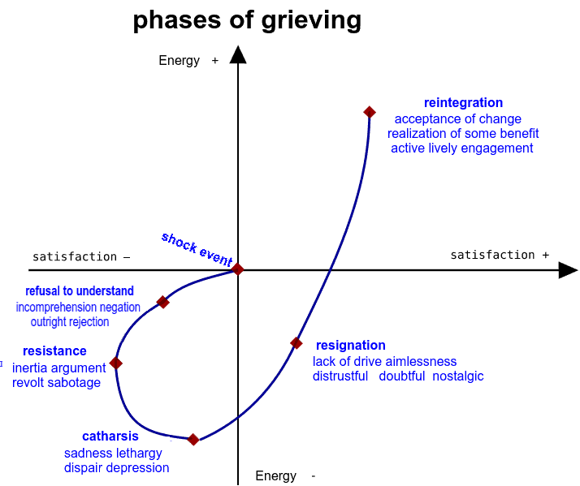
Bug Psychology
FOR INTERNAL USE ONLY
Apon finding a Bug, it can actually emerge as a Grief response
Information classiﬁcation: Public

Slide 18
Bug Psychology
FOR INTERNAL USE ONLY
Serious Production Bug are actually hard to deal with.
It’s important to not turtle up, or get overwhelmed at a team or personal mistake
2 basic rules to help you deal with the stress of bugs
Information classiﬁcation: Public

Slide 19
Bug Psychology
FOR INTERNAL USE ONLY
2 basic rules to help you deal with the stress of bugs
Rule 1: DON’T PANIC * * maybe grab a towel
Information classiﬁcation: Public

Slide 20
Bug Psychology
FOR INTERNAL USE ONLY
2 basic rules to help you deal with the stress of bugs
Rule 1: DON’T PANIC * * maybe grab a towel
Rule 2: Communication & Honesty - Report Issues immediately - Don’t Hide / Ignore Issues - Don’t dismiss Error Reports (always reply to reports)
Information classiﬁcation: Public

Slide 21
How to Fix Bugs : Discovery
FOR INTERNAL USE ONLY
Cliffnotes AKA:
Rule 1: DON’T PANIC
Rule 2: Communication & Honest Report Issues immediately
Information classiﬁcation: Public

Slide 22
Bugs
We’ve been through - roughly what a bug is
Roughly how it’ll make you feel
Lets chat about what types of bugs they are, and how to stop them

Slide 23
Types of Bug

Slide 24
6 Types of Bug
FOR INTERNAL USE ONLY
Classic 6 types of software bug
Compilation Bugs
Runtime Bugs
Logic Bugs
Racetime Bugs
Integration Bugs
Requirements Bugs
Information classiﬁcation: Public

Slide 25
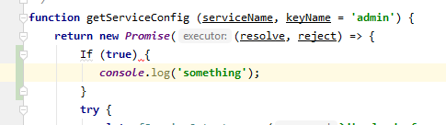
Bug Types: Compilation Bugs*
FOR INTERNAL USE ONLY
These are linting and syntax errors
- Should be caught by code review and unit testing
- Shouldn’t happen on prod * but can if dev/test/prod have different interpreter or library version
* In interpreted languages I mean linting/syntax
Information classiﬁcation: Public

Slide 26
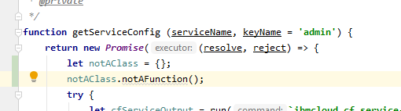
Bug Types: Runtime Bugs
FOR INTERNAL USE ONLY
These are Errors that occur at runtime
- Should be caught by code review and unit testing
- Can happen on production but should be caught and reported in alerting
Information classiﬁcation: Public

Slide 27
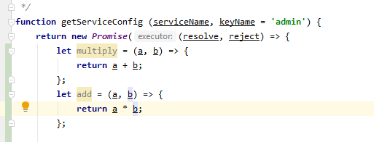
Bug Types: Logic Bugs
FOR INTERNAL USE ONLY
These are Errors that occur in code, where the code isn’t doing what’s expected
Should be caught by code review and unit testing
Can happen on production but should be caught and reported by users / business
Information classiﬁcation: Public

Slide 28
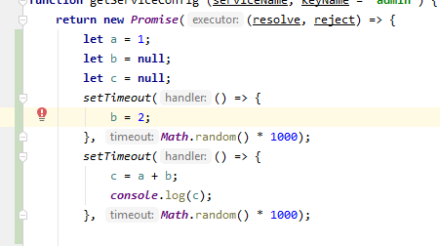
Bug Types: Race time Bugs
FOR INTERNAL USE ONLY
These are Errors that occur in runtime with typically async code, where the code isn’t handling the async nature of the code or a 3rd party
Should be caught by code review and unit testing
Can happen on production but should be caught and reported by users / business, sometimes alerting if a runtime error occurs
- Hard to debug as they are intermittent by nature
Information classiﬁcation: Public

Slide 29
Bug Types: Integration Bugs
FOR INTERNAL USE ONLY
These are Errors that occur where the code isn’t handling a 3rd party correctly
Should be caught by code review and integration testing
Occasionally on production should be caught and reported by users / business
Hard to spot issues find in dev/test if not representative of production
Hard to find in unit tests due to mocking Normally Integration testing is required
Information classiﬁcation: Public

Slide 30
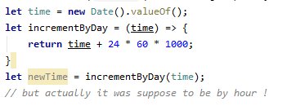
Bug Types: Requirements Bugs
FOR INTERNAL USE ONLY
These are Errors that occur when the code is working correctly but not doing the correct thing
Should be caught by code review or business testing
Important that release items are retested before release in a test environment
Due normally to poor communication or misunderstandings between people
Information classiﬁcation: Public

Slide 31
Bug Types
FOR INTERNAL USE ONLY
Bugs are hard
identify bug behaviour to discover type of bug
Type of bug will determine root cause
Type of bug will fix for bug
Type of bug will aid retrospective to prevent future types of that bug
Information classiﬁcation: Public

Slide 32
Questions ?
FOR INTERNAL USE ONLY
Else onto when bugs happen
Information classiﬁcation: Public

Slide 33
When bugs bug

Slide 34
When Bugs Bug: Normal Situations
These are the common times bugs occur
During Local Development
Non-Prod Environments
After Prod Release on Prod Box

Slide 35
When Bugs Bug : Fun Situations
Also for fun…. Non-deterministically
Long after Code Changes
After 3rd Party API Changes

Slide 36
When Bugs Bug: On Local
Local Runtime errors are:
Common in local
Rare in dev/test/prod
Normally due to inconsistent environments or developer error

Slide 37
When Bugs Bug: Pre-Production
Normal Errors in Non-Prod are a normal and common thing
Common in dev
Rare in test
Should be picked up by unit tests, business testing
* How normal / common will impact your productivity ☺

Slide 38
When Bugs Occur: Non-Prod Box
Prevention:
Pairing / Peer Code Reviews
Write unit tests to test new code
Business Testing new features in business review
Test out existing features in testing QA environment *
Carry out regular automatic system e2e testing in dev
* Called regression testing

Slide 39
When Bugs Bug: After Prod Release
These are called regression bugs, and are very high priority
Should be caught by business checkout
Test scripts should help caught these
Service impacting bugs should be immediately hotfixed
Minor or Non Service impacting bugs should be put onto the next sprint’s backlog

Slide 40
When Bugs Bug: After Prod Release
Prevention:
Do Code Freeze before production release, to aid code stability
Beta and A/B testing can help testing out code with sub set of users before main release
Release out of hours to reduce outage/risks
Carry out system e2e testing
Test new features in testing environment
Test out existing features in testing environment *
* Called regression testing

Slide 41
When Bugs Bug: Long after Prod Release
These are called post-launch production bugs
These often are low priority (or they would have been found sooner)
Should be put in backlog for prioritisation and fixing

Slide 42
When Bugs Bug: Long after Prod Release
Prevention:
Test new features in testing environment before releases
Test out existing features in testing environment * before releases
Have mature error reporting mechanism to catch issues early
* Called regression testing

Slide 43
When Bugs Bug: After 3rd Party API Change
These are 3rd Party / Vendor production bugs, and are high priority
These often not caught until production
Should be immediately hot fixed, as often cause immediate and ongoing outage

Slide 44
When Bugs Bug: After 3rd Party API Change
Prevention:
Contact 3rd parties vendors and obtain release / upgrade schedule
Carry out regular automatic system e2e testing
Hook out dev to dev, test to test for 3rd parties to catch bugs early*
* Can come with it’s own challenge dealing with others often broken environments

Slide 45
When Bugs Bug: Cliffnotes
Prod Release Bugs are just non caught Dev/Test Bugs
Prod Release Bugs are a nightmare, avoid at all costs
Only Prod bugs “matter”*
Keep good vendor contact to prevent Integration issues
Regression Test to prevent going backwards
Feature Test to ensure going forwards
Most* bugs happen after releases
* “matter” Dev/Test only matter to your productivity ☺
* Most up until working on Live Persion and IBMCloud…

Slide 46
When Bugs Bug: Questions ?
Onto
Schedule of Events
Finding Bugs
Reproduce Bugs
Fix Bugs
.

Slide 47
Schedule of Events

Slide 48
SCHEDULE OF EVENTS
Rules of thumb
Prod bugs are much much worse than dev bugs (upto x20 more expensive to fix)
Comms must be clear and Efficient (otherwise the cost of updated and comms will delay fixes)
Responsibly of the leadership in the team to protect the support engineers (Get help comms are becoming a problem / getting overwhelmed)

Slide 49
Idealised SCHEDULE OF EVENTS
Steps:
Discovery
Reproduce
Fix*

Slide 50
Schedule of Events
Worked examples for :
NON-PROD/INCIDENT SCHEDULE OF EVENTS
PROD INCIDENT SCHEDULE OF EVENTS

Slide 51
NON-PROD/INCIDENT SCHEDULE OF EVENTS
Steps:
Discovery
Reproduce in Dev/Local
Fix* in Dev/Local
Profit
* Fix includes verification of fix by business / testers

Slide 52
PROD INCIDENT SCHEDULE OF EVENTS
Steps:
Discovery
Reproduce in Dev/Local
Fix in Dev/Local
Reproduce in Test
Fix In Test
Paperwork…
Reproduce in Prod
Fix in Prod
Being chewed out for creating bug in first place…
Profit

Slide 53
SCHEDULE OF EVENTS: Cliffnotes
Do through code reviews and unit testing Help your team with pre-release testing Cause: - Dev bugs ok - Production bugs bad

Slide 54
How to find bugs

Slide 55
How to find Bugs: Overview
Steps:
Discovery*
Reproduce
Fix

Slide 56
Discovery
Discovery happens through many means:
Customer reports
System Testing
Developer Testing
Business Checkout
System Alerts
Remember the rules when handling Discovery

Slide 57
Discovery
Rule 1: DON’T PANIC
Rule 2: Communication & Honest Report Issues immediately

Slide 58
Discovery
Discovery should result in:
Communications
Tracking
Audit Trail
(for prod) email to management email to stakeholder snow or jira incident
Issue on outage page

Slide 59
Discovery
On to reproducing bugs

Slide 60
How to verify bugs

Slide 61
Reproduce
On to reproducing bugs, some things are :
Config aka easy
Code aka hard
External aka very hard

Slide 62
Reproduce
Here’s a 10 step guide to reproducing bugs

Slide 63
Reproduce: EASY STUFF
From https://sites.google.com/site/yacoset/Home/how-to-fix-bugs-step-by-step
First, look for Configuration / Library / simple issues
Step 1: Enter the bug in your case tracking system
Step 2: Google the error message

Slide 64
Reproduce: CODE STUFF
Second, look for code issues
Step 3: Identify the immediate line of code where the bug occurs
Step 4: Identify the line of code where the bug actually occurs
Step 5: Identify the species of bug
Step 6: Use the process of elimination
Step 7: Log everything and analyse the logs

Slide 65
Reproduce: EXTERNAL STUFF
3rd and lastly drill into the external stuff
Step 8: Eliminate the hardware, 3rd party vendor Step 8: Eliminate the hardware or platform as a cause
Step 9: Look at the correlations

Slide 66
Reproduce: GET HELP
LASTLY … DON’T PANIC, GET HELP
Step 10: Bring-in outside help Aka another colleague

Slide 67
Reproduce: Cliffnotes
Don’t panic
Go step by step verifying what went wrong and where
Onto in-depth fixing guide

Slide 68
How to fix bugs

Slide 69
Fixing bugs
This is the easy part “use the verification steps to see what is wrong and just fix it” “The Most Dangerous Word In Software Development”
https://alistapart.com/blog/post/the-most-dangerous-word-in-software-development/

Slide 70
Conclusions

Slide 71
Questions
I’ve been Anthony “Zapper” M^{c}Kale
Hopefully I’ve Educated, Informed, and even Entertained Good Testing is Good Security is Good software

Slide 72
Thank you

