Slide 1


Academy
Continuous Integration 101
Anthony McKale
Principal Software Engineer

Slide 2
Agenda
- Overview
- Terms
- CI/CD + pipelines + steps
- CI PROS / CONS
- CI Best Practice
- Quick Implementation Overview

Slide 3
CI OVERVIEW

Slide 4
CI: Continuous Intergation
Continuous Integration is the practice of doing automated :
1) Packaging of new code 2) Testing of packaged code
3) Documentation / analytics
4) Deployment of packaged assets
Every code change, via a server doing the automation

Slide 5
CI: Primer
90’s: CI Server usage introduced in Agile precursor Extreme Programming (XP)
00’s: CI Server usage solidified as part Agile Software Methodology
2005: Opensource Hudson created in became defacto Central CI Server solution
2011: Jenkins Hudson’s fork created after trademark dispute with Oracle*
2018: low/no-code micro cloud-based Github actions introduced into Github (replacing monolithic CI Servers)

Slide 6
CI TERMS

Slide 7
CI: Continuous Intergation
CI: Continuous Integration is the practice of :
- regular automated packaging of new code - regular automated testing of new code
CD: Continuous Delivery / Deployment*1 practice of :
- Regular deployments of new packaged code
CI/CD: Normally both practices observed

Slide 8
CI: Terms
Continuous Integration (CI)
- Verifying incoming merged code
Continuous Delivery (CD) *1 - Deployment incoming merged code to dev/qa environments
Continuous Deployment (CD) *1 - Deployment incoming merged code to production environments
Hence CI/CD, and yes CD and CD are ambigitous

Slide 9
CI: Terms
Task/Step/Action: - individual process on CI, aka run tests Pipeline
- Chained steps
Job / Build - Instance of a pipeline running

Slide 10
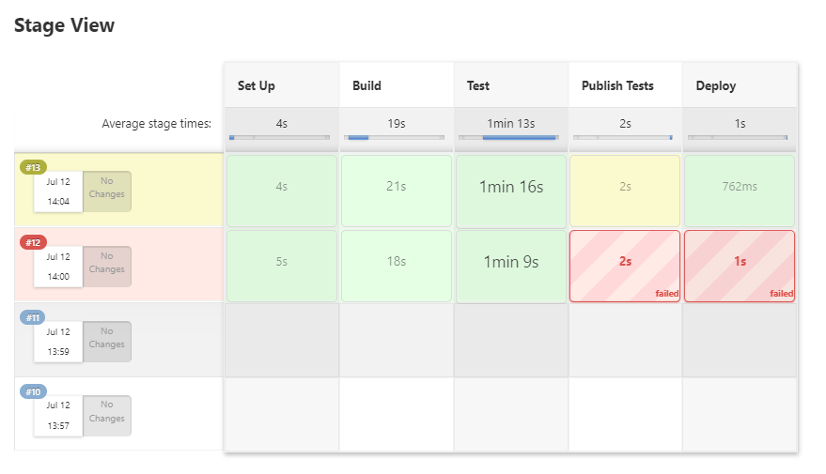
CI: Jenkins Pipeline Example
PIPELINE
STEPS
BUILDS

Slide 11
CI: Graph
Continuous Integration Pipeline (CI)
INIT
Build / Compile Steps
Testing Steps normally via Unit Testing
Continuous Delivery Pipeline (CI/CD)
INIT
Build / Compile Steps
Testing Steps normally via Unit Testing
Deployment to QA / DEV Steps
Continuous Deployment Pipeline (also CI/CD…)
INIT
Build / Compile Steps
Testing Steps normally via Unit Testing
Deployment to Prod Steps

Slide 12
CI: Graph
Sometimes other steps like “reporting” are added
Continuous Deployment Pipeline with Reporting
Build / Compile Steps
Testing Steps normally via Unit Testing
Reporting aka
Post API Docs Store unit tests Graph test coverage
Deployment to Prod Steps
INIT

Slide 13
CI: Branch Strategy
Common Dev / QA / Production Branch Strategy
On Develop branch Changed
Build / Compile Src
Testing
Deployment to DEV environment
On QA branch Changed
Build / Compile Src
Testing
Deployment to QA environment
On main branch Changed
Build / Compile Src
Testing
Deployment to prod environment

Slide 14
CI COMMON STEP TYPES

Slide 15
CI: Common Pipeline Steps
Initiation
Build
Test
Report [optional]
Deploy
INIT
BUILD
TEST
REPORT
DEPLOY

Slide 16
CI: Initiation
INIT
BUILD
TEST
REPORT
DEPLOY
Two typical initiation Types (pull / push):
Pull: Poll for changes on a CRON schedule e.g. every X hours
Push: Git commit hook tells CI server CI server exposes endpoint, explicitly called by Git Server on commits

Slide 17
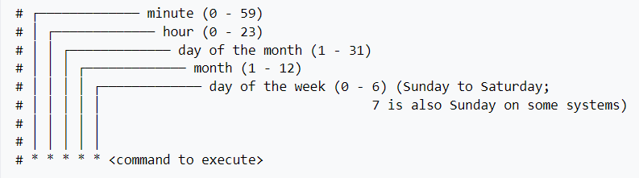
CI: CRON Sidenote
CRON is a format way of specifying a schedule to run a process aka run process every X hours CRON format = * * * * * = <mins> <hours> <month day> <month> <week day>
0 0 * * * == run every night at 12pm 30 0 * * * == run every night at 12.30pm 30 0 1 * * == run every of the 1st of the month at 12.30pm 30 0 1 1 * == run every of the 1st of January at 12.30pm https://en.wikipedia.org/wiki/Cron

Slide 18
CI: CRON Sidenote
CRON format = * * * * * = <mins> <hours> <month day> <month> <week day>
0 0 * * * == run every night at 12pm
Common Special characters
/ = frequency, */5 would be every 5 of that value 0 */12 * * * == run every 12 hours (00:00 and 12:00)
H = Hashed start time, spread load through out value 0 H * * * == run every day once, at random time 0 H/12 * * * == run every 12 hours, starting at random time
https://en.wikipedia.org/wiki/Cron

Slide 19
CI: Build
INIT
BUILD
TEST
REPORT
DEPLOY
Typical Build Steps:
Installing Dependencies
Compiling code / packaging for deployment e.g. docker images / java war files
Automated annotations e.g. generating / bumping version in source code
Building will be covered in Programming Topic

Slide 20
CI: Test
INIT
BUILD
TEST
REPORT
DEPLOY
Typical Test Steps:
Linting making sure code is syntactically correct
Unit Testing making sure code is logically correct
Integration Testing making sure code works with external systems correctly
Testing will be covered in Programming Topic

Slide 21
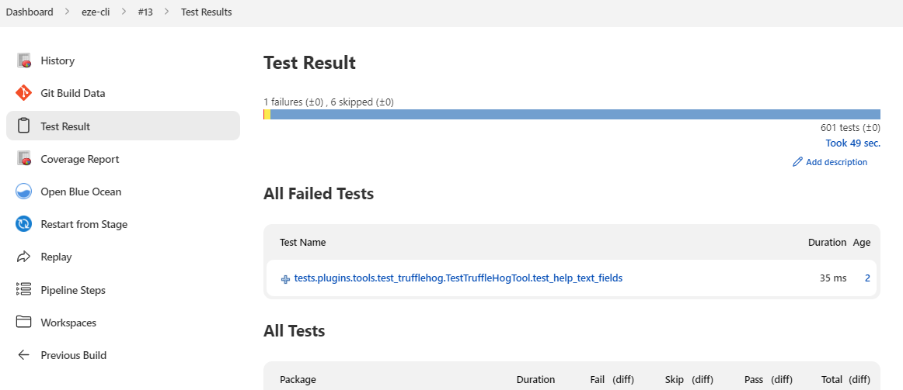
CI: (optional) Report
INIT
BUILD
TEST
REPORT
DEPLOY
Typical Reporting Steps:
Publishing test results
Publishing generated documentation

Slide 22
CI: Deploy
INIT
BUILD
TEST
REPORT
DEPLOY
Typical Deployment Steps:
Populating Databases
Storing assets in software registries e.g. docker images to DockerHub / war to Nexus
Deploying assets to Cloud or Servers e.g. copying files to web server / deploying Docker images

Slide 23
CI: Example Pipeline
Continuous Delivery Pipeline Node Example (CI/CD)
INIT Start Job and Download Source
On Git Commit
BUILD Build node application $ npm install $ npm build
VERIFY Run Linting & Unit Tests $ standard $ npm test
DEPLOY Deploy onto Webserver $ scp -r xxx yyy

Slide 24
CI PRO CONS

Slide 25
CI: PROS AND CONS
There are projects that don’t use CI Most projects start off without CI, and later introduce them as they mature
Here’s the PROs and CONs of using CI servers

Slide 26
CI: PROS AND CONS
PROS:
Always run tests on new code Catch bugs quicker, before prod!
Deployment becomes easier no special knowledge needed, CI does hard work
Environments automatically up to date Easy to see later code in environment
Better team communication real time dashboards show real time quality team notifications on build failures

Slide 27
CI: PROS AND CONS
CONS:
Initial cost / setup time
CI / Testing can impede quick changes can be problem for emergency fixes
CI/CD with Continuous Deployment can be dangerous if automated testing poor or if high number of bugs slip testing, CI/CD can turn into continuous breakage, very bad for production
Poorly built pipelines can be slow / spam team with notifications

Slide 28
CI BEST PRACTICE

Slide 29
CI: Best Practice: Init Steps
Use Version Control seen sharepoint drives being polled for changes before… git is better
Enforce versioning control best practice aka pre-commit hooks to run tests on local machines / disallow large file commits etc
Use Git hooks over CRON polling git hooks faster, polling should be only used as a fallback if git hooks not available

Slide 30
CI: Best Practice: Build Steps
Completely Automate build steps no copy and pasting before merging to main, custom db steps, etc
Include CI build number / git commit hash in application’s version string helps find exactly what code is deployed where
Broken Builds should fail pipeline
Keep secrets / credentials secure* NEVER HARD CODE secrets in scripts or in code! * CI Servers provide ways to protecting secrets, use them

Slide 31
CI: Best Practice: Tests
Keep testing and builds fast no more than 3-4 mins
Test all incoming builds
Test the compiled code
Broken Tests should fail pipeline

Slide 32
CI: Best Practice: Reporting
Enable Team Notifications on broken builds
Enable metric dashboards for team to see code quality

Slide 33
CI: Best Practice: Deployment
Use dedicated development / qa environments never use prod for testing or qa!
Configure deployment environments by config files not code hard coded config such as urls are very brittle / buggy
Favour IaC over manual bash deploy scripts IaC = Infrastructure as code
We’ll cover IaC in the Cloud Topic

Slide 34
CI SERVER OVERVIEW

Slide 35
CI Implementation
There are many CI servers:
JENKINS
CRUISE CONTROL
AWS CODE BUILD
AZURE PIPELINES
CONCOURSE
TRAVIS CI / CIRCLE CI + GITHUB ACTIONs… ?

Slide 36
CI Implementation
All work the same:
Pipeline each repo
Steps in pipeline
Step runs bash scripts or plugins running bash scripts

Slide 37
CI Implementation: Jenkins
Jenkins install https://www.jenkins.io/doc/book/installing/
config service users
https://www.jenkins.io/doc/book/using/
create some pipelines
https://www.jenkins.io/doc/book/pipeline/

Slide 38
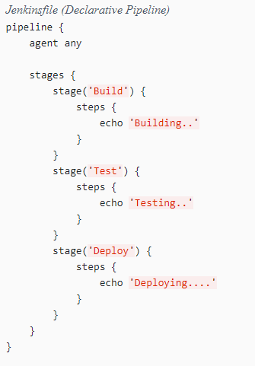
CI Implementation: Jenkins Pipelines
creating Pipelines
https://www.jenkins.io/doc/book/pipeline/ https://www.jenkins.io/doc/book/pipeline/syntax/
Create pipelines via UI or Jenkinsfile SCM
Powerful central CI server used, where all pipelines are ran and results correlated

Slide 39
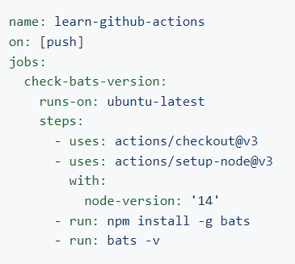
CI Implementation: Github Actions
create Actions
https://docs.github.com/en/actions/learn-github-actions/understanding-github-actions
New methodology in town, instead of pipelines of steps, all steps are all setup and ran individually (called Actions)
This reduces complexity, doesn’t require central server (built into Github’s cloud), all results are individually displayed in individual repo’s Github pages

Slide 40
Questions
I’ve been Anthony “Zapper” M^{c}Kale
Hopefully I’ve Educated, Informed, and even Entertained Good Testing is Good Security is Good software

Slide 41
Thank you

