Slide 1


Academy
Python 101
Anthony McKale Principal Software Engineer

Slide 2
Python 101
Today we’ll cover :
Python Facts
Variables
Operators
Control Flow
Functions
Modules
OO and classes will be covered later date

Slide 3
PYTHON FACTS

Slide 4
Python Facts
Born in the late 80’s by a chap called “Guido”
Named after Monty Python’s Flying Circus
Modern Python 3.0 came out in 2008
Adopted as the language of choice by Data Scientists
Adopted around the world as “hardcode” heavy lifting language for CPU bound applications …rust slowly taking over though
Though, Python is changing fast, new versions every year, with new incompatible features…

Slide 5
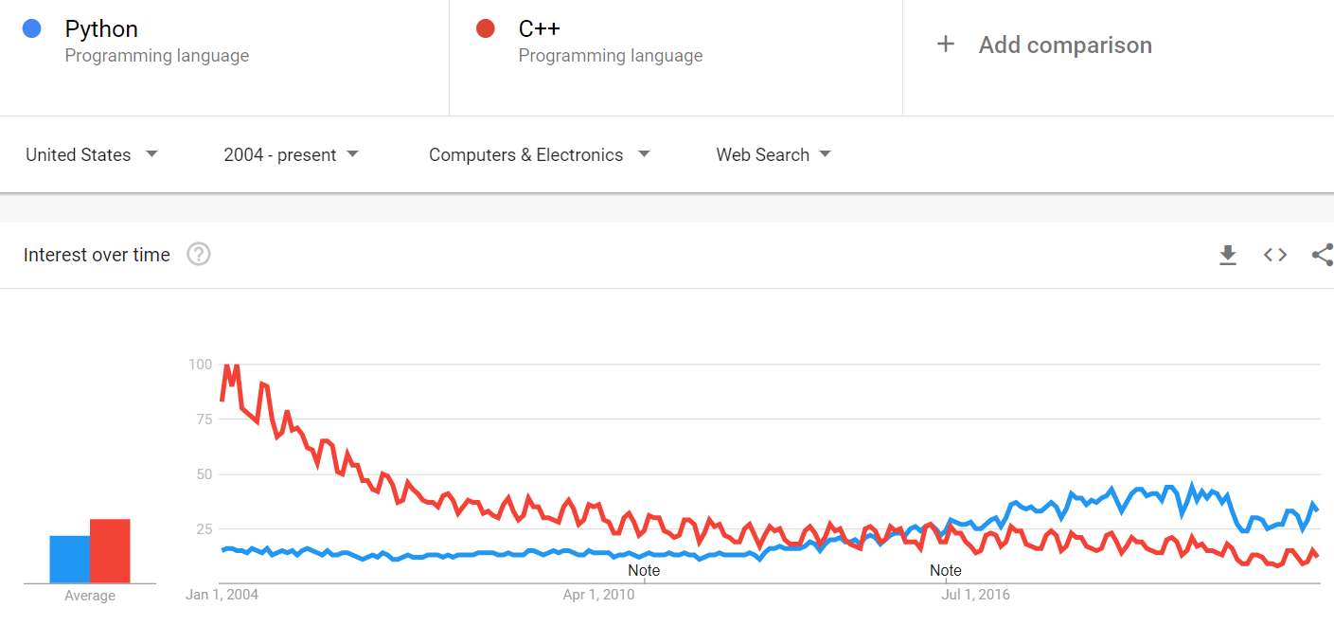
Python Facts
One of the most popular languages in the world

Slide 6
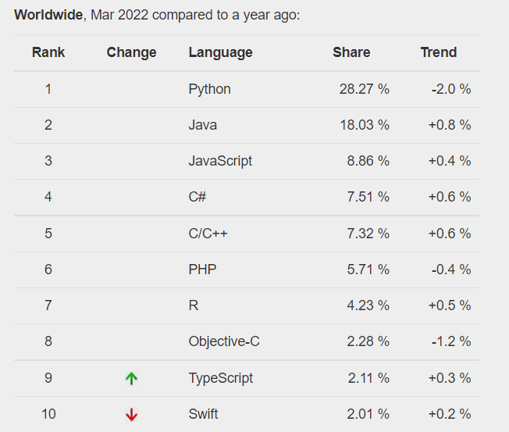
Python Facts
One of the most popular
languages in the world…
continued

Slide 7
Python Printing / Running: 101

Slide 8
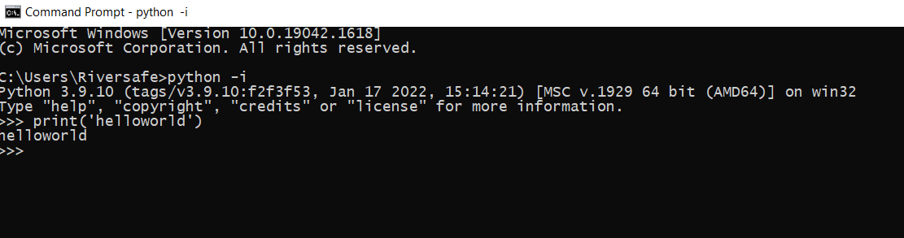
Python Primer: interactive
Jump straight into python with `python -i`

Slide 9

Python Primer: Hello World
print('thing'), easy right ?

Slide 10
Python Primer: 101
Now deeper…
Primitives
Functions

Slide 11
Python Comments

Slide 12
Python Primer: Comments
Single Line (# comment)
Multi Line ("""comment""") https://python.swaroopch.com/basics.html

Slide 13
Python Primitives

Slide 14
Python Primer: Primitives
Languages have variables for storing data
Read stdtype docs for more info
See https://docs.python.org/3/library/stdtypes.html

Slide 15
Python Primer: Primitives
Python’s simple variable types are:
Booleans:
True/False
Numbers:
1, 2, 3, 0, -1, 0.5
Strings:
‘word’, ‘some words’, ‘cHaRaCtRrS’
Collections:
[1,2,3]
{‘name’: ‘anthony’, age: ‘21’}

Slide 16

Python Primer: Primitives
Used to entry into functions like print
Example:
creates a string variable name_message
and runs function print with it
variables always use snake_case not camelCase

Slide 17
Python Primer: Primitives
Quick Syntax Primer

Slide 18

Python Primer: Boolean Primitives
Boolean = yes/no aka binary 1/0
( Warning: technically 3rd state : None, which is no value)
.

Slide 19
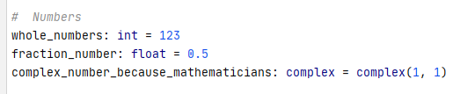

Python Primer: Number Primitives
int == Whole Numbers, float == Fraction Numbers
( Int and floats are very different so be careful )
PS: remember Python can’t count
.

Slide 20
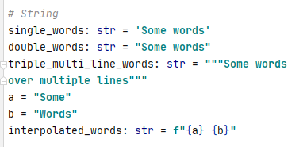
Python Primer: String Primitives
String == List of characters “String-ed” togther

Slide 21
Python Primer: String Primitives
String Escaping (\<SYMBOL>)
Most common is newline ( \n )
Escaped characters can be used inside strings to include quote characters ( \' / \" )
words = 'this is jeff\'s cat'

Slide 22

Python Collection: Sequence Primitives
list == Array
Remember you need to access via index, var[<index>]
(indexes start from 0 *)

Slide 23
Python Collection: range
list == Array
Python have built in function for creating lists of sequential numbers * done just-in-time, advanced topic: generator range(<START>,<END>))
list(range(1,5)) == [1,2,3,4]

Slide 24
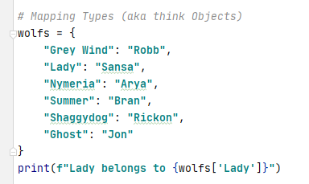
Python Collection: Mapping Primitives
Dict == Key Value pair map
Remember you need to access via key using “[]” var[“KEY”]
Type hint is var_name:dict

Slide 25
Python Collection: Accessing list / dict
Access Cheat list: use [<KEY / INDEX>]
some_dict[key_name]
some_list[index starting from 0]

Slide 26
Python Primer: Primitives Overview
It’s close enough to other languages, to be easy to pickup
It’s close enough to other languages, to make silly mistakes
So be careful ☺

Slide 27
Python Operators

Slide 28
Python Operators:
bool operators these create bool variables
< less than, aka 1 < 2 : True
<= less than or equal, aka 2 <= 2 : True
> greater than, aka 2 > 1 : True
>= greater than or equal, aka 2 >= 2 : True
== equal, aka "this" == "this" : True
!= not equal, aka "this" != "that" : True
https://python.swaroopch.com/op_exp.html

Slide 29
Python Operators:
Bool chain operators these create bool variables
and (True and True) else False, aka True and True : True
or (True and/or True) else False, aka True and False : True >
you can chain bool variables or other operators with and/or is_bob_or_jerry:bool = (cat_name == 'bob') or (cat_name == 'jerry')
https://python.swaroopch.com/op_exp.html

Slide 30
Python Control Flow

Slide 31

Python : Whitespace / indentation
Indention is important in Python use it to enter and leave control flow, aka functions, if, for, etc….
https://python.swaroopch.com/control_flow.html

Slide 32
Python Control Flow
IF FOR https://python.swaroopch.com/control_flow.html

Slide 33
Python Functions

Slide 34
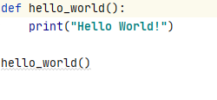
Python Primer: Function
You setup, stored lists of operations to run
Easy right ?
functions always use snake_case not camelCase

Slide 35
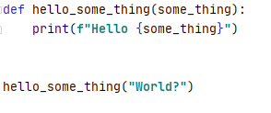
Python Primer: Function Parameters
You can customise your functions with Parameters
Parameters should be snake_case too

Slide 36
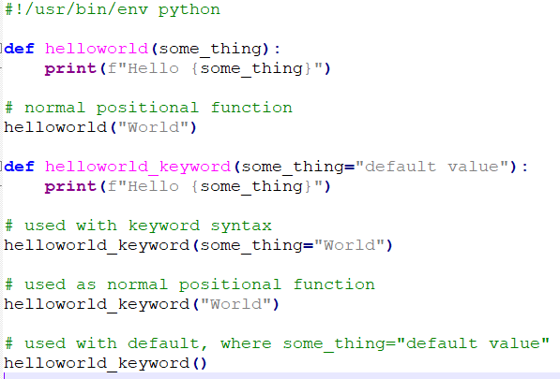
Python Primer: Function Parameters
You can customise your functions with Named Parameters
with Defaults

Slide 37
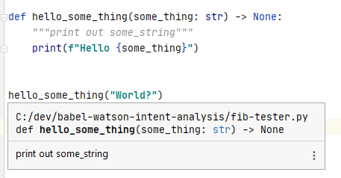
Python Primer: Function DocString
For documenting your code
“““documentation”””
Use typing as well to improve your self documenting code
Ps https://www.python.org/dev/peps/pep-0257/ for more info

Slide 38
Python Primer: Questions
5 mins breather, questions ?

Slide 39
Python Modules

Slide 40
Python Modules
import statement
Can be used :
Built in libraries
External libraries from pypi
Local .py files
https://python.swaroopch.com/modules.html

Slide 41
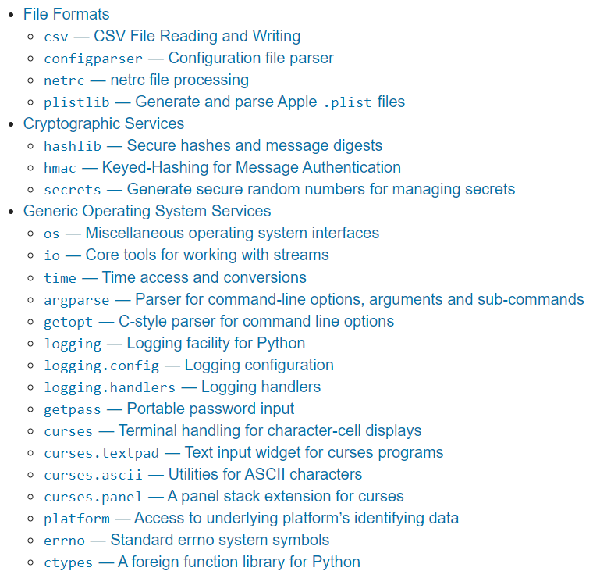
Python Modules: inbuilt
import statement gets awesome built-in libraries
https://docs.python.org/3/library/
handles all sorts of basic needs
- File Handling - Internet Requests
- Data processing
- De/Encryption
- Thread Management
And more …!

Slide 42

Python Modules: inbuilt
import statement with built-in libraries
Full Library
Partial Library
https://python.swaroopch.com/modules.html

Slide 43
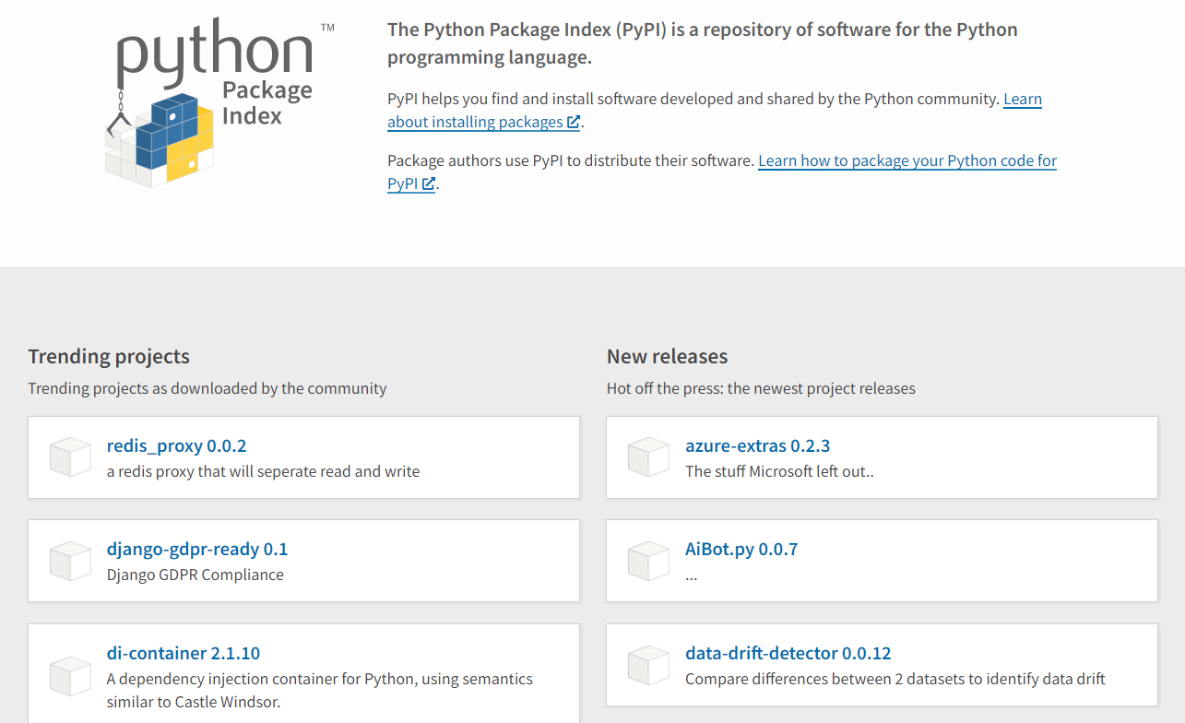
Python Modules: external
import statement gets awesome external opensource libraries
https://pypi.org/
handles everything else
Data Science
AI
Databases
And more …!

Slide 44
Python Modules: external
import statement with pypi libraries
install via pip pip install click
import like inbuilt librarays
import click
https://pypi.org/
https://python.swaroopch.com/modules.html

Slide 45
Python Modules: external file
For storing what external file to use, 3 main systems: requirements.txt (old) https://pip.pypa.io/en/stable/user_guide/#requirements-files
pipfile / piplock (new) https://github.com/pypa/pipfile
Poetry (newest)
https://python-poetry.org/

Slide 46
Python Modules: local
import statement gets local files
https://pypi.org/
import <FILENAME>.py import <FOLDER>/<FILENAME>.py * * all folders will need empty __init__.py in them
create a empty __init__.py with `touch __init__.py`
WARNING : DO NOT PUT CODE INTO A __init__.py file

Slide 47
Python Modules: local __init__.py
EXAMPLE ON __INIT__.py

Slide 48
Python Basic
Best Practice

Slide 49
Best Practice
use snake_case for variables and function names * Warning: CamelCase is for Class Names only, discussed next lesson!
use snake_case for python .py filenames
Use docstring ("""<comment>""") for all functions comments
Place empty __init.py__ files in all folders containing .py files * DO NOT PUT CODE INTO __init.py__ !
use pipfile / poetry for storing external dependencies * fallback to requirements.txt only if it’s all that’s available

Slide 50
Questions
I’ve been Anthony M^{c}Kale “Wizard without Portfolio” Fixer-Upper of Broken things, and creator of time-constrained workable Fudges for 15 years. Email : anthony@zapper.hodgers.com

Slide 51
Thank
you

