Slide 1


Academy
Python Beyond Basics
Anthony McKale Principal Software Engineer

Slide 2
Python beyond the basics
Today we’ll cover :
OO Concepts
Classes
Exceptions
Modules
Plugins
Async
It’ll aim to cover the class portions of the official python tutorial
https://docs.python.org/3/tutorial/

Slide 3
Basic OO

Slide 4
What is a OO ?
TODO
Wikipedia:
https://simple.wikipedia.org/wiki/Object-oriented_programming

Slide 5
What is a Class ?
“A class is written by a programmer in a defined structure to create an object … . It defines a set of properties and methods that are common to all objects of one type.”
Wikipedia:
https://simple.wikipedia.org/wiki/Class_(programming)

Slide 6
OO is common in Software Engineering but has critics
PROS
Tends to Modular design, good for large projects
Easier for new OO-trained developers to understand
Can aid good abstraction of concerns
CONS
OO code can be slower to execute over procedural code probe: function call overhead, memory usage
it’s complex overhead, heavy for small project
When mis-used can turn into code Spaghetti
http://www.paulgraham.com/noop.html
http://doc.cat-v.org/programming/bad_properties_of_OO

Slide 7
OO is common in Software Engineering but has critics
“ the purpose of OOP is to act as a herding mechanism which keeps average programmers in average organizations from "doing too much damage". This also slows down faster, better programmers who know how to do things in a more powerful and more compact way ” Generally agree, it’s a risk/speed/reward trade-off, rather than a bad thing PS: that average programmer is you 6 months after you wrote the code, and you’re going back on the project ☺
http://www.paulgraham.com/noop.html
http://doc.cat-v.org/programming/bad_properties_of_OO

Slide 8
PYTHON CLASSES

Slide 9
Python : What is a Class ?
“A class is written by a programmer in a defined structure to create an object … . It defines a set of properties and methods that are common to all objects of one type.”
Wikipedia:
https://simple.wikipedia.org/wiki/Class_(programming)

Slide 10
Python : What is a Class ?
Aka it’s a :
Variable container you can create multiple instances of (self variables)
Attach functions to that container (instance functions)
Attach functions and variables to the definition of the class (static variables and functions)
Classes can extend one another for complex behaviours (inheritance)

Slide 11
Python : Basic Class Parts
Constructor (initial function that setups up class __init__)
Static Variables
Static Functions
Functions
Variables

Slide 12
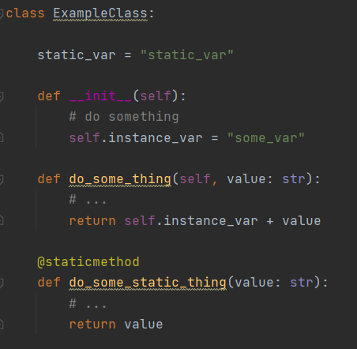
Python : Basic Class Parts
Constructor
Variables
Functions
Static Variables
Static Functions

Slide 13
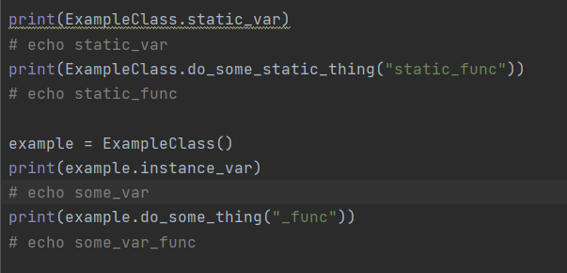
Python : Basic Class Parts

Slide 14
Python : Class Questions ?
Questions ?
Onto inheritance

Slide 15
PYTHON CLASS
INHERITANCE

Slide 16
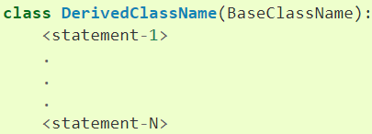
Python : Nested Classes Why ?
Python can nest (extend) classes This is where you have a base class, and classes that extend that
Overwriting / Adding new functions and variables
https://docs.python.org/3/tutorial/classes.html#inheritance

Slide 17
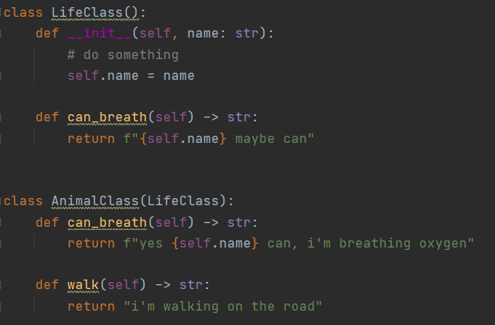
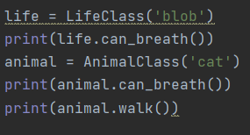
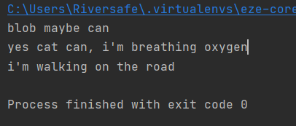
Python : Life / Animal Terrible Example
We have two classes, Life and it’s child Animal Life can maybe breath, Animal’s can definitely breath and they can walk

Slide 18
Python : Class Inheritance Questions ?
Questions ?
Onto ABC

Slide 19
PYTHON ABC CLASSES

Slide 20
Python : Abstract Base Class
Sometimes you define a Abstract Base Class
ABS is a class without working code, that is made to be extended and finished
Class that extend a ABC overwrite the functions providing implementation
This is a very common pattern
SPEC: https://www.python.org/dev/peps/pep-3119/

Slide 21
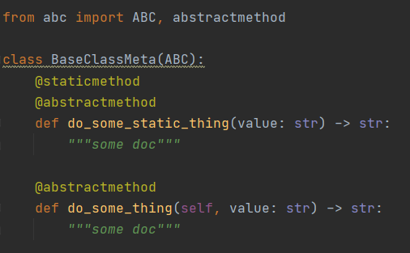
Python : ABC in python
abc package provides this functionality
With @abstractmethod annotation
and “abc” base class to extend
https://docs.python.org/3/library/abc.html

Slide 22
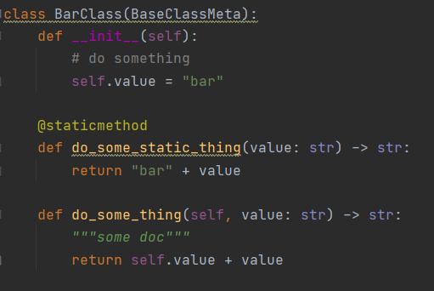
Python : ABC in python
Example
https://docs.python.org/3/library/abc.html

Slide 23
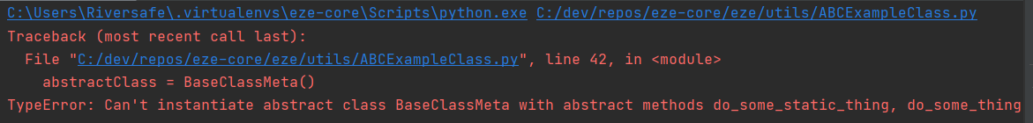
Python : ABC in python
Abstract base class will throw errors on init
https://docs.python.org/3/library/abc.html
abstractClass = BaseClassMeta()

Slide 24
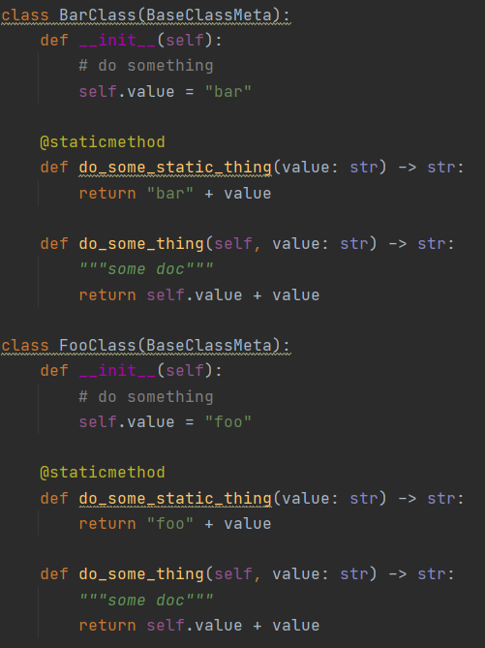
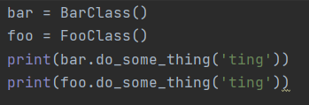
Python : ABC in python
Basic Example

Slide 25
Python : Abstract Base Class Meta Commentary
Aka for example… Say I’m building a Scanning engine that can take multiple tools
But I want to call the same functions for each tool
Create AbstractTool Class with common callable functions
Implement AbstractTool as say BlackDuckTool, SafetyTool and CheckmarksTool
Then my code can accept AbstractTool and call the common functions, and each function is finished off in the Final Classes

Slide 26
Python : ABC Questions ?
Questions ?
Onto Special Cases
Exception
Private vars
Setters and Getters
Reflection

Slide 27
PYTHON EXTRA CLASS STUFF

Slide 28
Python : Private Stuff
Sometimes you want functions and variables to be accessible only by the class it’s self This is done via a double underscore prefix “__”
Aka __mr_private_var or __mr_private_func
https://docs.python.org/3/tutorial/classes.html#private-variables

Slide 29
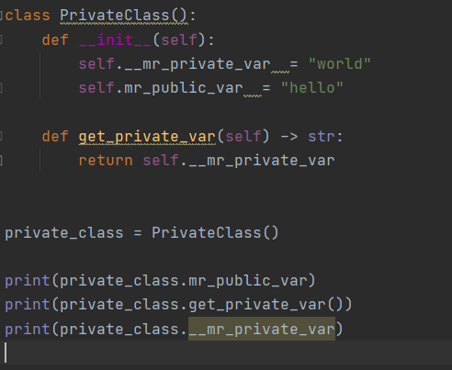
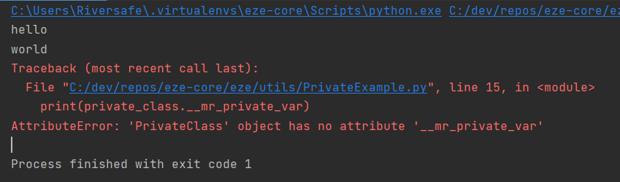
Python : Private Example

Slide 30
Python : Magic setter and getters
Wouldn’t it be great if I could call any function or variable, and get a reply? This is called magic setters and getters
Done via __get__ /__set__ / __getattr__ / __setattr__ and __delete__ (also __dict__ but that’s for another day)
https://docs.python.org/3/whatsnew/2.2.html#descriptors function level detail here...
https://python-reference.readthedocs.io/en/latest/docs/dunderattr/getattr.html

Slide 31
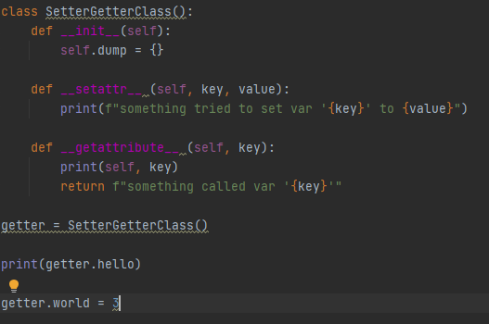
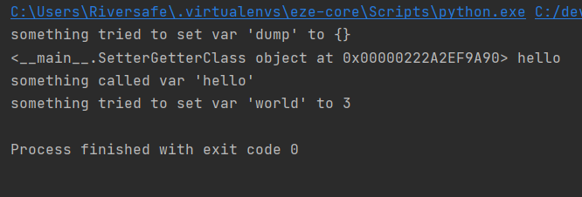
Python : Magic SG Example
. Ps excessive Getting and Setting is considered poor practice and is typically done by tooling code

Slide 32
Python : Magic setter and getters
DO NOT USE MAGIC WHEN CODING
IT CAUSES PAIN AND SUFFERING
Unless you have a “really” good reason ☺

Slide 33
Python : Reflection (tip-toe)
Sometimes you want to dynamically* know the structure of a class, or what line something is running / breaking on
This is called reflection, this is complex but the way this is done via the reflection library
This is normally done for you, but this is how unit tests and other tools get the exact line numbers
https://docs.python.org/3.6/c-api/reflection.html
https://docs.python.org/3/whatsnew/2.2.html#descriptors

Slide 34
PYTHON EXCEPTIONS

Slide 35
Python : Exception (tip-toe)
What do you do when a program crashes with a Exception ?
Can you carry on ? Or do you live with crashes ?
You Try to Catch the Exception obviously ☺

Slide 36
Python : Exception (tip-toe)
Welcome to Exception Catching
Aka the Art of Failing Gracefully

Slide 37
Python : Exception (tip-toe)
Exception is a special class used for try/except/raise functionality
All “raised” objects should extend base python “Exception” Class
Ps there can dragons here
(special rules apply. Read documentation before messing with Exception)
https://docs.python.org/3/whatsnew/2.5.html#pep-352-exceptions-as-new-style-classes
https://docs.python.org/3/library/exceptions.html#Exception

Slide 38
Python : Exception (tip-toe)
raise Exception(‘<human message>’)
Create exception
try: Start exception handled block
except <Exception Sub-Class>: On-<Exception Sub-Class> case handling block

Slide 39
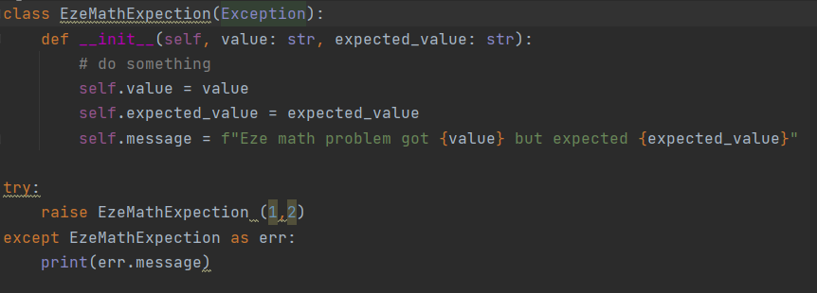
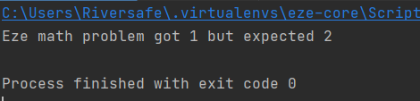
Python : Exception Example

Slide 40
Python : Class Questions
Class questions ?

Slide 41
PYTHON MODULES
RECAP

Slide 42
Python Modules
import statement
Can be used :
Built in libraries
External libraries from pypi
Local .py files
https://python.swaroopch.com/modules.html

Slide 43
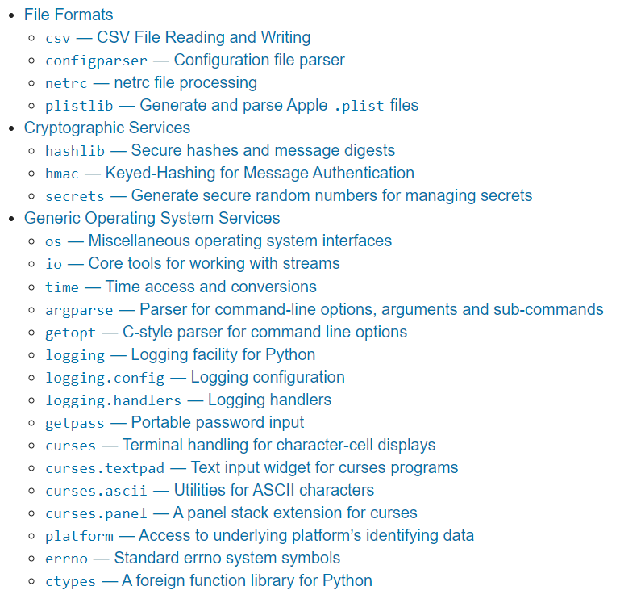
Python Modules: inbuilt
import statement gets awesome built-in libraries
https://docs.python.org/3/library/
handles all sorts of basic needs
- File Handling - Internet Requests
- Data processing
- De/Encryption
- Thread Management
And more …!

Slide 44

Python Modules: inbuilt
import statement with built-in libraries
Full Library
Partial Library
https://python.swaroopch.com/modules.html

Slide 45
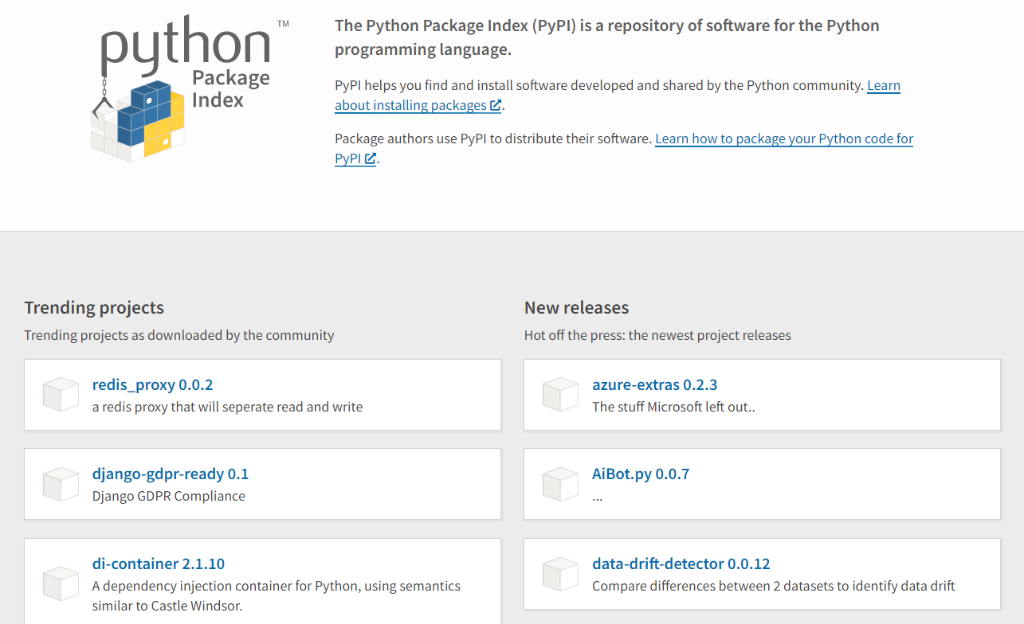
Python Modules: external
import statement gets awesome external opensource libraries
https://pypi.org/
handles everything else
Data Science
AI
Databases
And more …!

Slide 46
Python Modules: external
import statement with pypi libraries
install via pip pip install click
import like inbuilt librarays
import click
https://pypi.org/
https://python.swaroopch.com/modules.html

Slide 47
Python Modules: local
import statement gets local files
https://pypi.org/
import <FILENAME>.py
Note: to reference files in a folder, create a empty __init__.py DO NOT ADD CODE INTO A __init__.py file

Slide 48
PYTHON MODULES
REDUX

Slide 49
Modules
A module is basically just a py file containing statements
These can be classes, functions, executable code, and links to other modules
Multiple Modules* are used when your app gets bigger than a single file * rule of thumb, proactively split files bigger than 200-300 lines of code into sub modules

Slide 50
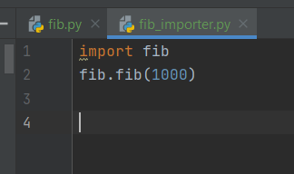
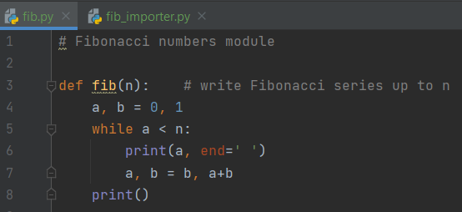
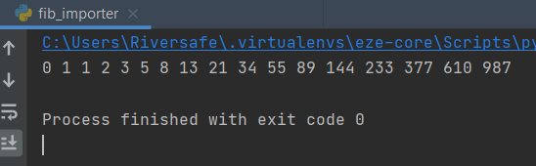
Modules
One module can reference another via the “import” statement
This pulls in that module into the requester aka

Slide 51

Self Executing Modules
For when you what to run a module as a run you need to bootstrap them using the __name__ magic variable and a if
using sys.argv for getting variables
https://docs.python.org/3/tutorial/modules.html#executing-modules-as-scripts

Slide 52
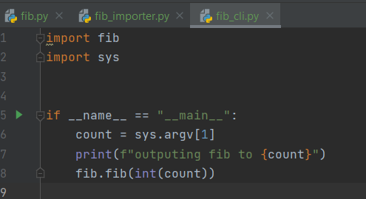
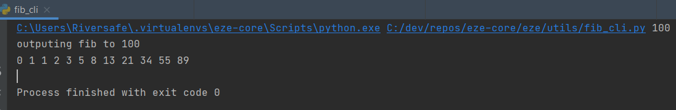
Self Executing Module Example

Slide 53
Finding Modules
Modules are discovered in multiple ways
Same Directory
Relative Packages (aka dotted format links to modules in other folders )
Pip installed modules (aka pip install xxx)
Standard Python Modules (aka inbuilt aka sys)
Will briefly speak about these

Slide 54
Finding Modules: Same Directory
Obvious right
For entire python file:
import xxx (for file xxx.py)
For particular Class or Function in python file:
from xxx import name (for file xxx.py, and name)
You can also rename things
from xxx import name as new_name

Slide 55
Finding Modules: Relative Packages
Package is just a folder with a __init__.py file in it
All packages require a __init__.py
Without it you won’t be able to reference those py files in that folder
Ps DO NOT BE CLEVER AND ADD CODE INTO __init__.py !!!
It’s the road to hell

Slide 56
Finding Modules: Relative Packages
For importing a module as a package:
import dir1.dir2.xxx (for file xxx.py)
For importing a pip module as a package:
import pip_name.dir1.dir2.xxx (for file xxx.py inside pip_name)
(from / import and as work as before)

Slide 57
Finding Modules: Pip installed modules
Everything you pip install is added to your pip libs
Pip libs directory is on your PYTHONPATH env var (including your current execution directory) Python will in order search for packages from your PYTHONPATH aka check locally, then your system inbuilt packages, then your pip folder, then etc etc

Slide 58
Finding Modules: Pip example
SHOW IN IDE PATH AND IT WORKING

Slide 59
Questions?: Modules
Questions ?

Slide 60
MAKING PLUGINS

Slide 61
Missing Knowledge Check
How to package a module for pip Cliffnotes:
install setup_tools
create a pyproject.toml
create a setup.py
Profit
I’ll assume you know this, otherwise further reading here:
https://setuptools.readthedocs.io/en/latest/index.html

Slide 62
Plugins
What if you want a module to :
Discover what modules are installed ?
Discover related modules ?
Welcome to python plugins

Slide 63
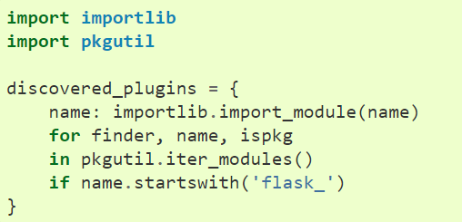
Plugins: Discovering Modules
Two std libraries in python are importlib and pkgutil
Unlikely you’d need to directly use these, but good to know
Example of getting all modules
Starting with flask_

Slide 64
Plugins
Three ways of discovering plugins:
Naming convention (aka all modules prefixed “pytest_” on previous slide)
Namespacing* (aka sub modules, variant of Naming convention)
Package entry_points (aka plugin module explicitly declares it’s connection to module in it’s setup.py)
https://packaging.python.org/guides/creating-and-discovering-plugins/
* For more info on namespacing* (it’s a advanced sub-module technique) see https://packaging.python.org/guides/packaging-namespace-packages/

Slide 65
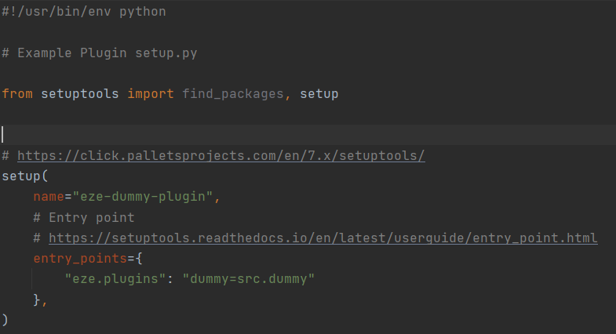
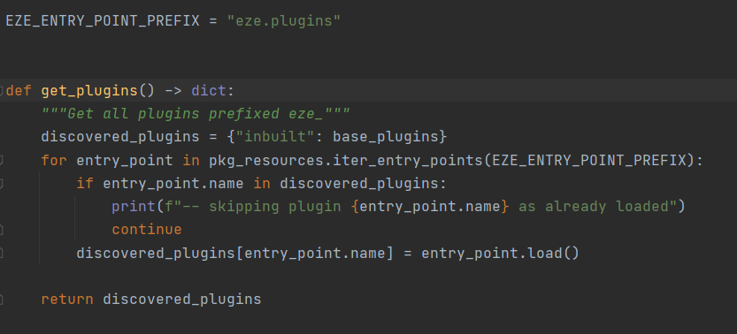
Eze Plugins
Eze uses Package entry_points
Modules say there entry_point is “eze.plugins” and it’s found when the eze module is run

Slide 66
Plugins Questions ?
.

Slide 67
Async Python

Slide 68
Async Python
As discussed python is “single threaded”
Python can’t do more than one thing at a time
This is not entirely true
Let’s talk python concurrency / parallelism

Slide 69
Async Python: 3 Approaches
Event Driven (single thread with lots of sleeps)
Multiple functions running at same time (in concurrent threads)
Multiple functions running at same time (in parallel processes)

Slide 70
Async Python: Event Driven
One approach to running concurrent tasks, is Event driven programming
Heart of this approach is the Event Queue, that is serially processed
Pythion handler function are attached to Event Queue
Application I/O dispatches incoming events onto this queue
https://en.wikipedia.org/wiki/Event-driven_programming

Slide 71
Async Python: Event Driven
1) Event Handler Loop
2) Event Dispatch Loop
Event Loop
Function
I/O Input
Mouse /
Keyboard /
Internet /
Filesystem
ELSE Event Queue Empty sleep for X ms And … Repeat
IF has Events in Queue,
run handlers for each until empty
On input, dispatch/add event queue
Python Handler
Function
WHEN ran all handlers, return to event loop
Event Queue
https://en.wikipedia.org/wiki/Event-driven_programming

Slide 72
Async Python
Implementation : asyncio
(fake parallel, single core) Used for “event driven” programming
Note: if a handler function is slow, it can block the event loop and make it look “non-responsive”
https://docs.python.org/3/library/asyncio.html

Slide 73
Async Python: Event Driven
One approach to running parallel tasks, is Event driven programming
https://en.wikipedia.org/wiki/Event-driven_programming

Slide 74
Async Python: Event Driven
Where the code has a check loop
Example:
on server request: return

Slide 75
Async Python
Python provides 3 major ways of doing things in parallel :
asyncio (event driven in fake parallel, single core)
theads library (threads in fake parallel, single core)
multiprocessing library (processes in true parallel, multi core)

Slide 76
Questions
I’ve been Anthony M^{c}Kale “Wizard without Portfolio” Fixer-Upper of Broken things, and creator of time-constrained workable Fudges for 15 years. Email : anthony@zapper.hodgers.com

Slide 77
Thank
you

