Slide 1


Academy
Continuous Integration 101
Anthony McKale
Principal Software Engineer

Slide 2
Agenda
- Overview
- Terms
- CI/CD
- Implementations

Slide 3
CI OVERVIEW

Slide 4
CI: Continuous Intergation
Continuous Integration is the practice of doing automated :
1) Packaging of new code 2) Testing of packaged code
3) Documentation / analytics
4) Deployment of packaged assets
Every code change, via a server doing the automation

Slide 5
CI: Primer
90’s: CI Server usage introduced in Agile precursor Extreme Programming (XP)
00’s: CI Server usage solidified as part Agile Software Methodology
2005: Opensource Hudson created in became defacto Central CI Server solution
2011: Jenkins Hudson’s fork created after trademark dispute with Oracle*
2018: low/no-code micro cloud-based Github actions introduced into Github (replacing monolithic CI Servers)

Slide 6
CI TERMS

Slide 7
CI: Continuous Intergation
Continuous Integration is the practice of :
- regular automated packaging of new code - regular automated testing of new code
- regular automated deployment of code

Slide 8
CI: Terms
Continuous Integration (CI)
- Verifying incoming merged code
Continuous Delivery (CD) - Deployment incoming merged code to dev/qa environments
Continuous Deployment (CD) - Deployment incoming merged code to production environments
Hence CI/CD

Slide 9
CI: Terms
Task/Step/Action: - individual process on CI, aka run tests Pipeline
- Chained steps
Job / Build - Instance of a pipeline running

Slide 10
CI: Graph
Continuous Integration Pipeline (CI)
INIT
Build / Compile Steps
Verification Steps normally via Testing
Continuous Delivery Pipeline (CI/CD)
INIT
Build / Compile Steps
Verification Steps normally via Testing
Deployment to QA / DEV Steps
Continuous Deployment Pipeline (also CI/CD…)
INIT
Build / Compile Steps
Verification normally via Testing
Deployment to Prod Steps

Slide 11
CI: Branch Strategy
Common Dev / QA / Production Branch Strategy
On Develop branch Changed
Build / Compile Src
Verification normally via Testing
Deployment to DEV environment
On QA branch Changed
Build / Compile Src
Verification normally via Testing
Deployment to QA environment
On main branch Changed
Build / Compile Src
Verification normally via Testing
Deployment to prod environment

Slide 12
CI STEPS TYPE

Slide 13
CI: Initiation
Typical Initiation Type:
Run on a CRON schedule e.g. every X hours
Git commit hook CI server exposes endpoint, explicitly called by Git Server on commits

Slide 14
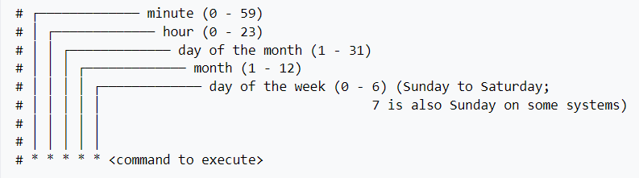
CI: Initiation: CRON side note
cron to control polling https://en.wikipedia.org/wiki/Cron
0 0 * * * == run every night at 12pm has a special H character which can be used instead of * eg H/5 * * * * * every 5 mins

Slide 15
CI: Build / Preparation
Typical Build Steps:
Installing Dependencies
Compiling code / packaging for deployment e.g. docker images / java war files
Automated annotations e.g. generating / bumping version in source code

Slide 16
CI: Testing / Verification
Typical Verification Steps:
Linting
Unit Testing
Integration Testing
Smoke Testing

Slide 17
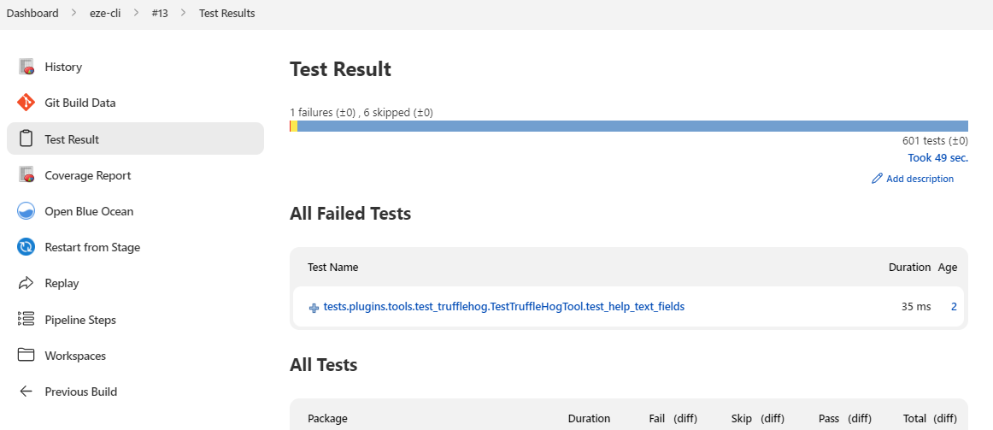
CI: (optional) Reporting
Typical Reporting Steps:
Publishing test results
Publishing generated documentation

Slide 18
CI: Deployment
Typical Deployment Steps:
Populating Test Databases / Datasets
DB schema or data population
Storing assets in software registries e.g. docker images to DockerHub / war to Nexus
Deploying assets to Cloud or Servers e.g. SCP : copying files to web server / deploying Docker images

Slide 19
CI: Example Pipeline
Continuous Delivery Pipeline Node Example (CI/CD)
INIT Start Job and Download Source
On Git Commit
BUILD Build node application $ npm install $ npm build
VERIFY Run Linting & Unit Tests $ standard $ npm test
DEPLOY Deploy onto Webserver $ scp -r xxx yyy

Slide 20
CI BEST PRACTICE

Slide 21
CI: PROS AND CONS
PROS: - Catch bugs quicker - Ensure testing ran - De-skills deployment
- Provides up to date environments - Automated Metric dashboards help devs/QA (aka tests / code quality) #
- Team notifications on failures

Slide 22
CI: PROS AND CONS
CONS: - Testing can slow down deployments (problem in emergencies) - Initial investment / setup - Continuous Deployment can be dangerous aka continuous broken production
Poorly built pipelines can be slow
Poorly built pipelines can spam notifications

Slide 23
CI: Best Practice
Use Version Control
Enforce versioning control best practice aka pre-commit hooks / no large files etc
Use Git hooks over CRON polling

Slide 24
CI: Best Practice
Completely Automate build no copy and pasting before merging to main, custom db steps, etc
Configure environments by config files not hard coded code
Secure pipeline secrets* * CI Servers provide ways to protecting secrets, use them
Favor IaC over manual deployment bash scripts IaC = Infrastructure as code

Slide 25
CI: Best Practice
Use dedicated development / qa environments
Enable Notifications to team on broken builds
Enable metric dashboards for team to see code quality

Slide 26
CI: Best Practice
Keep testing and builds fast
Test all builds
Test the compiled code (self-testing)
Broken Tests should fail pipeline

Slide 27
CI SERVER OVERVIEW

Slide 28
CI Implementation
There are many CI servers:
JENKINS
CRUISE CONTROL
CODE BUILD
AZURE PIPELINES
CONCOURSE
TRAVIS CI / CIRCLE CI + GIT HUB ACTIONs… ?

Slide 29
CI Implementation: Jenkins
Jenkins install https://www.jenkins.io/doc/book/installing/
config service users
https://www.jenkins.io/doc/book/using/
create some pipelines
https://www.jenkins.io/doc/book/pipeline/

Slide 30
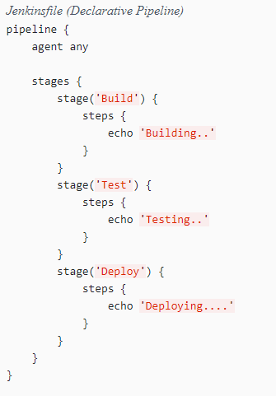
CI Implementation: Jenkins Pipelines
creating Pipelines
https://www.jenkins.io/doc/book/pipeline/ https://www.jenkins.io/doc/book/pipeline/syntax/
Create pipelines via UI or Jenkinsfile SCM
Powerful central CI server used, where all pipelines are ran and results correlated

Slide 31
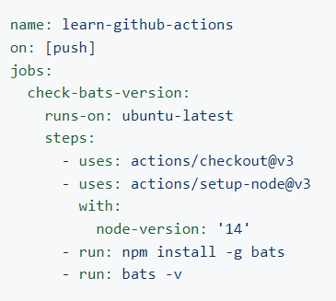
CI Implementation: Github Actions
create Actions
https://docs.github.com/en/actions/learn-github-actions/understanding-github-actions
New methodology in town, instead of pipelines of steps, all steps are all setup and ran individually (called Actions)
This reduces complexity, doesn’t require central server (built into Github’s cloud), all results are individually displayed in individual repo’s Github pages

Slide 32
Questions
I’ve been Anthony “Zapper” M^{c}Kale
Hopefully I’ve Educated, Informed, and even Entertained Good Testing is Good Security is Good software

Slide 33
Thank you

