Slide 1


Sky Talk
Friday Training Hour “Git 101”
And… Git Exercise Teaser ☺
Anthony McKale
Principal Software Engineer
29/04/2022

Slide 2
Agenda
- Primer
- Git Usage
- Git Flow
- Git Tooling - Exercise Teaser

Slide 3
GIT: Primer
Git History
Born in the early 00s, by Legend Linus Torvalds
Based on proprietary BitKeeper
Used originally on the Linux kernal

Slide 4
GIT: Primer
Git is Distributed: local and remote are separate stand-alone git servers
Git has local server for individual developers
Git has master server for combining all
Local and Remote Repos send changes to each other
Can work offline locally

Slide 5
GIT: Primer
Git is made of:
Code Repo
Repo maintains every change to the code base (called a commit)
Repo maintains codebase versions (called branches)
Repo maintains fixed versions of the codebase (called tags)

Slide 6
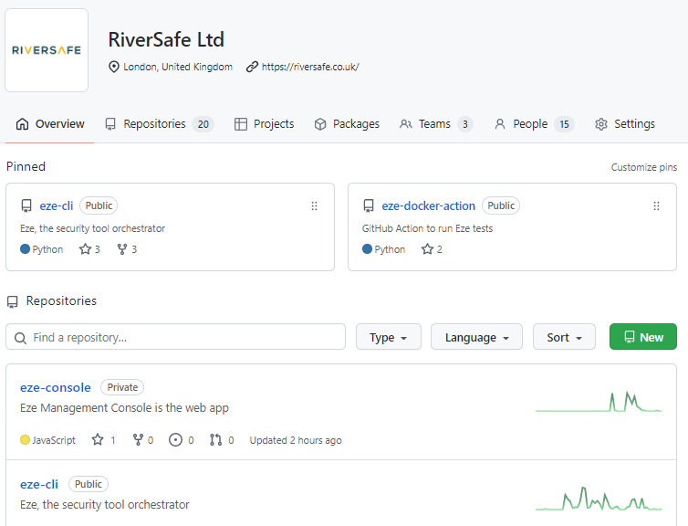
GIT: Primer
Github is made of:
Organisations
Git Code Repos (inside orgs)
Provides Remote
Server
https://github.com/RiverSafeUK

Slide 7
GIT: Primer
Github is a implementation
Git is the underlying tool / protocal
Gitlab; AWS Codecommit; Bitbucket; Azure Repos: just other implementations
All basically same thing, different day

Slide 8
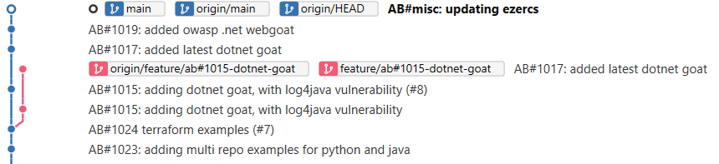
GIT: Primer
Example Git Project (Tree view)
https://github.com/RiverSafeUK/eze-goats/

Slide 9
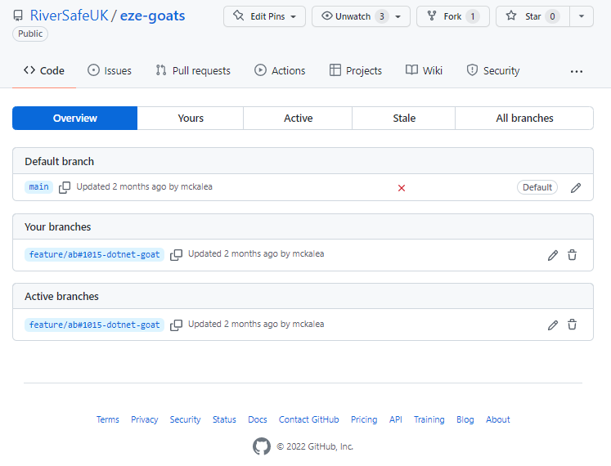
GIT: Primer
Example Git Project Page in Github
https://github.com/RiverSafeUK/eze-goats/branches

Slide 10
GIT: Usage
Git is a tool, it’s used for:
Separating development and production code
Separating work in progress from finished code
Tagging and versioning releases

Slide 11
GIT: Usage: Operations
Git Common Operations
Before we get started…

Slide 12
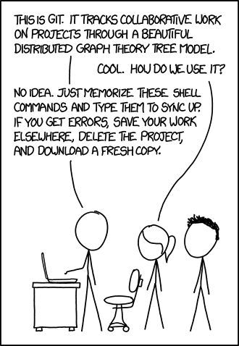
GIT USAGE
HERO
https://xkcd.com/1597/

Slide 13
GIT: Usage: Operations
Git Common Operations
clone remote repos to create local repos
commit file system changes to your local repo
pull remote changes to local repo
push local changes to remote repo
fork / branch create a copy of a branch
merge copy changes from one branch to another

Slide 14
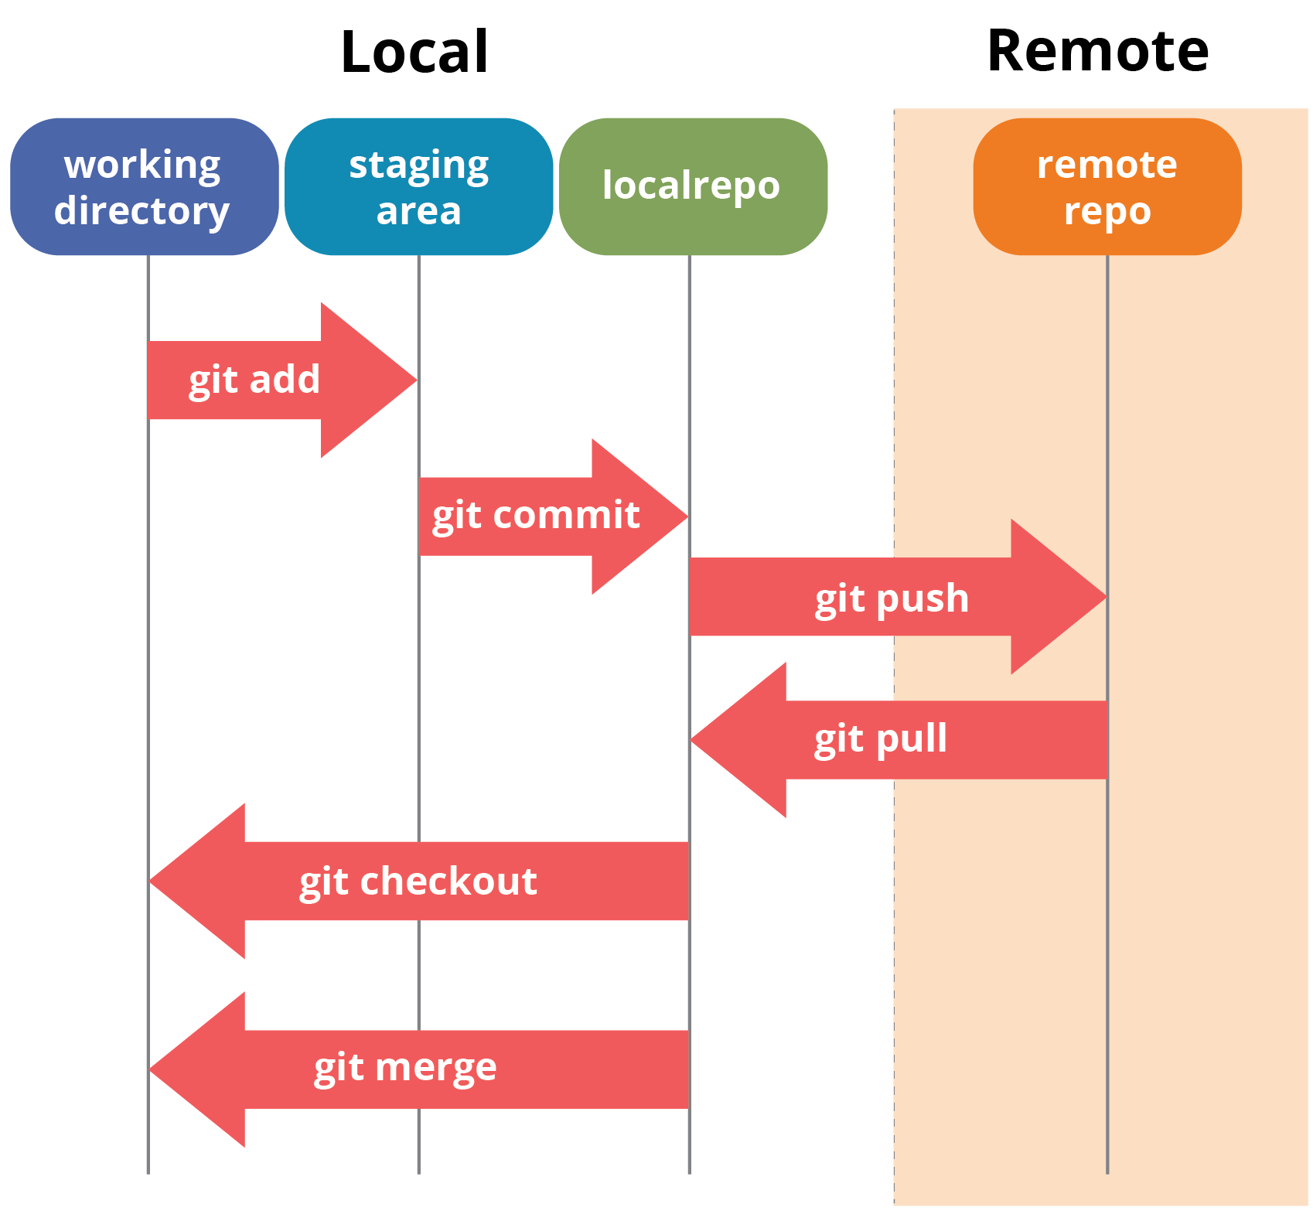
Eze: Architecture
clone create local repo
commit file system to local repo
pull remote changes to local repo
push local changes to remote repo
fork / branch copy branch
merge copy from branch to branch
from https://www.edureka.co/blog/git-tutorial/

Slide 15
GIT: Usage: Branch Conventions
Separating development and production code
- Current release work is stored in main
- Next-release work is stored in develop
- work in progress in feature branches
(normally named feature/<TICKET>_<NAME>)

Slide 16
GIT: Usage: Feature Branch
Separating work in progress from finished code: Feature Branches
main is primary codebase branch
feature branches are forked from main*, for safely reasons
Development is done on feature branch
When safe and ready, branch merged back into main*
* develop or main depending on git-flow used by team (will be discussed later)

Slide 17
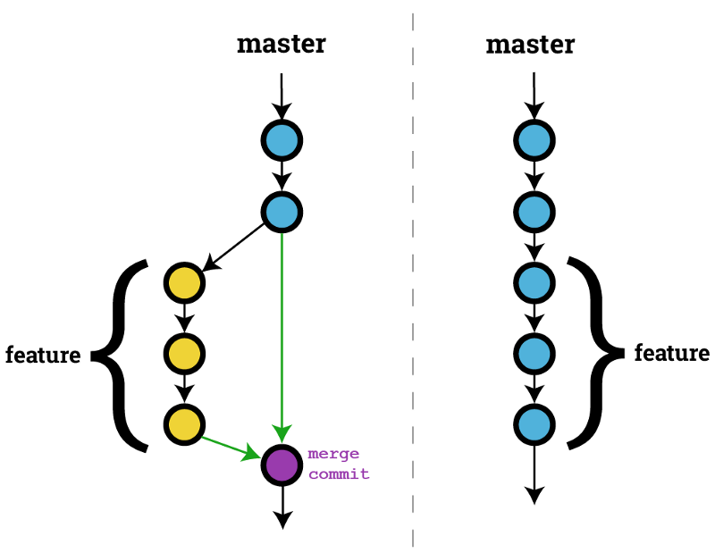
GIT: Usage: Feature Branch
Example of a feature branch:
being created from main
work committed
merged back into main
https://haydar-ai.medium.com/learning-how-to-git-merging-branches-and-resolving-conflict-61652834d4b0

Slide 18
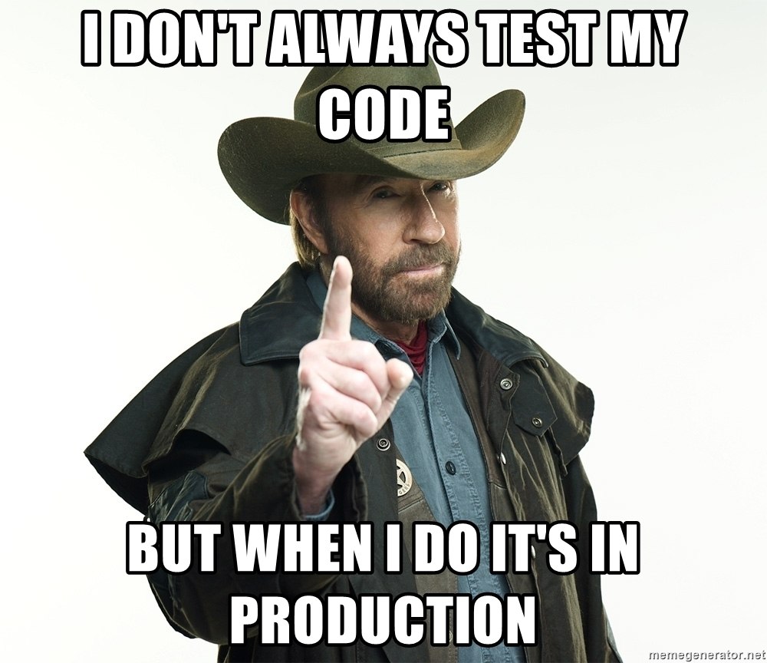
GIT FLOW: HERO

Slide 19
GIT: Git Flow
Old grand daddy convention
Git Flow is a process of committing work to repos Git Flow keeps the repos tidy Git Flow stops branch soup
(it might be getting old…)
https://www.atlassian.com/git/tutorials/comparing-workflows/gitflow-workflow

Slide 20
GIT: Git Flow
Old grand daddy convention
5 types of branch
- main – released code
- develop – next release code
- feature branches – work in progress (merged into develop)
- Release tags – tags of main + version number
- hotfixes - emergency hotfixes to release branches

Slide 21
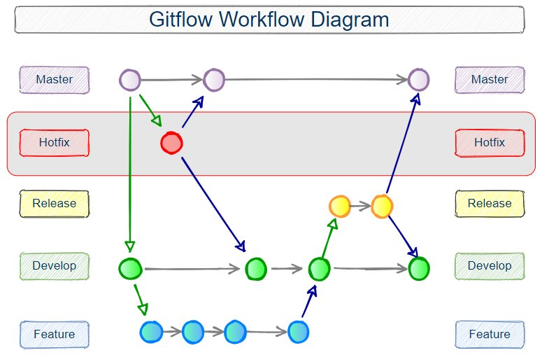
GIT: Usage: Git Flow
https://www.theserverside.com/blog/Coffee-Talk-Java-News-Stories-and-Opinions/Gitflow-release-branch-process-start-finish

Slide 22
GIT: Github Flow
new upstart convention
Github Flow is a process of committing work to repos Github Flow keeps the repos tidy Github Flow stops branch soup
Github Flow likes bleeding edge commits with no safeties or “releases”, aka continuous release

Slide 23
GIT: Github Flow
new upstart convention
2 types of branch
- main – released code
- feature branches – work in progress (merged into develop)
Bugs are fixed forward in feature branches

Slide 24
GIT: Github Flow
https://www.atlassian.com/continuous-delivery/continuous-integration/trunk-based-development

Slide 25
GIT: Git vs Github Flow
Opinions differ as to which is best
Typically:
Software which are periodically released best as Git Flow
Services which are continuously developed best as Github Flow

Slide 26
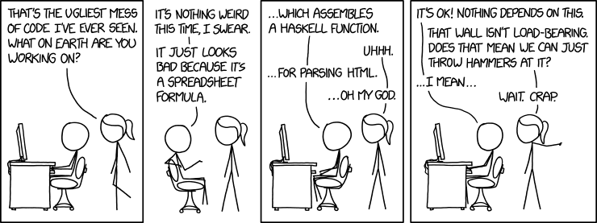
GIT Tooling HERO
https://www.explainxkcd.com/wiki/index.php/1926:_Bad_Code

Slide 27
GIT: Tooling
Are you a hero or a villain

Slide 28
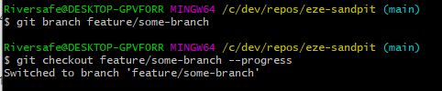
GIT: Tooling
Hero use raw git cli commands

Slide 29
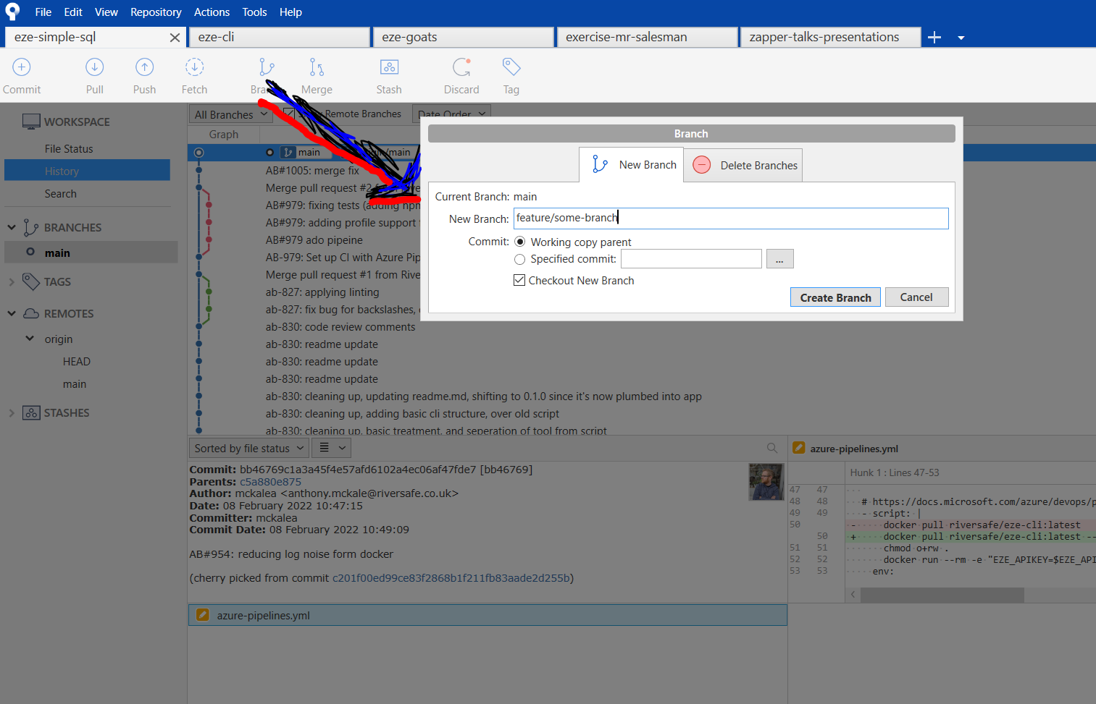
GIT: Tooling
Villian’s use git tooling aka SourceTree

Slide 30
GIT: Tooling
The devil has the best tools
Your choice, but I use SourceTree
Don’t be a Hero

Slide 31
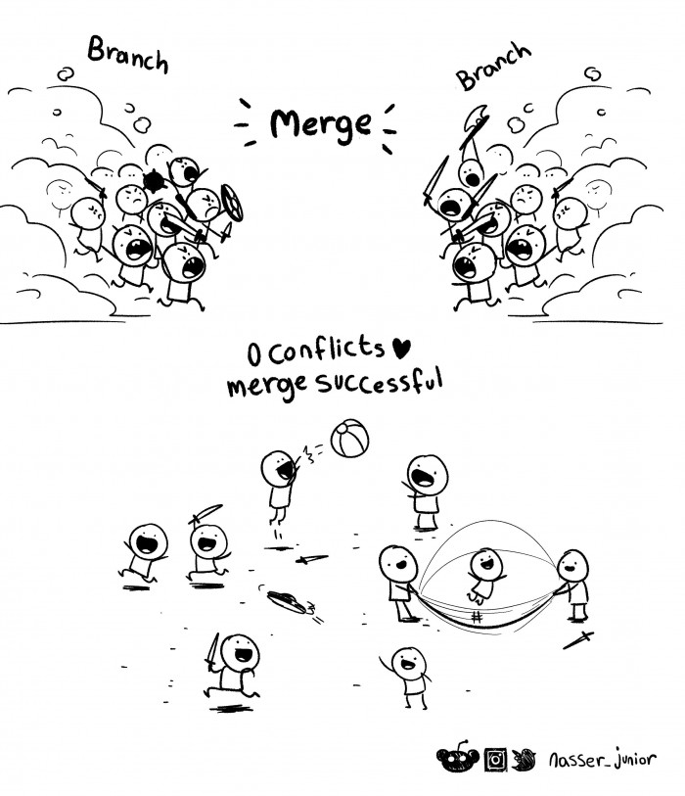
GIT:
Exercise
Merge
Conflict
https://devhumor.com/media/merge

Slide 32
GIT: Exercise Teaser
Will be providing these next week, with steps how to re-create situations Challenge is to merge all 4 situation in a sensible way

Slide 33
GIT: Exercise Teaser
4 Challenge Merges: Develop -> Main
when develop and main have changes Feature -> Develop
when develop has changes
Forked Child Feature -> Develop
when develop has changes from a Parent Feature
Lint Hell Develop
when developer does woods man ship without telling the team
https://devhumor.com/media/merge

Slide 34
GIT: Exercise Teaser
Exercise steps will be sent out next week for all those interested in improving their GIT skills

Slide 35
Questions
I’ve been Anthony “Zapper” M^{c}Kale
Hopefully I’ve Educated, Informed, and even Entertained Good Testing is Good Security is Good software

Slide 36
Thank you

