Slide 1


Nomura Talk
“Better, Cheaper, Faster”
Or… Why Eze ☺
xxx
xxx
06/04/2022

Slide 2
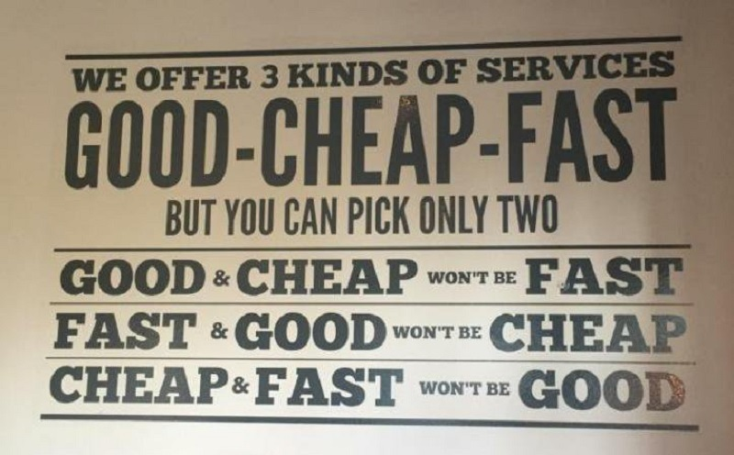
Intro

Slide 3
Intro
Hoping to convince the audience Eze is the rarest of things :
Good
Cheap
Fast!

Slide 4
Eze Agenda
- Overview
- Ease of Use
- Portable Data
- Opensource Thoroughbred - Sky Usage?

Slide 5
Eze: Overview
Multi Language* Support
Secrets Scanner
SCA Scanner
SAST Scanner
Strong Copy-left License Detection
Opensource (MIT License) (built ontop of best of class OS security tools)

Slide 6
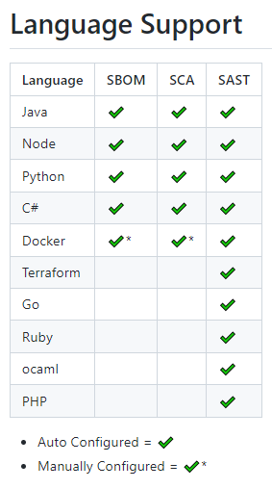
Eze: Overview
Current Language* Support * https://github.com/RiverSafeUK/eze-cli

Slide 7
Eze: Overview
Questions ?

Slide 8

Eze: Ease of Use
Eze auto configures tools and reports
on any laptop / CICD via single docker

Slide 9
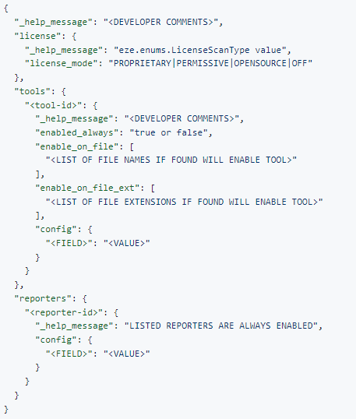
Eze: Ease of Use
Auto configured settings easy to change Default:
https://github.com/RiverSafeUK/eze-cli/blob/develop/eze/data/default_autoconfig.json

Slide 10
Eze: Ease of Use
Questions ?

Slide 11
Eze: Portable Data
Eze combines tools output into common combined formats
Supports multiple report types
* SARIF outputs are particularly useful for 3rd Party system
https://docs.oasis-open.org/sarif/sarif/v2.0/sarif-v2.0.html

Slide 12
Eze: Portable Data: Types
Name | Description
console | standard command line reporter
json | json output file reporter
s3 | s3 uploader reporter
junit | junit output file reporter
quality | quality gate check reporter
eze | eze management console reporter
bom | json cyclonedx bill of materials reporter
sarif | sarif output file reporter
markdown | markdown output file formatter
html | html output file formatter

Slide 13
Eze: Opensource
Eze stands on the shoulders on giants
Selecting the best opensource tools for the programming languages detected
Disparate Tool outputs are combined and returned, in industry standard SARIF
https://docs.oasis-open.org/sarif/sarif/v2.0/sarif-v2.0.html

Slide 14
Eze: Opensource
Type | Name | License
SCA | anchore-grype | Apache-2.0
SBOM | anchore-syft | Apache-2.0
SCA | container-trivy | Apache-2.0
SBOM | dotnet-cyclonedx | Apache-2.0
SECRET | gitleaks | MIT
SCA | kics | Apache-2.0
SBOM | java-cyclonedx | Apache-2.0
SCA | java-dependencycheck | Apache-2.0
SAST | java-spotbugs | LGPL
Type | Name | License
SCA | node-npmaudit | NPM
SCA | node-npmoutdated | NPM
SBOM | node-cyclonedx | Apache-2.0
SAST | python-safety | MIT
SCA | python-piprot | MIT
SAST | python-bandit | Apache-2.0
SBOM | python-cyclonedx | Apache-2.0
MISC | raw | inbuilt
SAST | semgrep | LGPL
SECRET | trufflehog | GPL

Slide 15
Eze: Opensource
Questions ?

Slide 16
Eze: Nomura Usage
REWRITE!!! And for Sky ?
SCA results for non-Github Repos
SCA Backup for Github + transitive package scanning ☺
License scanning across the estate, with exportable SBOMs
Secrets scanning across the estate
SAST scanning across the estate

Slide 17
Eze: Closing Thought
Eze uses best open source tools owasp / osv constantly improving tools eze uses
CLI Eze is Free As-in MIT / no vendor lock-in
Eze is easy runs in a single line

Slide 18
Eze: Closing Thought
BETTER: Eze uses best open source tools owasp / osv constantly improving tools eze uses
CHEAPER: CLI Eze is Free As-in MIT / no vendor lock-in
FASTER: Eze is easy runs in a single line

Slide 19
Questions
I’ve been Anthony “Zapper” M^{c}Kale
Hopefully I’ve Educated, Informed, and even Entertained Good Testing is Good Security is Good software

Slide 20
Thank you

