Slide 1


Academy
Python Beyond Basics
Anthony McKale Principal Software Engineer

Slide 2
Python beyond the basics
Today we’ll cover :
Decorators
Lambda Functions
Exceptions
Modules
Skim: Plugins
Skim: Async
It’ll aim to cover the class portions of the official python tutorial
https://docs.python.org/3/tutorial/

Slide 3
PYTHON Decorators

Slide 4
Python decorator
GO
https://python.swaroopch.com/more.html

Slide 5
PYTHON LAMBDA FUNCTIONS

Slide 6
Python Lambda
Lambda functions are the new hip way to write functional code old boring way
def add_a_b(a, b):
return a + b
new awesome 1-line way
add_a_b = lambda a, b: a + b

Slide 7
Python Lambda
The new awesome way is often abused and nested
divide_list_by_2 = (lambda _: list(map(lambda _: _ // 2, _)))([1,2,3,4,5,6,7,8,9,10])

Slide 8
Python Lambda
The new awesome way is often abused and nested
divide_list_by_2 = (lambda _: list(map(lambda _: _ // 2, _)))([1,2,3,4,5,6,7,8,9,10])
divide_by_two_floor = lambda _: _ // 2 divide_list_by_2 = (lambda _: list(map(divide_by_two_floor, _))) divided_list = divide_list_by_2([1,2,3,4,5,6,7,8,9,10])

Slide 9
Python Lambda
ALWAYS THINK KISS WITH LAMBDA
KISS = Keep It Simple Stupid
Remember you might need to maintain that complex code you just wrote !
AMAZING GUIDE HERE, WHICH EXPLAINS THEM BETTER THAN I EVER COULD
https://realpython.com/python-lambda/

Slide 11
PYTHON EXCEPTIONS

Slide 12
Python : Exception (tip-toe)
What do you do when a program crashes with a Exception ?
Can you carry on ? Or do you live with crashes ?
You Try to Catch the Exception obviously ☺

Slide 13
Python : Exception (tip-toe)
Welcome to Exception Catching
Aka the Art of Failing Gracefully

Slide 14
Python : Exception (tip-toe)
Exception is a special class used for try/except/raise functionality
All “raised” objects should extend base python “Exception” Class
Ps there can dragons here
(special rules apply. Read documentation before messing with Exception)
https://docs.python.org/3/whatsnew/2.5.html#pep-352-exceptions-as-new-style-classes
https://docs.python.org/3/library/exceptions.html#Exception

Slide 15
Python : Exception (tip-toe)
Create exception with raise
raise Exception(‘<human message>’)

Slide 16
Python : Exception Subclass (tip-toe)
Create exceptions can be sub-classed *
class AnthonyException(Exception):
def __init__(message): self.message = 'pointless prefix-' + message
Use also with raise
raise AnthonyException(‘<human message>’) * classes discussed more next section

Slide 17
Python : Exception Catching (tip-toe)
Catch exception inside a try block
try: # some code that will raise exception
except <Exception Type> as error: print('something happened!')

Slide 18
Python : Exception Example
SIMPLE EXAMPLE
try: raise Exception('happened')
except Exception as error: print(f'something happened! {error}')

Slide 19
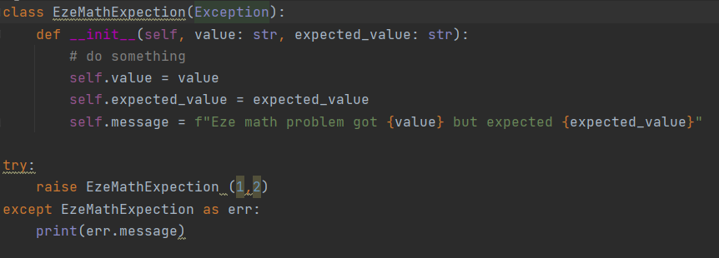
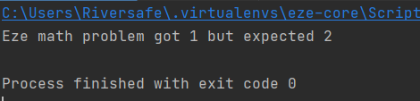
Python : Custom Exception Example
Extended Exception’s caught just like normal Exceptions

Slide 20
Python : Exception Questions
Class questions ?

Slide 21
Python Modules

Slide 22
Python Modules
import statement
Can be used :
Built in libraries
External libraries from pypi
Local .py files
https://python.swaroopch.com/modules.html

Slide 23
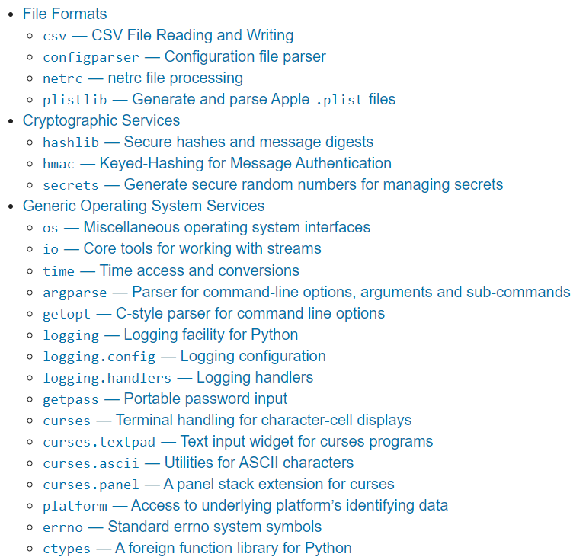
Python Modules: inbuilt
import statement gets awesome built-in libraries
https://docs.python.org/3/library/
handles all sorts of basic needs
- File Handling - Internet Requests
- Data processing
- De/Encryption
- Thread Management
And more …!

Slide 24

Python Modules: inbuilt
import statement with built-in libraries
Full Library
Partial Library
https://python.swaroopch.com/modules.html

Slide 25
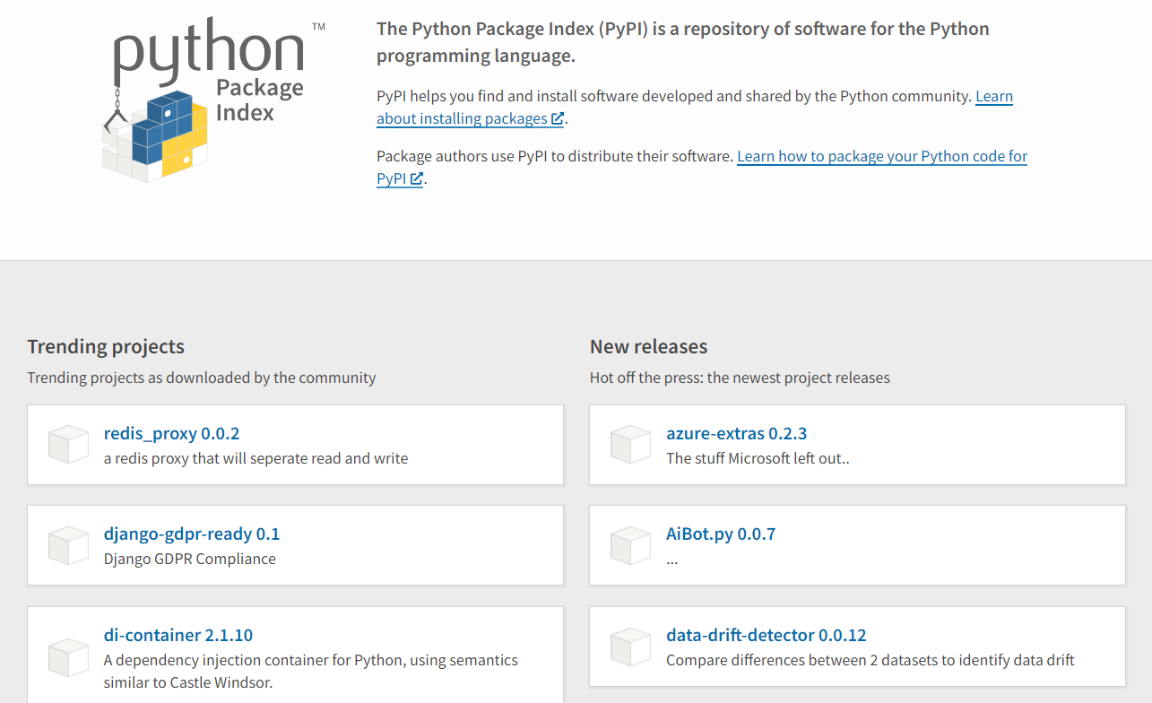
Python Modules: external
import statement gets awesome external opensource libraries
https://pypi.org/
handles everything else
Data Science
AI
Databases
And more …!

Slide 26
Python Modules: external
import statement with pypi libraries
install via pip pip install click
import like inbuilt librarays
import click
https://pypi.org/
https://python.swaroopch.com/modules.html

Slide 27
Python Modules: external file
For storing what external file to use, 3 main systems: requirements.txt (old) https://pip.pypa.io/en/stable/user_guide/#requirements-files
pipfile / piplock (new) https://github.com/pypa/pipfile
Poetry (newest)
https://python-poetry.org/

Slide 28
Python Modules: local
import statement gets local files
https://pypi.org/
import <FILENAME>.py import <FOLDER>/<FILENAME>.py * * all folders will need empty __init__.py in them
create a empty __init__.py with `touch __init__.py`
WARNING : DO NOT PUT CODE INTO A __init__.py file

Slide 29
Python Modules: local __init__.py
EXAMPLE ON __INIT__.py

Slide 30
PYTHON MODULES
RECAP

Slide 31
Python Modules
import statement
Can be used :
Built in libraries
External libraries from pypi
Local .py files
https://python.swaroopch.com/modules.html

Slide 32
Python Modules: inbuilt
import statement gets awesome built-in libraries
https://docs.python.org/3/library/
handles all sorts of basic needs
- File Handling - Internet Requests
- Data processing
- De/Encryption
- Thread Management
And more …!

Slide 33
Python Modules: inbuilt
import statement with built-in libraries
Full Library
Partial Library
https://python.swaroopch.com/modules.html

Slide 34
Python Modules: external
import statement gets awesome external opensource libraries
https://pypi.org/
handles everything else
Data Science
AI
Databases
And more …!

Slide 35
Python Modules: external
import statement with pypi libraries
install via pip pip install click
import like inbuilt librarays
import click
https://pypi.org/
https://python.swaroopch.com/modules.html

Slide 36
Python Modules: local
import statement gets local files
https://pypi.org/
import <FILENAME>.py
Note: to reference files in a folder, create a empty __init__.py DO NOT ADD CODE INTO A __init__.py file

Slide 37
PYTHON MODULES
REDUX

Slide 38
Modules
A module is basically just a py file containing statements
These can be classes, functions, executable code, and links to other modules
Multiple Modules* are used when your app gets bigger than a single file * rule of thumb, proactively split files bigger than 200-300 lines of code into sub modules

Slide 39
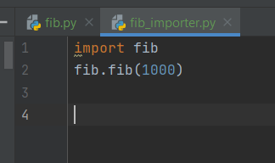
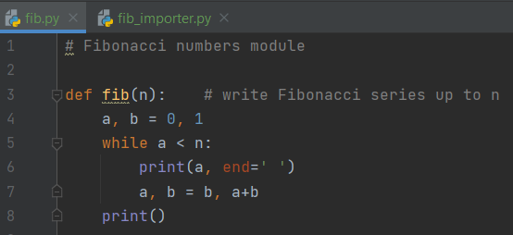
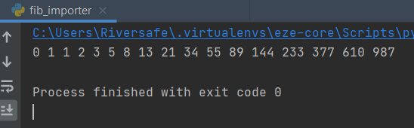
Modules
One module can reference another via the “import” statement
This pulls in that module into the requester aka

Slide 40

Self Executing Modules
For when you what to run a module as a run you need to bootstrap them using the __name__ magic variable and a if
using sys.argv for getting variables
https://docs.python.org/3/tutorial/modules.html#executing-modules-as-scripts

Slide 41
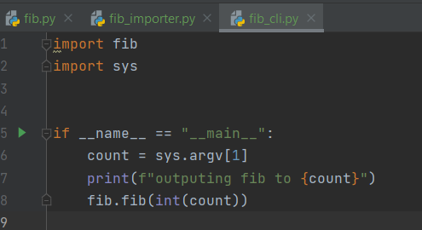
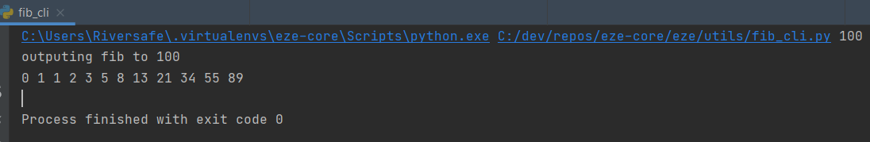
Self Executing Module Example

Slide 42
Finding Modules
Modules are discovered in multiple ways
Same Directory
Relative Packages (aka dotted format links to modules in other folders )
Pip installed modules (aka pip install xxx)
Standard Python Modules (aka inbuilt aka sys)
Will briefly speak about these

Slide 43
Finding Modules: Same Directory
Obvious right
For entire python file:
import xxx (for file xxx.py)
For particular Class or Function in python file:
from xxx import name (for file xxx.py, and name)
You can also rename things
from xxx import name as new_name

Slide 44
Finding Modules: Relative Packages
Package is just a folder with a __init__.py file in it
All packages require a __init__.py
Without it you won’t be able to reference those py files in that folder
Ps DO NOT BE CLEVER AND ADD CODE INTO __init__.py !!!
It’s the road to hell

Slide 45
Finding Modules: Relative Packages
For importing a module as a package:
import dir1.dir2.xxx (for file xxx.py)
For importing a pip module as a package:
import pip_name.dir1.dir2.xxx (for file xxx.py inside pip_name)
(from / import and as work as before)

Slide 46
Finding Modules: Pip installed modules
Everything you pip install is added to your pip libs
Pip libs directory is on your PYTHONPATH env var (including your current execution directory) Python will in order search for packages from your PYTHONPATH aka check locally, then your system inbuilt packages, then your pip folder, then etc etc

Slide 47
Finding Modules: Pip example
SHOW IN IDE PATH AND IT WORKING

Slide 48
Questions?: Modules
Questions ?

Slide 49
Async Python

Slide 50
Async Python
As discussed python is “single threaded”
Python can’t do more than one thing at a time
This is not entirely true
Let’s talk python concurrency / parallelism

Slide 51
Async Python: 3 Approaches
Event Driven (single thread with lots of sleeps)
Multiple functions running at same time (in concurrent threads)
Multiple functions running at same time (in parallel processes)

Slide 52
Async Python: Event Driven
One approach to running concurrent tasks, is Event driven programming
Heart of this approach is the Event Queue, that is serially processed
Pythion handler function are attached to Event Queue
Application I/O dispatches incoming events onto this queue
https://en.wikipedia.org/wiki/Event-driven_programming

Slide 53
Async Python: Event Driven
1) Event Handler Loop
2) Event Dispatch Loop
Event Loop
Function
I/O Input
Mouse /
Keyboard /
Internet /
Filesystem
ELSE Event Queue Empty sleep for X ms And … Repeat
IF has Events in Queue,
run handlers for each until empty
On input, dispatch/add event queue
Python Handler
Function
WHEN ran all handlers, return to event loop
Event Queue
https://en.wikipedia.org/wiki/Event-driven_programming

Slide 54
Async Python
Implementation : asyncio
(fake parallel, single core) Used for “event driven” programming
Note: if a handler function is slow, it can block the event loop and make it look “non-responsive”
https://docs.python.org/3/library/asyncio.html

Slide 55
Async Python: Event Driven
One approach to running parallel tasks, is Event driven programming
https://en.wikipedia.org/wiki/Event-driven_programming

Slide 56
Async Python: Event Driven
Where the code has a check loop
Example:
on server request: return

Slide 57
Async Python
Python provides 3 major ways of doing things in parallel :
asyncio (event driven in fake parallel, single core)
theads library (threads in fake parallel, single core)
multiprocessing library (processes in true parallel, multi core)

Slide 58
Async Python: theads
DEMO

Slide 59
Async Python: multiprocessing
DEMO

Slide 60
Python beyond
Best Practice

Slide 61
Best Practice
use snake_case for variables and function names
CamelCase is for Class Names only
Remember KISS when dealing with lambda functions
Place empty __init.py__ files in all folders containing .py files * DO NOT PUT CODE INTO __init.py__ !
use pipfile / poetry for storing external dependencies * fallback to requirements.txt only if it’s all that’s available

Slide 62
Questions
I’ve been Anthony M^{c}Kale “Wizard without Portfolio” Fixer-Upper of Broken things, and creator of time-constrained workable Fudges for 15 years. Email : anthony@zapper.hodgers.com

Slide 63
Thank
you

