Slide 1
Franklin Templeton Web Platform Team Aurelia + Redux Information Sharing 22/10/2017
By Anthony M^{c}Kale Wizard without Portfolio

Slide 2
Overview
Build Cycle (SVN / Tooling / Bamboo)
MMVV Structure + Redux / Aurelia

Slide 3
1) Build Cycle (SVN / Tooling / Bamboo)
Actors in Life cycle of a Release
Bamboo
SVN
Gulp / Aurelia CI
SCP / Linux Boxes

Slide 4
1) Bamboo
Bamboo is continuous integration server software
It’s setup with Plans which have a series of Tasks which download, configure, and compile Builds
Triggers are setup (e.g. on SVN commit) which start Jobs which execute the Plan, and create the Build
Builds are then deployed to servers
We have a instance with web-platform job in franklin setup for our work
https://en.wikipedia.org/wiki/Bamboo_(software)

Slide 5
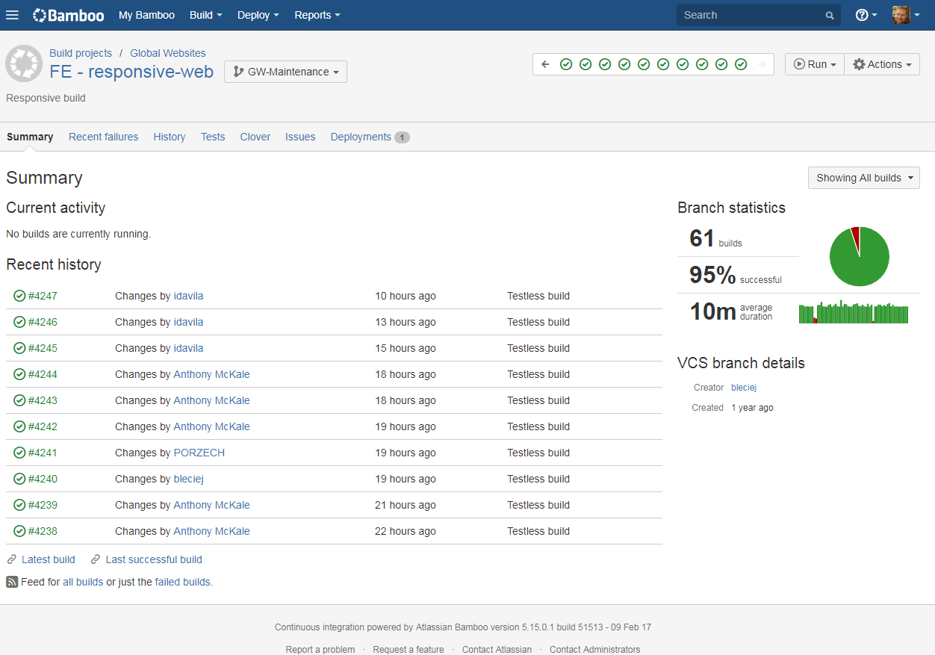
1) Bamboo : Show Off
xxx

Slide 6
1) Bamboo : Web-Platform Job
Web-Platform Plan Rough Breakdown
Download : SVN
Configure Compile Build : Gulp / Aurelia Cli
Deploy Build to servers : SCP

Slide 7
1) SVN
SVN in a piece of version control software
It’s super old but extremely common
It’s a tree structure with Tags / Trunk / Branches / Commits
https://sourcemgmtsvn.noam.corp.frk.com:18080/svn/globalweb/
http://svnbook.red-bean.com/
https://en.wikipedia.org/wiki/Version_control

Slide 8
1) SVN Web Platform : Urls
Develop Tools Repo
xxx
Dev Repo
xxx
Prod Repo
xxx

Slide 9
1) Bamboo : Web-Platform Job
Web-Platform Plan Rough Breakdown
Download : SVN
Configure Compile Build : Gulp / Aurelia Cli
Deploy Build to servers : SCP

Slide 10
1) Gulp / Aurelia Cli
Gulp / Aurelia Cli are JS build tools These manage dependencies, trans-compiling, minification, and any concatenation required As well as controlling any automated QA such unit tests, snapshot tests, UI tests, integration tests, and linting https://github.com/aurelia/cli https://gulpjs.com/
http://aurelia.io/docs/build-systems/aurelia-cli/

Slide 11
1) Gulp / Aurelia Cli
Gulp / Aurelia Cli is very easy to run and built using standard JS tools 1. npm install aurelia-cli -g // Install CLI 2. npm install // Download Dependencies 3. au build // Run Tooling and stop or au run --watch // Run Tooling and Serve

Slide 12
1) Gulp / Aurelia Cli
Gulp / Aurelia Cli configuration can be found here aurelia_project/tasks Help can be found in the tooling it’s self - au help // Output instructions

Slide 13
1) Bamboo : Web-Platform Job
Web-Platform Plan Rough Breakdown
Download : SVN
Configure Compile Build : Gulp / Aurelia Cli
Deploy Build to servers : SCP

Slide 14
1) Deploy Build to servers : SCP
Once a Build has completed, it can be deployed inside Bamboo Example : - Bamboo Build xxx
- Deployment xxx

Slide 15
1) Bamboo : Web-Platform Job
Web-Platform Plan Rough Breakdown
Download : SVN
Configure Compile Build : Gulp / Aurelia Cli
Deploy Build to servers : SCP
Easy ☺ Obviously “HC SVNT DRACONES!”

Slide 16
Overview
Build Cycle (SVN / Tooling / Bamboo)
MMVV Structure + Redux / Aurelia

Slide 17
2) MMVV Structure + Redux / Aurelia
Our web platform app, are a series of self bootstrapping Web Components They are built using : - The frontend of the Aurelia Framework - The Global Data State framework Redux - Following a M - MV – V Pattern (Model -> View Model -> View)
xxx

Slide 18
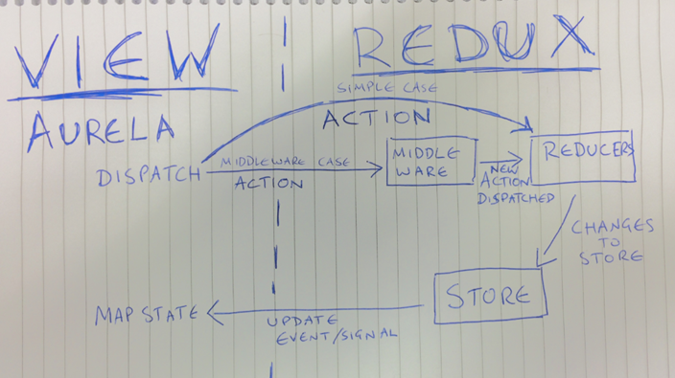
2) MMVV Structure + Redux / Aurelia

Slide 19
2) MMVV Structure
M <-> MV –> V Pattern (Model <-> View Model -> View) Model – Redux Reducer
View Model – Aurelia View Model
View – Aurelia Template View + Boiler Plate https://en.wikipedia.org/wiki/Model%E2%80%93view%E2%80%93viewmodel https://redux.js.org/docs/basics/Reducers.html http://aurelia.io/docs/fundamentals/components#creating-a-component
http://aurelia.io/docs/templating

Slide 20
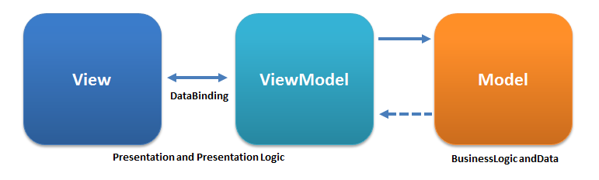
2) MMVV Structure
General rules of thumb : - Explicit Actions fired in ViewModel (MV) - Business Logic behind Actions only in Reducers(M) - Reducers(M) update global state, ViewModel(MV) implicitly Respond - View (V) Only presents data of ViewModel(VM) * Picture source https://en.wikipedia.org/wiki/Model%E2%80%93view%E2%80%93viewmodel

Slide 21
2) MMVV Structure + Redux / Aurelia
Obviously “HC SVNT DRACONES!!!!”
Badly written non-pure/immutable reducers
View Model with business logic https://translate.google.co.uk/?rlz=1C1GCEA_en___GB760&um=1&ie=UTF-8&hl=en&client=tw-ob#la/en/HC%20SVNT%20DRACONES

Slide 22
2) MMVV Structure + Redux / Aurelia
Redux Framework (Model)
Model – View Model – View Pattern
Aurelia Framework (View and View Model) Redux Model -> Aureila View Model -> Aurelia View

Slide 23
2) Aurelia Framework
Aurelia Framework is a modern web framework - Successor to Angular 1 (after Angular 2 jumped the shark)
Simple to use
Modular
Supports Web Components
https://www.webcomponents.org/
http://aurelia.io/docs/

Slide 24
2) Aurelia Components
We’re using Aurelia Components, composed of: - View (Templated HTML) - View Model (ES6 View Model Class)
- Value Converters - Testing
http://aurelia.io/docs/fundamentals/components#creating-a-component
http://aurelia.io/docs/templating
http://aurelia.io/docs/binding
http://aurelia.io/docs/testing

Slide 25
2) Aurelia Example : Fund Ratings
- View (Templated HTML) - View Model (ES6 View Model Class)
- Value Converters We sparingly use these - Testing Can cover this another day
xxx

Slide 26
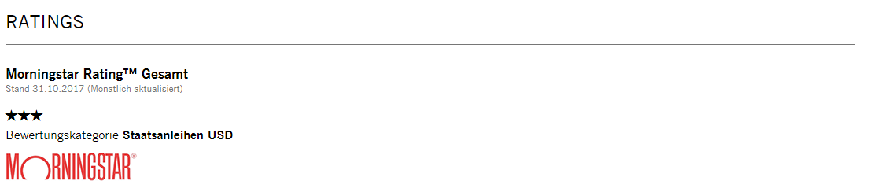
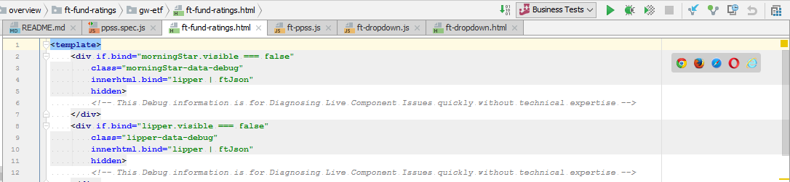
2) Example : Fund Ratings : View
xxx
view-source:xxx

Slide 27
2) Aurelia Example : Fund Ratings
- View (Templated HTML) - View Model (ES6 View Model Class)
- Value Converters We sparingly use these - Testing Can cover this another day
xxx

Slide 28
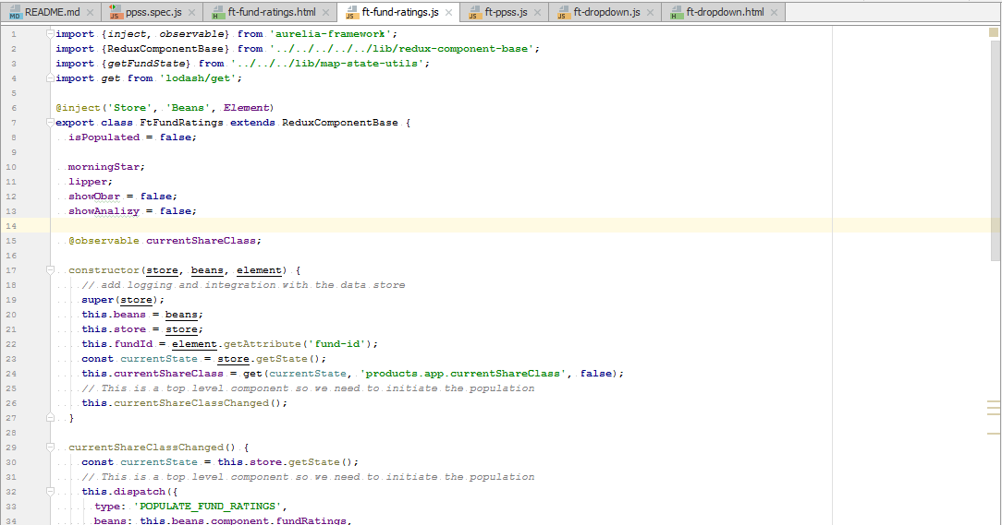
2)Example : Fund Ratings : View Model
xxx

Slide 29
2)Example : Fund Ratings : View Model
ES6 Class
Aurelia Web Component Attribute Binding / Watching
Aurelia Dependency Injection
Redux Global State “on update” hook

Slide 30
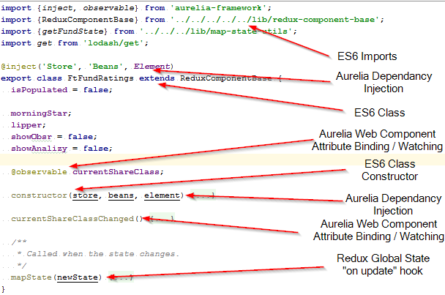
2)Example : Fund Ratings : View Model

Slide 31
2)Example : Fund Ratings : View Model Further Reading
ES6 Classes https://developer.mozilla.org/en-US/docs/Web/JavaScript/Reference/Classes
Aurelia Web Component Attribute Binding / Watching http://aurelia.io/docs/binding/binding-observable-properties http://aurelia.io/docs/binding/basics
Aurelia Dependency Injection http://aurelia.io/docs/fundamentals/dependency-injection#introduction
Redux Global State “on update” hook Magic in here xxx

Slide 32
2) Aurelia Example : Fund Ratings
- View (Templated HTML) - View Model (ES6 View Model Class)
- Value Converters We sparingly use these - Testing Can cover this another day
Easy, Aurelia Web Components ☺ Obviously “HC SVNT DRACONES!”

Slide 33
2) MMVV Structure + Redux / Aurelia
Model – View Model – View Pattern
Aurelia Framework (View and View Model)
Redux Framework (Model) Redux Model -> Aureila View Model -> Aurelia View

Slide 34
2) Redux
Redux is a framework for storing global state in our Web-Platform app It contains all the rest calls, configurations, and parsed data It is made up of Actions, States, Stores, and Reducers https://redux.js.org/

Slide 35
2) Redux
State
Dumb object full of serialisable data (e.g. no Maps or Functions, just JSON-ible data)
Store
Current State, wrapped around a Event Dispatcher which has Actions added
Action
Event to be fired on a Store, contains TYPE
Reducer
Event handler set in Store, which responds to specific Action TYPEs, and immutably edits the current State and returns it

Slide 36
2) Redux : Store Setup
1) State Initialisation :
configuration/common/configure.js getInitialState()
2) Reducers added to Store & Store bound to Aurelia DI
configuration/common/configure.js commonConfigure(aurelia, config) aurelia.container.registerInstance('Store', store); createStore(combineReducers(config.reducers ….)
3) Store injected and plumbed into Web Components
lib/redux-component-base.js 4) Store action fired in Web Components (example) components/products/overview/ft-fund-ratings/gw-etf/ft-fund-ratings.js https://redux.js.org/docs/basics/Store.html

Slide 37
2) Redux
State
Dumb object full of serialisable data (e.g. no Maps or Functions, just JSON-ible data)
Store
Current State, wrapped around a Event Dispatcher which has Actions added
Action
Event to be fired on a Store, contains TYPE
Reducer
Event handler set in Store, which responds to specific Action TYPEs, and immutably edits the current State and returns it

Slide 38
2) Redux : Action / Reducer
Store Action fired in Web Components
Picked up by corresponding Reducer
Store Update picked up in Web Components
Profit … sorry I mean HTML refresh
https://redux.js.org/docs/basics/Actions.html https://redux.js.org/docs/basics/Reducers.html

Slide 39
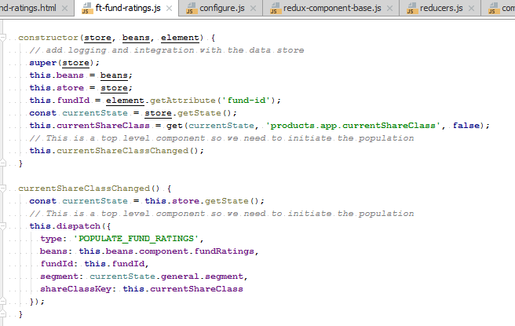
2) Redux : Action / Reducer Example
Store Action fired in Fund Ratings components/products/overview/ft-fund-ratings/gw-etf/ft-fund-ratings.js

Slide 40
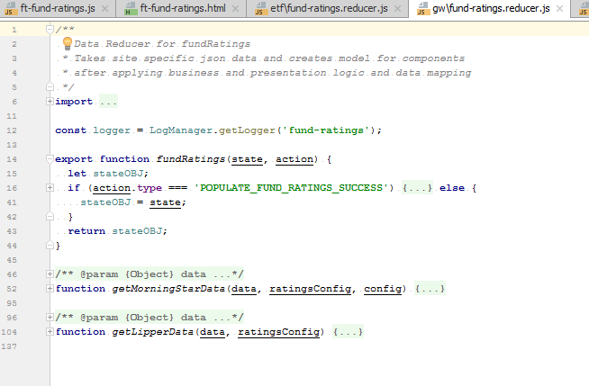
2) Redux : Action / Reducer Example
2) Picked up by corresponding Reducer components/products/overview/ft-fund-ratings/gw-etf/lib/gw/fund-ratings.reducer.js

Slide 41
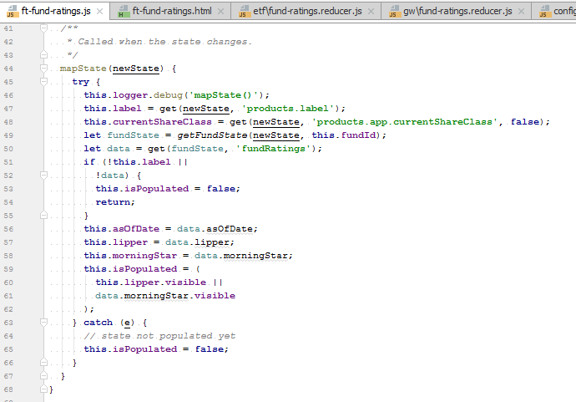
2) Redux : Action / Reducer Example
3) Store Update picked up in Web Components components/products/overview/ft-fund-ratings/gw-etf/ft-fund-ratings.js

Slide 42
2) Redux : Action / Reducer
Store Action fired in Web Components
Picked up by corresponding Reducer
Store Update picked up in Web Components
4) Profit … sorry I mean HTML refresh
Easy ☺ Obviously “HC SVNT DRACONES!”
xxx

Slide 43
2) MMVV Structure + Redux / Aurelia
Aurelia Framework (View and View Model)
Redux Framework (Model)
Model – View Model – View Pattern Redux Model -> Aureila View Model -> Aurelia View
Easy ☺

Slide 44

3) Questions ?
I’ve been Anthony M^{c}Kale “Wizard without Portfolio” Fixer-Upper of Broken things, and creator of time-constrained workable Fudges for 15 years. Email : anthony@zapper.hodgers.com

