Slide 1
Friday Training Hour
“Proxy Servers 101”
Anthony McKale
AI CoE Tech Lead 28/02/2020

Slide 2
Proxy Servers 101
FOR INTERNAL USE ONLY
This will cover some basic networking
Devices, Identifiers, and the day to day basics of http/https networking
ALL Corporate networks are much more complex than home or small business networks
It’s important to know the basics, or those complexities will trip you up !
Information classiﬁcation: Public

Slide 3
Proxy Servers 101
FOR INTERNAL USE ONLY
It will get to proxy servers at the end
But without those basics, the proxy stuff won’t make much sense !
Information classiﬁcation: Public

Slide 4
Proxy Servers 101: Table of Contents
FOR INTERNAL USE ONLY
Machine Identifiers
Protocols / Ports
Network Devices
RBS Proxy
Information classiﬁcation: Public

Slide 5
Network Primer: Machine Identifiers
FOR INTERNAL USE ONLY
You identity Machines on networks with unique identifiers
Topics:
MAC Addresses
IPs
DNS
DHCP
ASN
Find yours
Overview
Information classiﬁcation: Public

Slide 6
Network Primer: Identifers Overview
FOR INTERNAL USE ONLY
Basically…
MAC Address = device ID
IP Address = network ID (connected to MAC)
DNS Name = Internet IP Lookup name (connected to IP)
DHCP Name = LAN IP Lookup name (connected to IP)
ANS Number = Internet IP owner / provider (connected to IP)
In wee bit more details though…
Information classiﬁcation: Public

Slide 7

Network Primer: MAC Addresses
FOR INTERNAL USE ONLY
Every device in the world has a MAC address aka network card in computer / external router etc
multiple computer devices each a MAC address aka laptop “wifi card” and “LAN card” different mac addresses
very low level and rarely used outside of lower level networking devices
completely unique *
https://en.wikipedia.org/wiki/MAC_address
* Google MAC address spoofing
Information classiﬁcation: Public

Slide 8
Network Primer: IP Addresses
FOR INTERNAL USE ONLY
IP Address is your networking ID
It is connected to a MAC address
Every device on every network is assigned a unique IP Advanced topic: these can be statically or dynamically assigned
You use the IP address to contact a server
https://en.wikipedia.org/wiki/IP_address
Information classiﬁcation: Public

Slide 9
Network Primer: Multiple IP Addresses
FOR INTERNAL USE ONLY
Just for fun that IP is unique and different between each nested network between you and the internet
User computers have a local IP, and a external IP*1
External IP will be shared behind you and everyone else going through that internet proxy
it’s completely unique *2
https://en.wikipedia.org/wiki/IP_address
*1 - Several actually one per nested LAN
*2 - Handled out LAN by a DHCP server
Information classiﬁcation: Public

Slide 10
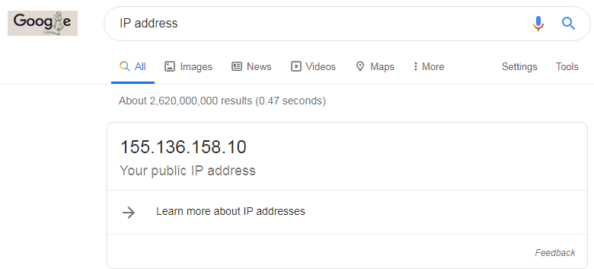
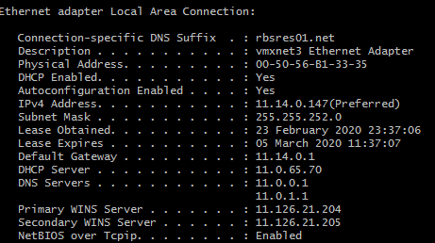
Network Primer: IP Addresses
FOR INTERNAL USE ONLY
External 155.136.158.10
Internal 11.14.0.147
Information classiﬁcation: Public

Slide 11
Network Primer: Special IP Addresses
FOR INTERNAL USE ONLY
Loopback: 0.0.0.0 and 127.0.0.1 this is you, always goes back to you
Private LAN IPs: 10.0.0.0/8 and 172.16.0.0/12 and 192.168.0.0/16
Multicast LAN IPs: 224.0.0.0/6
https://en.wikipedia.org/wiki/IP_address
Information classiﬁcation: Public

Slide 12
Network Primer: DNS
FOR INTERNAL USE ONLY
Internet IPs* are hard to remember / type in
DNS names (www.bbc.co.uk) are much easier to use
DNS lookup servers connect internet IPs to DNS names
* Especially IPv6 addresses
https://en.wikipedia.org/wiki/List_of_DNS_record_types
https://en.wikipedia.org/wiki/Domain_Name_System
Information classiﬁcation: Public

Slide 13
Network Primer: DHCP
FOR INTERNAL USE ONLY
IPs* are hard to remember / type in, also you need them to be unique
DHCP servers hand out unique LAN IPs to machines joining networks
Also DHCP names (gbmlvvcsw1127) are much easier to use
Fun Fact: If two DHCP servers are on one network, IPs stop being unique and the network breaks *
https://en.wikipedia.org/wiki/Dynamic_Host_Configuration_Protocol
* Have seen someone fired for connecting a home wifi hub with DHCP into a corporate network, and bringing down the buildings internet…
Information classiﬁcation: Public

Slide 14
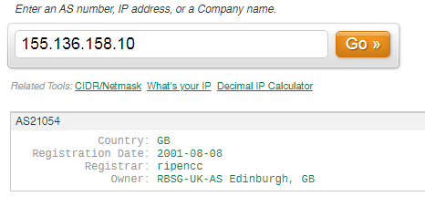
Network Primer: ASN
FOR INTERNAL USE ONLY
Internet network IPs controlled in blocks
Routing controlled by ASN *
* Advanced topic
https://en.wikipedia.org/wiki/Autonomous_system_(Internet) https://www.ultratools.com/tools/asnInfo
Information classiﬁcation: Public

Slide 15
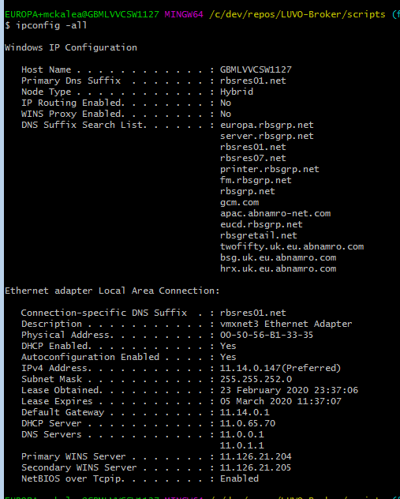
Machine Identifiers: How to Find Yours
FOR INTERNAL USE ONLY
In windows use: ipconfig -all to see them
Information classiﬁcation: Public

Slide 16
Network Primer: Identifers Overview
FOR INTERNAL USE ONLY
MAC Address = device ID
IP Address = network ID (connected to MAC)
DNS Name = Internet IP Lookup name (connected to IP)
DHCP Name = LAN IP Lookup name (connected to IP)
ANS Number = Internet IP owner / provider (connected to IP)
Questions ?
Information classiﬁcation: Public

Slide 17
Protocols / Ports
FOR INTERNAL USE ONLY
Very short primer…. Protocols and Ports are a feature of TCP
Which is a major internet protocol in it’s self.
https://en.wikipedia.org/wiki/Transmission_Control_Protocol
Information classiﬁcation: Public

Slide 18
Protocols / Ports: Ports
FOR INTERNAL USE ONLY
TCP Ports are a 16bit unsigned number (0 – 65535)
A numbers are assigned to either Well known protocols aka 80 HTTP 443 HTTPS
For dynamically by servers
aka 8080 common development http server
This allows multiple protocols to be serviced by one IP
Aka 10.x.x.x:80 is http server, 10.x.x.x:22 ssh server on same device
https://en.wikipedia.org/wiki/Transmission_Control_Protocol#TCP_ports
Information classiﬁcation: Public

Slide 19
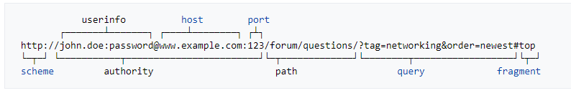
Protocols / Ports: Protocols
FOR INTERNAL USE ONLY
For HTTP resources you can tell the protocol and port in the URL
Each Scheme (http/https/ftp etc) has a default port
Information classiﬁcation: Public

Slide 20
Protocols / Ports: HTTPS Protocol
FOR INTERNAL USE ONLY
Certificates being provided by HTTPS server granted by 3rd party* that the server and browser both trust, verifying they are who they say they are.
* See man in the middle attack later
https://www.thesslstore.com/knowledgebase/ssl-support/explaining-the-chain-of-trust/
Information classiﬁcation: Public

Slide 21
HTTPS Protocol: Chain of trust
FOR INTERNAL USE ONLY
HTTP over SSL (https) is a very important protocol
It encrypts all data to prevent 3rd parties snooping *
It signs data which can be verified source *
It signs data to make sure it’s not been tampered with *
Security through Chain of trust
* See man in the middle attack later
https://en.wikipedia.org/wiki/HTTPS
Information classiﬁcation: Public

Slide 22
Protocols / Ports: Protocols
FOR INTERNAL USE ONLY
Told you it was short, questions ?
More info here
https://en.wikipedia.org/wiki/Hypertext_Transfer_Protocol
Information classiﬁcation: Public

Slide 23
Network Devices
FOR INTERNAL USE ONLY
Basic Network Device Primer… short version
DNS Server
Firewalls
Gateways
Proxies
Information classiﬁcation: Public

Slide 24
Network Devices: DNS Server
FOR INTERNAL USE ONLY
Each time you need to connect to server you need the IP, if you have the DNS name you need to do a DNS lookup
1) What’s the IP of www.bbc.co.uk
DNS SERVER
LAPTOP
2) www.bbc.co.uk is x.x.x.x
4) Here you go
3) x.x.x.x whats the web page of www.bbc.co.uk/news
WEB SERVER
x.x.x.x
Information classiﬁcation: Public

Slide 25
Network Devices: Gateways
FOR INTERNAL USE ONLY
Gateways Connect two networks together aka Corporate LAN to say Internet (the WAN)
https://en.wikipedia.org/wiki/Proxy_server
MACHINE
LAN 1 IP: 10.x.x.x
GATEWAY SERVER
LAN 1 IP: 10.x.x.x
LAN 2 IP: 10.y.y.y
SOME OTHER MACHINE
LAN 2 IP: 10.y.y.y
Information classiﬁcation: Public

Slide 26
Network Devices: Proxy
FOR INTERNAL USE ONLY
Proxy is a type of gateway, there are several types
Open Proxies for devices accessing other devices ( anonymous / transparent flavours)
Reverse Proxies for sitting in front of outgoing / incoming traffic to a device
https://en.wikipedia.org/wiki/Gateway_(telecommunications)
Information classiﬁcation: Public

Slide 27
Network Devices: Proxy Features
FOR INTERNAL USE ONLY
Open / Reverse Proxies often
Blocking Addresses / Blocking Protocols / Filter content aka block and remove porn and other unsuitable content
Alerting / Logging / Eaves Dropping alert proxy controllers of bad behaviour
Data Loss Protection of Encrypted Data https traffic can not be analysed for filtering / alerting, so proxy might do “man in middle” attack to be able to do so
Enhancement Proxies can also transform content, aka adding compression, translation of languages, or adding https protocols, etc
Bypassing filters and censorship (super no-no bad in corporate land) Anonymous Proxies can be used to bypass IP firewalls, GEO location protections, or alerting and filtering
Information classiﬁcation: Public

Slide 28
Network Devices: Firewalls
FOR INTERNAL USE ONLY
Specialised network devices that protect servers by vetting devices attempting to communicate to a server
Firewalling is often a feature of a proxy server
Often common to block by:
MAC address / IP address lists
Port numbers
More modern use AI to detect patterns
https://en.wikipedia.org/wiki/Firewall_(computing)
Information classiﬁcation: Public

Slide 29
Network Devices
FOR INTERNAL USE ONLY
short version done… questions ?
Information classiﬁcation: Public

Slide 30
RBS Bluecoat Proxy Server
FOR INTERNAL USE ONLY
REMOVED
Information classiﬁcation: Public

Slide 31
Questions ?
FOR INTERNAL USE ONLY
I’ve been Anthony M^{c}Kale “Wizard without Portfolio” Fixer-Upper of Broken things, and creator of time-constrained workable Fudges for 15 years. Email : anthony@zapper.hodgers.com
Information classiﬁcation: Public

Slide 32
FOR INTERNAL USE ONLY
Thank you
Information classiﬁcation: Public

