Slide 1
Friday Training Hour
“Local Chatbot Development”
… and the Merging of Broker into Botmaster
Anthony McKale
AI CoE Tech Lead 27/03/2020

Slide 2
Local Chatbot Development
FOR INTERNAL USE ONLY
This will cover :
What is local development
How to setup a machine for development
How to run a Chatbot locally
The recent broker => botmaster merge
Will be aimed at the developer knowledge level
Information classiﬁcation: Public

Slide 3
Table of Contents
FOR INTERNAL USE ONLY
What is local development
How to setup a machine for development
How to run a Chatbot locally
The recent broker => botmaster merge
Information classiﬁcation: Public

Slide 4
What is local development
FOR INTERNAL USE ONLY
The following are 6 common local development requirements / features / practises
Hardware (Computer with Admin rights and clean internet)
Standards (Contributing Documentation + Code Standards)
Local Interpreter (For running Code)
Test Framework (For running Code Tests)
Version Control (For storing / sharing code)
IDE (for bringing everything together)
Information classiﬁcation: Public

Slide 5
What is local development
FOR INTERNAL USE ONLY
Lets give each of those a 1-2 overview
Information classiﬁcation: Public

Slide 6
LD: Hardware
FOR INTERNAL USE ONLY
At RBS you require :
a VCSe computer aka a terminal computer that’s not being shared
admin rights this is required for later setup
Clean(ish) internet, delivered by the proxy due to security setup you need to manually config this
REMOVED
Information classiﬁcation: Public

Slide 7
LD: Standards : Code Standards
FOR INTERNAL USE ONLY
For clean development you need code standards
These are enforced by a tool called ESLint
All committed code must follow same standards or you end up with “spaghetti code”
Documentation: https://eslint.org/
REMOVED
Information classiﬁcation: Public

Slide 8
LD: Standards : Contributing Documentation
FOR INTERNAL USE ONLY
For clean development you need contributing standards
For us that means everything must be in a feature branch, no committing straight to master
And everything must be code reviewed by a Tech Lead developer (that’s mainly me, but other’s fill in from time to time)
And everything must have a jira ticket stating the work before being merged, that’s been agreed by Product Owner (no wild / woods man ship commits)
…
Information classiﬁcation: Public

Slide 9
LD: Standards : Contributing Documentation
FOR INTERNAL USE ONLY
To help with Contributing and Code Standards we ask every new developer goes through the new starter training
That’s ensure everyone is aware of the code standards and tools involved
Documentation:
REMOVED
Information classiﬁcation: Public

Slide 10
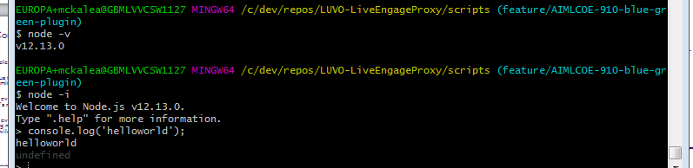
LD: Interpreter: For running Code
FOR INTERNAL USE ONLY
For every programming language there is a compiler or interpreter (scripting languages only) for it
For us we must install the node interpreter to run code locally
Documentation: REMOVED
Information classiﬁcation: Public

Slide 11
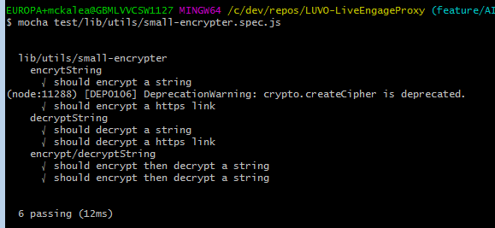
LD: Test Framework : For Testing Code
FOR INTERNAL USE ONLY
For every professional programmer you write unit tests to ensure code is still running as expected, every time the code changes.
For us we must install the mocha test framework to run test locally
Documentation: Friday Training Day REMOVED
Information classiﬁcation: Public

Slide 12
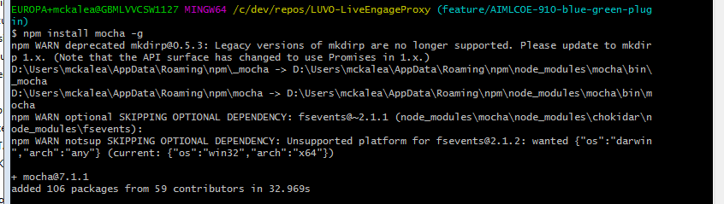
LD: Test Framework : For Testing Code
FOR INTERNAL USE ONLY
PS Global Install is this npm install mocha -g
(adds mocha as a command line program)
Information classiﬁcation: Public

Slide 13
LD: Version Control : For storing / sharing code
FOR INTERNAL USE ONLY
So everyone can work together
Modern development uses a system called “version control”
This helps:
everyone work on code together (pulling)
share the changes (merging)
Areas for work in progress or experiments (branchies)
Conflict resolution
Audit Trail of work done
Information classiﬁcation: Public

Slide 14

LD: Version Control : For storing / sharing code
FOR INTERNAL USE ONLY
We use the Git Version Control System
And the Git server is a GitLab server hosted on IBMCloud
On windows it’s easier to install git-bash command line tool to use git
Documentation:
Friday training day REMOVED Git Setup
REMOVED
Information classiﬁcation: Public

Slide 15
LD: IDE : Integrated Development Environment
FOR INTERNAL USE ONLY
Final piece of the puzzle the IDE, this brings all the rest together!
Information classiﬁcation: Public

Slide 16
LD: IDE : Integrated Development Environment
FOR INTERNAL USE ONLY
Final piece of the puzzle the IDE, this brings all the rest together!
For modern professional development you’ll need a integration development environment
Good options are: VSCode or IntelliJ
Bad options are: notepad++ or eclipse you could use notepad++ but DON’T
Documentation: Visual Code Friday Training Day REMOVED
Information classiﬁcation: Public

Slide 17
LD: IDE : Integrated Development Environment
FOR INTERNAL USE ONLY
IDEs will give you:
Easy to use version control
Easy to understand Code Standards Support
Easy to run unit tests
Easy to run code interpreters
Documentation: Visual Code Friday Training Day REMOVED
Information classiﬁcation: Public

Slide 18
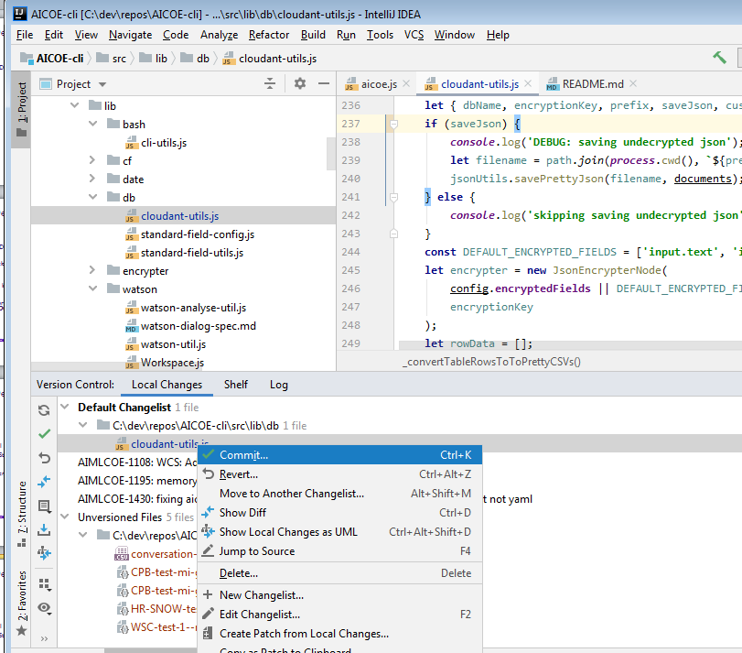
LD: IDE : Integrated Development Environment
FOR INTERNAL USE ONLY
Aka Easy to use version control
Information classiﬁcation: Public

Slide 19
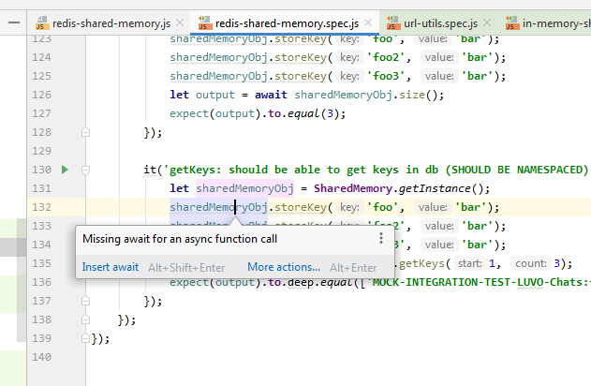
LD: IDE : Integrated Development Environment
FOR INTERNAL USE ONLY
Easy to understand Code Standards Support
Information classiﬁcation: Public

Slide 20
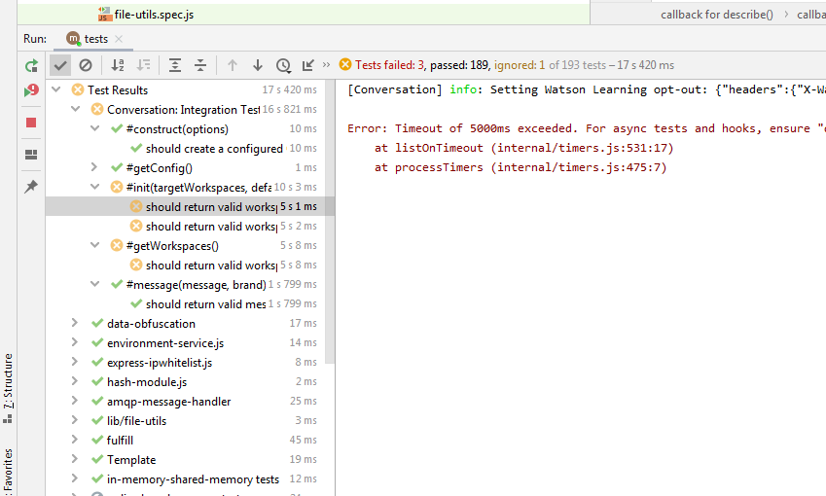
LD: IDE : Integrated Development Environment
FOR INTERNAL USE ONLY
Easy to run unit tests
Information classiﬁcation: Public

Slide 21
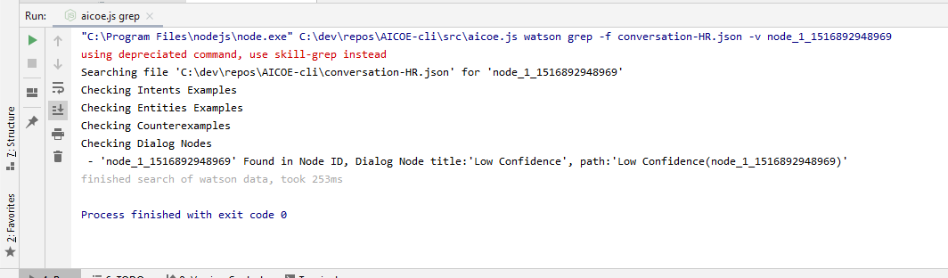
LD: IDE : Integrated Development Environment
FOR INTERNAL USE ONLY
Easy to run code interpreters
Information classiﬁcation: Public

Slide 22
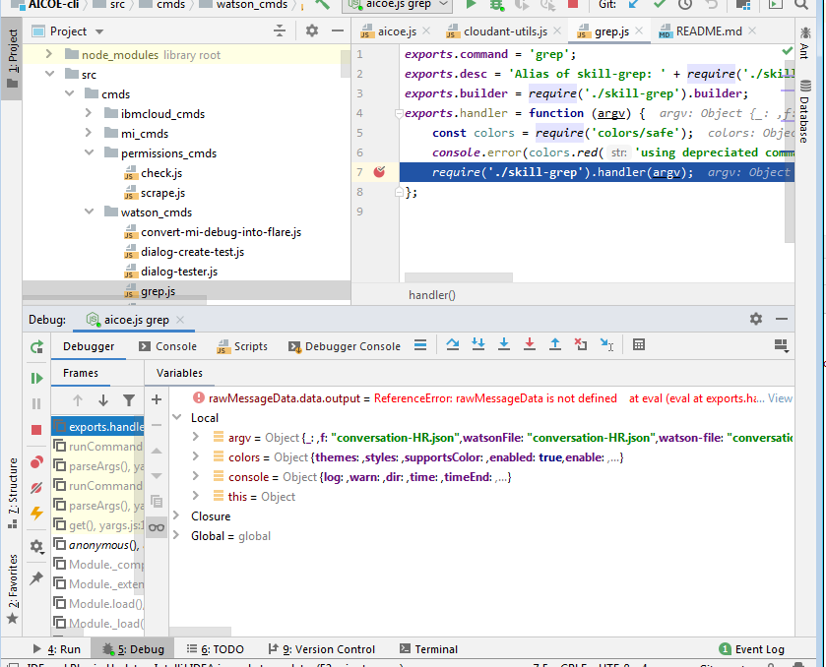
LD: IDE : Integrated Development Environment
FOR INTERNAL USE ONLY
Easy to run code interpreters + debugging with breakpoints !
Information classiﬁcation: Public

Slide 23
What is local development
FOR INTERNAL USE ONLY
Questions ?
For simplicity I haven’t mentioned deployment aka cf / ibmcloud tooling see this Friday trianing day for details:
REMOVED
Information classiﬁcation: Public

Slide 24
How to setup a machine for development
FOR INTERNAL USE ONLY
REMOVED
Information classiﬁcation: Public

Slide 25
Broker into Botmaster Merge
FOR INTERNAL USE ONLY
REMOVED
Information classiﬁcation: Public

Slide 26
Questions ?
FOR INTERNAL USE ONLY
I’ve been Anthony M^{c}Kale “Wizard without Portfolio” Fixer-Upper of Broken things, and creator of time-constrained workable Fudges for 15 years. Email : anthony@zapper.hodgers.com
Information classiﬁcation: Public

Slide 27
FOR INTERNAL USE ONLY
Thank you
Information classiﬁcation: Public

