Slide 1
Friday Training Hour
“Pair Programming 101”
… and the Quality Control vs Quality Assurance
Anthony McKale
AI CoE Principal Software Engineer 24/04/2020

Slide 2
Pair Programming 101
FOR INTERNAL USE ONLY
PROVISO :
THIS TALK IS HEAVILY (“HEAVILY”) BASED OFF MARTIN FOWLER’S EXCELLENT ARTICLE
I RECOMMEND EVERYONE READS THIS
https://martinfowler.com/articles/on-pair-programming.html#PairDevelopment
Information classiﬁcation: Public

Slide 3
Pair Programming 101
FOR INTERNAL USE ONLY
Table of Contents
Quality Control & Assurance History
Quality Control vs Quality Assurance
Pair Programming Styles
Pair Programming Gotchas
Pair Programming Benefits
Pair Programming Challenges
Will be aimed at the developer knowledge level
Information classiﬁcation: Public

Slide 4
Quality Control & Assurance History
FOR INTERNAL USE ONLY
BC – 1800 AD
Everything was hand made and bespoke
Therefore there was no need for standardised control
It was a time of milk and honey
Then came the Industrial Revolution…
Information classiﬁcation: Public

Slide 5
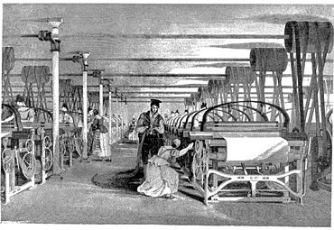
Quality Control & Assurance History
FOR INTERNAL USE ONLY
1800 AD – 1900 AD
Industrial Revolution
Brought great benefits mass manufacturing
Quality was maintained by Master Engineers with great skill and learning
You increased quality by poaching these great masters
https://en.wikipedia.org/wiki/Industrial_Revolution
Information classiﬁcation: Public

Slide 6

Quality Control & Assurance History
FOR INTERNAL USE ONLY
1920 AD
Henry Fords Mass Production
Production was broken into small parts
Part Production is heavily optimised and de-master skilled
Final Product is combination of parts
Final Product checked by Quality Control
https://en.wikipedia.org/wiki/Mass_production
Information classiﬁcation: Public

Slide 7
Quality Control & Assurance History
FOR INTERNAL USE ONLY
1940-1970s AD
Toyota Production System
Worked like Henry’s Mass Production but with…
Sociology processes introduced to improve Team communication
Continuous Improvement introduced into Processes * based on learnings from previous run’s errors
Part Production checked and processes improved by Quality Assurance
This was adapted to software as the LEAN process in the 80s
https://en.wikipedia.org/wiki/Toyota_Production_System
Information classiﬁcation: Public

Slide 8
Quality Control & Assurance History
FOR INTERNAL USE ONLY
QC and QA
1800 AD – 1900 AD
Industrial Revolution
introduced Mass Production
1920 AD
Henry Fords Mass Production
introduced QC and Division of labour
1940-1970s AD
Toyota Production System
introduced QA and Continuous improvement
Information classiﬁcation: Public

Slide 9
Quality Control vs Quality Assurance
FOR INTERNAL USE ONLY
Quality Control
- Checking the final product is right
Quality Assurance
- Preventing mistakes and avoiding problems
https://en.wikipedia.org/wiki/Quality_assurance
https://en.wikipedia.org/wiki/Quality_control
https://en.wikipedia.org/wiki/QA/QC
Information classiﬁcation: Public

Slide 10
Automated Quality Control
FOR INTERNAL USE ONLY
Automated Quality Control used in our Software
- integration tests
* on Release code in Test / Prod Environments
smoke tests
pre-commit hooks (to ensure running)
- Continuous integration * to ensure qa environment regularly updated
Information classiﬁcation: Public

Slide 11
Manual Quality Control
FOR INTERNAL USE ONLY
Manual Quality Control used in our Software
- hand testing new features
* on Release code in Test / Prod Environments
- hand testing regression checking
* on Release code in Test / Prod Environments
- hand testing by business on Environments
Information classiﬁcation: Public

Slide 12
Automated Quality Assurance
FOR INTERNAL USE ONLY
Automated Quality Assurance used in our Software
linting styling tests
unit tests
- integration tests
* on Dev Environments
pre-commit hooks (to ensure running)
continuous integration
* to ensure qa/dev environment regularly updated
Information classiﬁcation: Public

Slide 13
Manual Quality Assurance
FOR INTERNAL USE ONLY
Manual Quality Assurance used in our Software
hand testing new features
merge requests + code review
- Running a continuous improvement development methodology
* aka Scrum in our case
- … pair programming
Information classiﬁcation: Public

Slide 14
Pair Programming Styles
FOR INTERNAL USE ONLY
Styles
- Driver and Navigator
- Ping Pong
- Strong-Style Pairing
- (2+ pairing) Swarming, whole team based pairing
- (1 to many KT) "Show and Tell" team, team based knowledge sharing
Information classiﬁcation: Public

Slide 15
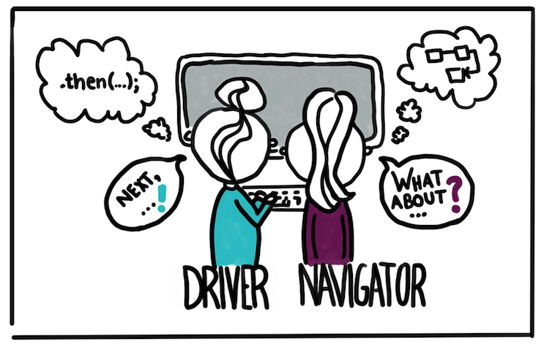
Pair Programming: Driver and Navigator
FOR INTERNAL USE ONLY
https://martinfowler.com/articles/on-pair-programming.html#DriverAndNavigator
Information classiﬁcation: Public

Slide 16
Pair Programming: Driver and Navigator
FOR INTERNAL USE ONLY
These classic pair programming role definitions can be applied in some way or other to many of the approaches to pairing.
The Driver is the person at the wheel, i.e. the keyboard. She is focussed on completing the tiny goal at hand, ignoring larger issues for the moment. A driver should always talk through what she is doing while doing it.
The Navigator is in the observer position, while the driver is typing. She reviews the code on-the-go, gives directions and shares thoughts. The navigator also has an eye on the larger issues, bugs, and makes notes of potential next steps or obstacles.
Information classiﬁcation: Public

Slide 17
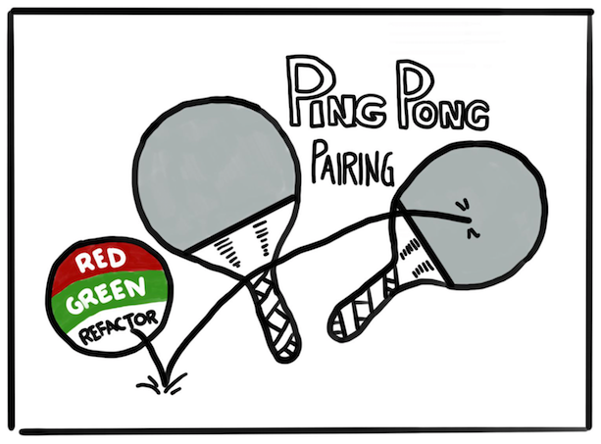
Pair Programming: Ping Pong
FOR INTERNAL USE ONLY
https://martinfowler.com/articles/on-pair-programming.html#PingPong
Information classiﬁcation: Public

Slide 18
Pair Programming: Ping Pong
FOR INTERNAL USE ONLY
This technique embraces Test-Driven Development (TDD) and is perfect when you have a clearly defined task that can be implemented in a test-driven way.
"Ping": Developer A writes a failing test
"Pong": Developer B writes the implementation to make it pass.
Developer B then starts the next "Ping", i.e. the next failing test.
Each "Pong" can also be followed by refactoring the code together, before you move on to the next failing test. This way you follow the "Red - Green - Refactor" approach: Write a failing test (red), make it pass with the minimum necessary means (green), and then refactor.
Information classiﬁcation: Public

Slide 19
Pair Programming: Style-Style Pairing
FOR INTERNAL USE ONLY
This is a technique particularly useful for knowledge transfer.
The rule: "For an idea to go from your head into the computer it MUST go through someone else's hands". In this style, the navigator is usually the person much more experienced with the setup or task at hand, while the driver is a novice (with the language, the tool, the codebase, ...). The experienced person mostly stays in the navigator role and guides the novice.
An important aspect of this is the idea that the driver totally trusts the navigator and should be "comfortable with incomplete understanding". Questions of "why", and challenges to the solution should be discussed after the implementation session. In a setting where one person is a total novice, this can make the pairing much more effective.
https://martinfowler.com/articles/on-pair-programming.html#Strong-stylePairing
Information classiﬁcation: Public

Slide 20
2+ Programming: Swarming
FOR INTERNAL USE ONLY
Advanced Technique for large project, often used in emergencies to get a whole team onto a critical problem.
Multi programmers working on the same problems to get multiple view points.
https://medium.com/agile-outside-the-box/swarming-a-team-based-approach-to-getting-work-done-1434243f38b8
Information classiﬁcation: Public

Slide 21
1 to Many KT: Show and Tell
FOR INTERNAL USE ONLY
A related technique of quality assurance is “Show and Tell”.
Often done as part of a sprint cycle, this allows the whole team to learn about new work or existing sub systems
https://medium.com/@markdalgarno/the-show-and-tell-what-its-for-and-how-to-do-it-right-32c2c7b3708b
Information classiﬁcation: Public

Slide 22
Pair Programming Styles Overview
FOR INTERNAL USE ONLY
Driver and Navigator Classical non TDD pair programming, requires good communication
Ping Pong Classic TDD pair programming, requires good specification
Strong-Style Pairing
KT pair programming, good for knowledge sharing / new starters
(2+ pairing) Swarming Good for emergencies or large problems, should only be used rarely
(1 to many KT) "Show and Tell" team Excellent for team based knowledge sharing
Information classiﬁcation: Public

Slide 23
Common Pairing Practises
FOR INTERNAL USE ONLY
- (pre-coding practise) Pair Development
- (practise) Pair Rotation
Information classiﬁcation: Public

Slide 24
Pair Development
FOR INTERNAL USE ONLY
When pairing and working on projects where the specifications are not perfect or need work.
Often pairers will pair together before starting work to plan, shape and harden the specification, technical solution, and criteria of the ticket.
More common in teams without dedicated business analysists or developers in test.
This practise can be done in isolation or as part of pair programming (aka pairs of developers can shape up tickets for individuals to work on)
https://martinfowler.com/articles/on-pair-programming.html#PairDevelopment
Information classiﬁcation: Public

Slide 25
Pair Rotation
FOR INTERNAL USE ONLY
WARNING: rotations less than 1-2 days can result in poor team performance!
Another practise for large tickets of work, is for developers to be swapped out to improve the knowledge transfer.
Advanced technique done by large teams.
Benefits:
improves code ownership
Good for knowledge sharing
Costs:
Decreased development efficiency
Increased developer disruption and context switching
https://martinfowler.com/articles/on-pair-programming.html#PairRotations
Information classiﬁcation: Public

Slide 26
Common Pairing Practises Overview
FOR INTERNAL USE ONLY
(pre-coding practise) Pair Development Useful for improvement specifications * especially useful for ping-pong style pairing with poor specifications
(practise) Pair Rotation Useful for increasing knowledge transfer, if over-used can dramatically reduce team productivity
Information classiﬁcation: Public

Slide 27
Pairing Gotchas
FOR INTERNAL USE ONLY
Time management
Plan the Day
Physical Setup
Things to Avoid
Information classiﬁcation: Public

Slide 28
Pairing Gotchas: Time management
FOR INTERNAL USE ONLY
Pairing is very tiring and intensive, it’s easy for pairs to get overwhelmed by tasks or each other!
- Plan work into 25 mins small chunks
Only work in 25 minute bursts on a single chunk
Make sure you take coffee breaks between burst !
These steps should reduce tension between pairers and make the work easier for both.
https://martinfowler.com/articles/on-pair-programming.html#TimeManagement
Information classiﬁcation: Public

Slide 29
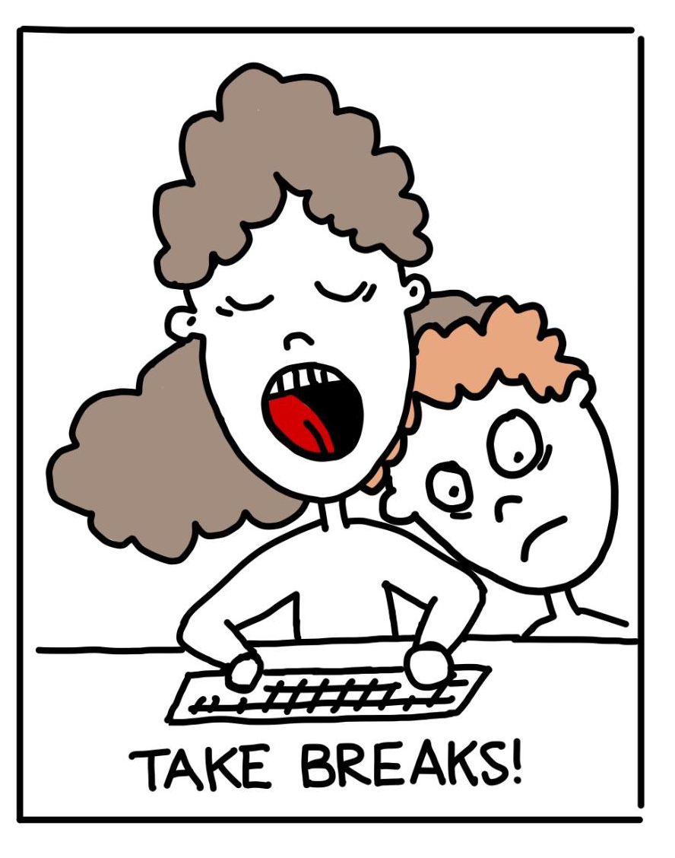
Pairing Gotchas: Time management
FOR INTERNAL USE ONLY
https://martinfowler.com/articles/on-pair-programming.html#TimeManagement
Information classiﬁcation: Public

Slide 30
Pairing Gotchas: Plan the Day
FOR INTERNAL USE ONLY
Pairers need to be working together
Common solutions:
working the same hours * some teams dictate team core coding hours where no meetings can take place
Individual pairer meetings and disruptions should be avoided
Make sure everyones aware of each other’s holidays
https://martinfowler.com/articles/on-pair-programming.html#PlanTheDay
Information classiﬁcation: Public

Slide 31
Pairing Gotchas: Physical Setup
FOR INTERNAL USE ONLY
Best way to pair is co-located, however remote is possible…
Basic rules
Respect each others space
Keep in constant contact while pairing * in-person / skype / zoom etc
Be respectful of each other ( don’t be afraid to apologises and accepting of said apology ) * inter-personal conflicts are easy to happen when working so closely, especially when working remotely
https://martinfowler.com/articles/on-pair-programming.html#PhysicalSetup
https://martinfowler.com/articles/on-pair-programming.html#RemotePairing
Information classiﬁcation: Public

Slide 32
Pairing Gotchas: Physical Setup Cont..
FOR INTERNAL USE ONLY
If you ever get annoyed at your pair, always count to 10
and read the agile prime directive
“Regardless of what we discover,
we understand and truly believe that everyone did the best job they could,
given what they knew at the time,
their skills and abilities,
the resources available,
and the situation at hand.”
REMOVED LINK
Information classiﬁcation: Public

Slide 33
Pairing Gotchas: Things to Avoid
FOR INTERNAL USE ONLY
Some pitfalls to avoid:
Drifting apart * keep good comms
Micro-Management Mode
Impatience
Keyboard / Navigator Hogging
Full time pairing * don’t pair all 8 hours of the day or you’ll go mad !
https://martinfowler.com/articles/on-pair-programming.html#ThingsToAvoid
Information classiﬁcation: Public

Slide 34
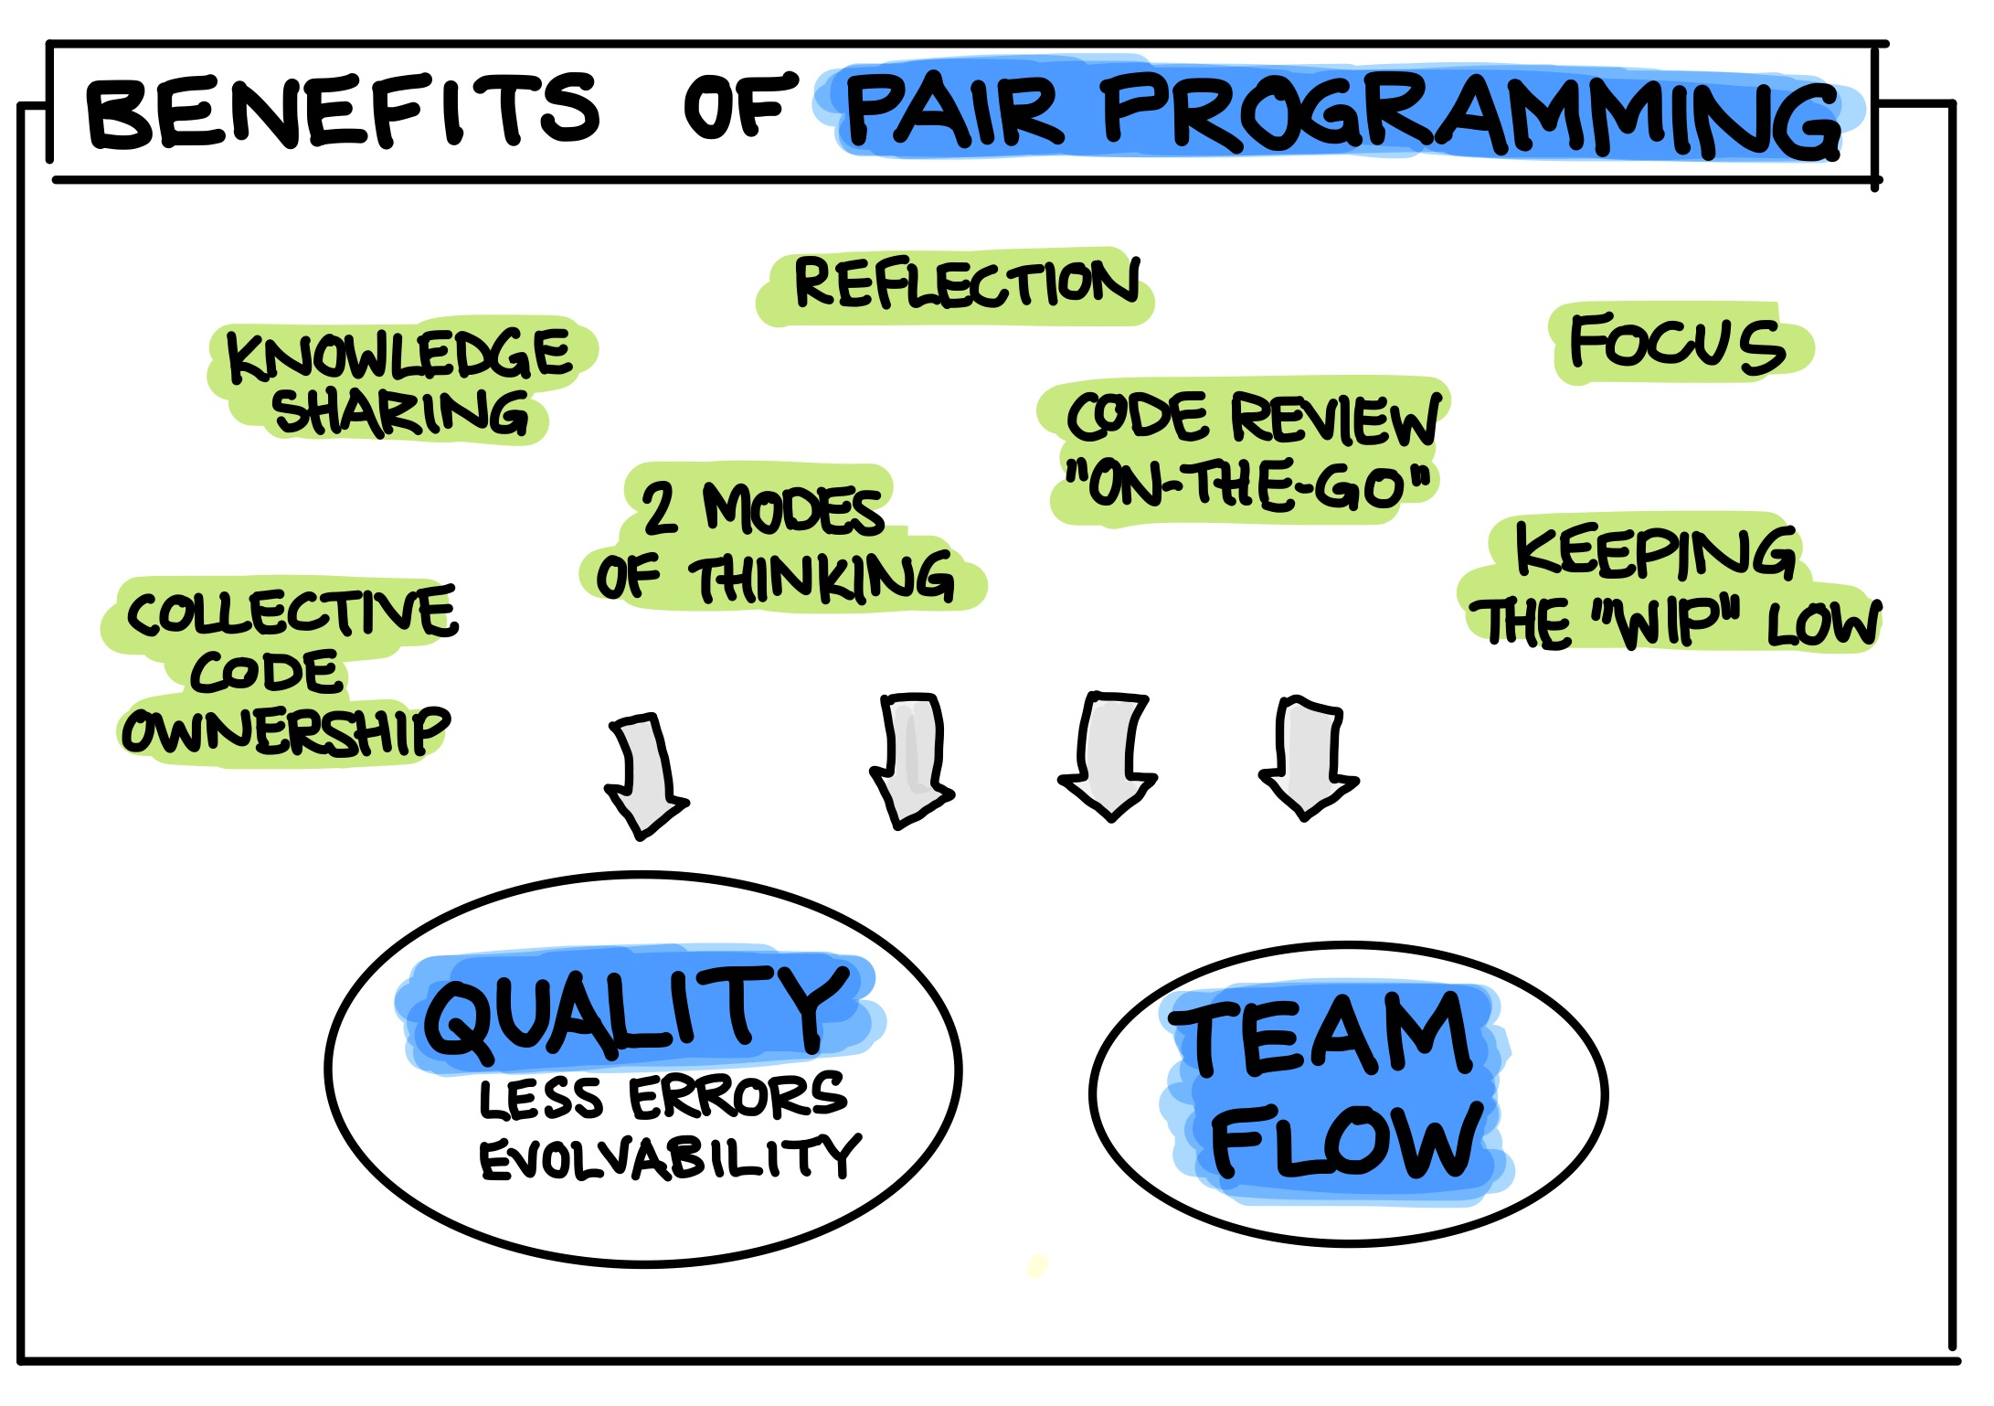
Pairing Benefits
FOR INTERNAL USE ONLY
https://martinfowler.com/articles/on-pair-programming.html#Benefits
Information classiﬁcation: Public

Slide 35
Common Pairing Challenges
FOR INTERNAL USE ONLY
- Pairing can be exhausting
- Intense collaboration can be hard
- Interruptions by meetings
- Different skill levels
- Power Dynamics / Personality clashes
- Pairing with lots of Unknowns
- No time for yourself
- Rotations lead to context switching
- Pairing requires vulnerability
https://martinfowler.com/articles/on-pair-programming.html#Challenges
Information classiﬁcation: Public

Slide 36
Questions ?
FOR INTERNAL USE ONLY
I’ve been Anthony M^{c}Kale “Wizard without Portfolio” Fixer-Upper of Broken things, and creator of time-constrained workable Fudges for 15 years. Email : anthony@zapper.hodgers.com
Information classiﬁcation: Public

Slide 37
FOR INTERNAL USE ONLY
Thank you
Information classiﬁcation: Public

