Slide 1


Friday Training Hour
“Python 101”
+ Best Practices
Anthony McKale Principal Engineer
16/04/2021

Slide 2
Python 101
Today we’ll cover :
History, versions, and local install
Basic Language Constructs
Tooling: Code styling, Testing, and IDEs

Slide 3
PYTHON HISTORY

Slide 4
Python 101 : What is Python?
“Python is an interpreted, high-level, general-purpose programming language. (…)” “Python’s design philosophy emphasises code readability with its notable use of significant whitespace. (…)” “(designed for) writing clear, logical code for small and large-scales projects.”
Wikipedia:
https://en.wikipedia.org/wiki/Python_(programming_language)

Slide 5
Python 101: History
Born in the late 80’s by a chap called “Guido”
Named after Monty Python’s Flying Circus
Python 2.0 came out in the 2000 marks the modern version of the programming language aka garbage collection, character set support, etc
Python 3.0 came out in 2008 modern version of the programming language aka typing, better modules / classes, string interpolate, etc
Strange high level language, that been be compiled for low level performance

Slide 6
Python 101: Adoption
Adopted as main shell language for Apple
Adopted as the language of choice by Data Scientists
Adopted around the world as “hardcode” heavy lifting language for CPU bound applications …rust slowly taking over though
Adopted as scripting language for many embedded devices

Slide 7
PYTHON VERSIONS

Slide 8
Versions: Python-Versions...
When getting into python it isn’t long before you run into python’s different versions…
Python 2 != Python 3
Python 3.2 != Python 3.8

Slide 9
Versions: Python 2 /Python 3 a comparison
PYTHON 2
Legacy – still entrenched in lots of old software
Library – many old libraries are not forwards compatible
ASCII – Strings are stored as ASCII by default
5/2 = 2 – Integer calculations are rounded down
Print “hello world” – print in python 2 style
PYTHON 3
Future – It is slowly but surely taking over
Library-most new libraries are not developed with backwards compatibility using tech only in python 3.
Unicode – Strings are in Unicode by default
5/2 = 2.5-The expression will return the expected result
Print (“Hello World”)
For more info
https://dev.azure.com/riversafe/DevSecOps/_wiki/wikis/DevSecOps.wiki/187/Python-Best-Practice
https://docs.python.org/2/whatsnew/
https://docs.python.org/3/whatsnew/
https://docs.python.org/3/whatsnew/3.8.html

Slide 10
Versions: Overview
Use PYTHON 3 for all new projects
simples ☺
PYTHON 2 is dead move these to python 3 ASAP

Slide 11
LOCAL INSTALL
GUIDE

Slide 12
Follow Wiki Guide
Python
https://www.python.org/downloads/
Riversafe@DESKTOP-GPVF0RR MINGW64 /
$ pip --version pip 20.2.3 from c:\dev\bin\python39\lib\site-packages\pip (python 3.9)
Riversafe@DESKTOP-GPVF0RR MINGW64 /
$ python --version Python 3.9.2
https://dev.azure.com/riversafe/DevSecOps/_wiki/wikis/DevSecOps.wiki/195/New-Starter-Guide

Slide 13
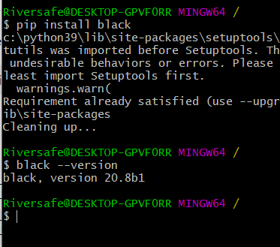
Dependency Installation: Pip Modules
pretty much every language has a package manager and python is no exception, it’s called PIP
It’s just like npm or maven but for python
You get it for free with the python install
Use like so:
pip install xxx # simple dependency
pip install -r xxx.txt # multiple dependencies
More details
https://packaging.python.org/tutorials/installing-packages/

Slide 14
Python Install / History: Questions
5 mins breather, questions ?

Slide 15
Python Primer: 101

Slide 16
Python Primer: JS (Node) vs Python
Python | Node
Python is a scripting language Deployable as driver, desktop and web applications. ( Even your BT set top box or router) | JS primarily a web programming language Deployable via browser, or as server application side via Node JS
Python has a comprehensive standard library (like Java) | JS has a very limited set of utility objects.
Python uses a true class based inheritance model | Node has a limited by functionality class based inheritance model (missing abstract / interfaces… cough cough)
Strings in python are immutable | So are strings in JS

Slide 17

Python Primer: Hello World
Easy right ?

Slide 18
Python Primer: 101
Now deeper…
Primitives
Functions

Slide 19
Python Primitives

Slide 20
Python Primer: Primitives
Now will go over some of those built in data types spoken about previously
Booleans
Numbers
Strings
Collections
Read stdtype docs for more info
See https://docs.python.org/3/library/stdtypes.html

Slide 21

Python Primer: Boolean Primitives
Boolean = bool
Treat None like “undefined” in Node
See https://docs.python.org/3/library/stdtypes.html

Slide 22
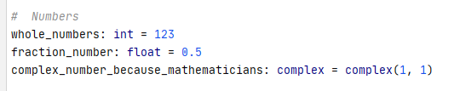

Python Primer: Number Primitives
Number
Int and floats are very different so be careful
Also remember like Node, Python can’t count
See https://docs.python.org/3/library/stdtypes.html

Slide 23
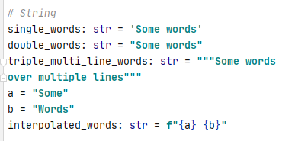
Python Primer: String Primitives
String
See https://docs.python.org/3/library/stdtypes.html

Slide 24
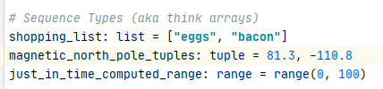
Python Collection: Sequence Primitives
Sequences
Remember Tuples great for generics and putting into lists
Remember ranges are super efficient (and are just in time calc-ed and created)
See https://docs.python.org/3/library/stdtypes.html

Slide 25
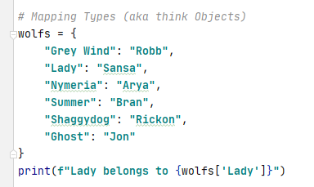
Python Collection: Mapping Primitives
Dict == Dictionary
Remember you need to access via angle brackets dict[“KEY_NAME”]
See https://docs.python.org/3/library/stdtypes.html

Slide 26
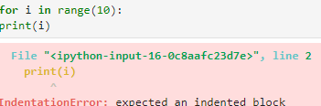
Python Primer: Important Notes
Unlike Arrays and Object in Javascript….
{} – They call this dictionary not an object
[] – And this is a List not an array
Whitespace is really important
Though as I will mention later you should have a linter running on save so you never have to worry about this

Slide 27
Python Primer: Primitives Overview
It’s close enough to other languages, to be easy to pickup
It’s close enough to other languages, to make silly mistakes
So be careful ☺

Slide 28
Python Functions

Slide 29
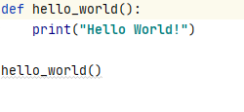
Python Primer: Function
Easy right ?
Watch out, always use snake_case not camelCase

Slide 30
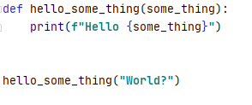
Python Primer: Function Parameters
Parameters should be snake_case too
Ps: For strings you can also do interpolation using f“{xxx}”

Slide 31
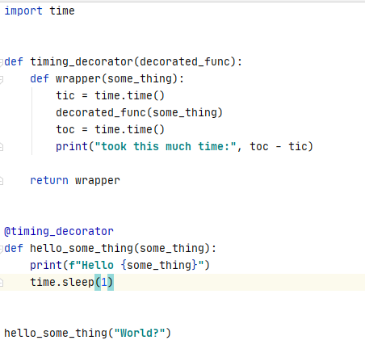
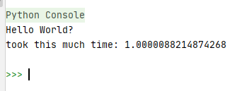
Python Primer: Function Decoration
You can wrap functions easily with decorators
(called annotations in other languages)
.

Slide 32
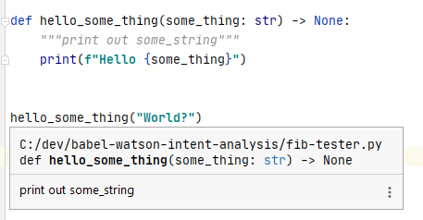
Python Primer: Function DocString
For documenting your code
“““documentation”””
Use typing as well to improve your self documenting code
Ps https://www.python.org/dev/peps/pep-0257/ for more info

Slide 33
Python Primer: Questions
5 mins breather, questions ?

Slide 34
Python Tooling

Slide 35
Python Tooling
What’s the difference between a “Python Developer” and a “Python Software Engineer” …

Slide 36
Python Tooling
What’s the difference between a “Python Developer” and a “Python Software Engineer”
Good Tooling

Slide 37
Python Tooling
Tooling:
Code Style Tooling
Code Testing Tooling
Code Writing Tooling

Slide 38
Code
Styling

Slide 39
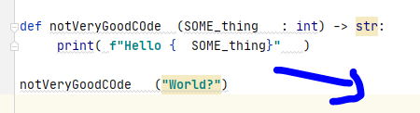
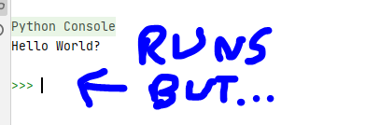
Python Primer: Detect Code Styling
Use pylint or similar for all code so your code follows python’s commonly agreed styling
Install with pip
pip install pylint
Ps https://www.python.org/dev/peps/pep-0008/ for more info be sure to read allegory “A Foolish Consistency is the Hobgoblin of Little Minds”

Slide 40
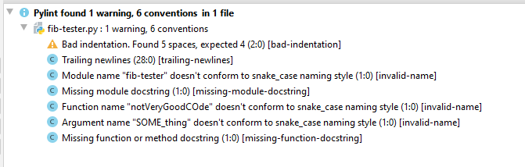
Python Primer: Detect Code Styling
Run pylint to find your errors
Ps https://www.python.org/dev/peps/pep-0008/ for more info be sure to read allegory “A Foolish Consistency is the Hobgoblin of Little Minds”

Slide 41
Python Primer: Detect Code Styling
Other solutions exist
Big fan of flake8 for example
https://flake8.pycqa.org/en/latest/
.

Slide 42
Python Primer: Auto fix Code Styling
Use black or similar for all code to fix said mistakes in your code
Install with pip
pip install black
black *.py
https://pypi.org/project/black/

Slide 43
Code
Testing

Slide 44
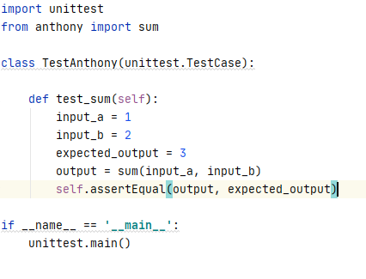
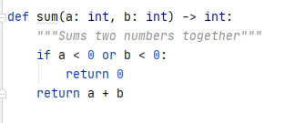
Python Primer: Code Testing
For use pytest or unittest for all code
Ps https://docs.python.org/3/library/unittest.html for more info

Slide 45
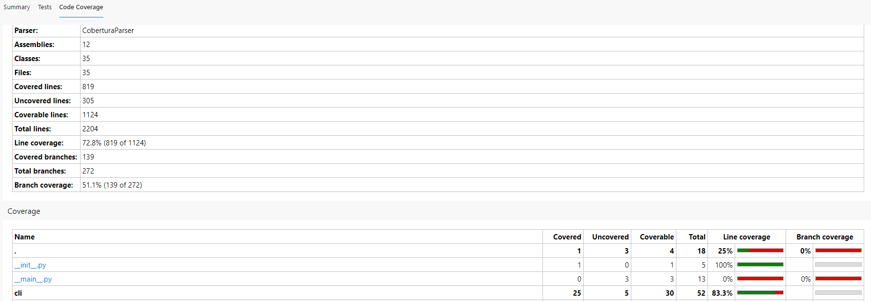
Python Primer: Coverage
With a few arguments you can get code coverage from pytest , aim for 80% coverage

Slide 46
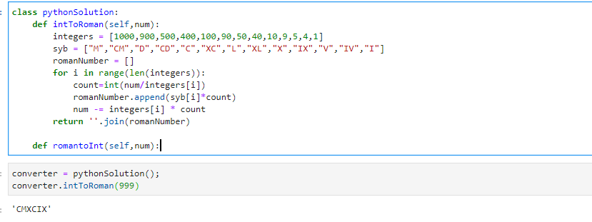
Python Primer: Sample App
Roman Numerals converter
.
Bonus points: can anyone say what’s wrong style wise with this code

Slide 47
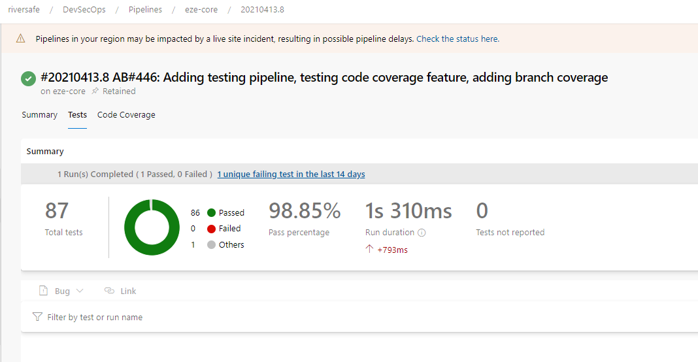
Python Primer: Code Testing
Integrate unit and coverage report files into your ci pipeline
Example:
https://dev.azure.com/riversafe/DevSecOps/_build/results?buildId=137

Slide 48
Code
Writing

Slide 49
Python Primer: Code Testing
Remember I mentioned linting on save? Running tests inline ?
Don’t be a hero programmer, use a IDE
This WILL speed up your development compared to notepad++ or eMacs
Visual Studio has excellent python support
VSScode can be downloaded from https://code.visualstudio.com/

Slide 50
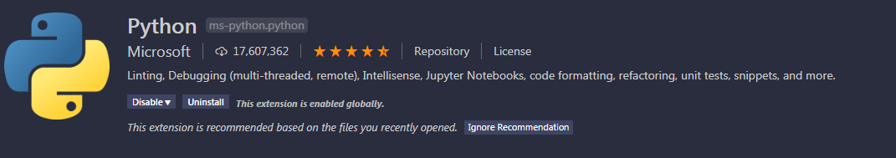
Python: VS Code
To get started with python install the above package
note it includes out of the box
unit test support
Linting support
debugging support

Slide 51

Python: Multiple Environments
As mentioned previously sometimes you need multiple python versions or to isolate packages from each other
Python environment are a advanced topic by VS Code makes it easy: Note this button at the bottom of vscode
Clicking this allows you to choose you python environment within VS code
Manually can be done via venv https://docs.python.org/3/tutorial/venv.html or
pyenv https://realpython.com/intro-to-pyenv/

Slide 52
Python Tooling: Questions
Cliffnotes:
Use Tooling to do your linting and Testing
Use a IDE* to control your tooling
* VSCode* is vastly better than writing in a raw editor like notepad or eclipse…
* Footnote Disclaimer other good IDEs exist than VSCode (cough cough … pycharm, cough cough … IntelliJ)

Slide 53
Further
Reading

Slide 54
Further Python Training:
Luckily we’re drowning in further resources here’s some further reading

Slide 55
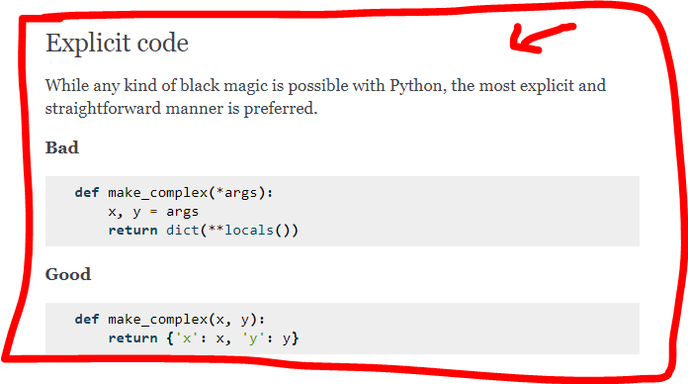
Further Python Training: Styling
Excellent guide on PEP-008 aka how to write “Python” style code
https://docs.python-guide.org/writing/style/
also
https://pep8.org/
https://www.python.org/dev/peps/pep-0008/

Slide 56
Further Python Training: External
Tutorials by Google, as recommended by the python community
Sorting
https://developers.google.com/edu/python/sorting
Dicts and Files
https://developers.google.com/edu/python/dict-files
Regular Expressions (which are always useful, even to non Perl chaps)
https://developers.google.com/edu/python/regular-expressions
Utilities
https://developers.google.com/edu/python/utilities

Slide 57
Further Python Training: External
Free Tutorials by Kaggle, as recommended by the data science community
Kaggle Challenge | Content
5 Day Challenge on Data Visualisation, Chi-Sq & T-test | Are you new to Data Science or need a quick refresher? This five day challenge will give you the guidance and support you need to kick-start your data science journey.
7 Day Challenge - Learn Python for first timers | This is a learn Python Challenge helping you to become familiar with the Python programming language.
5 Day Challenge - Data Cleansing | This challenge will help you handle missing values, scaling & normalisation, parsing dates, character encoding and manage inconsistent data entry.

Slide 58
Questions
I’ve been Anthony M^{c}Kale “Wizard without Portfolio” Fixer-Upper of Broken things, and creator of time-constrained workable Fudges for 15 years. Email : anthony@zapper.hodgers.com

Slide 59
Thank
you

