Slide 1


Friday Training Hour
“AWS 101”
Anthony McKale Principal Engineer
11/06/2021

Slide 2
AWS 101 Basics
Today we’ll cover :
Provisioning Access
IAM user setup
Common Resources Available
It’ll aim to give you the knowledge to gain a account, provision resources, and start developing in AWS

Slide 3
AWS Intro

Slide 4

AWS
AWS launched in 2002
Biggest Cloud provider in the world
Revenue $46 Billion a year
Provides computing services in regions around the world
https://en.wikipedia.org/wiki/Amazon_Web_Services

Slide 5
RiverSafe AWS Access Provisioning

Slide 6
AWS 101: Access Provisioning
Honesty Box Time

Slide 7
AWS 101: Access Provisioning
Honesty Box Time
Our internal AWS capability is new and hot off the press

Slide 8
AWS 101: Access Provisioning
Honesty Box Time
Our internal AWS capability is new and hot off the press
We have actions to mature our setup and onboarding processes

Slide 9
AWS 101: Access Provisioning TODOS
What I’m saying is … TODOs:
1) Finish defining onboarding process
https://dev.azure.com/riversafe/Knowledge%20Base/_wiki/wikis/Knowledge-Base.wiki/276/AWS
2) Creation of standard developer usergroup with well defined policies
(WIP) https://dev.azure.com/riversafe/DevSecOps/_workitems/edit/511/ "A_RiverSafeDeveloperAccess"
3) Define best practices
Aka : prefixes “A_RiverSafe_” or “RS_” ?
Aka : tagging policy
https://dev.azure.com/riversafe/Knowledge%20Base/_wiki/wikis/Knowledge-Base.wiki/241/Best-Practice

Slide 10
AWS 101: Access Provisioning Current
2) Current approach
Ask Anirudh for Access with Justification
AWS app will be added to your Microsoft apps
create a IAM user for AWS (added to "A_RiverSafeDeveloperAccess")
Config apikeys and AWS cli
...
Profit
TODO: to lock down and document
https://dev.azure.com/riversafe/Knowledge%20Base/_wiki/wikis/Knowledge-Base.wiki/276/AWS

Slide 11
AWS 101: Access Provisioning
Questions ?

Slide 12
IAM user setup demo

Slide 13
AWS 101: IAM Demo
(ASSUMED TO BE DONE) Ask Anirudh for Access with Justification
AWS app will be added to your Microsoft apps
create a IAM user for AWS (added to "A_RiverSafeDeveloperAccess")
Config AWS ( and apikeys and AWS cli)

Slide 14
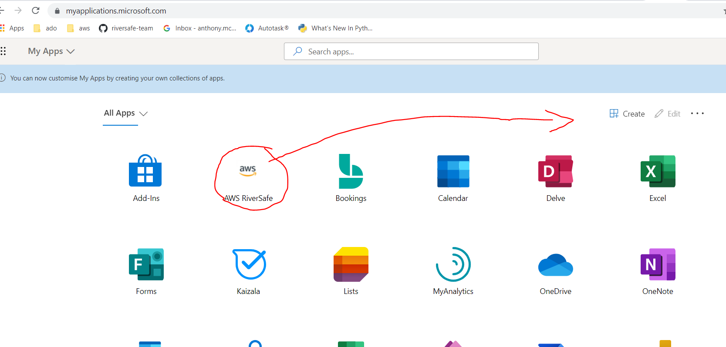
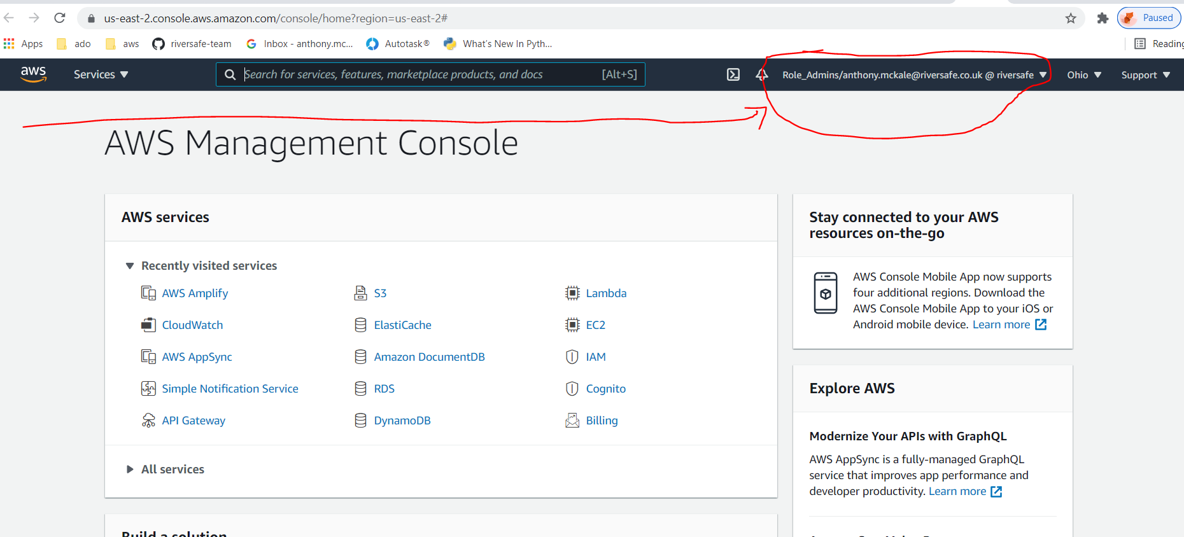
AWS 101: IAM Demo 1.
AWS app will be added to your Microsoft apps
Navigate to "AWS Riversafe" microsoft app
(by Anirudh)
https://myapplications.microsoft.com/
Click to login as federated user (via saml2 link)
.

Slide 15
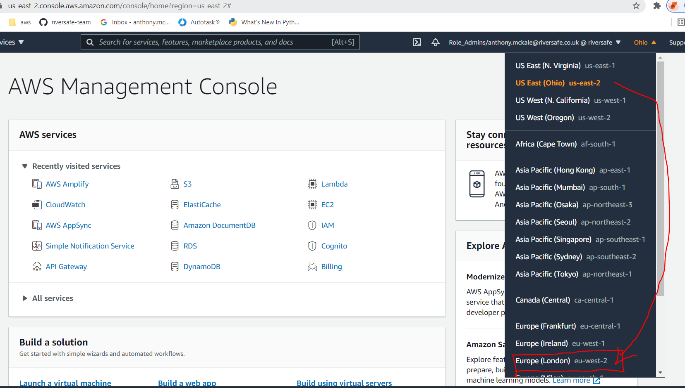
AWS 101: IAM Demo 1.
1.5) CHANGE TO “EU-WEST-2”
All services should be created in
EU-WEST-2 region

Slide 16
AWS 101: IAM Demo 2.
2) Create a IAM user for AWS (added to "A_RiverSafeDeveloperAccess")
- Navigate to aws iam console https://console.aws.amazon.com/iam/home?#/users
- Create a user with console "AWS Management Console access"
(Optional) If developer add cli access "Programmatic access“
Add to user group : A_RiverSafeDeveloperAccess
- Logout as federated User
More info:
https://docs.aws.amazon.com/IAM/latest/UserGuide/id_users_create.html

Slide 17
AWS 101: IAM Demo 3.
3) Config AWS ( and apikeys and AWS cli)
For non developer, you’re done ☺
- Sign in as new console user
https://riversafe.signin.aws.amazon.com/console

Slide 18
AWS 101: IAM Demo 3.
3) Config AWS ( and apikeys and AWS cli)
For developer, you’re started…
- Sign in as new console user
https://riversafe.signin.aws.amazon.com/console
- install aws cli https://aws.amazon.com/cli/
- test install
$ aws --version
aws-cli/2.1.29 Python/3.8.8 Windows/10 exe/AMD64 prompt/off

Slide 19
AWS 101: IAM Demo 3.
3) Config AWS ( and apikeys and AWS cli)
- get security credentials
https://console.aws.amazon.com/iam/home#/security_credentials

Slide 20
AWS 101: IAM Demo 3.
3) Config AWS ( and apikeys and AWS cli)
- Set credentials
~/.aws/credentials
[default]
aws_access_key_id=xxx
aws_secret_access_key=xxx
~/.aws/config
[default]
# Important !
# WARNING: All resources MUST be created in the eu-west-2
region=eu-west-2
output=json

Slide 21
AWS 101: IAM Demo 3.
Test credentials set correctly
$ aws sts get-caller-identity
{
"UserId": "AIDAWxxxx",
"Account": "46684xxx",
"Arn": "arn:aws:iam::46684xxx:user/amckale-developer"
}
DONE

Slide 22
AWS 101: IAM / Provisioning
Summary
- We’re still getting our AWS stack setup
- Go to Wiki for latest instructions
https://dev.azure.com/riversafe/Knowledge%20Base/_wiki/wikis/Knowledge-Base.wiki/276/AWS
- Watch this space!

Slide 23
AWS 101: IAM Demo
Questions ?

Slide 24
Common AWS Resources

Slide 25
AWS Resources
AWS’s power is the mountain of services provided
AWS has (deliberately?) branded everything different names to rest of industry
As such it’s hard when starting out to know:
What capabilities are available
Where’s the capability you’d like use

Slide 26
AWS Resources
We’ll cover some of the most common application capabilities:
IAM
Logging and Scheduling
Data Management
Running Code
Gateways and Resource Wrappers

Slide 27
AWS IAM

Slide 28
IAM: AWS IAM
IAM = Central AWS Identity Access Management
aka AWS account user management / application permission management
- For all console and cli user permissions
- For all inter-resource permissions
- Only game in town
https://aws.amazon.com/iam/
https://console.aws.amazon.com/iam/home#/users

Slide 29
IAM: AWS Cognito
Cognito = Simple application user management
aka Application user management
For application users
Handles sign-up / sign-out / registration actions
https://aws.amazon.com/cognito/
https://eu-west-2.console.aws.amazon.com/cognito/users/?region=eu-west-2

Slide 30
IAM: API Gateway
(Covered inside Gateways and Resource Wrappers)
- Handles application apikeys
https://aws.amazon.com/api-gateway/
https://eu-west-2.console.aws.amazon.com/apigateway/main/apis?region=eu-west-2

Slide 31
IAM Summary
NAME | PURPOSE
IAM | AWS user / inter-resource permission*
Cognito | Application users (integrates nicely into 3rd party SAML/SSO)
API Gateway | Application apikeys (integrates nicely into Cognito and IAM)
=
= =
* Developers will grow to love (and hate) IAM permissions there’s a lot of devil in those “inter-resource permission” details

Slide 32
AWS LOGGING

Slide 33
AWS Logging: CloudWatch
AWS’s central monitoring and observability service
aka all logs of all resources go here
Only game in town
It’s world class
Unfortunately best features/analysis are paywalled (exposed via different services)
https://aws.amazon.com/cloudwatch/
https://eu-west-2.console.aws.amazon.com/cloudwatch/home

Slide 34
AWS Logging: SNS
Simple Notification Service: application-to-application/-person communication engine
For all your notification / alert needs
Wide support of outputs (email / sms / whatsapp messages / rest api calls everything)
https://aws.amazon.com/sns/
https://eu-west-2.console.aws.amazon.com/sns/v3/home?region=eu-west-2

Slide 35
AWS Logging: SQS
Simple Queue Service: queuing service aka queuing AMQP engine
For all your queuing needs
https://aws.amazon.com/sqs/ https://eu-west-2.console.aws.amazon.com/sqs/v3/home?region=eu-west-2

Slide 36
Logging Summary
CloudWatch – monitoring dashboard for everything
SNS –engine for sending alerts / notifications
SQS – engine for queuing actions and alerts for processing

Slide 37
AWS DATA

Slide 38
AWS Data: DynamoDB
Fast and flexible NoSQL database service for any scale
aka Toy DB with 25 cap on inserts, it can handle small inserts and reads from a large DB though
storing lots of small linked things
very easy to integrate into other systems
Fast
Hard and low limits on max Read/Write sizes
https://aws.amazon.com/dynamodb/
https://eu-west-2.console.aws.amazon.com/dynamodb/home?region=eu-west-2

Slide 39
AWS Data: Aurora
MySQL and PostgreSQL-compatible relational database built for the cloud
aka Real DB haven't used in anger, but latest version promises serverless RDS so interesting
- storing linked data
- professional level of database
- fast
https://aws.amazon.com/rds/aurora/
https://eu-west-2.console.aws.amazon.com/rds/home?region=eu-west-2#

Slide 40
AWS Data: ElastiCache
fully managed Redis / Memcached service, provides very fast key - value
- storing blobs by key
- blobs can self expire
- super fast
- not meant for long term storage
https://aws.amazon.com/elasticache/
https://eu-west-2.console.aws.amazon.com/elasticache/home

Slide 41
AWS Data: documentdb
DocumentDB is a database service that is purpose-built for JSON data management at scale
aka it’s just mongoDB / couchDB / cloudant
storing searchable json
Can handle huge numbers of files / content
"slow“, power is in the indexing
https://aws.amazon.com/documentdb/
https://eu-west-2.console.aws.amazon.com/docdb/home?region=eu-west-2

Slide 42
AWS S3
long term blob storage
- storing blobs by key similar to a filesystem
- slow
- very cheap
- meant for long term storage
- can handle large file (aka TB / GB of data)
https://aws.amazon.com/s3/
https://s3.console.aws.amazon.com/s3/

Slide 43
Data Summary
Aurora LARGE* = Do not store blobs in dbs
DynamoDB FAST* = limited READ / WRITE at once (~25 inserts at a time)
NAME | PURPOSE | MAX ROW | MAX CONTENT | SPEED | CONTENT LIFE
DynamoDB | Searchable Data | MEDIUM | MEDIUM | FAST* | LONG
Aurora | Searchable Data | LARGE | LARGE* | FAST | LONG
ElastiCache | Keyed Data | HUGE | SMALL | VERY FAST | SHORT
documentdb | Searchable Documents | LARGE | HUGE | SLOW | LONG
s3 | Document Storage | HUGE | VERY HUGE | MEDIUM | ARCHIVAL

Slide 44
AWS CODE

Slide 45
AWS Code: EC2
Virtual Machine in the Cloud
Warning: can be very expensive / cloud only cheap for small fast interactions
Full Computer on Cloud
Meant for heavy loads
needs overisght before spinning up possible to create thousands of pounds of expense in just a few clicks!
https://aws.amazon.com/ec2/
https://eu-west-2.console.aws.amazon.com/ec2/home?region=eu-west-2

Slide 46
AWS Code: Lambda
"Serverless" Code in the Cloud
aka it's not serverless, it's just totally abstracted
Cheap
Fast
Very pure (as in pure code no side effects)
https://aws.amazon.com/lambda/
https://eu-west-2.console.aws.amazon.com/lambda/home?region=eu-west-2

Slide 47
AWS Code: Lightsail
Mini Virtual Server in the Cloud
Server is not for heavy load like EC2 so it much cheaper, and has all the web routing/DNS/SSH/server stuff out the box
Pre-Configured Full Server on Cloud
Not mean for heavy loads, but low loads over long period
https://aws.amazon.com/lightsail/
https://lightsail.aws.amazon.com/ls/webapp/home/instances

Slide 48
Code Summary
NAME | PURPOSE | MAX TASK SIZE | COST | TYPE
EC2 | VM on Cloud | LARGE | LARGE | VM
Lambda | Serverless Functions | MEDIUM | LOW | Serverless
Lightsail | Light weight server on Cloud | SMALL | MEDIUM | Pre-Provisioned VM

Slide 49
AWS GATEWAYS & WRAPPERS

Slide 50
AWS Gateways: API Gateway
Provides human urls, throttling, DNS and more
Easy api keys
Easy DNS
Easy Throttling
https://aws.amazon.com/api-gateway/
https://eu-west-2.console.aws.amazon.com/apigateway/main/apis?region=eu-west-2

Slide 51
AWS Gateways: AppSync
Provides GraphQL API
aka simple graphql frontend that sits on top of dynamodb to provide easy to use searching
Easy searching of DB data
Excellent Auth integration into Cognito
biggest limitation is the toy db underneath
https://aws.amazon.com/appsync/
https://eu-west-2.console.aws.amazon.com/appsync/home?region=eu-west-2

Slide 52
AWS Gateways: Amplify
Web app framework
wraps other services underneath amplify so they can be deployed as a cloud formation stack
Nice interface and cli to other services aka AppSync/Api Gateway/Lambda/Cognito etc
Bit limited compared to using tools individually
https://aws.amazon.com/amplify
https://eu-west-2.console.aws.amazon.com/amplify/home

Slide 53
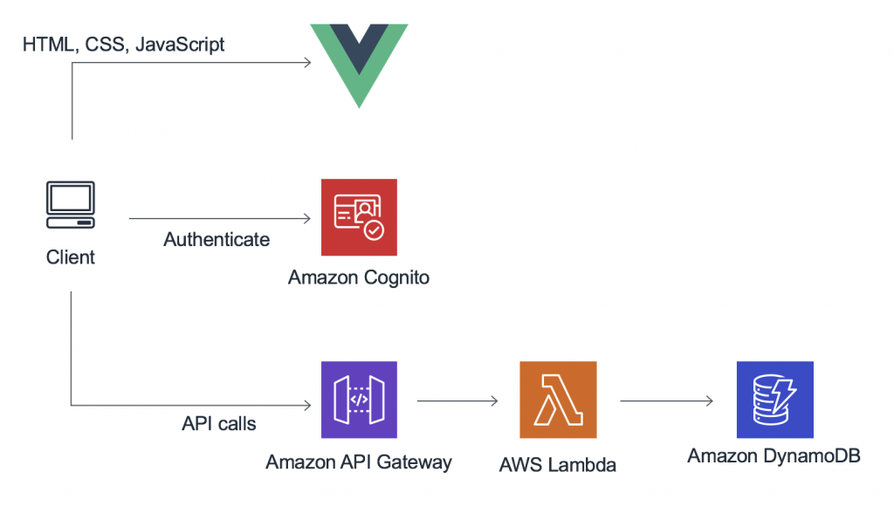
AWS Gateways: Amplify
Example of putting it all together
https://aws.amazon.com/amplify
https://eu-west-2.console.aws.amazon.com/amplify/home

Slide 54
AWS Gateways
API Gateway – for wrapping / exposing lambda and other resources behind rest api urls
AppSync – for wrapping dbs and exposing a graphql search endpoint
Amplify – for wrapping API Gateway / S3 / AppSync behind a website url

Slide 55
Further
Reading

Slide 56
Further Testing Read:
here’s some further reading
AWS docs
https://eu-west-2.console.aws.amazon.com/console/home

Slide 57
Questions
I’ve been Anthony M^{c}Kale “Wizard without Portfolio” Fixer-Upper of Broken things, and creator of time-constrained workable Fudges for 21 years. Email : anthony@zapper.hodgers.com

Slide 58
Thank
you

