Slide 1


Academy
Python Beyond Basics
Anthony McKale Principal Software Engineer

Slide 2
Python beyond the basics
Today we’ll cover :
OO Concepts
Classes
(Recap) Exceptions
It’ll aim to cover the class portions of the official python tutorial
https://docs.python.org/3/tutorial/

Slide 3
Basic OO

Slide 4
What is a OO ?
OO-programming, is a style of programming, where state variables and functions are grouped together in logical containers called classes Opposed to procedural programming, where functions stand alone not attached to state variables
Wikipedia:
https://simple.wikipedia.org/wiki/Object-oriented_programming
https://en.wikipedia.org/wiki/Procedural_programming

Slide 5
What is a Class ?
“A class is written by a programmer in a defined structure to create an object … . It defines a set of properties and methods that are common to all objects of one type.”
Wikipedia:
https://simple.wikipedia.org/wiki/Class_(programming)

Slide 6
What is a Class ?
Class is a template with fixed functions, and default variables Class Instances created* from this template * there is a constructor function called to create the default variables Class Instances use their own variables Class Instances use the template functions *normally passing themselves are a parameter (self python, this node)
Wikipedia:
https://simple.wikipedia.org/wiki/Class_(programming)

Slide 7
Concepts: inheritance and abstract
Inheritance: Classes can be nested on top of one another reason: DRY, so child Classes reuse the functions of their parents
Abstract*: Classes can be abstract, this means some functions on the template aren’t implemented yet, and child Classes are required used for defining common interfaces, aka a DBAbstract, with DBPostgres and DBMysql children
* Abstract classes not covered in academy details for interested
https://www.geeksforgeeks.org/abstract-classes-in-python/

Slide 8
OO is common in Software Engineering but pros and cons
PROS
Tends to Modular design, good for large projects
Easier for new OO-trained developers to understand
Can aid good abstraction of concerns
CONS
OO code can be slower to execute over procedural code probe: function call overhead, memory usage
it’s complex overhead, heavy for small project
When mis-used can turn into code Spaghetti
http://www.paulgraham.com/noop.html
http://doc.cat-v.org/programming/bad_properties_of_OO

Slide 9
OO is common in Software Engineering but has critics
“ the purpose of OOP is to act as a herding mechanism which keeps average programmers in average organizations from "doing too much damage". This also slows down faster, better programmers who know how to do things in a more powerful and more compact way ” Generally agree, it’s a risk/speed/reward trade-off, rather than a bad thing PS: that average programmer is you 6 months after you wrote the code, and you’re going back on the project ☺
http://www.paulgraham.com/noop.html
http://doc.cat-v.org/programming/bad_properties_of_OO

Slide 10
PYTHON CLASSES

Slide 11
What is a Class in Python ?
Constructor: __init__ called to create Class
State variables: self.xxx these are instance variables for Class
State functions: self.xxx these are instance function for Class*
Considered a anti-pattern do not do this !
Class variables: self.xxx <class>.xxx these are the global Class variables
* Available for all instances globally
Class function: self.xxx <class>.xxx these are the global Class functions
* These called normally with instance as self param, but can be called statically (globally without self)

Slide 12
self in Python Classes ?
self is magic!*
It’s three things at once: - 1) first it checks local instance for a set key self.xxx = xxx
2) checks Class template for a set key
3) checks all parent class templates for a set key
* warning: this explanation is a not how it’s actually done under bonnet, just how it works! See magic explainer later in presentation

Slide 13
Python : Basic Class Parts
Constructor (initial function that setups up class __init__)
Variables
Functions

Slide 14
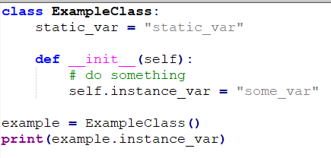
Python Class: Constructor
initial function that setups up class __init__
See self this links to instance

Slide 15
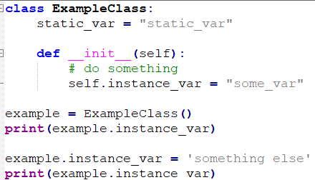
Python Class: Variables
See self this links to instance
as does class instantiation <Class>()
also class variables don’t need []

Slide 16
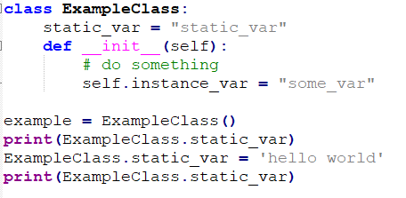
Python Class: Static Variables
You can store global variables on the
Class Template
also class variables don’t need []

Slide 17
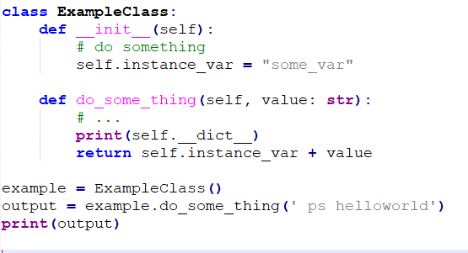
Python Class: Functions
See self this links to instance
Class template defines Function
self lets you access the instance

Slide 18
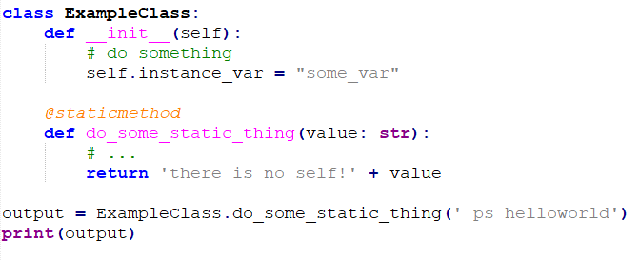
Python Class: Static Functions
Class template defines Function
without self
@staticmethod annotation decorator makes class static

Slide 19
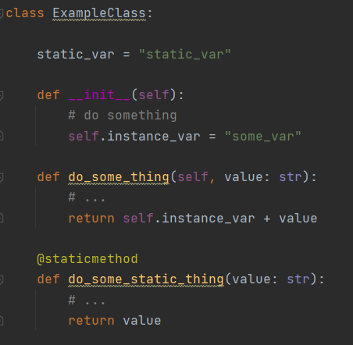
Python : Basic Class Parts
Constructor
Variables
Functions
Static Variables
Static Functions

Slide 20
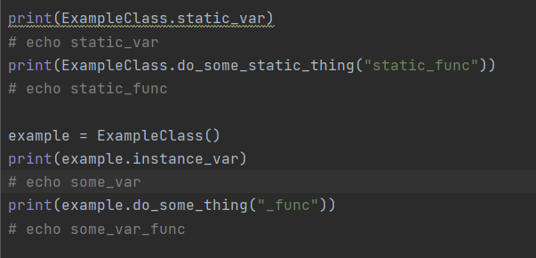
Python : Basic Class Parts

Slide 21
Python : Class Questions ?
Questions ?
Onto inheritance

Slide 22
PYTHON CLASS
INHERITANCE

Slide 23
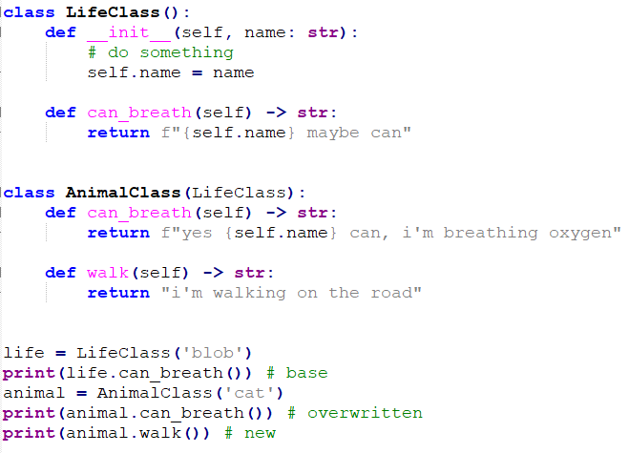
Python : Nested Classes Why ?
As discussed Python can nest / extend classes The last parent is called a base class
Children of that parent are called child classes
Children can overwrite functions
Children can overwrite constructors
Have own static variables
https://python.swaroopch.com/oop.html
https://docs.python.org/3/tutorial/classes.html#inheritance

Slide 24
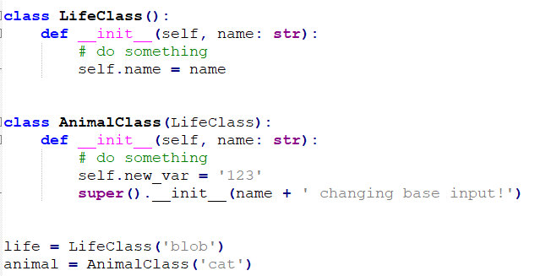
Python : Nested Classes Create
Creating Child Class
Use super().xxx to reach parent class functions * useful when overwritten so self doesn’t work
https://python.swaroopch.com/oop.html
https://docs.python.org/3/tutorial/classes.html#inheritance

Slide 25
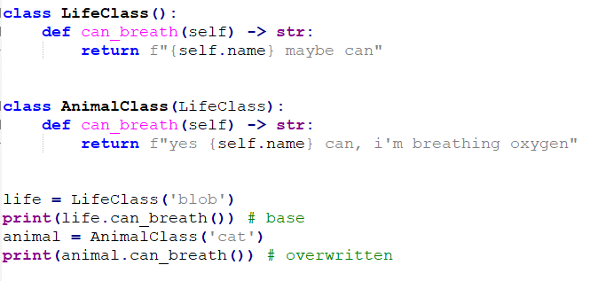
Python : Nested Classes Overwrite
Overwrite parent Class function
Use super().xxx to reach parent
class functions
https://python.swaroopch.com/oop.html
https://docs.python.org/3/tutorial/classes.html#inheritance

Slide 26
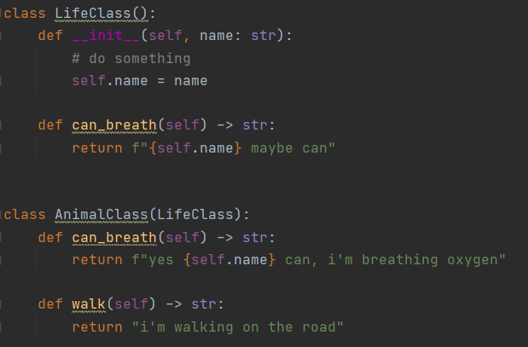
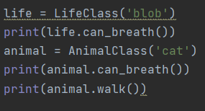
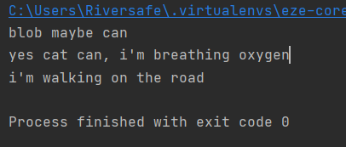
Python : Life / Animal Terrible Example
We have two classes, Life and it’s child Animal Life can maybe breath, Animal’s can definitely breath and they can walk

Slide 27
Python : Class Inheritance Questions ?
Questions ?
Onto Misc Class stuff

Slide 28
PYTHON EXTRA CLASS STUFF

Slide 29
Python : Extra Class Stuff
- Private variables
AND
- Magic variables

Slide 30
Python : Private Stuff
Sometimes you want functions and variables to be accessible only by the class it’s self This is done via a double underscore prefix “__”
Aka __mr_private_var or __mr_private_func
https://docs.python.org/3/tutorial/classes.html#private-variables

Slide 31
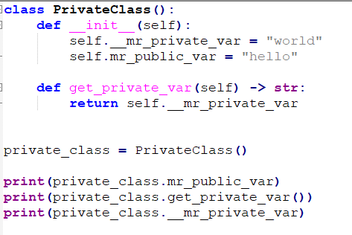
Python : Private Stuff
prefix “__”
Link:
https://docs.python.org/3/tutorial/classes.html#private-variables

Slide 32
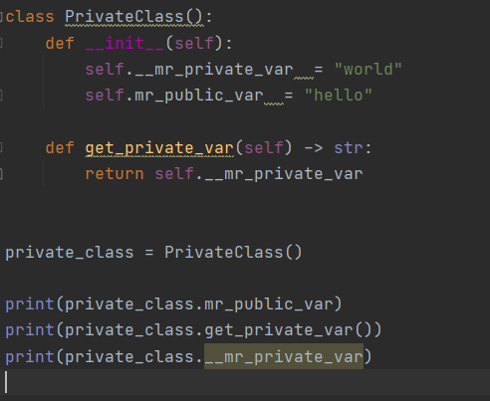
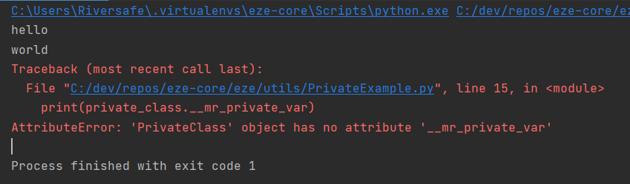
Python : Private Example

Slide 33
Python : Magic setter and getters
Wouldn’t it be great if I could call any function or variable, and get a reply? This is called magic setters and getters
Done via __get__ /__set__ / __getattr__ / __setattr__ and __delete__ (also __dict__ but that’s for another day)
https://docs.python.org/3/whatsnew/2.2.html#descriptors function level detail here...
https://python-reference.readthedocs.io/en/latest/docs/dunderattr/getattr.html

Slide 34
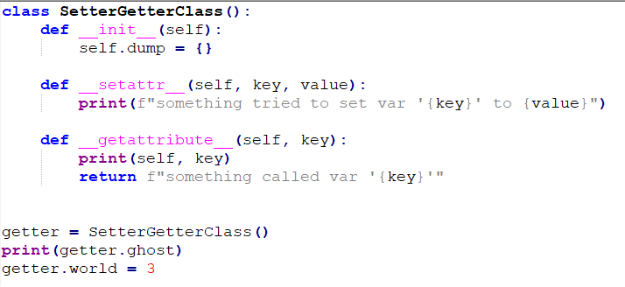
Python : Private Stuff
See magic “__setattr__”
for setting fake variables See magic “__getattribute__”
for setting fake variables
And these can return functions
as well ☺
Link:
https://docs.python.org/3/tutorial/classes.html#private-variables

Slide 35
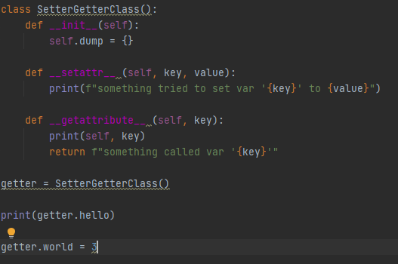
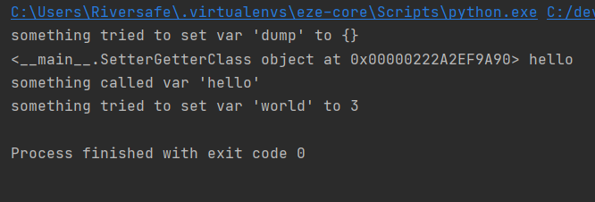
Python : Magic SG Example
. Ps excessive Getting and Setting is considered poor practice and is typically done by tooling code

Slide 36
Python : Magic setter and getters
DO NOT USE MAGIC WHEN CODING
IT CAUSES PAIN AND SUFFERING
Unless you have a “really” good reason ☺

Slide 37
PYTHON EXCEPTIONS
(Recap)

Slide 38
Python : Exception (tip-toe)
What do you do when a program crashes with a Exception ?
Can you carry on ? Or do you live with crashes ?
You Try to Catch the Exception obviously ☺

Slide 39
Python : Exception (tip-toe)
Welcome to Exception Catching
Aka the Art of Failing Gracefully

Slide 40
Python : Exception (tip-toe)
Exception is a special class used for try/except/raise functionality
All “raised” objects should extend base python “Exception” Class
Ps there can dragons here
(special rules apply. Read documentation before messing with Exception)
https://docs.python.org/3/whatsnew/2.5.html#pep-352-exceptions-as-new-style-classes
https://docs.python.org/3/library/exceptions.html#Exception

Slide 41
Python : Exception (tip-toe)
Create exception with raise
raise Exception(‘<human message>’)

Slide 42
Python : Exception Subclass (tip-toe)
Create exceptions can be sub-classed
class AnthonyException(Exception):
def __init__(message): self.message = 'pointless prefix-' + message
Use also with raise
raise AnthonyException(‘<human message>’)

Slide 43
Python : Exception Catching (tip-toe)
Catch exception inside a try block
try: # some code that will raise exception
except <Exception Type> as error: print('something happened!')

Slide 44
Python : Exception Example
SIMPLE EXAMPLE
try: raise Exception('happened')
except Exception as error: print(f'something happened! {error}')

Slide 45
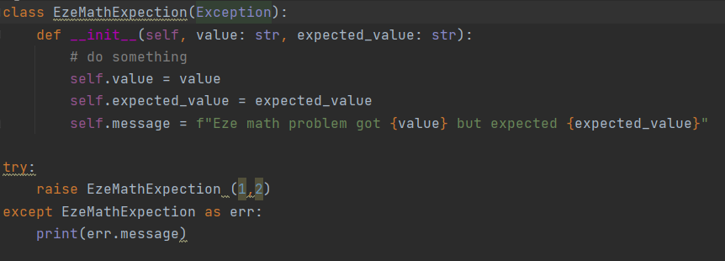
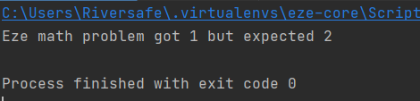
Python : Custom Exception Example
Extended Exception’s caught just like normal Exceptions

Slide 46
Python : Exception Questions
Class questions ?

Slide 47
Questions
I’ve been Anthony M^{c}Kale “Wizard without Portfolio” Fixer-Upper of Broken things, and creator of time-constrained workable Fudges for 15 years. Email : anthony@zapper.hodgers.com

Slide 48
Thank
you

