Slide 1


Academy
Data Tennis 101 ( in python )
Anthony McKale
Principal Software Engineer

Slide 2
Agenda
- Overview
- Major Data File Formats Overview
- Data File Formats Revisited in Python CSV / JSON / Files

Slide 3
Overview

Slide 4
Data == IO
There’s a standard module for everything generic https://docs.python.org/3/library/ There’s a pypi module for everything else https://pypi.org/

Slide 5
Data Formats

Slide 6
Data Formats: what is data
Information that is
Portable
Structured
Readable
Writable

Slide 7
Data Formats: what is data
Different data format have difference strengths and weaknesses
Some are slow to read a data entry, others are slow to write entries
A parser is the name of a program or library that reads a data format, and converts it into program data

Slide 8
Warning: Text Encoding
When is text in a file not the same as other text in files Aka Why do Windows Notepad “.txt” text files not open in Linux ?

Slide 9
Warning: Text Encoding
When is text in a file not the same as other text in files Answer : When encoding different
The text is encoded as a binary file, aka each A-Z as a mapping in binary
ASCII simple encoding table: A-Z a-z characters
https://en.wikipedia.org/wiki/ASCII https://theasciicode.com.ar/
A=65 | B=66 | C=67 | D=68 | E=69 | F=70 | G=71 | H=72 | I=73 | J=74 | K=75 | L=76 | M=77
N=78 | O=79 | P=80 | Q=81 | R=82 | S=83 | T=84 | U=85 | V=86 | W=87 | X=88 | Y=89 | Z=90
a=97 | b=98 | c=99 | d=100 | e=101 | f=102 | g=103 | h=104 | i=105 | j=106 | k=107 | l=108 | m=109
n=110 | o=111 | p=112 | q=113 | r=114 | s=115 | t=116 | u=117 | v=118 | w=119 | x=120 | y=121 | z=122

Slide 10
Warning: Text Encoding
English and other languages are encoded into 0-1s
Encoding patterns are different across OSes
Common formats:
ISO excellent cross-platform format, old defacto standard pre-web, still in use
UTF excellent cross-platform format, defacto standard for web traffic
Windows-1252 cursed windows format, never use, convert to UTF when detected
If in doubt use UTF-8 it’s the best accepted https://en.wikipedia.org/wiki/ISO/IEC_8859-1 https://en.wikipedia.org/wiki/UTF-8 https://en.wikipedia.org/wiki/Windows-1252

Slide 11
Data Formats: common formats
Text Logs commonly for write lots, read little, lists of data
Text Data commonly for structured data, aka Objects and Lists
Binary Data commonly proprietary or for speed/size

Slide 12
Data Formats: Text Data formats
Human readable structured data
Log file
JSONL
CSV

Slide 13
Data Formats: Text Log formats
Simplest of the formats, for rows of data it’s rows of data, each on a line
Log file
JSONL
CSV

Slide 14
Data Formats: Log line format
Log line format
Log format :
Line Data is text, often structured, see links*
Rows (divided by newlines)
Examples
https://en.wikipedia.org/wiki/Extended_Log_Format https://en.wikipedia.org/wiki/Common_Log_Format
2020-01-01 Anthony logged in
2020-01-02 Anthony did action

Slide 15
Data Formats: JSONL format
Log lines but with minified* JSON
JSONL : JSON log lines
Line Data is minified* JSON
Rows (divided by newlines)
Examples
minified* = will be covered later https://en.wikipedia.org/wiki/Minification_(programming) https://jsonlines.org/
{"title": "dev", "name": "anthony"},
{"title": "dev", "name": "toby"},

Slide 16
Data Formats: CSV format
You’ll come across this format for transferring simple data from/to spread sheets
CSV : comma separated values
Columns (divided by commas)
Rows (divided by newlines)
Examples
https://en.wikipedia.org/wiki/Comma-separated_values
"title", "name"
"dev", "anthony"

Slide 17
Data Formats: Text Data formats
Data formats able to encode structured trees and lists
XML
JSON
YAML

Slide 18
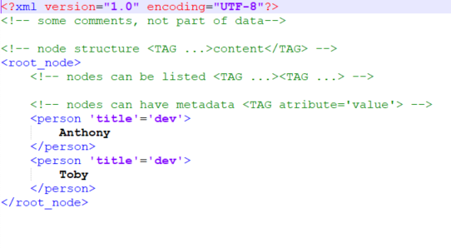
Data Formats: XML
XML the grand daddy of all human readable data
- XML is a tree structure
- Starts with a single root “node” - Nodes have a type called “tag”
- Nodes can have metadata (called attributes) - Nodes have children / content
- .xml file extension
https://en.wikipedia.org/wiki/XML

Slide 19
Data Formats: XML
XML is :
Big, that XML takes up a lot of space
Slow to read, XML is hard to parse (no newlines to scan for)
Slow to write, XML needs parsed and edited with nesting
“Easy…” to read by humans
https://en.wikipedia.org/wiki/XML

Slide 20
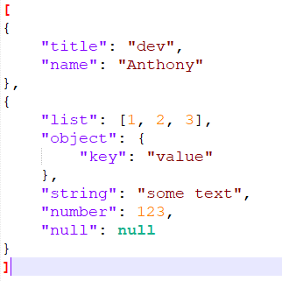
Data Formats: JSON
JSON the defacto standard for human readable data
- JSON is javascript structure
- Javascript-style primitive data types Aka numbers / lists / strings etc
- .json file extension
https://en.wikipedia.org/wiki/JSON

Slide 21
Data Formats: JSON
JSON is :
Medium size, that json is smaller than XML, bigger than binary
Medium to read / write, JSON has regular syntax, no complex attributes
Maps programming language objects directly (easy to serialize / transfer data )
“Easy” to read by humans
https://en.wikipedia.org/wiki/JSON

Slide 22
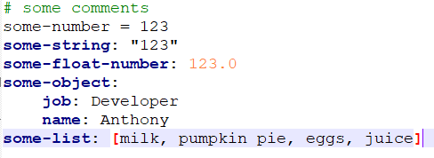
Data Formats: YAML
Yet Another Markup Language, the defacto standard for human readable configuration
- YAML used python-style indentation
- Python-style primitive data types Aka numbers / lists / strings etc
- .yaml file extension
https://en.wikipedia.org/wiki/YAML

Slide 23
Data Formats: YAML
YAML is :
Large-Medium size, roughly same as json unminifed, due to whitespace indentation can not be minified* ! Making it unsuitable for data transfer
Medium to read / write, YAML has regular syntax, no complex attributes
Maps programming language objects directly (easy to serialize / transfer data )
“Very-Easy” to read by humans
https://en.wikipedia.org/wiki/YAML * https://developers.google.com/speed/docs/insights/MinifyResource

Slide 24
JSON vs XML / YAML Security
XML and YaML have meta language features, you can write simple code, that can be exploited to hack/crash computers reading
Simplified formats like JSON or TOML/INI are used instead for untrusted configuration or data transfer
Mitigations for accepting untrusted data:
Special parsers with features disabled can be used to read XML / YAML from unknown/remote sources
https://en.wikipedia.org/wiki/YAML#Security https://cheatsheetseries.owasp.org/cheatsheets/XML_Security_Cheat_Sheet.html

Slide 25
Data Formats: Binary formats
Binary Data formats are non-human readable in notepad or other tools
Vendors will provide Libraries / APIs for read and writing in your language, or a reference spec to build your own
Only use these when necessary for customer: aka generate pdf binary format when displaying read-only documents

Slide 26
Data Formats: Binary formats
Binary Data formats are sometimes just an intermediate format for transfer
Examples
size reduction during internet transfer (gzip compression format / zip files)
Protection when stored at rest (encryption)
* stored at rest = when data is in DB/file storage and not in memory

Slide 27
Data Formats Overview
Human readable structured data
 | Space used | Data Types | Read Speed | Write Speed | Human Readability
Log file | Medium | No | Quick | Quick | High
JSONL | Medium | Yes | Medium | Quick | Medium
CSV | Medium | No | Quick | Quick | Low* *Very High with Excel
XML | Large | Yes | Slow | Slow | Low
JSON | Medium | Yes | Medium | Medium | Medium
YAML | Large-Medium | Yes | Medium | Medium | High
Binary | Small | Yes | Quick | Quick | None

Slide 28
Data Formats: Overview
JSON is the king of readable data
LogFile/JSONL are the kings of log data
CSV is the king of spreadsheet data
Binary is a transport wrapper, or for special use cases

Slide 29
Data File Formats Revisited

Slide 30
Data Formats: what is data
Different data format have difference strengths and weaknesses
Some are slow to read a data entry, others are slow to write entries
A parser is the name of a program or library that reads a data format, and converts it into program data

Slide 31
Data Formats: common pattern
Reading Load data + use parser = python list/dict
Writing python list/dict + use parser + write data = file
IO standard module is your friend for read/writes
https://docs.python.org/3/library/io.html

Slide 32
Data Formats: what is data
Data comes from EVERYWHERE
- Local Files
- User Input
- Web Servers
- Database Servers
These examples are for Local Files

Slide 33
Warning: Text Encoding
English and other languages are encoded into 0-1s
Encoding patterns are different across OSes
Common formats:
ISO excellent cross-platform format, old defacto standard pre-web, still in use
UTF excellent cross-platform format, defacto standard for web traffic
Windows-1252 cursed windows format, never use, convert to UTF when detected
If in doubt use UTF-8 it’s the best accepted https://en.wikipedia.org/wiki/ISO/IEC_8859-1 https://en.wikipedia.org/wiki/UTF-8 https://en.wikipedia.org/wiki/Windows-1252

Slide 34
Data Formats: Raw .txt format
A .txt file, full of text Commonly used for human textual data

Slide 35

Data Formats: .txt format
How to load use with open to read text
WARNING: encoding on windows might be weird !

Slide 36
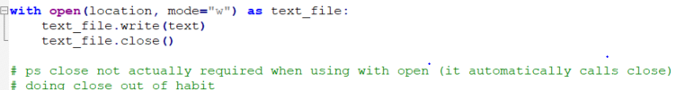
Data Formats: .txt format
How to load use with open to write text
with is magic, it knows to clean up afterwards many io commands use with to clean up after usage

Slide 37
Data Formats: common libaries
Text Logs commonly for write lots, read little, lists of data
Text Data commonly for structured data, aka Objects and Lists
Binary Data commonly proprietary or for speed/size

Slide 38
Data Formats: Log line format
Log line format
Log format :
Line Data is text, often structured, see links*
Rows (divided by newlines)
Examples
https://en.wikipedia.org/wiki/Extended_Log_Format https://en.wikipedia.org/wiki/Common_Log_Format
2020-01-01 Anthony logged in
2020-01-02 Anthony did action

Slide 39

Data Formats: Log line format
How to load use with open to read text, and .split('\n') to turn into list

Slide 40
Data Formats: JSONL format
Log lines but with minified* JSON
JSONL : JSON log lines
Line Data is minified* JSON
Rows (divided by newlines)
Examples
minified* = will be covered later https://en.wikipedia.org/wiki/Minification_(programming) https://jsonlines.org/
{"title": "dev", "name": "anthony"},
{"title": "dev", "name": "toby"},

Slide 41

Data Formats: JSON Log line format
How to load use with open to read text, and then json.loads + shorthand python loop through lines * json.dumps is for turning list/dicts into json strings btw)
https://docs.python.org/3/library/json.html

Slide 42
Data Formats: CSV format
You’ll come across this format for transferring simple data from/to spread sheets
CSV : comma separated values
Columns (divided by commas)
Rows (divided by newlines)
Examples
https://en.wikipedia.org/wiki/Comma-separated_values
"title", "name"
"dev", "anthony"

Slide 43
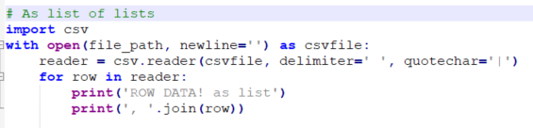
Data Formats: CSV format
How to load use with open to read text, and then pass to csv.reader to get a list of list rows
https://docs.python.org/3/library/csv.html

Slide 44
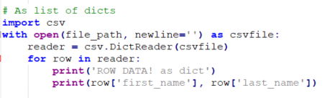
Data Formats: CSV format
How to load use with open to read text, and then pass to csv.DictReader to get a list of dict rows (first row used to get keys)
https://docs.python.org/3/library/csv.html

Slide 45
Data Formats: XML
XML the grand daddy of all human readable data
- XML is a tree structure
- Starts with a single root “node” - Nodes have a type called “tag”
- Nodes can have metadata (called attributes) - Nodes have children / content
- .xml file extension
https://en.wikipedia.org/wiki/XML

Slide 46
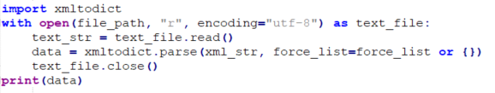
Data Formats: XML format
How to load use with open to read text, and then pass to xmltodict (other options exist too!)
https://pypi.org/project/xmltodict/

Slide 47
Data Formats: JSON
JSON the defacto standard for human readable data
- JSON is javascript structure
- Javascript-style primitive data types Aka numbers / lists / strings etc
- .json file extension
https://en.wikipedia.org/wiki/JSON

Slide 48

Data Formats: JSON format
How to load use with open to read text, and then pass to json.parse
https://docs.python.org/3/library/json.html

Slide 49
Data Formats: YAML
Yet Another Markup Language, the defacto standard for human readable configuration
- YAML used python-style indentation
- Python-style primitive data types Aka numbers / lists / strings etc
- .yaml file extension
https://en.wikipedia.org/wiki/YAML

Slide 50
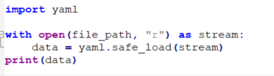
Data Formats: YAML format
How to load use with open to read text, and then pass to yaml.safe_load
https://pypi.org/project/PyYAML/

Slide 51
File Questions ?
Cliffnotes: Reading Load data + use parser = python list/dict
Writing python list/dict + use parser + write data = file

Slide 52
Data Tennis

Slide 53
Data Overview
Most applications are just I/O 1) input from WEB / DB / File / User etc 2) do some processing 3) output processed data into WEB / DB / File / User
4) Repeat ☺

Slide 54
Overview Questions
…. aka just data tennis

Slide 55
Questions
I’ve been Anthony “Zapper” M^{c}Kale
Hopefully I’ve Educated, Informed, and even Entertained Good Testing is Good Security is Good software

Slide 56
Thank you

