Slide 1


Academy
Data Tennis 101 ( in python )
Anthony McKale
Principal Software Engineer

Slide 2
Agenda
- Overview
- Data File Formats Revisited CSV / JSON / Files
- HTTP 101
- DB SQL

Slide 3
Overview

Slide 4
Data == IO
There’s a standard module for everything generic https://docs.python.org/3/library/ There’s a pypi module for everything else https://pypi.org/

Slide 5
Data File Formats Revisited

Slide 6
Data Formats: what is data
Different data format have difference strengths and weaknesses
Some are slow to read a data entry, others are slow to write entries
A parser is the name of a program or library that reads a data format, and converts it into program data

Slide 7
Data Formats: common pattern
Reading Load data + use parser = python list/dict
Writing python list/dict + use parser + write data = file
IO standard module is your friend for read/writes
https://docs.python.org/3/library/io.html

Slide 8
Data Formats: what is data
Data comes from EVERYWHERE
- Local Files
- User Input
- Web Servers
- Database Servers
These examples are for Database Servers

Slide 9
Warning: Text Encoding
English and other languages are encoded into 0-1s
Encoding patterns are different across OSes
Common formats:
ISO excellent cross-platform format, old defacto standard pre-web, still in use
UTF excellent cross-platform format, defacto standard for web traffic
Windows-1252 cursed windows format, never use, convert to UTF when detected
If in doubt use UTF-8 it’s the best accepted https://en.wikipedia.org/wiki/ISO/IEC_8859-1 https://en.wikipedia.org/wiki/UTF-8 https://en.wikipedia.org/wiki/Windows-1252

Slide 10
DB 101

Slide 11
NOTE: Sockets and HTTP requests
HTTP is one way requests of information
Single Request Message sent from client to server
Response received
Sockets are two tunnels of information - connection from client to server made
- messages can be sent back and forth
https://en.wikipedia.org/wiki/Network_socket

Slide 12
NOTE: Sockets and HTTP requests
HTTP Servers use HTTP Requests
DB Servers use Sockets
https://en.wikipedia.org/wiki/Network_socket

Slide 13
Relational Databases
We’ll cover RDBMS, other types exist
Relational Databases are the most popular choice of dynamic data source for large corps Implementation Examples: postgres, oracle, MicrosoftSQL, MySql, AWS Auroria
https://en.wikipedia.org/wiki/Relational_database

Slide 14
Relational Databases
Relational Databases store structured tables of data Each table has rows and columns Each table’s column has a data type The rows are the actual data in the database
https://en.wikipedia.org/wiki/Relational_database

Slide 15
Relational Databases: READING
Relational Databases take queries in SQL language These return result sets, aka rows that match the query
https://en.wikipedia.org/wiki/Relational_database

Slide 16
Relational Databases: READING
E.g. Query, return all rows where age < 10 SQL uses a SELECT query for reading rows “SELECT <columns> FROM <table> WHERE<conditions> <sorting>”
Tutorials will teach more https://en.wikipedia.org/wiki/Select_(SQL)

Slide 17
Relational Databases: READING
E.g. Query, return all rows where age < 10 in SQL “SELECT * FROM people WHERE age < 10”
Given table ‘people’, returns result set
id | name | age
1 | Anthony | 21
2 | Sarah | 32
2 | Rosie | 1
id | name | age
1 | Anthony | 21
2 | Sarah | 32

Slide 18
Relational Databases: READING
E.g. Query, return row where id = 2 in SQL “SELECT * FROM people WHERE id = 2”
Given table ‘people’, returns result set
id | name | age
1 | Anthony | 21
2 | Sarah | 32
2 | Rosie | 1
id | name | age
2 | Sarah | 32

Slide 19
Relational Databases: WRITING
Relational Databases take queries in SQL language that insert / delete rows and alter structure of the database

Slide 20
Relational Databases: WRITING
SQL language that insert rows INSERT INTO <table> (<columns>)
VALUES (<column data>) https://www.postgresql.org/docs/current/sql-insert.html

Slide 21
Relational Databases: WRITING
E.g. Query, add row in SQL “INSERT INTO people (id, name, age)
VALUES (4, ‘Veronica’, 75)”
Given table ‘people’
id | name | age
1 | Anthony | 21
2 | Sarah | 32
2 | Rosie | 1

Slide 22
Relational Databases: WRITING
SQL language that updates rows UPDATE <table>
SET <columns>=<VALUE>
WHERE <conditions> https://www.postgresql.org/docs/current/sql-update.html

Slide 23
Relational Databases: WRITING
SQL language that deletes rows DELETE FROM <table> WHERE <conditions> https://www.postgresql.org/docs/current/sql-delete.html

Slide 24
Relational Databases: ALTER DB
SQL language that alter db Advanced topic, know you can use ALTER <conditions> to edit columns, add tables, etc Will be covered in tutorials https://www.postgresql.org/docs/current/sql-altertable.html

Slide 25
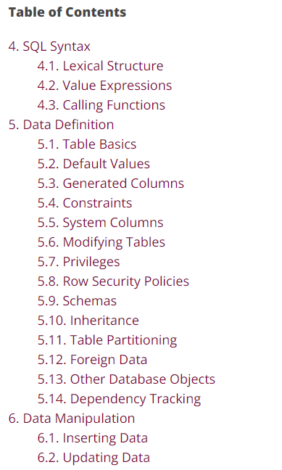
Relational Databases: SQL
SQL language is large so there be details Lots more commands, it’s a full language Reference Guide: https://www.postgresql.org/docs/current/sql.html

Slide 26
Relational Databases: SQL
SQL Database administration
Like Git, SQL has command line, tools on top, and can be called via code Reference Guide: https://www.postgresql.org/docs/current/sql.html

Slide 27
Relational Databases: SQL
SQL Database administration
Like Git, SQL has command line, tools on top, and can be called via code Reference Guide: https://www.postgresql.org/docs/current/sql.html

Slide 28
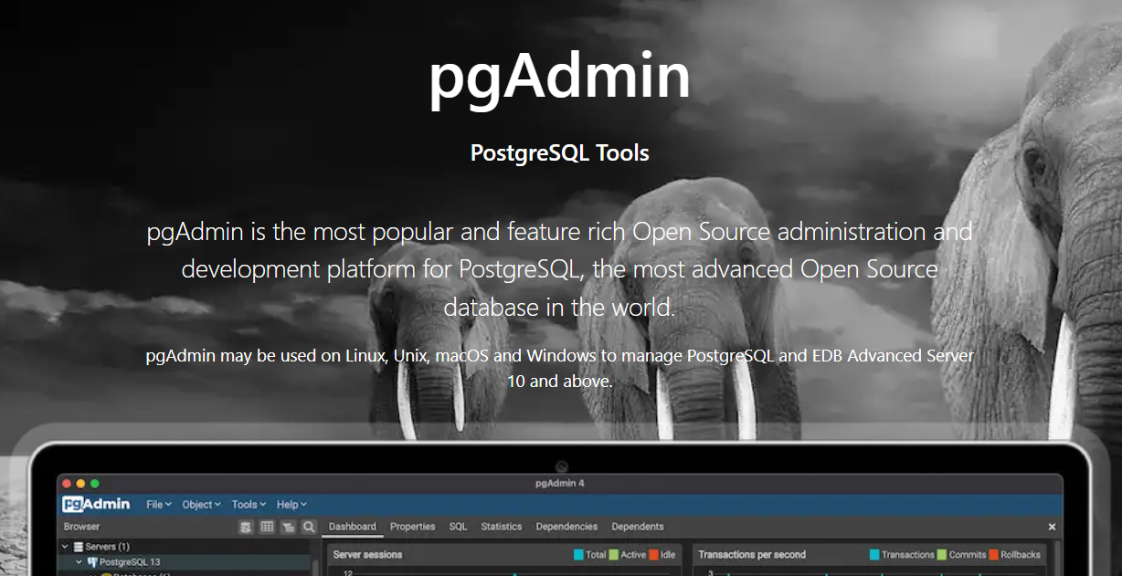
Relational Databases: SQL
SQL Database administration
Postgres Admin tool (other implementation all have their own) https://www.pgadmin.org/

Slide 29
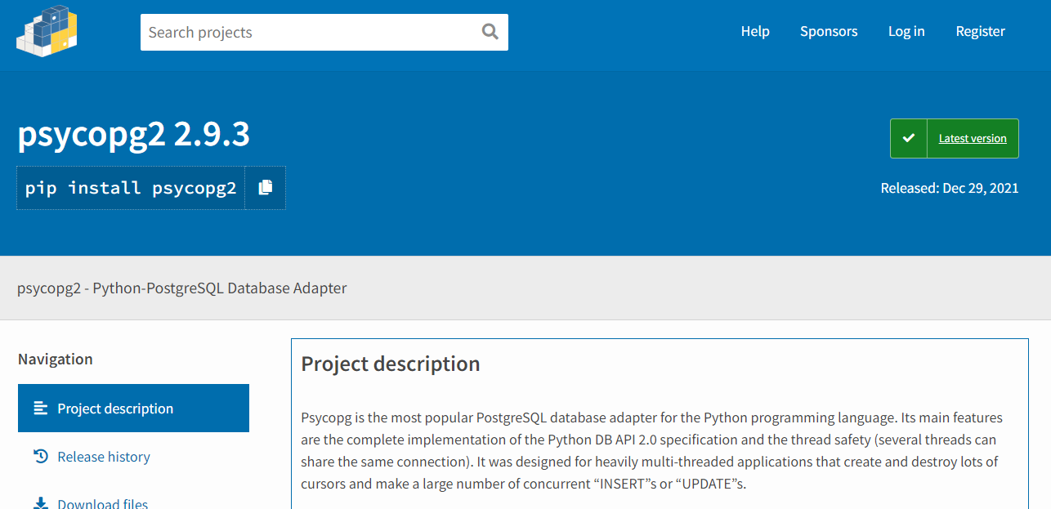
Relational Databases: SQL
SQL Database + Python
pip install psycopg2 https://pypi.org/project/psycopg2/

Slide 30
DB Questions
….

Slide 31
Data Tennis

Slide 32
Data Overview
Most applications are just I/O 1) input from WEB / DB / File / User etc 2) do some processing 3) output processed data into WEB / DB / File / User
4) Repeat ☺

Slide 33
Overview Questions
…. aka just data tennis

Slide 34
Questions
I’ve been Anthony “Zapper” M^{c}Kale
Hopefully I’ve Educated, Informed, and even Entertained Good Testing is Good Security is Good software

Slide 35
Thank you

