Slide 1


Academy
AWS Compute 101
Anthony McKale
Principal Software Engineer

Slide 2
Agenda
- Containers vs VMs
- AWS Compute
- Logging in AWS
- Security Aside: CIS vs NIST (part 1)

Slide 3
Containers vs VMs

Slide 4
Containers vs VMS
Reminder on Containers versus VMs
From Basics Topic

Slide 5
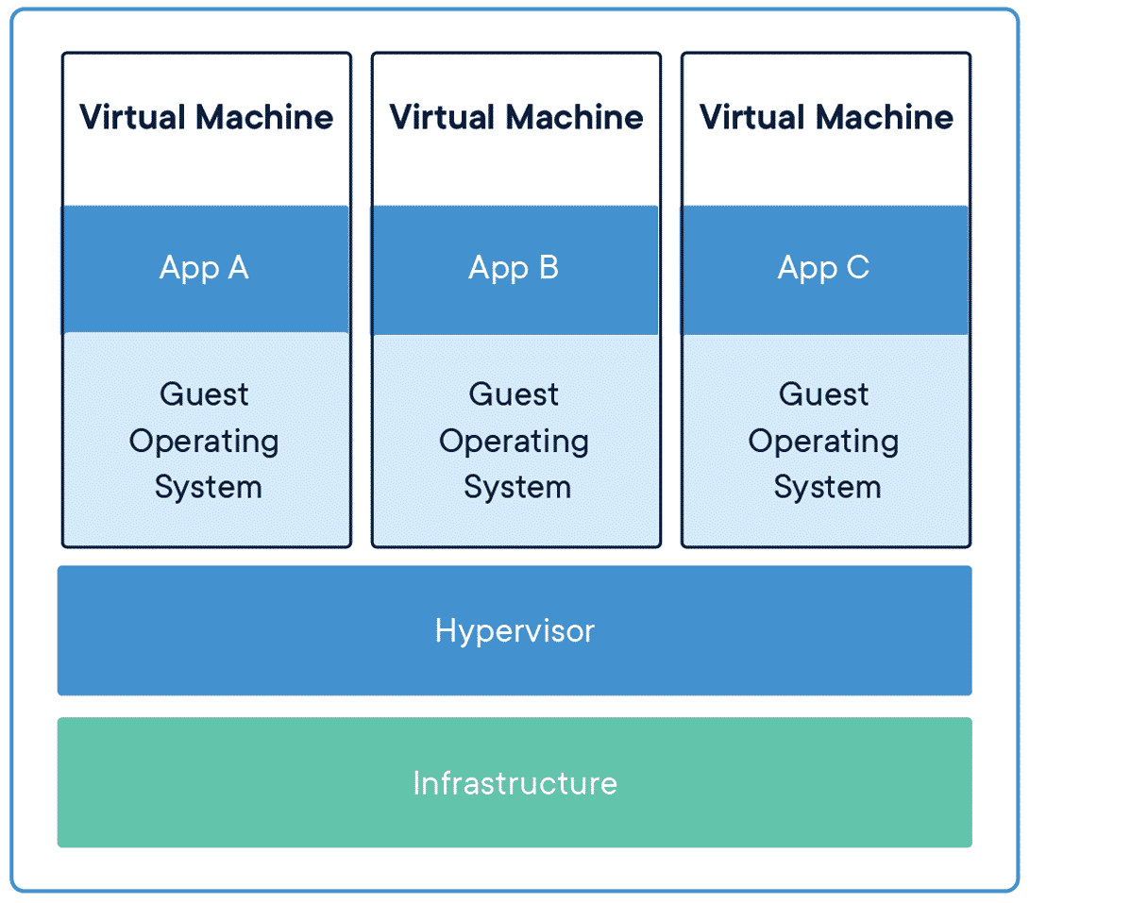
Virtual Machines

Slide 6
Virtual Machines
A Virtual Machine is an emulated computer system: System virtual machines: Fully emulated computer, running Operating System Image

Slide 7
Virtual Machines: pros and cons
PROS:
Portable: Images Completely portable
CONS:
Speed: emulated code is slow even with hypervisors
Bootup: OS needs booted up, taking mins

Slide 8
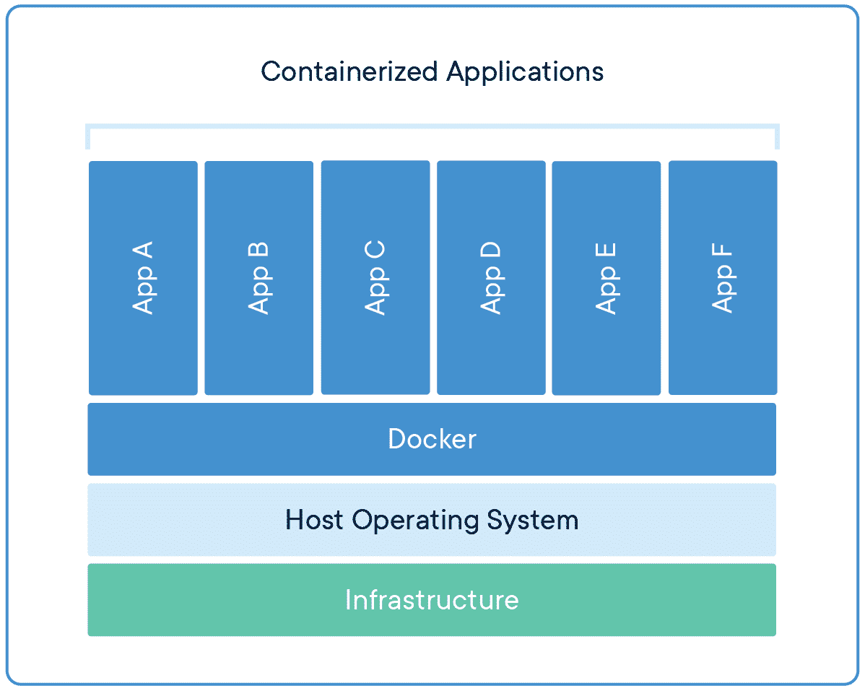
Containers

Slide 9
Container
A container is an partial OS / Application running on a hosted OS
Containers are isolated on the computer, using OS process isolation features
For Linux this is typically a service called containerd under the bonnet
https://containerd.io/

Slide 10
Containers : pros and cons
PROS:
Bootup: container only needs copied, taking secs
Speed: Code runs at native speed
CONS:
Portable: Images portable to supported OS * for docker linux, with VMs used for Windows / Mac support

Slide 11
Container vs VMs
Questions ?
Cliffnotes:
Containers == Cheaper / Faster
VMs == More flexible

Slide 12
AWS Compute

Slide 13
AWS Compute
For running programs
Two main types:
Code in a (long lived) VM often called EC2, Azure Compute…
Code in (Short lived) Containers often called a Lambda function, Azure Function…

Slide 14
AWS Compute
Lied… there’s one or two more

Slide 15
AWS Compute: VM Solutions
.
Solution | Type |  | Cost
EC2 | VM | Long lasting VM, any OS, any software, any performance level https://aws.amazon.com/ec2/pricing/on-demand/ | $8/month +
Lightsail | VM | Cheap small VMs, running pre-configured OSs and Application https://aws.amazon.com/lightsail/pricing/ | $8/month +
WorkSpaces | VM | Employee Remote Desktop https://aws.amazon.com/workspaces/pricing/ | $23/month +

Slide 16
AWS Compute: Serverless Solutions
.
Solution | Type |  | Cost
Lambda | Container | Short lasting Container, any software, any performance level https://aws.amazon.com/lambda/pricing/ | $0.20/million + $0.000016 compute/sec
Fargate | Container | Long lasting Container, any software, any performance level, any size of task Can be ran for as long or short as needed https://aws.amazon.com/fargate/pricing/ | $24/month + Note: normally used for 10-30 min jobs at a time
Step Functions | Container / low-code | Connected Lambdas with logic gates / graphical decision tree https://aws.amazon.com/step-functions/features/ | $0.20/million + $0.000016 compute/sec

Slide 17
AWS Compute
Important configurable performance characteristics
- CPU
- RAM
- Storage

Slide 18
CPU : Electronic Brain
central processing unit, brains of the operation
Clock Speed
number of mathematical operations a second per CPU core, counted in gigahertz (billions per second) CPU Count number of CPUs in a computer 1 low end desktop, 2 high end desktop, 4-64 for high servers
Cores special micro CPU inside a CPU, so if a CPU has 4 cores, then can do 4 things at once, and ~4 times as fast https://en.wikipedia.org/wiki/Central_processing_unit

Slide 19
Electronic Memory
Memory / Storage
Latency: amount of time to start accessing a piece of memory
Aka on old hard disks/or DVD drives, the time to move the laser to that part of the disk
Transfer Read/Write Speed: the amount of data per second that can be transferred, often different for writing and reading
Storage Size: total amount of data that can be stored
Volatility: if the data persists if the computer switches off or loses power https://en.wikipedia.org/wiki/Random-access_memory

Slide 20
RAM : Electronic Memory
Random Access Memory, the short term memory fast to read and write, disappears when the computer shuts down, aka Program Variables
SMALL compared to hard drive
FAST compared to hard drive
Volatile not for long term storage
https://en.wikipedia.org/wiki/Random-access_memory

Slide 21
Storage : Electronic Memory
Hard disk drives, this is where files live - BIG compared to RAM
- SLOW compared to RAM
Not Volatile file can be stored for many years on hard drives
https://en.wikipedia.org/wiki/Hard_disk_drive

Slide 22
AWS Compute Terms
Ephemeral Storage – temporary storage, disappears once container or VM closes
Concurrency – running multiple VMs or Lambdas at the same time
Data Transfer – often you are charged for non-AWS network traffic

Slide 23
AWS Compute
Questions ?

Slide 24
AWS Logging

Slide 25

Logging aka CloudWatch
.

Slide 26
Logging aka CloudWatch
Logging is done in 4 steps - Collect - Monitor - Act - Analyze https://aws.amazon.com/cloudwatch/

Slide 27
Logging aka CloudWatch
- Collect - Monitor - Act - Analyze

Slide 28
CloudWatch: Collection
Every AWS service sends data to Cloudwatch
As does every application
Data is automatically index and aggregated according to metadata

Slide 29
Logging aka CloudWatch
- Collect - Monitor - Act - Analyze

Slide 30
CloudWatch: Monitor
Streaming: Every metric available via real time stream, via the aws cli or console (aka a lambda functions logs) Dashboards: pretty UI available in console
Insights: Logs searchable via SQL like language

Slide 31
CloudWatch: Monitor (extras)
Anomaly detection: ML library can look for issues in logs ServiceLens: pretty visualizing of health, performance bottlenecks
Synthetics: 24/7 integration tests to make sure everything is working
RUM: frontend application data analytics

Slide 32
CloudWatch: Monitor
Streaming: Every metric available via real time stream, via the aws cli or console (aka a lambda functions logs) Dashboards: pretty UI available in console
Insights: Logs searchable via SQL like language

Slide 33
Logging aka CloudWatch
- Collect - Monitor - Act - Analyze

Slide 34
CloudWatch: Act
Auto-scaling: Compute can be set up to scale on demand WARNING: can be expensive on DOS Alarms: Compute can be triggered by conditions set (called Alarms) a.k.a too many errors send email etc
CloudWatch Events: Compute can be triggered on cloudwatch events (advanced topic: see SNS / SQS)

Slide 35
Logging aka CloudWatch
- Collect - Monitor - Act - Analyze

Slide 36
CloudWatch: Analyze
Export: All cloudwatch data is exportable / connects into all data AWS services Dasbhoard: All metrics, events, and alarms graphable and dashboardable
Insights: All metrics, events, and alarms queryable via SQL-like languageInsights

Slide 37

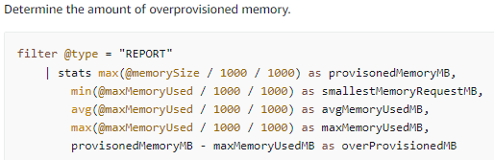
Aside Cloudwatch Query Language (CWL)

Slide 38
Aside Cloudwatch Query Language (CWL)
It’s an Advanced Topic Further Reading Links:
https://docs.aws.amazon.com/AmazonCloudWatch/latest/logs/CWL_QuerySyntax-examples.html https://docs.aws.amazon.com/AmazonCloudWatch/latest/logs/CWL_QuerySyntax.html
https://docs.aws.amazon.com/en_us/AmazonCloudWatch/latest/logs/CWL_AnalyzeLogData-discoverable-fields.html

Slide 39
Logging aka CloudWatch
Questions ?

Slide 40
Security: CIS vs NIST

Slide 41
CIS versus NIST
Computer security is important
Cloud security is important and HARD
Luckily, clever people have created guidelines
Introducing CIS and NIST

Slide 42

CIS
Centre for Internet Security (CIS) created in 2000
American Non-profit that published controls and benchmarks to help secure systems
https://en.wikipedia.org/wiki/Center_for_Internet_Security

Slide 43
CIS: Controls and Benchmarks
CIS Controls: 18 Best Practices for Security https://www.cisecurity.org/controls/cis-controls-list CIS benchmarks: Platform specific best practices https://www.cisecurity.org/cis-benchmarks/

Slide 44
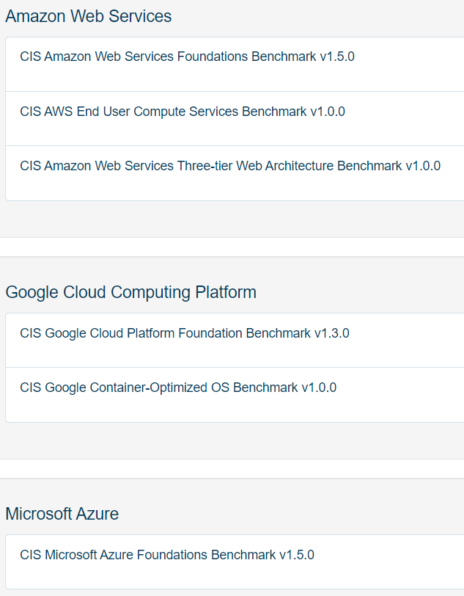
CIS: Controls and Benchmarks
CIS benchmarks: Platform specific best practices there are a lot of them! https://www.cisecurity.org/cis-benchmarks/

Slide 45

NIST
National Institute of Standards and Technology (NIST) created in 1901 (renamed 1988)
American Government agency that published NIST cybersecurity Framework to help secure systems
https://www.nist.gov/ https://en.wikipedia.org/wiki/National_Institute_of_Standards_and_Technology

Slide 46
NIST: Cybersecurity Framework
Cybersecurity Framework https://www.nist.gov/cyberframework
Sidenote: also publishes excellent CVE database https://nvd.nist.gov/

Slide 47
CIS versus NIST
Questions ?
Both commonly used in industry

Slide 48
Questions
I’ve been Anthony “Zapper” M^{c}Kale
Hopefully I’ve Educated, Informed, and even Entertained Good Testing is Good Security is Good software

Slide 49
Thank you

