Slide 1


Academy
Infrastructure as Code 101
Anthony McKale
Principal Software Engineer

Slide 2
Agenda
- Overview
- Terms
- IaC
- Pros and Cons
- Implementations
- Terraform

Slide 3
OVERVIEW

Slide 4
History
50s – Advent of Super and Office computers, deployed manually
80s – Advent of Personal Mini/Micro-computers, deployed manually 90s – Continuous Integration created to deploy code automatically
2000s – Advent of Serverless-computers, deployed manually

Slide 5
History
2005 – first IaC projects Chef and puppet released
2012 – IaC Anisable released
2014 – current defacto Terraform released

Slide 6
TERMS

Slide 7
IaC Terms
Infrastructure as code: snazzy name for programs that deploy cloud stuff from an instruction lists (will also scan existing resources, and just remove/add what’s different)
Mutable Infrastructure: changeable after deploy aka databases, file storage, ec2, etc…
Immutable Infrastructure: non changeable after deploy
aka lambda, IAM permissions

Slide 8
Infrastructure as Code 101

Slide 9
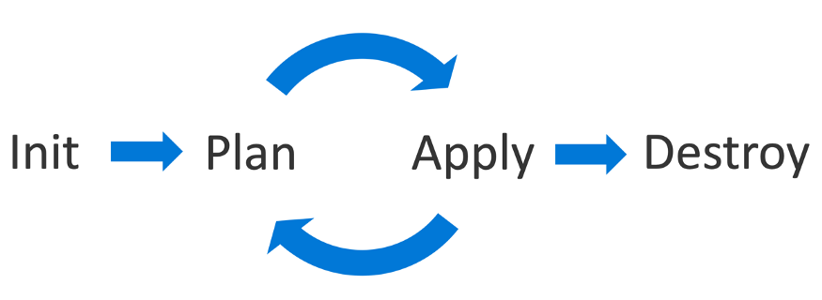
IaC 101

Slide 10
IaC 101
All Solutions have: (with different names)
INIT: setup and initialize the state file of a IaC project
PLAN-APPLY: PLAN: analyse existing infrastructure, create diff list
APPLY: execute diff list
DESTROY: teardown and delete all created assets

Slide 11
PROS and CONS

Slide 12
IaC Pros
Cost: cheaper in the long run for larger projects, to have a quicker or reliable process
Collaboration / Visibility: Everyone can edit and see the infrastructure setup
Consistency: new deployments of IaC environment all setup the same (no funny setup mistake bugs!)

Slide 13
IaC Cons
Cost: cheaper in the short run for small projects, to just use the UI
Access / Poor Secrets management: Whole team see the infrastructure setup, and provides another place for poor practice of hardcoding secrets (DO NOT DO THIS!)
Complexity: IaC solutions are more complexity than manually deploying assets, on the rare occasions problems arise, can be hard to debug

Slide 14
Implementations

Slide 15
Common IaC
Serverless Framework (2015) – opensource*, javascript, IaC
Terraform (2014) – Hashicorp, IaC
SAM (2013*) – AWS, IaC
Anisible (2012) – Redhat, python, IaC

Slide 16
Terraform

Slide 17
Terraform 101

Slide 18
Terraform
Terraform has a cli
Terraform is multi cloud aka GCP, AWS, Azure, etc…
Terraform uses plugins called providers to implement each cloud
Terraform state is a file that MUST be protected
More information in tutorials
https://registry.terraform.io/browse/providers https://registry.terraform.io/

Slide 19
TERRAFORM BEST PRACTICE
https://www.terraform-best-practices.com/

Slide 20
Naming
Name assets with underscores (_) not dashes (-)
* Exception is s3 buckets as they require dashes….
Name assets with lowercase letters and numbers
https://www.terraform-best-practices.com/naming

Slide 21
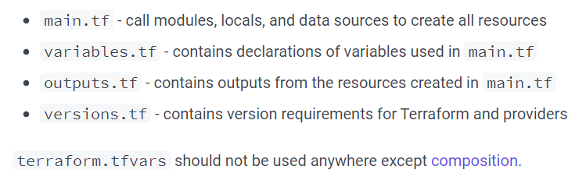
Repo structure
Follow structure repo structure
https://www.terraform-best-practices.com/code-structure

Slide 22
Repo structure
Terraform state should NOT be in git
Use a S3 bucket backend for state it’s full of secrets so shouldn’t be in GIT
https://www.terraform-best-practices.com/code-structure https://developer.hashicorp.com/terraform/language/settings/backends/s3

Slide 23
Advanced Best Practice in Wiki
https://vizer.sharepoint.com/:w:/r/sites/RiverSafe/_layouts/15/Doc.aspx?sourcedoc=%7B16CF1A84-3981-4DFF-9EC5-77C44E76845D%7D&file=Terraform%20Best%20Practices.docx&action=default&mobileredirect=true

Slide 24
Questions
I’ve been Anthony “Zapper” M^{c}Kale
Hopefully I’ve Educated, Informed, and even Entertained Good Testing is Good Security is Good software

Slide 25
Thank you

