Slide 1


Academy
Agile 101
Anthony McKale
Principal Software Engineer

Slide 2
Agenda
- Pre-Agile
- Agile 101
- Scrum 101

Slide 3
Pre-Agile

Slide 4
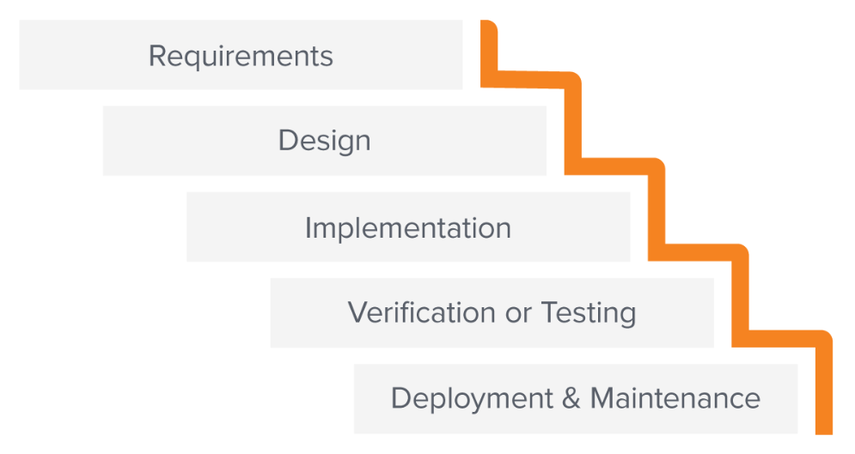
Waterfall
First there was Waterfall (1970s), based loosely off Ford’s Quality control
Development was split into 5 phases, with quality control applied at the end of each
Image from https://business.adobe.com/blog/basics/waterfall an excellent resource on the matter

Slide 5
Waterfall Methodology
The underlying concepts behind Waterfall are:
Measure twice cut once Complete all design before analysis and coding
Quality Control: Dev Bugs x200 cheaper than Prod Bugs Testing must be professionally administered after coding, and involve customer feedback
Divide and Conquer Project broken into Milestones, each milestone having overlapping concurrent phases aka while Testing milestone 1, Dev Team can work on milestone 2

Slide 6
Waterfall Why ?
Waterfall though old fashioned is still used for projects with :
Clear non-ambiguous requirements
Clear upfront costs and time estimates are required (Ironically, these are almost always wrong, but they can be given)
Large Clients unlikely to change the scope of work mid-flight (aka government contracts*)
Older organizations where staff trained in methodology such as RUP
When software tightly integrated to Physical devices (where design changes are expensive once manufacturing starts)
https://en.wikipedia.org/wiki/Waterfall_model

Slide 7
Waterfall Who ?
Waterfall fell out of fashion in the 2000s, and is now relegated to the project previously described It’s Clients normally dictate Waterfall due to it’s ability to give upfront costs and time estimates
Ironically, these are normally very inaccurate and incur higher cost than in modern agile methodology, but they are upfront…
Onto Agile….
https://en.wikipedia.org/wiki/Waterfall_model

Slide 8
Agile

Slide 9
Agile Methodology History
Next there was Agile* (2000s), based loosely off Toyotas' Kazan way
Development was split into small phases called sprints, with quality control applied as software is written
This approach focused on Quality Assurance, and allowing controlled change rather than slavishly following preset plan
* And precursors like Xtreme Programming! (XP)… etc

Slide 10
Agile Values + Principles

Slide 11
Agile Manifesto Values
Agile Manifesto was the rallying cry, these are the 4 core values
Individuals and interactions over processes and tools
Working software over comprehensive documentation
Customer collaboration over contract negotiation
Responding to change over following a plan
https://agilemanifesto.org/

Slide 12
Agile Principles
Behind the Agile Manifesto was the12 principles
4 on Customers
4 on Teams
4 on Planning and Design
https://www.agilealliance.org/agile101/12-principles-behind-the-agile-manifesto/

Slide 13
Agile Principles
4 Principles on Customers:
Give Customer satisfaction early via working software
Welcome changing requirements, no matter how late
Deliver working software frequently via CI
Working software is a measure of progress/success
https://www.agilealliance.org/agile101/12-principles-behind-the-agile-manifesto/

Slide 14
Agile Principles
4 principles on Teams:
Daily cooperation between business and developers
Projects built around motivated individuals, trust them
Have regular honest team reviews, plan and take actions that make us more effective
Face-to-face is the best form of communication (co-location)
https://www.agilealliance.org/agile101/12-principles-behind-the-agile-manifesto/

Slide 15
Agile Principles
4 principles on Planning and Design:
Best architectures, requirements, and designs emerge from self-organizing teams
Plan Sustainable development, able to maintain a constant pace aka no crunch time, burning out developers for unrealistic goals
Continuous attention required for technical excellence and good design aka software only as good as it’s worst bug
Simplicity is essential aka work smart not hard
https://www.agilealliance.org/agile101/12-principles-behind-the-agile-manifesto/

Slide 16
Agile Principles
See how the Principles and Values have shaped the Agile processes and artifacts
Self organising teams
Quick iterative working software
Close integration to Customer
We’ll go through the Scrum Agile methodology now*
* Other agile methodologies exist, Scrum is the biggest
https://www.agilealliance.org/agile101/12-principles-behind-the-agile-manifesto/

Slide 17
Scrum 101

Slide 18
Scrum 101
Scrum is a Agile framework for Software project management
Scrum is Business focused, helping and concentrating on delivering business value, and born in response to large scale failures delivered by Waterfall teams.
Large parts of Scrum are actually designed to detect failure fast, so failing software teams can be helped or disbanded* * historically Waterfall teams could dis-functionally run for years before finally failing to produce any software
https://en.wikipedia.org/wiki/Scrum_(software_development)

Slide 19
Scrum 101
Scrum is a Agile framework for Software project management,
it covers :
Goals Business focused but similar to raw Agile Principals and Values
Team member roles and responsibilities
Artifacts to help Team self-organise
Workflow of Ceremonies to be completed within release cycle
Lastly, the Regular Release Cycle for producing new working code the 1-2 week famous sprint
https://en.wikipedia.org/wiki/Scrum_(software_development)

Slide 20
Scrum Goals

Slide 21
Scrum Goals
Scrum goals, overlapping Agile’s values but business focused:
High visibility of Value / Work Don’t hide things
Frequent inspection Detect, Spot, and fix issues quickly
Quickly adapt Resolve / Migrate issues quickly
Frequently Release Realise value quickly and frequently via working code
https://en.wikipedia.org/wiki/Scrum_(software_development)

Slide 22
Scrum Roles

Slide 23
Scrum Roles
Scrum roles, responsibilities are split into dedicated roles:
Product Owner Voice of customer, responsible for project delivery and backlog
Scrum Master Protector of Team and Process, responsible for protecting team from distraction and unblocking issues, and running ceremonies
Developers Resolve / Migrate issues quickly
Common optional extras: QA engineers, Business Analysists
https://en.wikipedia.org/wiki/Scrum_(software_development)

Slide 24
Scrum Roles: Developer
Developer Role Responsibilities
- Help breakdown tickets in Grooming / Planning - Daily updates in Scrum, and updating board
- Do Work on Tickets
- Showcase completed work in Showcases
https://en.wikipedia.org/wiki/Scrum_(software_development)

Slide 25
Scrum Artifacts

Slide 26
Scrum Artifacts
Scrum object, these help the team self-organise and plan:
Product Backlog List of todo Epic Tickets
Sprint Backlog Master List of todo Epic Tickets (each broken down into Work Tickets)
Sprint Board Progress of Work Tickets in the current Sprint, displayed for team
https://en.wikipedia.org/wiki/Scrum_(software_development)

Slide 27
Artifacts: Product Backlog
List of Epic Tickets *
Created by Product Owner ahead of each sprints
Required to be groomed by devs ahead of sprint start
Epics should broken down at this stage
* Types of Ticket: Epic : Group of Work Tickets, covering software feature
Work/Task: Work Ticket belonging to Epic
Bug: Bug Ticket, issues discovered by QA, attached to Epic
https://en.wikipedia.org/wiki/Scrum_(software_development)

Slide 28
Artifacts: Sprint Backlog
List of Epic Tickets
Taken from Product Backlog ahead of sprint planning
Required to be groomed by devs ahead of sprint start Either in grooming sessions or sprint planning
Epics need broken down at this stage
https://en.wikipedia.org/wiki/Scrum_(software_development)

Slide 29
Artifacts: Sprint Board
List of Work Tickets (and Epic Tickets)
Displays Sprint Backlog Each ticket shows who’s working on it Each Ticket is in a progress column Columns are custom, typically: TODO, INPROGRESS, DONE With optional extras like : QA / RELEASED TO PROD / etc
https://en.wikipedia.org/wiki/Scrum_(software_development)

Slide 30
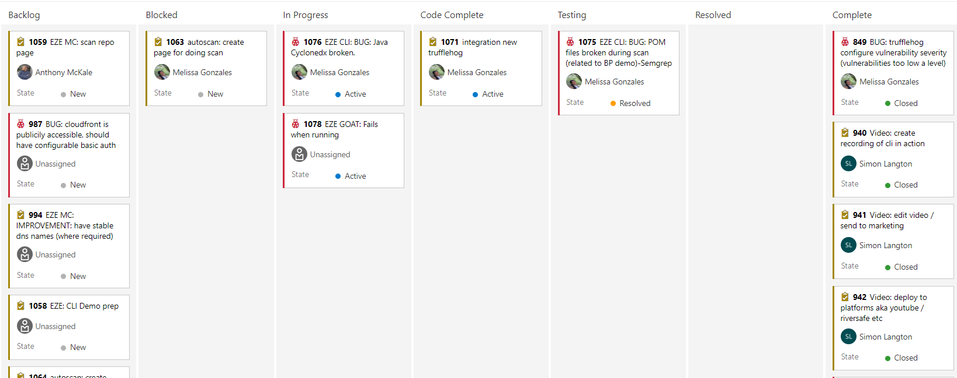
Artifacts: Sprint Board
Azure Boards Example
https://en.wikipedia.org/wiki/Scrum_(software_development)

Slide 31
Artifacts: Ticketing Systems
Normally Backlogs and Boards contained on online Ticketing Systems: aka Jira Trello
Azure Boards Github Projects etc
https://en.wikipedia.org/wiki/Scrum_(software_development)

Slide 32
Scrum Ceremonies

Slide 33
Scrum Ceremonies
5 core Scrum meetings, each helps a agile principal :
Sprint Planning Done at start to plan out the Sprint Release cycle (optional pre-planning: Sprint Grooming)
Daily Scrum Daily inter-team comms check
Sprint Review / Showcase New working code completed in sprint review
Sprint Retrospective Meta Review on team performance and practices
https://en.wikipedia.org/wiki/Scrum_(software_development)

Slide 34
Scrum Ceremonies
5 core Scrum meetings, each helps a agile principal :
Sprint Planning self-organizing teams, Plan Sustainable development
Daily Scrum Daily cooperation, Face-to-face, self-organizing teams
Sprint Review / Showcase Give Customer satisfaction early, Deliver working software, Working software is a measure
Sprint Retrospective regular honest team reviews
https://en.wikipedia.org/wiki/Scrum_(software_development)

Slide 35
Ceremonies: Sprint Planning
Sprint Planning is the start of a sprint Take Product Backlog Epics and Turn them into a Sprint Backlog + Sprint Board Clean up last sprint, and breakdown any ungroomed epics
https://en.wikipedia.org/wiki/Scrum_(software_development)

Slide 36
Ceremonies: Sprint Planning
Frequency: Planning is once a start of each sprint
Duration: Timebox to 1-3 hours
Audience: Whole Team
Input: Grouped tickets called Epics
(Optional) Broken down / Estimated work tickets Prioritised backlog of Epics Output: Take raw tickets, ensure broken down and developer ready
Confidence Team capacity to meet sprint goals
https://en.wikipedia.org/wiki/Scrum_(software_development)

Slide 37
Ceremonies: Sprint Planning
Agenda
Get team’s capacity aka holidays etc during sprint (any interruptions)
State sprint goals
Confirm estimated story points for all items on the backlog *
Review existing items to make sure they are correct /or need removing updating
Agree on the items to move to the new sprint
Q&A to ensure all team members are on the same page
start new sprint
* See Planning Poker (next slide)
https://en.wikipedia.org/wiki/Scrum_(software_development)

Slide 38
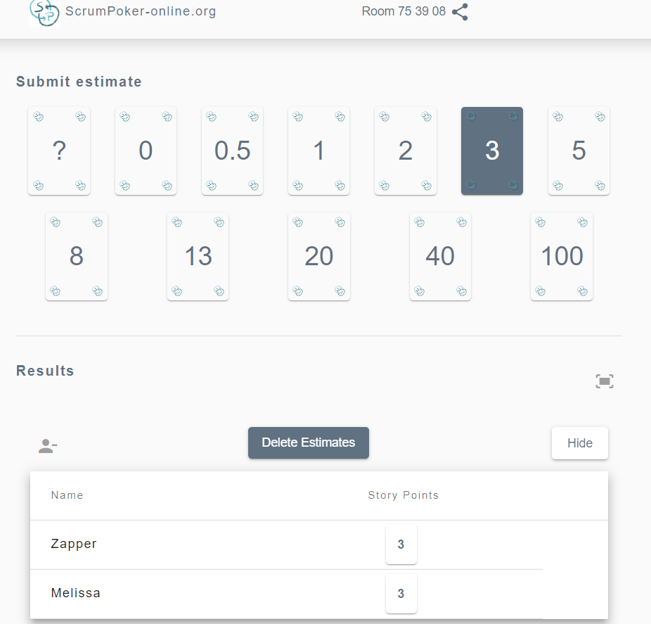
Ceremonies: Planning Poker
Estimate items on scale (normally Fib)
Team blind estimates size, and reveals score together
Concepts: - Arbitrary Numbers are Rubbish for Estimation
- Absolute Time is even Worse
T-Shirt / Animals also Excellent for Relative Sizing aka small/medium/large aka frog/cat/dog/bear/lion/unicorn
https://www.scrumpoker-online.org/en/room/753908/scrum-poker
https://www.mountaingoatsoftware.com/agile/planning-poker

Slide 39
Ceremonies: Planning
Visual aid
START
Define Goals
Breakdown Goals into Tickets
Size Tickets as Team
Agree Sprint Tickets
Put Sprint Tickets on board
https://www.mountaingoatsoftware.com/agile/planning-poker

Slide 40
Ceremonies: Sprint Grooming
Sprint Grooming is a optional ceremony, arranged by the team either ad-hoc or regular frequency Take Product Backlog Epics ahead of planning
Breakdown any ungroomed epics
https://en.wikipedia.org/wiki/Scrum_(software_development)

Slide 41
Ceremonies: Sprint Grooming
Frequency: Custom
Duration: Timebox to 1 hours
Audience: Scrum Master + 1+ developers
Input: Prioritised backlog of Epics Output: Broken down / Estimated work tickets
https://en.wikipedia.org/wiki/Scrum_(software_development)

Slide 42
Ceremonies: Sprint Grooming
Agenda
state epic tickets inscope
state epic priorities
break down epic tickets into small tasks (with rough 10s estimate fib style)
https://en.wikipedia.org/wiki/Scrum_(software_development)

Slide 43
Ceremonies: Sprint Daily Standup
Sprint Daily is the catch up ceremony, every day to coordinate team actions and to unblock issues as they arise Take Sprint Board
Team highlights individual progress
Offline at end to resolve problems highlighted
https://en.wikipedia.org/wiki/Scrum_(software_development)

Slide 44
Ceremonies: Sprint Daily Standup
Frequency: Daily
Duration: Timebox to 15 mins
Audience: Whole team
Input: Sprint Board Output: Team coordination
https://en.wikipedia.org/wiki/Scrum_(software_development)

Slide 45
Ceremonies: Sprint Daily Standup
Agenda
Emergency callout: is anything really broken that needs immediately fixed (anything broken on prod, aka requiring immediate stop for developer to break glass / swarm live issue)
Individual Status: what you did yesterday, what you did today, any blockers
A.O.B
Offlining: Everyone not offlining can leave, and get time back Sort those offlining, into individual calls so developers/etc can help each other
https://en.wikipedia.org/wiki/Scrum_(software_development)

Slide 46
Ceremonies: Sprint Daily Standup
Standup is the most important call for developer! Benefits:
Visibility of each others work
Visibility of Work in progress
Visibility of Outstanding Work (sprint backlog)
Highlights Blockers / Problems
Starts Group problem solving (swarming)
Tips:
Keep It Regular
Keep It Short (10 minutes max)
https://en.wikipedia.org/wiki/Scrum_(software_development)

Slide 47
Ceremonies: Sprint Daily Standup
Standup Best Practice DO NOT:
Talk off topic (keep it short and sweet)
Work on multiple Tickets (Time slicing)
Skip Standups (destroys routine)
Talking when other are talking
Hide problems (tell team immediately !)
https://en.wikipedia.org/wiki/Scrum_(software_development)

Slide 48
Ceremonies: Sprint Review
Sprint Review is the end of sprint catchup with Business
Show off working code, get customer feedback
Ps has many names: Show and Tell, Catchup, Review, Showcase etc…..
https://en.wikipedia.org/wiki/Scrum_(software_development)

Slide 49
Ceremonies: Sprint Review
Frequency: End of Sprint
Duration: Timebox to 1 hour
Audience: Whole team + Business
Input: Prepared Ticket for showcasing Output: Stakeholder coordination + Team morale
https://en.wikipedia.org/wiki/Scrum_(software_development)

Slide 50
Ceremonies: Sprint Review
Agenda
intro
show and tell of completed work
Q&A
https://en.wikipedia.org/wiki/Scrum_(software_development)

Slide 51
Ceremonies: Sprint Retrospective
Sprint Retrospective is state of the nation meeting Honest, sometimes hard feedback session (without Managers!) Poor Scrum Master gets to be the messenger delivering the news, good and bad to Management about What went well
What went badly
What is miscellaneous (aka moving to new office, must migrate XXX servers)
https://en.wikipedia.org/wiki/Scrum_(software_development)

Slide 52
Ceremonies: Sprint Retrospective
Frequency: Custom, Typically End of 2nd Sprint
Duration: Timebox to 1-3 hours
Audience: Whole team (minus Product Owner + Business)
Input: Team comments Output: Team performance Improvement
https://en.wikipedia.org/wiki/Scrum_(software_development)

Slide 53
Ceremonies: Sprint Retrospective
Agenda
Intro
Status update of previous actions
Topics Discussion
Group Topics
Discussion on Topics / create actions
Restate created actions
AOB (any other business)
Outro
https://en.wikipedia.org/wiki/Scrum_(software_development)

Slide 54
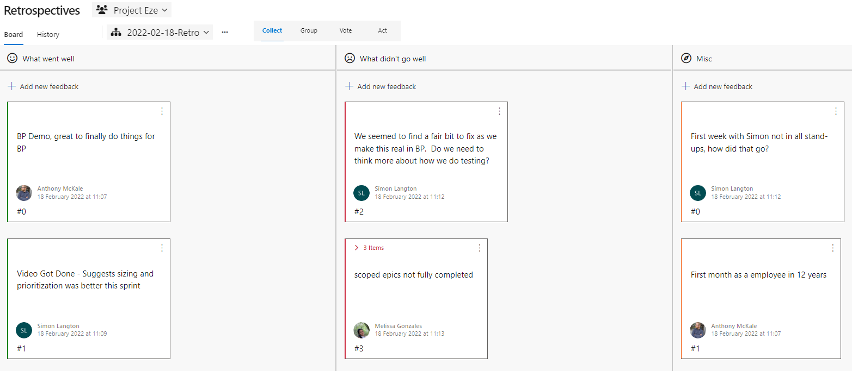
Ceremonies: Sprint Retrospective
Example
https://en.wikipedia.org/wiki/Scrum_(software_development)

Slide 55
Release Cycle aka the Sprint

Slide 56
The Sprint
Sprint is a cycle
Time boxed (typically 2 weeks)
Starts with ‘Planning’ (what to do)
Daily ‘Standups’ (daily status updates)
End with ‘Review’ (what was achieved)
with ‘Retrospective’ every 2 sprints or so (how is it going)
https://en.wikipedia.org/wiki/Scrum_(software_development)

Slide 57
The Sprint
Let put it all together Ceremonies + Artifacts (with actual work done by Roles)
https://en.wikipedia.org/wiki/Scrum_(software_development)

Slide 58
The Sprint
Sprint is a cycle
PLANNING
STANDUP
SHOWCASE
RETROSPECTIVE
https://en.wikipedia.org/wiki/Scrum_(software_development)

Slide 59
The Sprint
Sprint is a cycle
PLANNING
STANDUP
SHOWCASE
RETROSPECTIVE
PRODUCT
BACKLOG
SPRINT
BACKLOG
WORKING CODE
https://en.wikipedia.org/wiki/Scrum_(software_development)

Slide 60
Pros and Cons

Slide 61
Pros and Cons
Discussion PROS: https://www.indeed.com/career-advice/career-development/pros-cons-of-agile-methdology Excellent for ongoing projects CONS: Dark scrum (slavish adherence) https://ronjeffries.com/articles/016-09ff/defense/
Planning Issues https://www.planview.com/resources/articles/disadvantages-agile/ https://alistapart.com/blog/post/the-most-dangerous-word-in-software-development/ Poor for fixed engagement projects, estimation ( ironically long-term estimation is effectively same as Waterfall )

Slide 62
Further Reading

Slide 63
Further Reading
Better System for Business as Usual / Software Maintenance Teams Replaces Planning/Sprints with On-demand Ticket Creation/Planning Buckets
https://en.wikipedia.org/wiki/Scrumban
Better System for Non-Development Teams Replaces Pushing Epic Tickets into Sprints with Pulling Work from a common Pool
https://en.wikipedia.org/wiki/Kanban_(development)
Description of Scrum
https://en.wikipedia.org/wiki/Scrum_(software_development)#Planning
Scrum Training (Where I did my scrum master course many moons ago)
http://www.agilebear.com/

Slide 64
Questions
I’ve been Anthony “Zapper” M^{c}Kale
Hopefully I’ve Educated, Informed, and even Entertained Good Testing is Good Security is Good software

Slide 65
Thank you

