Slide 1


Academy
Professionalism
Anthony McKale
Principal Software Engineer

Slide 2
Preface
Professionalism starts with the simple :
Tidy appearance
Punctuality
Good Email and Verbal skills
The above is expected of a professional
The following is how to be a good professional

Slide 3
Academy
Professionalism
Professional Mindset
Anthony McKale
Principal Software Engineer

Slide 4
Professional Mindset
Minus the looking and sounding professional, that is expected knowledge

Slide 5
Professional Mindset
4 elements of effective professionals
Good Engineering
Attention to Quality via Control and Assurance
Effective Teamworking
Continuous Self improvement
* See similarity to agile methodologies for effective teams of professionals

Slide 6
Good Engineering

Slide 7
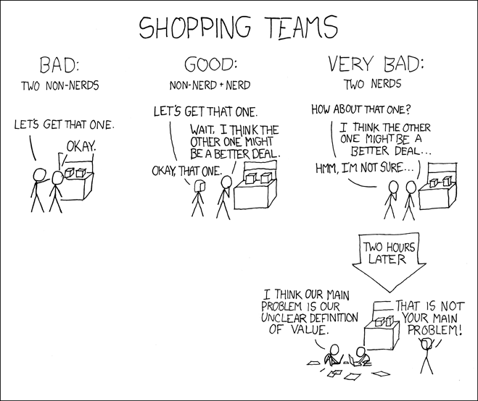
Perfect is the Enemy of Good
.
https://xkcd.com/309/

Slide 8
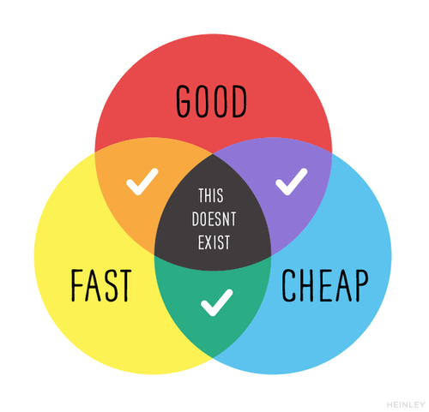
Good Engineering
Engineering is making things via trade offs and compromises
Rules of thumb for professional modern engineer

Slide 9
Good Engineering
3 rules to engineer by
- KISS
- Every job has a few good tools and lots of bad tools…
- Perfect is the enemy of good

Slide 10
Good Engineering
Keep It Simple Stupid
Backed mathematically provable theory “Occam’s Razor” “For two equal successful methods, the more complex is more likely to be incorrect”
https://www.merriam-webster.com/dictionary/Occam%27s%20razor

Slide 11
Good Engineering
KISS - use as few moving parts as possible
- use plain simple coding style
- refactor unnecessary complexity at the design phase

Slide 12
Good Engineering
3 rules to engineer by
- KISS
- Every job has a few good tools and lots of bad tools…
- Perfect is the enemy of good

Slide 13
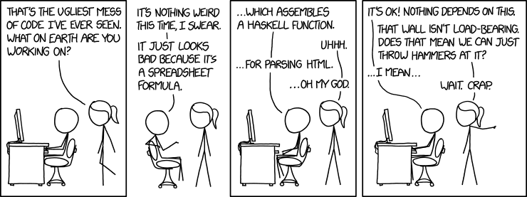
If you only have a hammer, everything looks like a nail
.
https://www.explainxkcd.com/wiki/index.php/1926:_Bad_Code

Slide 14
Good Engineering
Every job has a few good tools “If you only have a hammer, everything looks like a nail”
Use the right tool for the job Not every problem is a python problem,
Not every problem is a programming problem,
Not every problem is a technical problem

Slide 15
Good Engineering
3 rules to engineer by
- KISS
- Every job has a few good tools and lots of bad tools…
- Perfect is the enemy of good

Slide 16
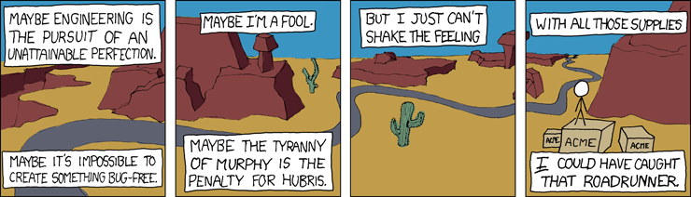
Perfect is the enemy of Good
.
https://xkcd.com/319/

Slide 17
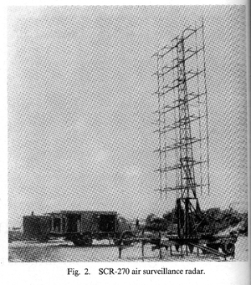
Good Engineering
Perfect is the enemy of good Much of the rapid progress made …by British radar… can be attributed to Watson-Watt's doctrine “Give them the third best to go on with; the second best comes too late, the best never comes.”
https://ethw.org/Radar_during_World_War_II https://ethw.org/Robert_Watson-Watt

Slide 18
Good Engineering
Perfect is the enemy of good Agile teaches working code is preferred to perfect design
Do this:
- P.O.C first with working prototypes
- get working code into develop / production fast - don’t wait for perfect, do working today

Slide 19
Good Engineering Questions ?
3 rules to engineer by
- KISS
- Every job has a few good tools and lots of bad tools…
- Perfect is the enemy of good

Slide 20
Attention to Quality

Slide 21
Attention to Quality
Engineering is only as good as it’s weakest link
Whether that is poor design choice, or a bug in code
Rules of thumb for professional modern engineer

Slide 22
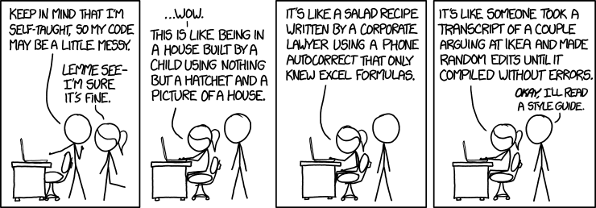
Fail to plan, plan to fail: Style Guides
.
https://www.explainxkcd.com/wiki/index.php/1513:_Code_Quality

Slide 23
Attention to Quality
3 rules of quality
Fail to plan, plan to fail aka “the 5 Ps”
Measure twice, cut once
Continuously struggle to be better
Team-Exercise
Learning from Failure: Post-mortems

Slide 24
Attention to Quality
3 rules of quality
Fail to plan, plan to fail aka “the 5 Ps”
Measure twice, cut once
Continuously struggle to be better

Slide 25
Fail to plan, plan to fail
Agile teaches to plan the future at high abstraction (epic level), and breakdown the now “just in time” (work ticket level)
Not
Don’t plan the future at all…
This is a common agile anti pattern

Slide 26
Fail to plan, plan to fail
Think of the spirit backlog when implementing current work
Look for easy ways to lay out infrastructure for future work
Lookout for “two birds with one stone” opportunities
Good engineers build the roads of today, while laying the foundations of the future

Slide 27
Fail to plan, plan to fail: 5 Ps
Also known as the 5 Ps in the British army

Slide 28
Fail to plan, plan to fail: 5 Ps
Also known as the 5 Ps in the British army
Proper
Planning
Prevents
Poor
Performance

Slide 29
Attention to Quality
3 rules of quality
Fail to plan, plan to fail aka “the 5 Ps”
Measure twice, cut once
Continuously struggle to be better

Slide 30
Measure twice, cut once
Walk forward, and don’t go fall backwards Remember: Prod bugs cost x100 what a develop bug costs
- Check your completed work is working
- Check your previous work is still working

Slide 31
Measure twice, cut once
you are responsible for your work output NEVER fire and forget when writing code, or making system changes
ALWAYS kick the tyres when completing work you build it, you run it

Slide 32
Measure twice, cut once
You build it, you run it, tips:
- Use unit / integration testing if programming - Setup alarms and automated checks if setting up systems
- nothing wrong with a quick eyeball check too !

Slide 33
Continuously struggle to be better
Agile teaches continuous improvement - Hunt out poor inefficient processes
- Spot common anti-patterns
- Refactor the places that bugs lurk
Now for a saying by a very special guy, someone who knew a thing or two about affecting change in rigid complex systems in the real world Same rules apply to software

Slide 34
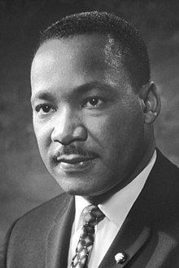
Continuously struggle to be better
“Change does not roll in on the wheels of inevitability, but comes through continuous struggle.“ ~Martin Luther King, Jr. https://en.wikipedia.org/wiki/Martin_Luther_King_Jr.

Slide 35
Continuously struggle to be better
“Change … comes through continuous struggle.“ Same rules apply to software…. and just about anything worth fighting for

Slide 36
Attention to Quality
3 rules of quality
Fail to plan, plan to fail aka “the 5 Ps”
Measure twice, cut once
Continuously struggle to be better

Slide 37
Attention to Quality Questions ?
Team-Exercise
Learning from Failure: Post-mortems

Slide 38
Post-mortem after Failure
The sprint regular post-mortem is the Retrospective
After serious or large scale failures, large success Devops teams commonly carry out Post-mortems*
* Also called After Action Reports, and Washups
https://sre.google/sre-book/postmortem-culture/

Slide 39
Post-mortem after Failure
Post-mortem reports/meetings are method for discovering true reasons for failure
After serious or large scale failures, large success Devops teams commonly carry out Post-mortems*
* Also called After Action Reports, and Washups
https://sre.google/sre-book/postmortem-culture/

Slide 40
Post-mortem after Failure
Often there in non-blameless teams, the obvious is covered up for fear of blame
Post-mortems are designed to rip that band aid off to find the true malaise behind failure events
https://sre.google/sre-book/postmortem-culture/

Slide 41
Post-mortem Process
Failure event
Post-mortem report
Post-mortem meeting
Profit … ? I mean value
https://sre.google/sre-book/postmortem-culture/

Slide 42
Post-mortem: 1) Failure Event
Organisations often grade severity of bugs / outages / events
Mature organisation mandate post-mortems above a severity threshold
https://sre.google/sre-book/postmortem-culture/

Slide 43
Post-mortem Severity Example
From Atlassian, who create Jira / Confluence
https://www.atlassian.com/incident-management/kpis/severity-levels
Severity | Description | Examples
P1 | Critical incident with very high impact | A customer-facing service, like Jira Cloud, is down for all customers Confidentiality or privacy is breached Customer data loss
P2 | Major incident with significant impact | A customer-facing service is unavailable for a subset of customers Core functionality (e.g. git push, issue create) is significantly impacted
P3 | Minor incident with low impact | A minor inconvenience to customers, workaround available Usable performance degradation

Slide 44
Post-mortem: 2) Report
Post-mortem reports are Blameless* documents created by the Engineers call-on / in-charge of event
* Blameless = See Agile Prime Directive

Slide 45
Post-mortem: 2) Report
Post-mortem reports record the “anatomy of the disaster”:
Actions where took at time of failure
Affect effects observed
Expectations of actions
Assumptions made
Timeline
Mature incident response processes, might even record these in real time inside a ticketing system for incidents

Slide 46
Post-mortem: 3) Team Meeting
Post-mortem reports are analysed in post-mortem meetings where the “Second Story” is found The Why behind the What/Where
Then actions can be queued next sprint to work on that Why

Slide 47
Post-mortem Process
Failure event
Post-mortem report
Post-mortem meeting
Actions
https://sre.google/sre-book/postmortem-culture/

Slide 48
Post-mortem after Failure
Questions ?
Highly effective devops Engineers carry out blameless post-mortems on serious failures

Slide 49
Attention to Quality Questions ?
3 rules of quality
Fail to plan, plan to fail aka “the 5 Ps”
Measure twice, cut once
Continuously struggle to be better
Team-Exercise
Learning from Failure: Post-mortems

Slide 50
Effective Teamworking

Slide 51
Effective Teamworking
Engineering is a team sport
Each member as a role and responsibility
Engineers must balance support with quality-regulation

Slide 52
Effective Teamworking
3 rules of teamworking
Agile Prime Directive
Trust, but verify
Don't be a BOFH
Self-Exercise
Conflict management: Bozo test

Slide 53
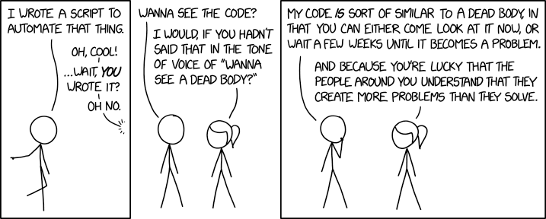
Trust, but verify
.
https://www.explainxkcd.com/wiki/index.php/2138:_Wanna_See_the_Code%3F

Slide 54
Teamworking: Agile Prime Directive
"Regardless of what we discover,
we understand and truly believe
that everyone did the best job they could,
given what they knew at the time,
their skills and abilities,
the resources available,
and the situation at hand.“
--Norm Kerth, Project Retrospectives: A Handbook for Team Review
http://retrospectivewiki.org/index.php?title=The_Prime_Directive

Slide 55
Teamworking: Agile Prime Directive
Rule’s to live by, when in a mixed ability team Also commonly known as Napoleon's law “Don’t ascribe to malice, what can be plainly explained by incompetence*.” * incompetence : broad term standing for situation as a whole
Ability; Knowledge; Communication Failures; Resourcing; etc https://en.wikipedia.org/wiki/Hanlon%27s_razor

Slide 56
Effective Teamworking
3 rules of teamworking
Agile Prime Directive
Trust, but verify
Don't be a BOFH

Slide 57
Teamworking: Trust, but verify
We all have bad days
Peer Review prevent these moments becoming problems
If your team doesn’t do peer-review, suggest and request it
Remember the team is only as good as it’s worse code/implementation

Slide 58
Teamworking: Trust, but verify
Remember the team is only as good as it’s worse code/implementation
The impression of months of work can be ruined by one critical bug
Production bugs x100 worse than a dev bugs

Slide 59
Teamworking: Trust, but verify
Peer Review 101
Be Humble, be grateful
Ask for clarification, no sarcasm/hyperbole
Avoid selective or personal ownership of code
Offer alternative implementations, but assume considered
Remember provide feedback, not gatekeep
https://github.com/thoughtbot/guides/tree/main/code-review

Slide 60
Effective Teamworking
3 rules of teamworking
Agile Prime Directive
Trust, but verify
Don't be a BOFH

Slide 61
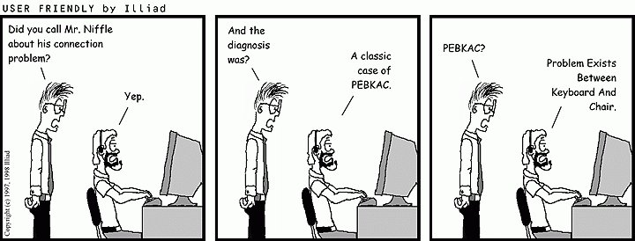
Don't be a BOFH
.
https://en.wikipedia.org/wiki/User_Friendly

Slide 62
Teamworking: BOFH
When you start : you have to learn
After that : you have to teach
After that : you have to manage
No matter where you are as a Engineer Be Humble, be grateful, be kind
No one wants to work with arrogant, selfish, cruel people

Slide 63
Effective Teamworking
3 rules of teamworking
Agile Prime Directive
Trust, but verify
Don't be a BOFH

Slide 64
Effective Teamworking
Self-Exercise
Conflict management: Bozo test

Slide 65
Teamworking: Bozo test
At some point every one has a chalk and cheese moment Two engineers unable to peacefully work together
It’s unfortunate but inevitable at some point someone will rub / or be rubbed the wrong way

Slide 66
Teamworking: Bozo test
Chalk-Cheese moments Common questions: - Is it me ?
- Is it them ?
- Can we work it out ? (without help)
Enter the Bozo Test to help out

Slide 67
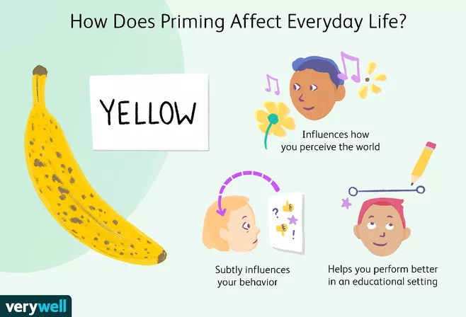
Teamworking: Bozo test
.
https://www.verywellmind.com/priming-and-the-psychology-of-memory-4173092

Slide 68
Teamworking: Bozo test
Bozo test aims to answer these three Chalk-Cheese questions: - Is it me ?
- Is it them ?
- Can we work it out ? (without help)

Slide 69
Teamworking: Bozo test steps
Imagine your self having some thing lovely done by a loved one aka Mum buying you flowers, or a stayaway trip
Now imagine your worst enemy colleague doing this aka your colleague buying you flowers, or a stayaway trip
PAUSE we are analysing YOUR INITIAL PRIMED RESPONSE https://thedecisionlab.com/biases/priming

Slide 70
Teamworking: Bozo test
If you are happy with both scenerios: Excellent it’s them If you are unhappy with the colleague for the present: Sadly it’s you (and possibly also them) This is called a personality conflict, they happen ! Don’t panic !

Slide 71
Teamworking: Bozo test
You’ll need a trusted 3rd party* to help mediate
If you try to solve the conflict yourselves it’s likely to escalate
3rd party* = Manager, Scrum Master, trusted colleague

Slide 72
Teamworking: Bozo test
PS: If your colleague fails the bozo test
You still need a 3rd party

Slide 73
Effective Teamworking Questions?
3 rules of teamworking
Agile Prime Directive
Trust, but verify
Don't be a BOFH
Self-Exercise
Conflict management: Bozo test

Slide 74
Continuous Self Improvement

Slide 75
Continuous Self Improvement
Good engineers work smart not hard
That’s a learnt behaviour
Don’t grind against problems, work with or around them

Slide 76
Continuous Self Improvement
2 rules of self-improvement
Saving a penny, losing a pound
Work smart not necessarily hard
Self-Exercise for life change
Over-extending yourself <exercise> WhaWha Effect

Slide 77
Improvement: Saving a penny, losing a pound
If I had nine hours to chop down a tree, I’d spend the first six sharpening my axe
Be wary of false economies, when self-improving “spending 4 years at Uni, to get your first interview easier”
“spending 2 months Retrofitting unit tests, onto the project about to be shutdown”

Slide 78
Continuous Self Improvement
2 rules of self-improvement
Saving a penny, losing a pound
Work smart not necessarily hard
Self-Exercise for life change
Over-extending yourself <exercise> WhaWha Effect

Slide 79
Improvement: Smart not hard
Important to work smart not necessarily hard to be productive Examples of hard but stupid things:
using cheap/poor IDEs (like notepad)
poor developer machines
excessive or slow or duplicated testing
following overly complex designs

Slide 80
Continuous Self Improvement
2 rules of self-improvement
Saving a penny, losing a pound
Work smart not necessarily hard
Self-Exercise for life change
Over-extending yourself <exercise> WhaWha Effect

Slide 81
Improvement: WhaWha Effect
Important when doing new things: - know it’s ok/normal to overwhelmed
- know when to ask for help
A technique for identifying this is the WhaWha effect

Slide 82
Improvement: WhaWha Effect
When starting something new it is hard Your head goes Wha
Then you get used to the thing, and all is calm
Then something unusual happens and it’s hard again!
Your head goes Wha
And then you learn the new thing, and the cycle repeats

Slide 83

Improvement: WhaWha Effect
Happy path WhaWha effect
Starting new thing
Problem 1
Problem 2
Problem 3
At this point, time for new challenges

Slide 84
Improvement: WhaWha Effect
And there’s the downward cycle version
starting something new it is hard Your head goes Wha
Then you don’t get used to it, something unusual happens and it’s even harder!
Your head goes WhaWha
And then it gets worse and worse without recovery, until you quit or are removed from the thing

Slide 85

Improvement: WhaWha Effect
Sad path WhaWha effect
Problem 3
Problem 2
At this point, you quit or are removed
Problem 1
Starting new thing

Slide 86
Improvement: WhaWha Effect
Solution: know your WhaWha state If it’s getting out of control, or your not able to have those calm moments: get help
If it’s too calm, and you’re bored or unable to get challenge: get new challenges
It’s really bad for your emotional and mental health to be in a repeated WhaWha state, or in a steady state too!

Slide 87
Continuous Self Improvement Questions ?
2 rules of self-improvement
Saving a penny, losing a pound
Work smart not necessarily hard
Self-Exercise for life change
Over-extending yourself <exercise> WhaWha Effect

Slide 88
Engineer Rules of Thumb

Slide 89
Good Engineering Questions ?
3 rules to engineer by
- KISS
- Every job has a few good tools and lots of bad tools…
- Perfect is the enemy of good

Slide 90
Attention to Quality Questions?
3 rules of quality
Fail to plan, plan to fail aka “the 5 Ps”
Measure twice, cut once
Continuously struggle to be better

Slide 91
Effective Teamworking Questions?
3 rules of teamworking
Agile Prime Directive
Trust, but verify
Don't be a BOFH
Self-Exercise for Conflict Management
Conflict management <exercise> Do the Bozo test

Slide 92
Continuous Self Improvement Questions ?
2 rules of self-improvement
Saving a penny, losing a pound
Work smart not necessarily hard
Self-Exercise for life changes
Over-extending yourself <exercise> WhaWha Effect

Slide 93
Questions ?
…

Slide 94
Postface

Slide 95
Postface: Aim for the moon
Always aim for the moon, because all projects start in a hole*
Only by aiming high can you reach success
* Software projects actually start deep underground

Slide 96
Questions
I’ve been Anthony “Zapper” M^{c}Kale
Hopefully I’ve Educated, Informed, and even Entertained Good Testing is Good Security is Good software

Slide 97
Thank you

