Slide 1

Effective Engineering Professionalism
By Anthony McKale Associate Director of DevOps and Cloud
Date 02-2024

Slide 2

Disclaimer This talk is based off many previous talks, done at many previous times and place, over many many years THIS TALK IS MIT LICENSED

Slide 3
TABLE OF CONTENTS - INTRO - QUALITY WORK
- ATTENTION TO DETAIL
- TEAMWORK - SELF IMPROVEMENT

Slide 4
What is Professionalism

Slide 5
What: is Professionalism
Audience participation Question: What is Professionalism ?

Slide 6
What: is Professionalism
Question: What is Professionalism ?
Tidy appearance
Punctuality
Good Email and Verbal skills
The above expected basic professionalism Not how to be a good professional

Slide 7
What is Professionalism
Professional Mindset
Minus the looking and sounding professional, that is expected knowledge

Slide 8
Professional Mindset
4 elements of effective professionals
Good Engineering
Attention to Quality via Control and Assurance
Effective Team working
Continuous Self improvement

Slide 9
Professional Mindset
Rules of thumb for each follow
Good Engineering
Attention to Quality via Control and Assurance
Effective Team working
Continuous Self improvement

Slide 10
Good Engineering

Slide 11
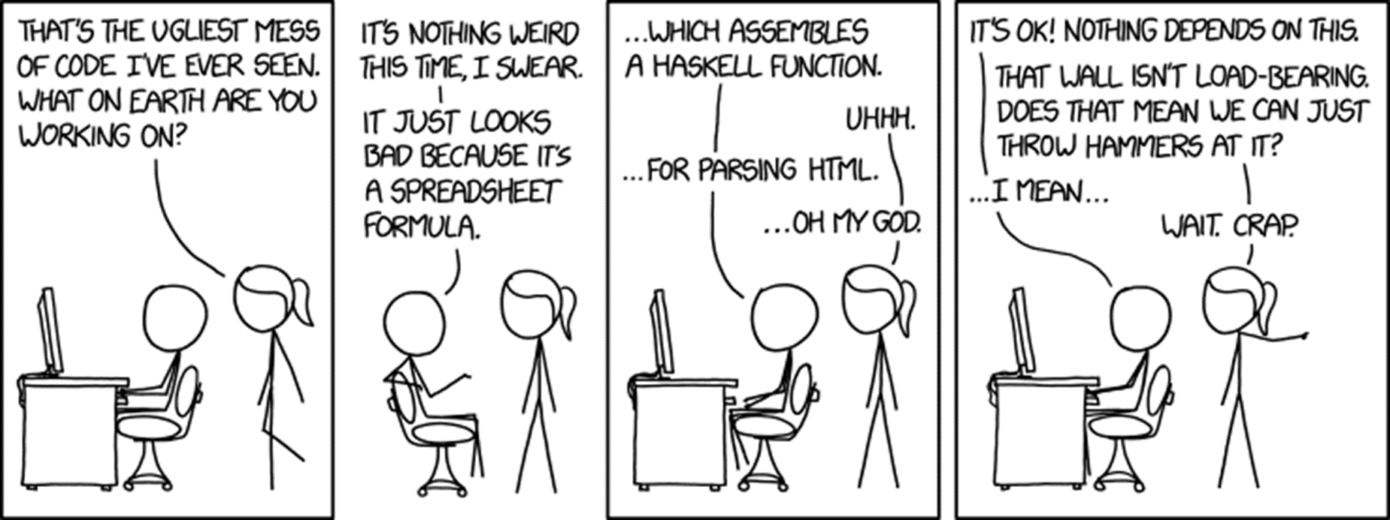
Good Engineering
If you only have a hammer, everything looks like a nail
https://www.explainxkcd.com/wiki/index.php/1926:_Bad_Code

Slide 12
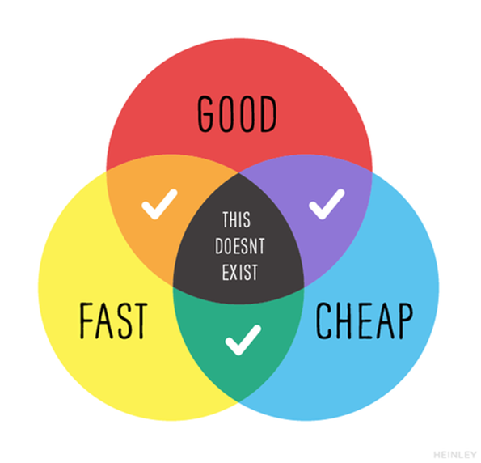
Good Engineering
Engineering is making things via trade offs and compromises
Rules of thumb for professional modern engineer

Slide 13
Good Engineering
3 rules to engineer by
KISS
Every job has a few good tools and lots of bad tools…
Perfect is the enemy of good

Slide 14
Good Engineering
Keep It Simple Stupid
Backed mathematically provable theory “Occam’s Razor” “For two equal successful methods, the more complex is more likely to be incorrect”
https://www.merriam-webster.com/dictionary/Occam%27s%20razor

Slide 15
Good Engineering
KISS in practice
use as few moving parts as possible
use plain simple coding style
refactor unnecessary complexity at the design phase

Slide 16
Good Engineering
Every job has a few good tools in practice “If you only have a hammer, everything looks like a nail”
Use the right tool for the job
Not every problem is a python/java problem
Not every problem is a programming problem
Not every problem is a technical problem

Slide 17
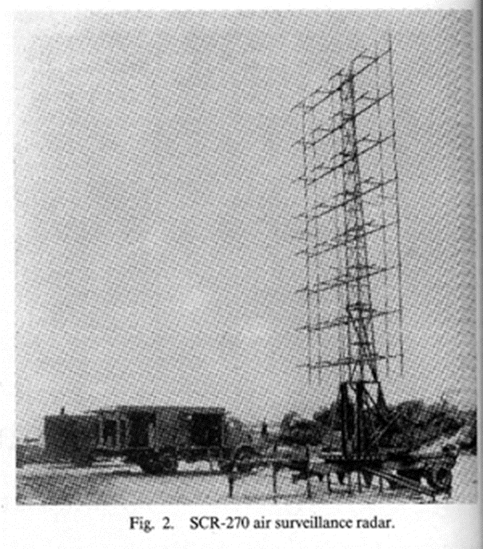
Good Engineering
Perfect is the enemy of Good Much of the rapid progress made …by British radar… can be attributed to Watson-Watt's doctrine “Give them the third best to go on with; the second best comes too late, the best never comes.”
https://ethw.org/Radar_during_World_War_II https://ethw.org/Robert_Watson-Watt

Slide 18
Good Engineering
Perfect is the enemy of Good is Practice Agile teaches working code is preferred to perfect design
Start with working prototypes
Get working pipelines sending code into develop / production fast
Don’t wait for perfect, do working today

Slide 19
Good Engineering
3 rules to engineer by
KISS Engineer it simple
Every job has a few good tools and lots of bad tools…
Use right language or arena for solutioning
Perfect is the enemy of good Working is better than in-progress

Slide 20
Attention to Detail
Quality

Slide 21
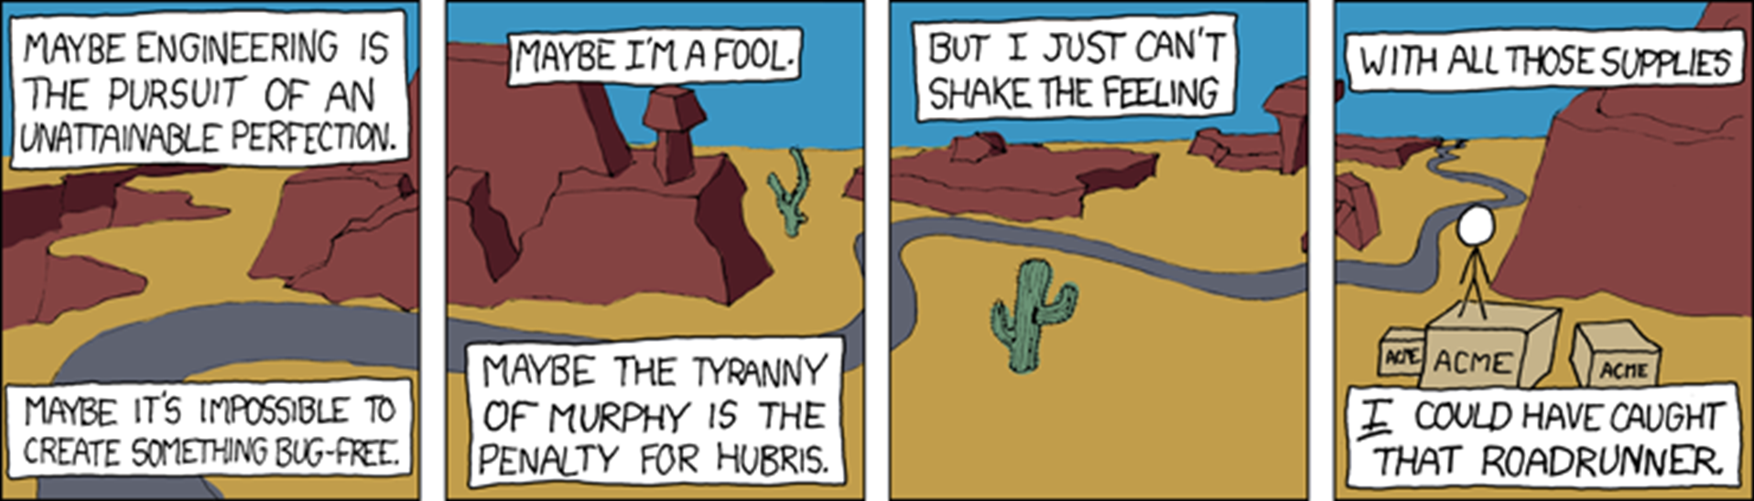
Attention to Quality
https://xkcd.com/319/

Slide 22
Attention to Quality
Engineering is only as good as its weakest link
Whether that is poor design choice, or a bug in code

Slide 23
Attention to Quality
Rules of thumb for professional modern quality engineering
Fail to plan, plan to fail (aka “the 5 Ps”)
Measure twice, cut once
Continuously struggle to be better

Slide 24
Attention to Quality
Fail to plan, plan to fail in practice (engineer version)
Help your scrum master, when planning phase
Prepare/Groom essential work for the spirit backlog before hand
Write up design proposals with peer review
If you don’t have work, find or create work!

Slide 25
Attention to Quality
Fail to plan, plan to fail in practice (engineer version)
Help your scrum master, when working
Think of the spirit backlog (Lookout for “two birds with one stone” opportunities)
Plan ahead, look for easy ways to lay out infrastructure for future work
If you don’t have work, find or create work!

Slide 26
Attention to Quality
Measure twice, cut once
you are responsible for your work output you build it, you run it
NEVER fire and forget when writing code, or making system changes
ALWAYS kick the tyres when completing work

Slide 27
Attention to Quality
Measure twice, cut once in practice
You build it, you run it, tips:
Use unit / integration / synthetic testing ( if programming / testing )
Setup alarms and automated checks ( if setting up systems )
Nothing wrong with a quick eyeball check too!

Slide 28
Attention to Quality
Continuously struggle to be better
Agile teaches continuous improvement
Good engineers are always learning, and making their surroundings better
This isn’t easy, to quote a Great man “<improvement> takes continuous struggle”

Slide 29
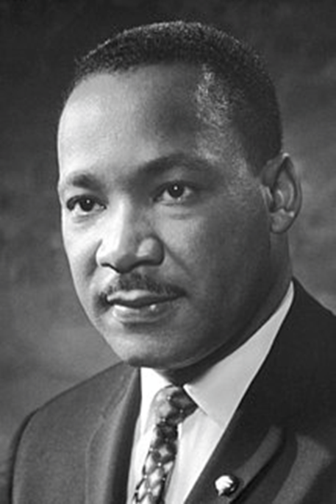
Attention to Quality
Continuously struggle to be better
“Change does not roll in on the wheels of inevitability, but comes through continuous struggle.“ ~Martin Luther King, Jr. https://en.wikipedia.org/wiki/Martin_Luther_King_Jr.

Slide 30
Attention to Quality
“Change … comes through continuous struggle.“ Same rules apply to software…. and just about anything worth fighting for
Tips:
Hunt out poor inefficient processes
Spot common anti-patterns
Refactor the places that bugs lurk
Engage in the post mortems
Engage in the Retrospectives

Slide 31
Attention to Quality
Engineering is only as good as its weakest link
Fail to plan, plan to fail (aka “the 5 Ps”)Be Involved in planning
Measure twice, cut once Test, Test, and Test
Continuously struggle to be better Make the effort!

Slide 32
Effective Teamworking
Aka how to win friends and influence people

Slide 33
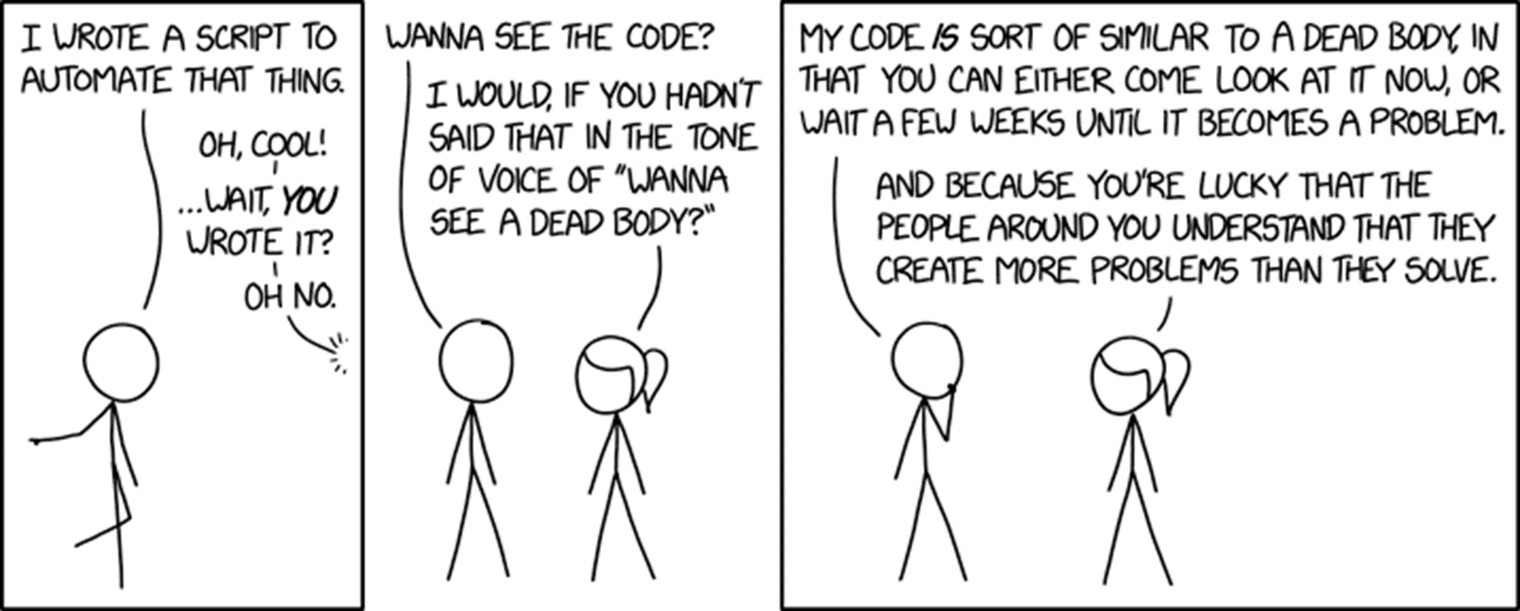
Effective Teamworking
https://www.explainxkcd.com/wiki/index.php/2138:_Wanna_See_the_Code%3F

Slide 34
Effective Teamworking
Teamworking Facts Engineering is a team sport
Each member as a role and responsibility
Engineers must balance support with quality-regulation

Slide 35
Effective Teamworking
Team working Rules of Thumb
Agile Prime Directive
Trust, but verify
Don't be a BOFH

Slide 36
Effective Teamworking
Agile Prime Directive "Regardless of what we discover,
we understand and truly believe
that everyone did the best job they could,
given what they knew at the time,
their skills and abilities,
the resources available,
and the situation at hand.“
--Norm Kerth, Project Retrospectives: A Handbook for Team Review
http://retrospectivewiki.org/index.php?title=The_Prime_Directive

Slide 37
Effective Teamworking
Agile Prime Directive in practice commonly known as Napoleon's law “Don’t ascribe to malice, what can be plainly explained by incompetence*.” * incompetence : broad term standing for situation as a whole
Ability; Knowledge; Communication Failures; Resourcing; etc https://en.wikipedia.org/wiki/Hanlon%27s_razor

Slide 38
Effective Teamworking
Trust, but verify (and in practice) We all have bad days
Peer Review prevent these moments becoming problems
If your team doesn’t do peer-review, suggest and request it
The impression of months of work can be ruined by one critical bug

Slide 39
Effective Teamworking
Trust, but verify (and in practice) … continued Peer Review 101
Be Humble, be grateful
Ask for clarification, no sarcasm/hyperbole
Avoid selective or personal ownership of code
Offer alternative implementations, but assume considered
Peers provide feedback, not gatekeeper
https://github.com/thoughtbot/guides/tree/main/code-review

Slide 40
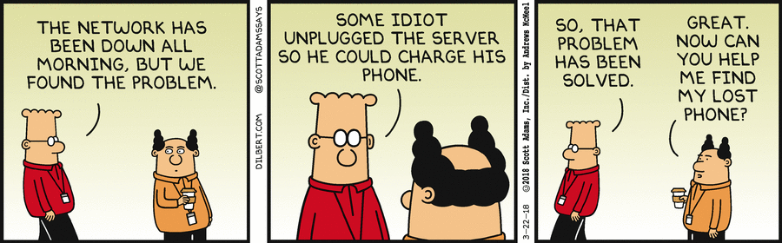
Effective Teamworking
Don't be a BOFH
https://en.wikipedia.org/wiki/Bastard_Operator_From_Hell https://mamchenkov.net/wordpress/2019/03/24/bofh-the-bastard-operator-from-hell/

Slide 41
Effective Teamworking
Team working Rules of Thumb
Agile Prime Directive Don’t Blame
Trust, but verify Peer Review well
Don't be a BOFH Be assertive, firm but not cruel, vindictive

Slide 42
Continuous Self Improvement
Aka how to win friends and influence people

Slide 43
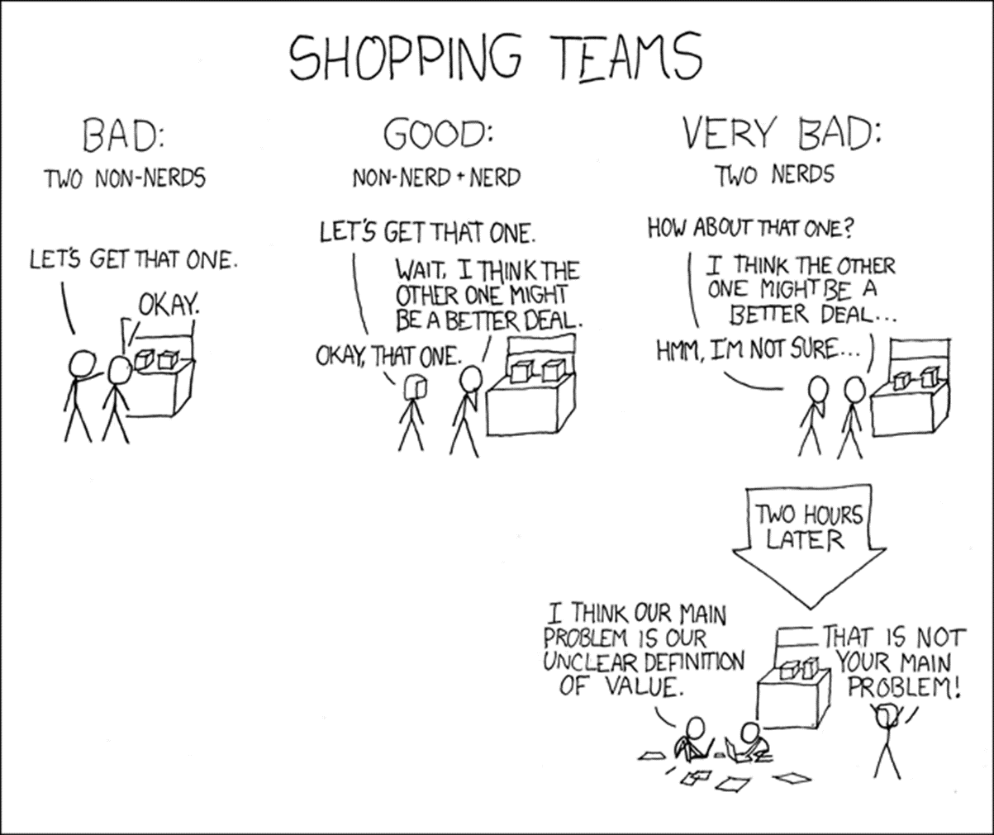
Self Improvement

Slide 44
Self Improvement
Good engineers work smart not hard
That’s a learnt behaviour
Don’t grind against problems, work with or around them

Slide 45
Self Improvement
2 rules of self-improvement
Saving a penny, losing a pound
Work smart not necessarily hard

Slide 46
Self Improvement
Saving a penny, losing a pound
If I had nine hours to chop down a tree, I’d spend the first six sharpening my axe

Slide 47
Self Improvement
Saving a penny, losing a pound
Be wary of false economies, when self-improving your time is precious
“spending 2 months Retrofitting unit tests, onto the project about to be shutdown”
“spending 4 years at Uni, to get your first interview easier”

Slide 48
Self Improvement
Work smart not hard Easy to work hard and not achieve much
Important be productive first, with working effort being variable

Slide 49
Self Improvement
Work smart not hard Examples of hard but stupid things:
Cheap/poor IDEs (like notepad not vscode)
Poorly setup developer machines
Excessive or slow or duplicated testing
Overly complex system designs or software frameworks

Slide 50
Self Improvement
2 rules of self-improvement
Saving a penny, losing a pound Concentrate on value!
Work smart not necessarily hard Use productive tooling and techniques!

Slide 51

Questions?

Slide 52
Thank you for your Awesomeness
If you have any questions anthony.mckale@6point6.co.uk #dep-eng-devops (slack)

