Slide 1


Friday Training Hour
“Python 101” v2
+ Mr McKale’s Shipping Exercise
Anthony McKale Principal Engineer
18/03/2022

Slide 2
Python 101 v2
Today we’ll cover :
Python Facts
Variables
Functions
Tooling
Mr McKale’s Shipping

Slide 3
PYTHON FACTS

Slide 4
Python Facts
Born in the late 80’s by a chap called “Guido”
Named after Monty Python’s Flying Circus
Modern Python 3.0 came out in 2008
Adopted as the language of choice by Data Scientists
Adopted around the world as “hardcode” heavy lifting language for CPU bound applications …rust slowly taking over though
Though, Python is changing fast, new versions every year, with new incompatible features…

Slide 5
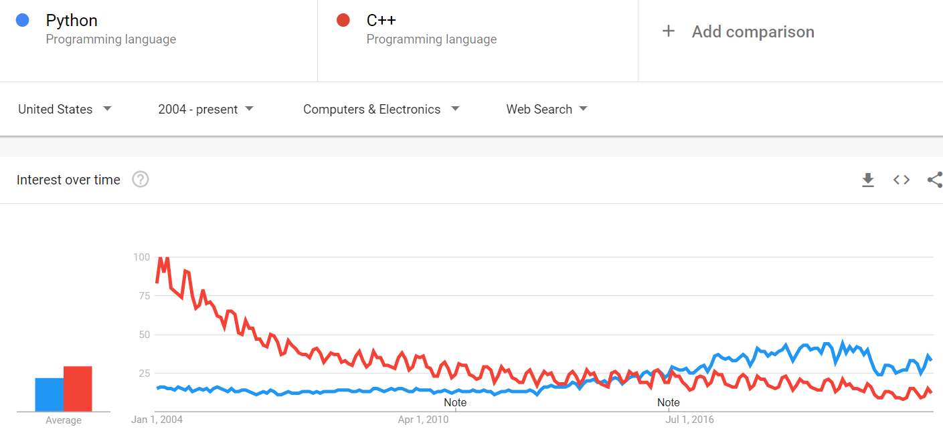
Python Facts
One of the most popular languages in the world

Slide 6
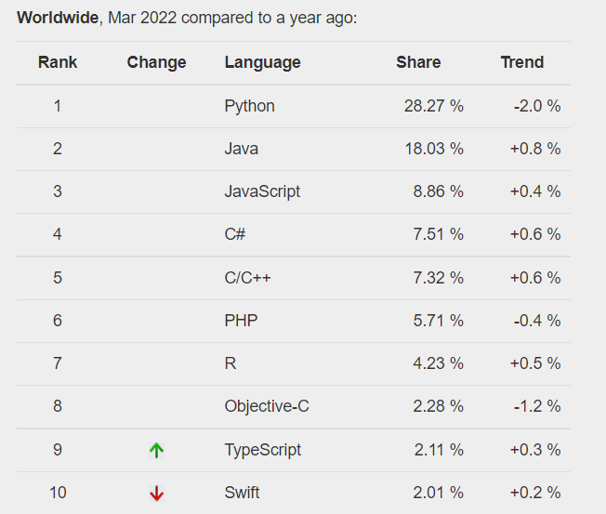
Python Facts
One of the most popular
languages in the world…
continued

Slide 7
Python Printing / Running: 101

Slide 8
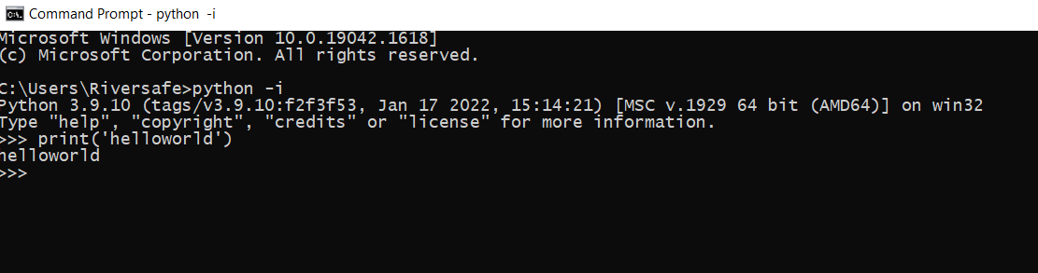
Python Primer: interactive
Jump straight into python with `python -i`

Slide 9

Python Primer: Hello World
print('thing'), easy right ?

Slide 10
Python Primer: 101
Now deeper…
Primitives
Functions

Slide 11
Python Primitives

Slide 12
Python Primer: Primitives
Languages have variables for storing data
Read stdtype docs for more info
See https://docs.python.org/3/library/stdtypes.html

Slide 13
Python Primer: Primitives
Python’s simple variable types are:
Booleans:
True/False
Numbers:
1, 2, 3, 0, -1, 0.5
Strings:
‘word’, ‘some words’, ‘cHaRaCtRrS’
Collections:
[1,2,3]
{‘name’: ‘anthony’, age: ‘21’}

Slide 14

Python Primer: Primitives
Used to entry into functions like print
Example:
creates a string variable name_message
and runs function print with it
variables always use snake_case not camelCase

Slide 15
Python Primer: Primitives
Quick Syntax Primer

Slide 16

Python Primer: Boolean Primitives
Boolean = yes/no aka binary 1/0
( Warning: technically 3rd state : None, which is no value)
.

Slide 17
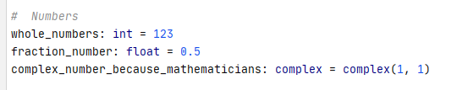

Python Primer: Number Primitives
int == Whole Numbers, float == Fraction Numbers
( Int and floats are very different so be careful )
PS: remember Python can’t count
.

Slide 18
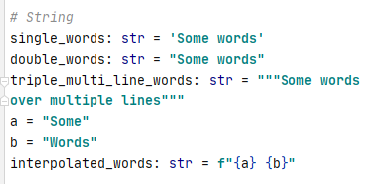
Python Primer: String Primitives
String == List of characters “String-ed” togther

Slide 19

Python Collection: Sequence Primitives
list == Array
Remember you need to access via index, var[<index>]
(indexes start from 0)

Slide 20
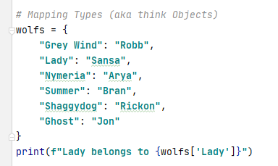
Python Collection: Mapping Primitives
Dict == Key Value pair map
Remember you need to access via key using “[]” var[“KEY”]
.

Slide 21
Python Primer: Primitives Overview
It’s close enough to other languages, to be easy to pickup
It’s close enough to other languages, to make silly mistakes
So be careful ☺

Slide 22
Python Functions

Slide 23
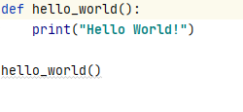
Python Primer: Function
You setup, stored lists of operations to run
Easy right ?
functions always use snake_case not camelCase

Slide 24
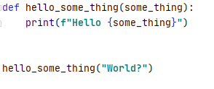
Python Primer: Function Parameters
You can customise your functions with Parameters
Parameters should be snake_case too

Slide 25
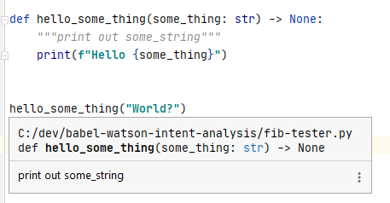
Python Primer: Function DocString
For documenting your code
“““documentation”””
Use typing as well to improve your self documenting code
Ps https://www.python.org/dev/peps/pep-0257/ for more info

Slide 26
Python Primer: Questions
5 mins breather, questions ?

Slide 27
Python Tooling

Slide 28
Python Tooling
What’s the difference between a “Python Developer” and a “Python Software Engineer” …

Slide 29
Python Tooling
What’s the difference between a “Python Developer” and a “Python Software Engineer”
Good Tooling
Code Style Tooling
Code Testing Tooling

Slide 30
Code
Styling

Slide 31
Code
Styling
aka
use ‘Black’

Slide 32
Python Primer: Auto fix Code Styling
Use black or similar for all code to fix said mistakes in your code
Install with pip
pip install black
black *.py
https://pypi.org/project/black/

Slide 33
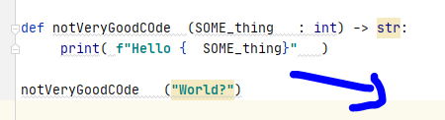
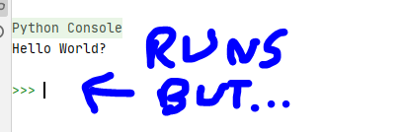
Python Primer: Example
Use black or similar for all code so your code follows python’s commonly agreed styling
pip install black
Ps https://www.python.org/dev/peps/pep-0008/ for more info be sure to read allegory “A Foolish Consistency is the Hobgoblin of Little Minds”

Slide 34
Code
Testing

Slide 35
Python Primer: Code Testing
Part of modern development is testing
Unit testing
aka individual functions
Integration testing aka functions working together (beyond scope)
End-to-end e2e
aka whole app testing (beyond scope)

Slide 36
Python Primer: Code Testing
First why write tests, when your code is perfect

Slide 37
Why Unit Test ?

Slide 38
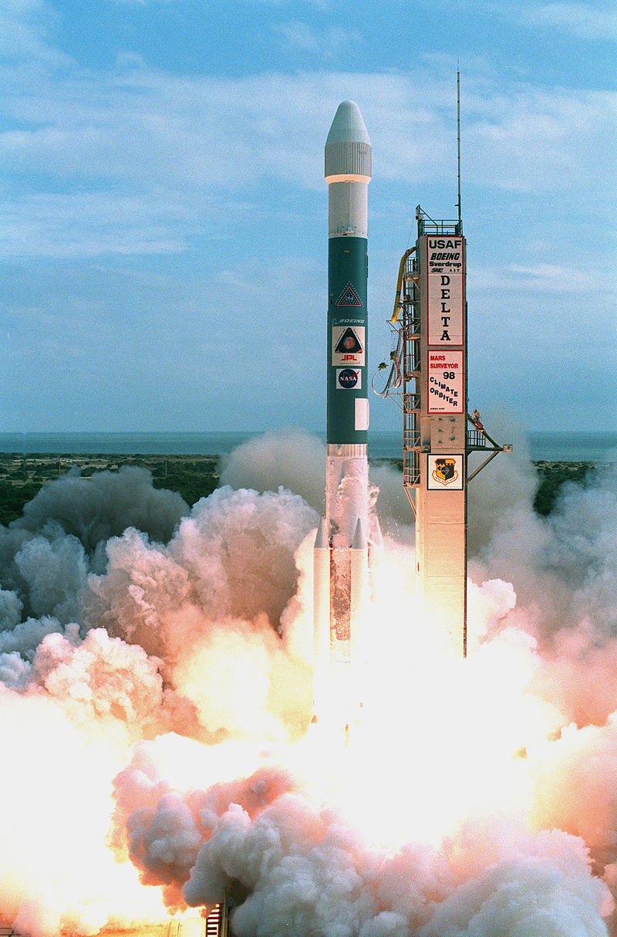
Python : Test Theory Why ? History Lesson
Most famous Software Bug
Boeing Delta II 1998
https://en.wikipedia.org/wiki/Mars_Climate_Orbiter

Slide 39
Python : Test Theory Why ? History Lesson
Most famous Software Bug
Boeing Delta II 1998
System A: gave pounds of force required for lift off
https://en.wikipedia.org/wiki/Mars_Climate_Orbiter

Slide 40
Python : Test Theory Why ? History Lesson
Most famous Software Bug
Boeing Delta II 1998
System A: gave pounds of force required for lift off
System B: required newtons per sq meter for lift off
https://en.wikipedia.org/wiki/Mars_Climate_Orbiter

Slide 41
Python : Test Theory Why ? History Lesson
Most famous Software Bug
Boeing Delta II 1998
System A: gave pounds of force required for lift off
System B: required newtons per sq meter for lift off
When A and B spoke the Rocket blew up at a total cost of $327 million
https://en.wikipedia.org/wiki/Mars_Climate_Orbiter

Slide 42
Python : Test Theory Why ? History Lesson
This is a lesson why proper testing is needed before things go Live!
System A and B needed Unit, integration, and manual testing
Even Nasa can occasionally mess up
https://en.wikipedia.org/wiki/Mars_Climate_Orbiter

Slide 43
Python : Test Theory Why ? History Lesson
How do you know which systems to test ?
https://en.wikipedia.org/wiki/Mars_Climate_Orbiter

Slide 44
Python : Test Theory Why ? History Lesson
How do you know which A and B will blow up your app ?
Dirty Secret: You don’t*¹
You need to test everything*² to be semi sure*³
https://en.wikipedia.org/wiki/Mars_Climate_Orbiter

Slide 45
Python : Test Theory Why ? History Lesson
How do you know which A and B will blow up your app ?
Dirty Secret: You don’t*¹
*¹ Complexity, previous impacting bug locations can help
https://en.wikipedia.org/wiki/Mars_Climate_Orbiter

Slide 46
Python : Test Theory Why ? History Lesson
You need to test everything*² to be semi sure*³
*² Conventionally you aim for a percentage of everything called coverage
*³ Another dirty secret, testing code can have bugs…
https://en.wikipedia.org/wiki/Mars_Climate_Orbiter

Slide 47
Python : Test Theory Why ? History Lesson
How do you know which A and B will blow up your app ?
Dirty Secret: You don’t*¹
You need to test everything*² to be semi sure*³
*¹ Complexity, previous impacting bug locations can help
*² Conventionally it’s a percentage of everything called coverage
*³ Another dirty secret, testing code can have bugs…
https://en.wikipedia.org/wiki/Mars_Climate_Orbiter

Slide 48
Questions?: Test Theory
Questions ?

Slide 49
Code
Testing

Slide 50
Python Primer: Code Testing
Programmers Doing Unit Testing:
create tests
(aka function + inputs = expected outputs)
run all together as a testsuite
calculate lines in code were ran
(aka % of lines executed = code coverage)

Slide 51
Python Primer: Code Testing
Super brief python testing at a glance…

Slide 52
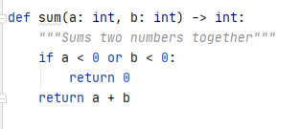
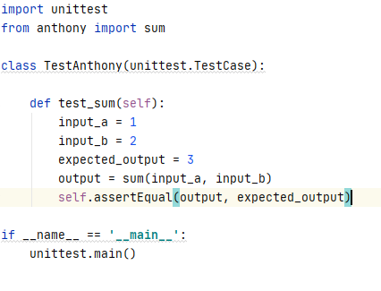
Python Primer: Code Testing
create tests + run all together as a testsuite
For use pytest or unittest for all code
.

Slide 53
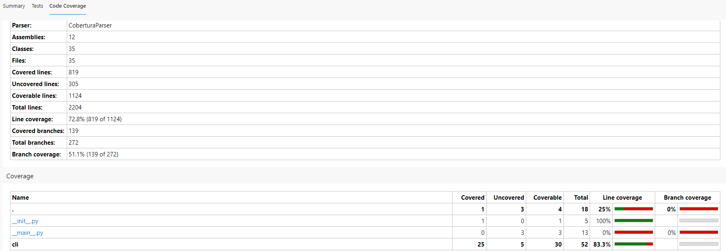
Python Primer: Coverage
calculate lines in code were ran
use cov plugin from pytest, aim for 80% coverage

Slide 54
Python Primer: Code Testing
Super brief python testing complete

Slide 55
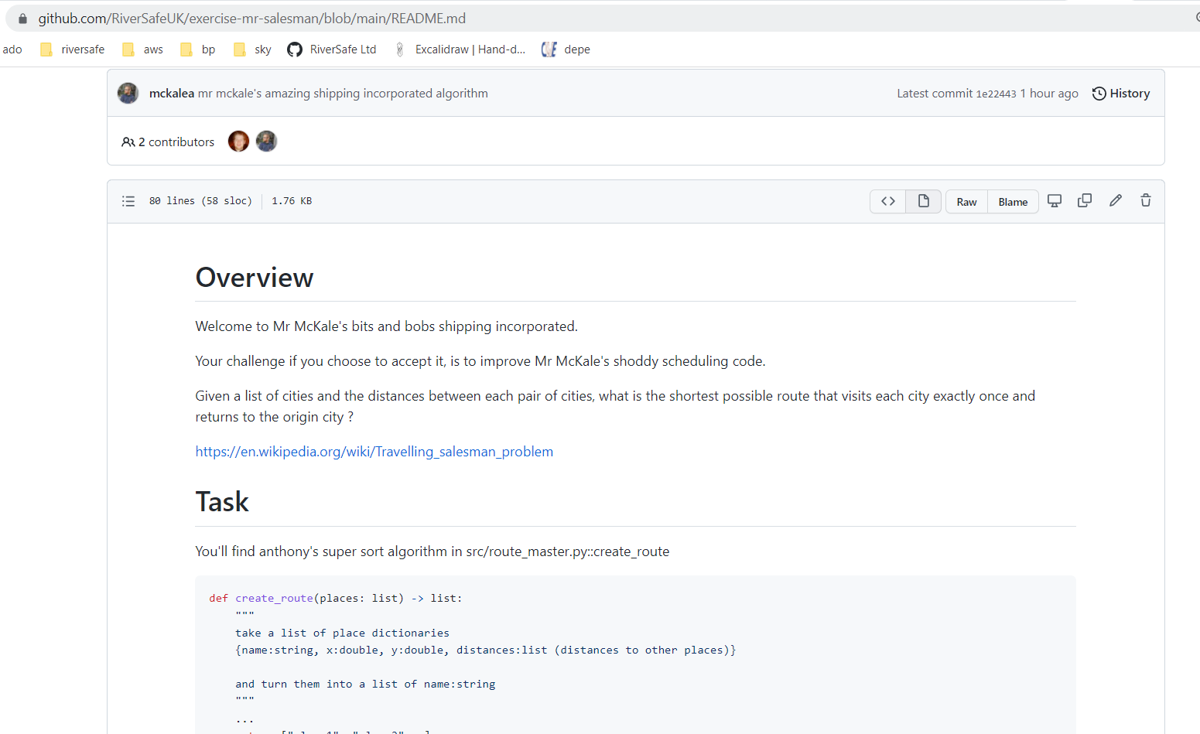
Mr McKale’s Shipping
Welcome to Mr McKale’s Shipping
https://github.com/RiverSafeUK/exercise-mr-salesman
.

Slide 56
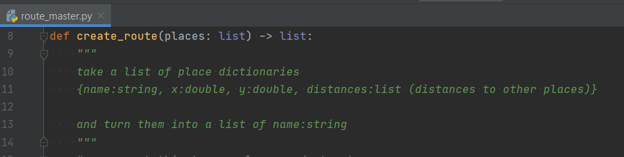
Mr McKale’s Shipping
Task:
- 2 weeks
Write one function
Save Mr McKale’s shipping company from Ruin
.

Slide 57
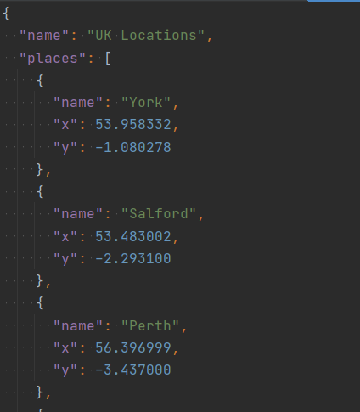
Mr McKale’s Shipping
Function Tasks
Given :
a list of cities
the distances between each pair of cities
.

Slide 58
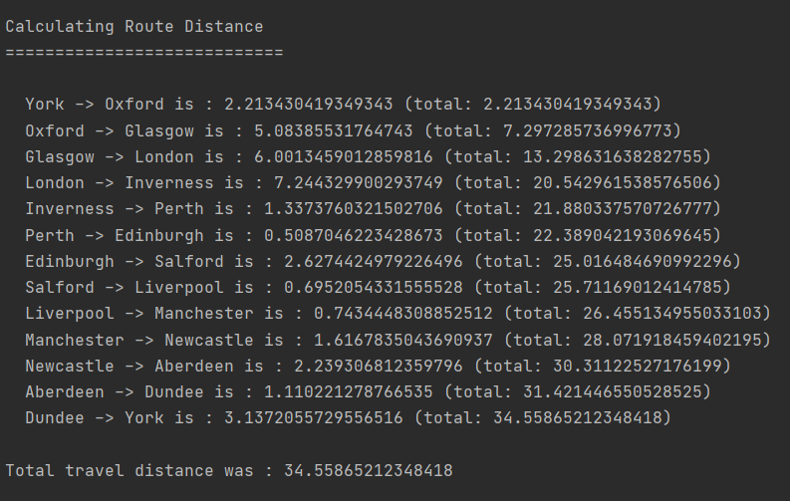
Mr McKale’s Shipping
Function Tasks
Find Route that:
visit each city
return to the origin city
find shortest route as possible

Slide 59
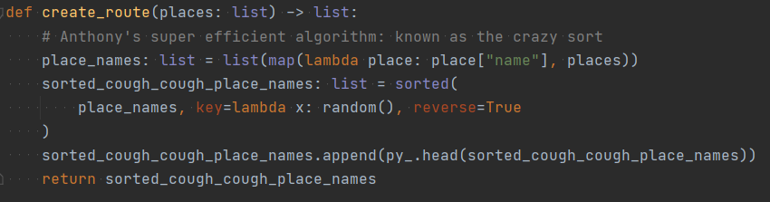
Mr McKale’s Shipping
Current Function written by Anthony

Slide 60
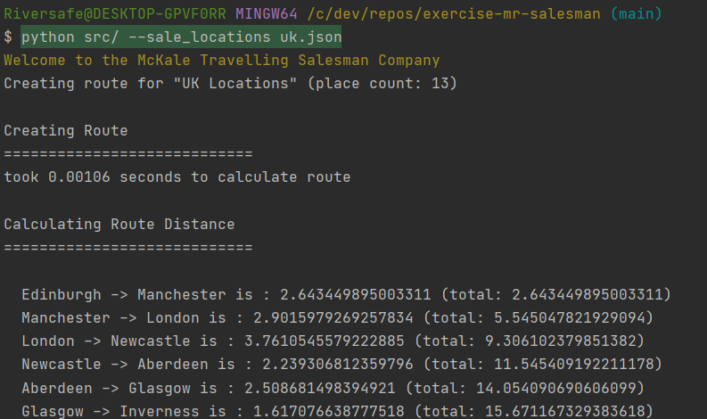
Mr McKale’s Shipping
How to run:

Slide 61
Mr McKale’s Shipping
Best of luck!
Fork from project into your personal Github accounts
Send me your entries by Thursday 31st March
review solutions on 1st April

Slide 62
Questions
I’ve been Anthony M^{c}Kale “Wizard without Portfolio” Fixer-Upper of Broken things, and creator of time-constrained workable Fudges for 15 years. Email : anthony@zapper.hodgers.com

Slide 63
Thank
you

