Slide 1


Friday Training Hour
Mr McKale’s Shipping Exercise
Good, Bad, Ugly
How to write fast code
Anthony McKale Principal Engineer
01/04/2022

Slide 2
Good, Bad, Ugly
Today we’ll cover, the :
Good
Bad
Ugly

Slide 3
Computational Complexity
101

Slide 4
Computational Complexity
“Different algorithms, take different times, to do the same thing” Anthony McKale 01/04/2022
Often these algorithms trade off accuracy, resource consumption, or speed aka the famous “3 kinds of service”
https://en.wikipedia.org/wiki/Computational_complexity

Slide 5
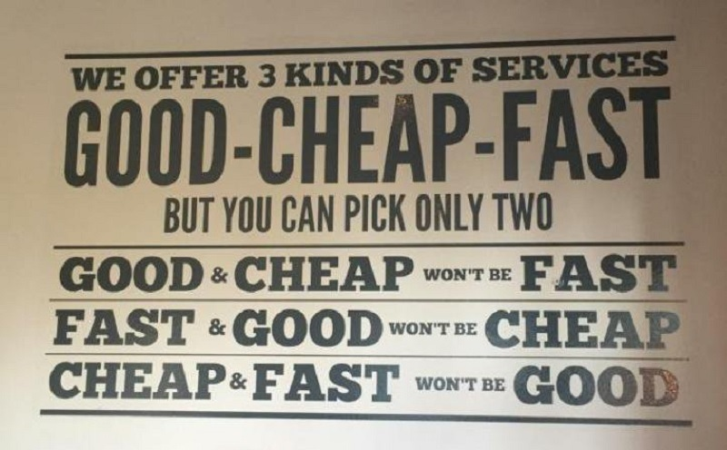
Computational Complexity: Trade offs 101

Slide 6
Computational Complexity: cost examples
CPU Time
MEMORY
NETWORK WORK TRANSFER
DISK I/O
Cloud Costs
Developer Time

Slide 7
Computational Complexity: common trade offs
Compress network traffic
CON costs CPU
PRO saves Network IO
Cache index keys in a database
CON costs MEMORY
PRO saves CPU and DISK IO

Slide 8
common trade offs
Discussion / Questions
Traffic Compression is it always good?
DB Indexes are they always needed?

Slide 9
Computational Complexity
Quantification

Slide 10
Computational Complexity
“Different algorithms, take different times, to do the same thing” Anthony McKale 01/04/2022
There’s a name to count that
https://en.wikipedia.org/wiki/Big_O_notation

Slide 11
Computational Complexity: Quantifying cost
Often the costs vary wildly for a given situation and algorithm
Factors in a situation, aka say rows in a database are called variables
How the cost changes based on these variables called O notation
Different costs often have different O notations aka memory costs different than say CPU costs

Slide 12
Computational Complexity: Quantifying cost: Examples
EXAMPLES
Aka For a Database scan, where variable is number rows in a database, lets describe some common O notations
INDEXED SCAN
UNINDEXED SCAN
UNINDEXED RIGHT JOIN SCAN

Slide 13
Computational Complexity: Quantifying cost: INDEXED
Algorithms: Database scan on indexed key in database
SPEED / CPU = CONSTANT
same no matter the variable
If there was 1000000 rows it’d execute as fast as 1 row
MEMORY: X * rows = LINEAR (X)
One unit of million is consumed per row to store the index

Slide 14
Computational Complexity: Quantifying cost: UNINDEXED
Algorithms: Database scan on un-indexed key in database
SPEED / CPU = X * rows = LINEAR (X)
Each row must be scanned so it’s 1000 scans for 1000 rows
(note if a limit of 1 was applied this would but lower as on average it’d find the row before the scan is complete, but this is a advanced topic we’ll talk only about worst case)
MEMORY: CONSTANT
Only 1 row (aka the one returned required)

Slide 15
Computational Complexity: Quantifying cost: JOINED UNINDEXED
Algorithms: Database scan on un-indexed key in database joined to it’s self
SPEED / CPU = X * rows * rows = SQUARE (X²)
Each row is joined to all other rows, meaning 1000 * 1000 scans for 1000 rows
MEMORY: Needs experimental data ☺ Ironically depends on algorithm
Depending on Database engine algorithm:
Might do everything just in time and only need the 1 row being estimate
might need to generate table of 1000 * 1000 rows, so it’d be X²

Slide 16
Computational Complexity: Quantifying cost
Common costs:
Constant : that’s the best, always the same cost
Log : that’s the good, scales well with growth
Linear : that’s the ok, scales exactly with growth
Power (X² ³ ⁴ ⁵) : that’s starting to get bad, doesn’t scale at all
Exponential (2^{X}) : very bad, only for last resort or low X numbers

Slide 17
Computational Complexity: Quantifying cost
Costs in time units
Example X | Constant | Log | Linear | Power | Exponential
1 row | 1 | 1 | 1 | 1 | 2.71
1,000 rows | 1 | 3 | 1,000 | 1,000,000 | Too big exp(100) = 2.71 + 43 zeros
1,000,000 rows | 1 | 6 | 1,000,000 | 1,000,000,000,000 | Too big

Slide 18
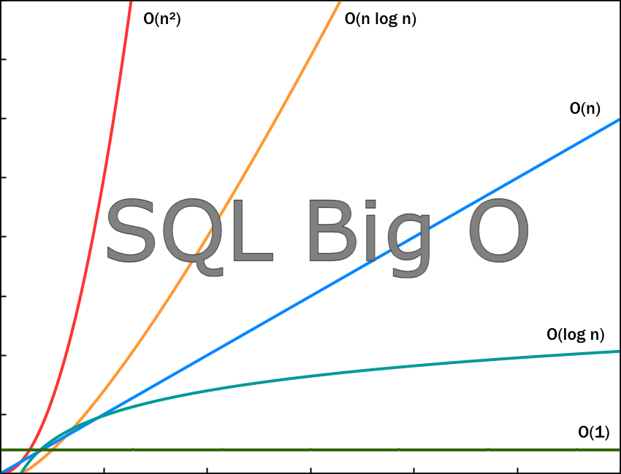
Computational Complexity: Quantifying cost
https://blog.devgenius.io/estimate-time-complexity-of-java-and-sql-query-afa13a88a981

Slide 19
Computational Complexity
Discussion / Questions
Can large C be worse that low X

Slide 20
Counting
1 to a million
Good, Bad, Ugly

Slide 21
Computational Complexity
“Different algorithms, take different times, to do the same thing” Anthony McKale 01/04/2022
aka lets count all the number from 1 to 1,000,000
https://en.wikipedia.org/wiki/Computational_complexity

Slide 22
Ugly: 1 to 1,000,000
Ugly brute force
Create array of numbers 1 to 1,000,000
Count numbers together
This could be considered to have a :
- CPU time complexity of 2X (Linear)
- MEMORY complexity of X (Linear)
(where X = 1,000,000)

Slide 23
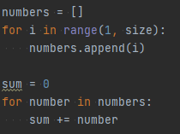
Ugly: 1 to 1,000,000

Slide 24
Bad: 1 to 1,000,000
Bad brute force
Count 1 to 1,000,000 numbers together
This could be considered to have a :
- CPU time complexity of X (Linear)
- MEMORY complexity of C (Constant)
(where X = 1,000,000)

Slide 25

Ugly: 1 to 1,000,000

Slide 26
Good: 1 to 1,000,000, Gaussian
In the 1780s a provincial German schoolmaster gave his class the tedious assignment of summing the first 100 integers. The teacher's aim was to keep the kids quiet for half an hour, but one young pupil almost immediately produced an answer
5050
https://www.americanscientist.org/article/gausss-day-of-reckoning
Maths: X = 1 + 2 + … + N = N (N + 1) / 2

Slide 27
Good: 1 to 1,000,000, Gaussian
In the 1780s a provincial German schoolmaster gave his class the tedious assignment of summing the first 100 integers. The teacher's aim was to keep the kids quiet for half an hour, but one young pupil almost immediately produced an answer
If you could audience ?

Slide 28
Good: 1 to 1,000,000, Gaussian
In the 1780s a provincial German schoolmaster gave his class the tedious assignment of summing the first 100 integers. The teacher's aim was to keep the kids quiet for half an hour, but one young pupil almost immediately produced an answer
5050
https://www.americanscientist.org/article/gausss-day-of-reckoning
Maths: X = 1 + 2 + … + N = N (N + 1) / 2

Slide 29
Good: 1 to 1,000,000, Gaussian
Good brute force
Count Gauss 1 to 1,000,000 = (0.5 * 1,000,000 * (1 + 1,000,000))
This could be considered to have a :
- CPU time complexity of C (Constant)
- MEMORY complexity of C (Constant)
(where X = 1,000,000)

Slide 30
Good: 1 to 1,000,000, Gaussian

Slide 31
1 to 1,000,000
Discussion / Questions
Good ?
Bad ?
Ugly ?

Slide 32
Hard vs Smart

Slide 33
How to speed up a program
Ways to speed up code:
Better* Language
Better* Hardware
Better* Code
Better* Algorithms
* Better = faster

Slide 34
How to speed up a program
Ways to speed up code: Better* Language
Low Level C++ / Rust : Das Best
High Level PY/JS: Das Worse

Slide 35
How to speed up a program: Languages (versus)
Dumb 1 to 1,000,000
rows | JS | PY | RUST
1,000,000 | 0.325s | 0.17s | 0.0016s
1,000,000,000 | Ugly: ran out of memory Bad: 0.978s but compiler cheating and number is wrong ☺ ps previous presentations why JS can’t count | Ugly: ran out of memory (and crashed computer) Bad : 121.57s | Ugly: 15s Bad: 2.8s
SPEED INCREASE | x2 Slower | Base Line | x100 Faster
DEVELOPER COST | LOW | MEDIUM | HIGH
PY 1 to 1000000000 = 500000000500000000
JS 1 to 1000000000 = 500000000067109000

Slide 36
How to speed up a program
Ways to speed up code: Better* Language Engine
Compiled PYPY : Das Best
Interpreted PYTHON 3: Das Worse

Slide 37
How to speed up a program: Languages (custom engines)
Dumb 1 to 1,000,000
rows | PYPY (simulated better hardware) | PYTHON 3
1,000,000 | 0.0398s | 0.17s
1,000,000,000 | Ugly: 80.94s Bad: 1.49s | Ugly: ran out of memory (and crashed computer) Bad : 121.57s
SPEED INCREASE | x80 Faster | Base Line
BOOTUP SPEED | SLOW (Just in time compiled) | FAST
PY3 1 to 1000000000 = 500000000500000000
PYPY 1 to 1000000000 = 500000000500000000

Slide 38
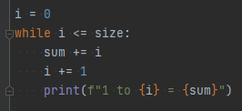
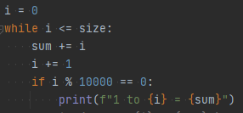
How to speed up a program
Ways to speed up code: Better* code
Example code with too many debug statements

Slide 39
How to speed up a program: Code (debug statements + bad algorithm)
Dumb 1 to 1,000,000
rows | PYTHON 3 Unrefactored | PYTHON 3 Refactored (few statements) | PYTHON 3 Refactored (no statements)
1,000,000 | Bad : 14.41s | Bad : 0.16s | Bad : 0.12s
1,000,000,000 | Estimate ~ 4 Hours ~ 144100s | Bad : 162.27s | Bad : 132.25s
SPEED INCREASE | x90 Slower | Base Line | x1.2 Faster
LOG COST | HUGE | SMALL | NONE

Slide 40
How to speed up a program
Ways to speed up code: Better* algorithm

Slide 41
How to speed up a program: Code (debug statements + bad algorithm)
Dumb 1 to 1,000,000
rows | PYTHON 3 UGLY | PYTHON 3 BAD | PYTHON 3 GOOD
1,000,000 | 0.16s | 0.12s | 0s
1,000,000,000 | Out of mem | 132.27s | 0s
1,000,000,000,000 | Out of mem | Estimate ~ 22 mins | 0s
SPEED COST | HUGE 2X | HUGE X | LOW C
MEMORY COST | HUGE X | LOW C | LOW C

Slide 42
How to speed up a program
Discussion / Questions
Algorithms
Refactor (Code)
Language
Hardware

Slide 43
Onto the Salesman

Slide 44
Premise
You are a salesman
Travel to all destinations
Finish at the starting destination
Try to find the shortest distance

Slide 45
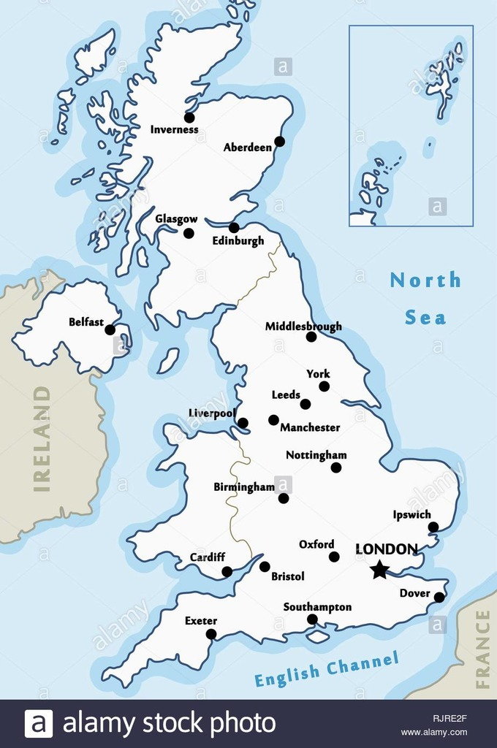
Premise
Eg: how to get around the UK cities
What’s the fastest route

Slide 46
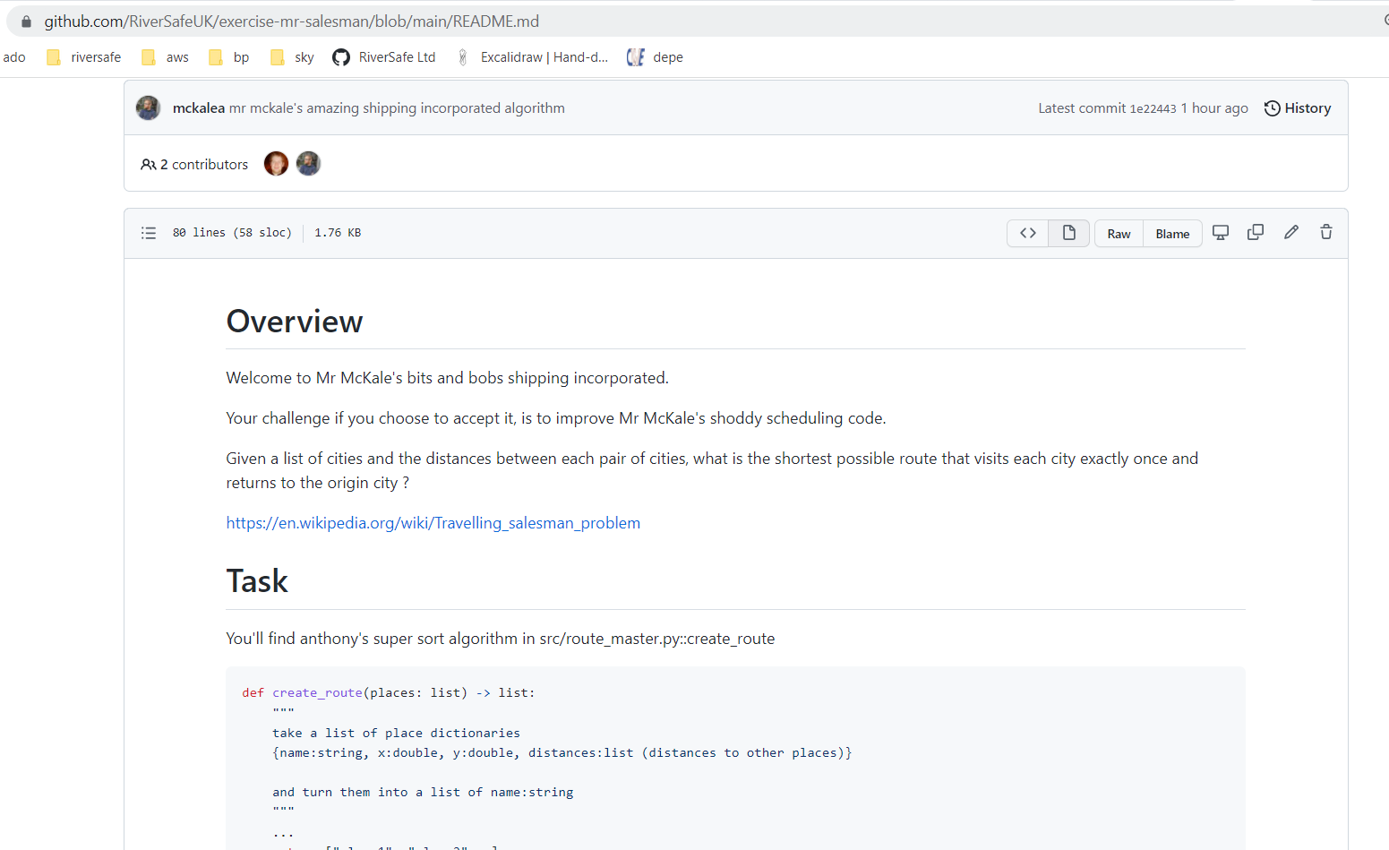
Mr McKale’s Shipping
Welcome to Mr McKale’s Shipping
https://github.com/RiverSafeUK/exercise-mr-salesman
.

Slide 47
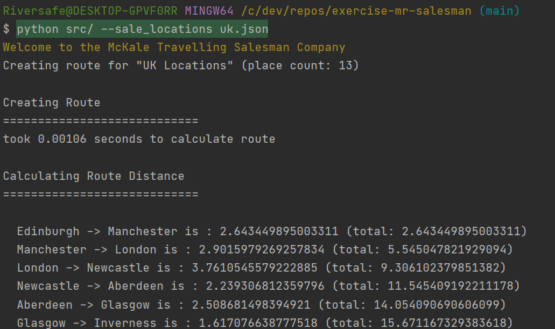
Mr McKale’s Shipping
How to run:

Slide 48
Onto the Salesman:
Solutions

Slide 49
Algorithms Evaluation
Costs:
CPU Speed
Memory Cost
Completeness aka is it the fastest route?

Slide 50
Algorithms: Anthony’s Crazy Sort
Steps:
Jumble up list of places
Add first place to end of list

Slide 51
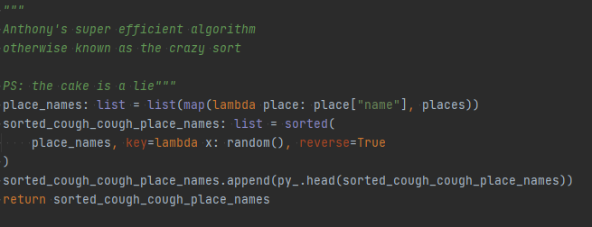
Algorithms: Anthony’s Crazy Sort
Speed | Memory | Completeness
FAST | LOW | NOT EVEN CLOSE
sub second 0.0014 |  | average ~39 2698 miles

Slide 52
Algorithms: best of 10 randoms
Steps:
Jumble up list of places
Add first place to end of list
Repeat 10 times, and choose bets

Slide 53
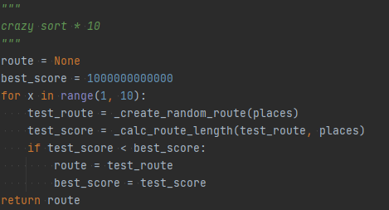
Algorithms: Anthony’s Crazy Sort
Speed | Memory | Completeness
FAST | LOW | OK-ish
sub second 0.012 |  | average ~30 2097 miles

Slide 54
Algorithms: brute force
Steps:
Choose a starting location
Try every single route possible
Choose best route

Slide 55
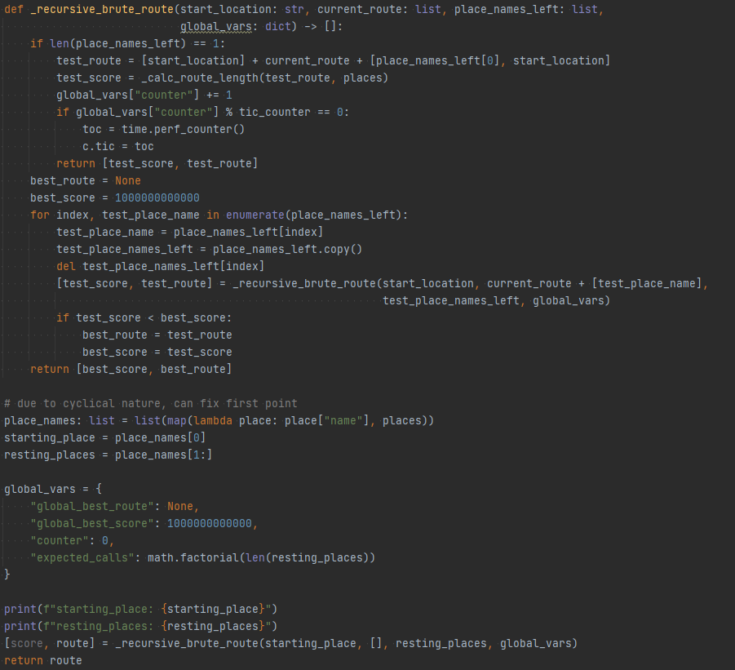
Algorithms: Anthony’s Crazy Sort
Speed | Memory | Completeness
SLOW Factorial Time | LOW-MEDIUM | PERFECT
5888 mins 500 billion routes tested |  | 18.07 1263 miles

Slide 56
Algorithms: Anthony’s Crazy Sort

Slide 57
Algorithms: brute force mk2
Steps:
Choose a starting location
Try every single route possible
Choose best route
+ Refactoring

Slide 58
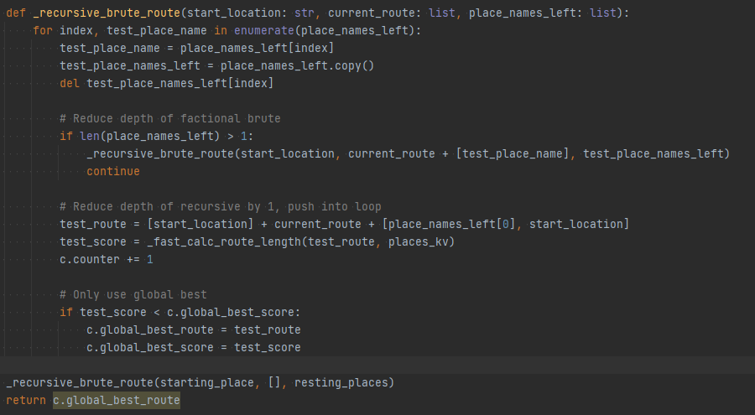
Algorithms: brute force mk2
Speed | Memory | Completeness
SLOWish Factorial Time | LOW-MEDIUM | PERFECT
13 mins 500 billion routes tested |  | 18.07 1263 miles

Slide 59
Algorithms: Anthony’s Crazy Sort
Speed | Memory | Completeness
SLOWish Factorial Time | LOW-MEDIUM | PERFECT
13 mins 500 billion routes tested |  | 18.07 1263 miles

Slide 60
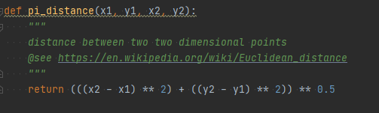

Algorithms: brute force mk2

Slide 61
Algorithms: Liam’s nearest neighbour
Steps:
LIAM TAKE OVER

Slide 62
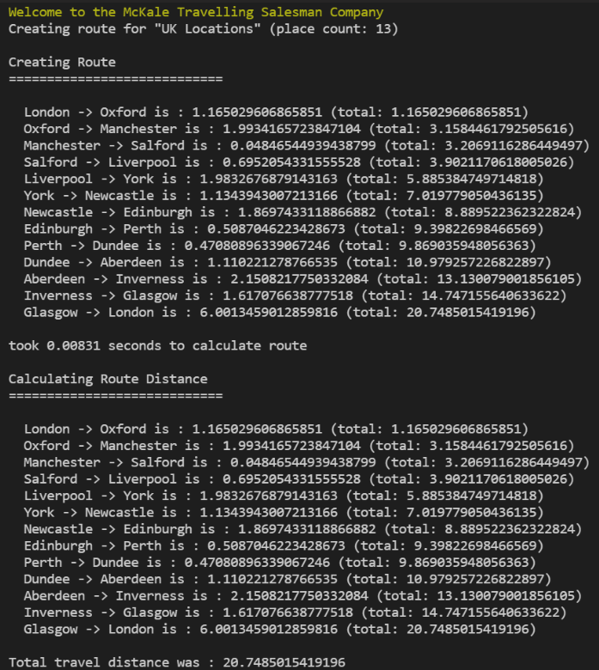
Algorithms: Liam’s nearest neighbour
Speed | Memory | Completeness
FAST Constant Time | LOW | GOOD, not perfect
0.013s 1 route tested |  | ~20 1398 miles

Slide 63
Algorithms: Any others
Any others… before Anthony cheats
.

Slide 64
Algorithms: Anthony’s cheat
Steps:
use opensource library
…
Profit
Aka or don’t reinvent the wheel

Slide 65
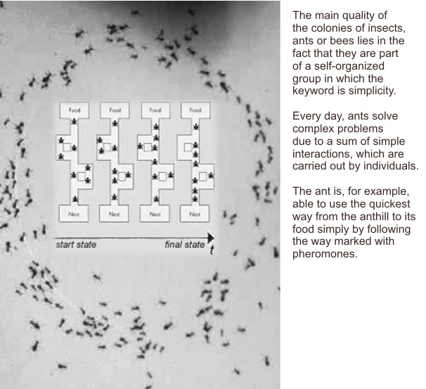
Algorithms: Ant Colony Optimisation
Steps:
Use nearest neighbor to get close
Randomise route with how good heuristic ( aka Ant Pheromones )
Algorithm to randomise the routes further based on improvement
https://en.wikipedia.org/wiki/Ant_colony_optimization_algorithms

Slide 66
Algorithms: Ant Colony Optimisation
Speed | Memory | Completeness
FAST Constant Time | MEDIUM | PERFECT, not always perfect
0.087s |  | ~18 1258 miles

Slide 67
Algorithms: Ant Colony Optimisation
Speed | Memory | Completeness
FAST Constant Time | MEDIUM | Randomly PERFECT, but not always perfect
0.087s |  | ~18 1258 miles

Slide 68
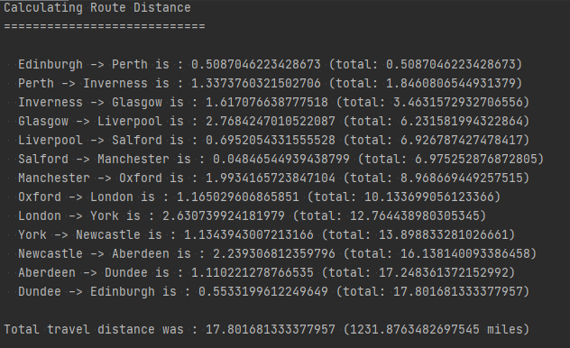
Salemans Discussion / Questions
Best Route
.

Slide 69
Questions
I’ve been Anthony M^{c}Kale “Wizard without Portfolio” Fixer-Upper of Broken things, and creator of time-constrained workable Fudges for 15 years. Email : anthony@zapper.hodgers.com

Slide 70
Thank
you

