Slide 1
SD Card input to VGA output
Created by:
Salar Mirkarimi, Anthony Sandoval
ECE 178: Embedded System

Slide 2
Problem Statement
The DE2-115 board has a lot of external features that were never used in any class assignments and we wanted to implement them. The use of the SD card was covered in depth throughout multiple lectures and we wanted to read images from a SD card and output them through the vga component on the board.

Slide 3
Objective
Demonstrate our understanding on the use of Qsys with two new peripherals ( SD card and VGA)
One image will be loaded into the SD card and it will show the image through the VGA output.

Slide 4
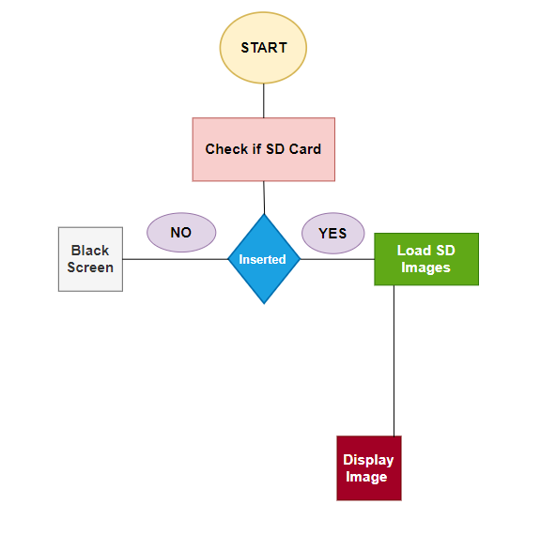
Flow Chart

Slide 5
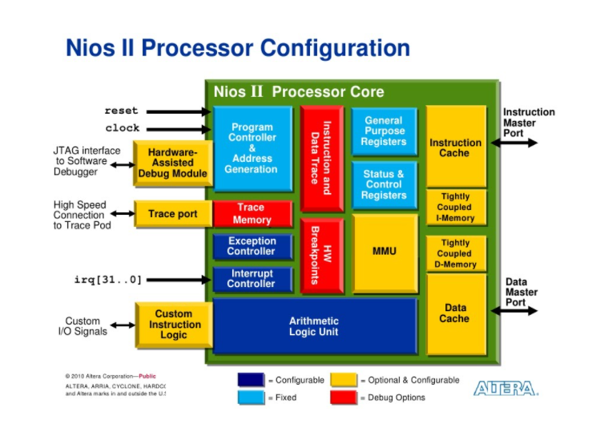
Hardware Requirements
Nios II Processor
JTAG Port
SD Card Controller
On-chip Memory
Interval Timer
System ID
SRAM
SDRAM
Video_pll
Scalar

Slide 6
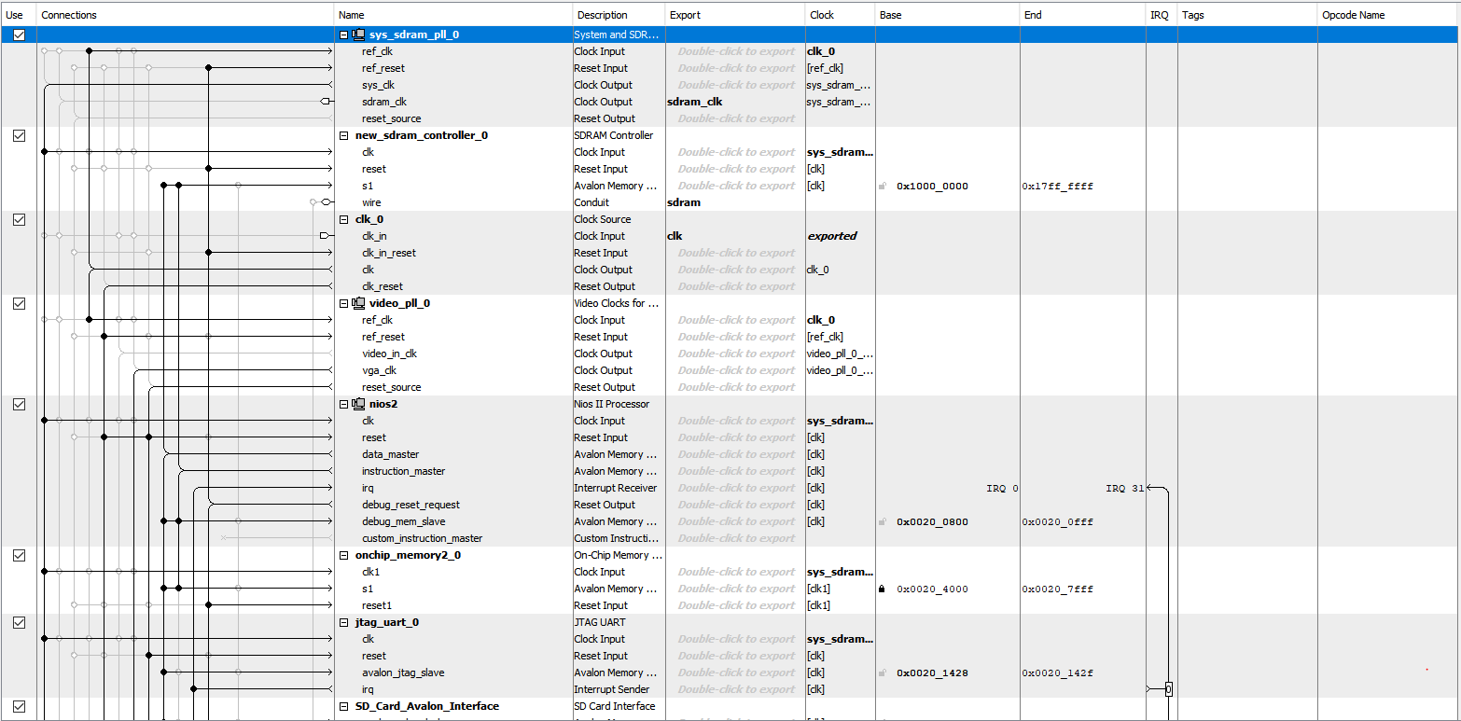
QSYS Build
Figure 1: First Half of Qsy

Slide 7
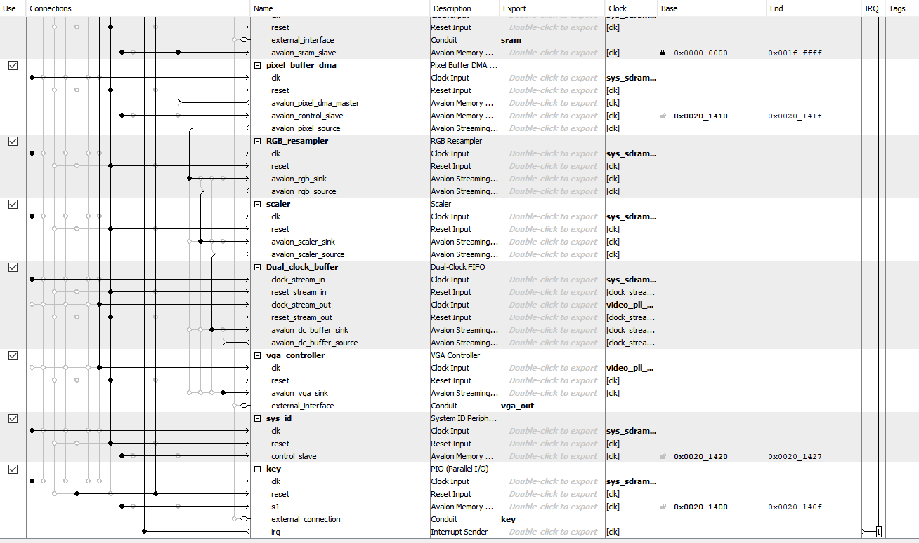
Qsys Build continued
Figure 2: Second half of Qsys with no errors

Slide 8
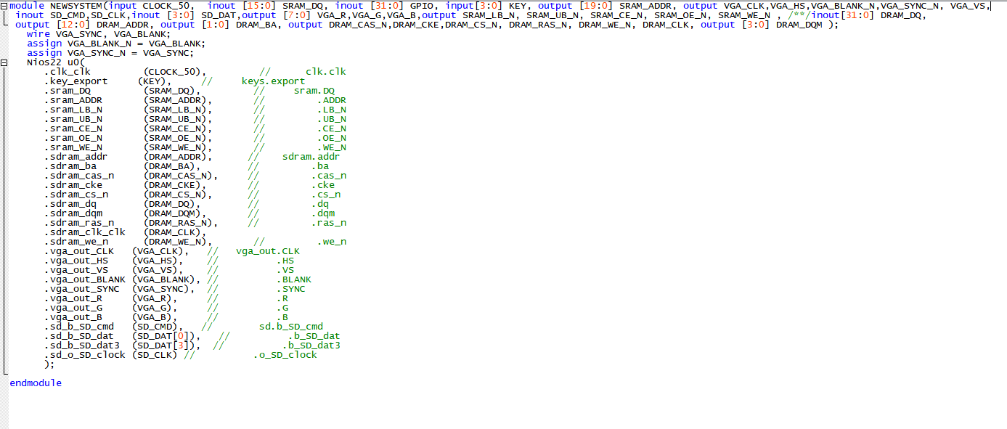
Quartus Instantiations
Figure 3: V.file with connections

Slide 9
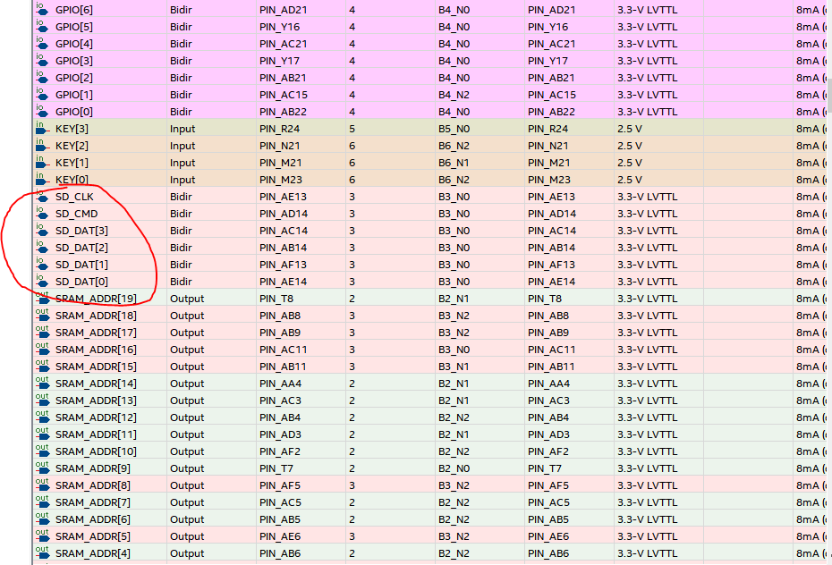
Pin Planner sdcard
Figure 4: Pin Placement according to Design

Slide 10
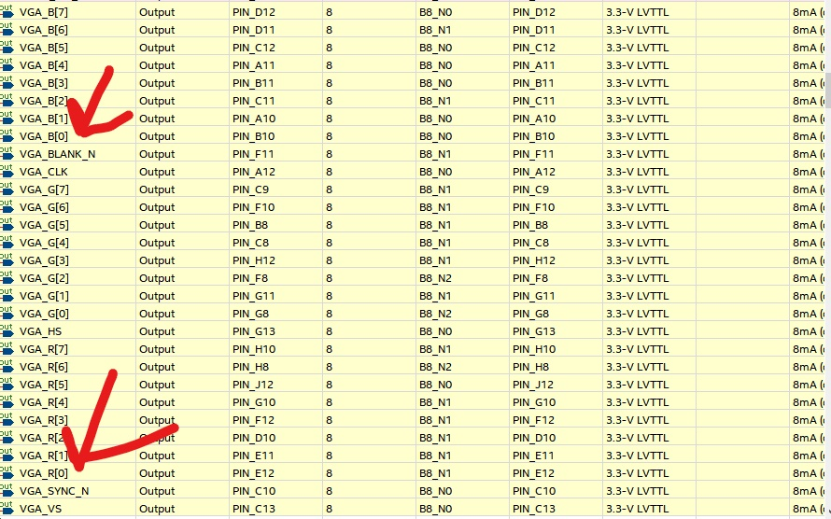
Pin Planner VGA

Slide 11
Challenges of Project
Implementing sd card correctly
Implementing VGA correctly
Using PLL’s
Correct bits for images

Slide 12
Conclusion
The project taught us how important it was to use the correct clock signals because every single peripheral on our design needed a clock input and we were using two clock sources. Confusion of what clock was needed for each individual peripheral caused many problems but once looked at logically it made a lot of sense.

Slide 13


