Slide 1
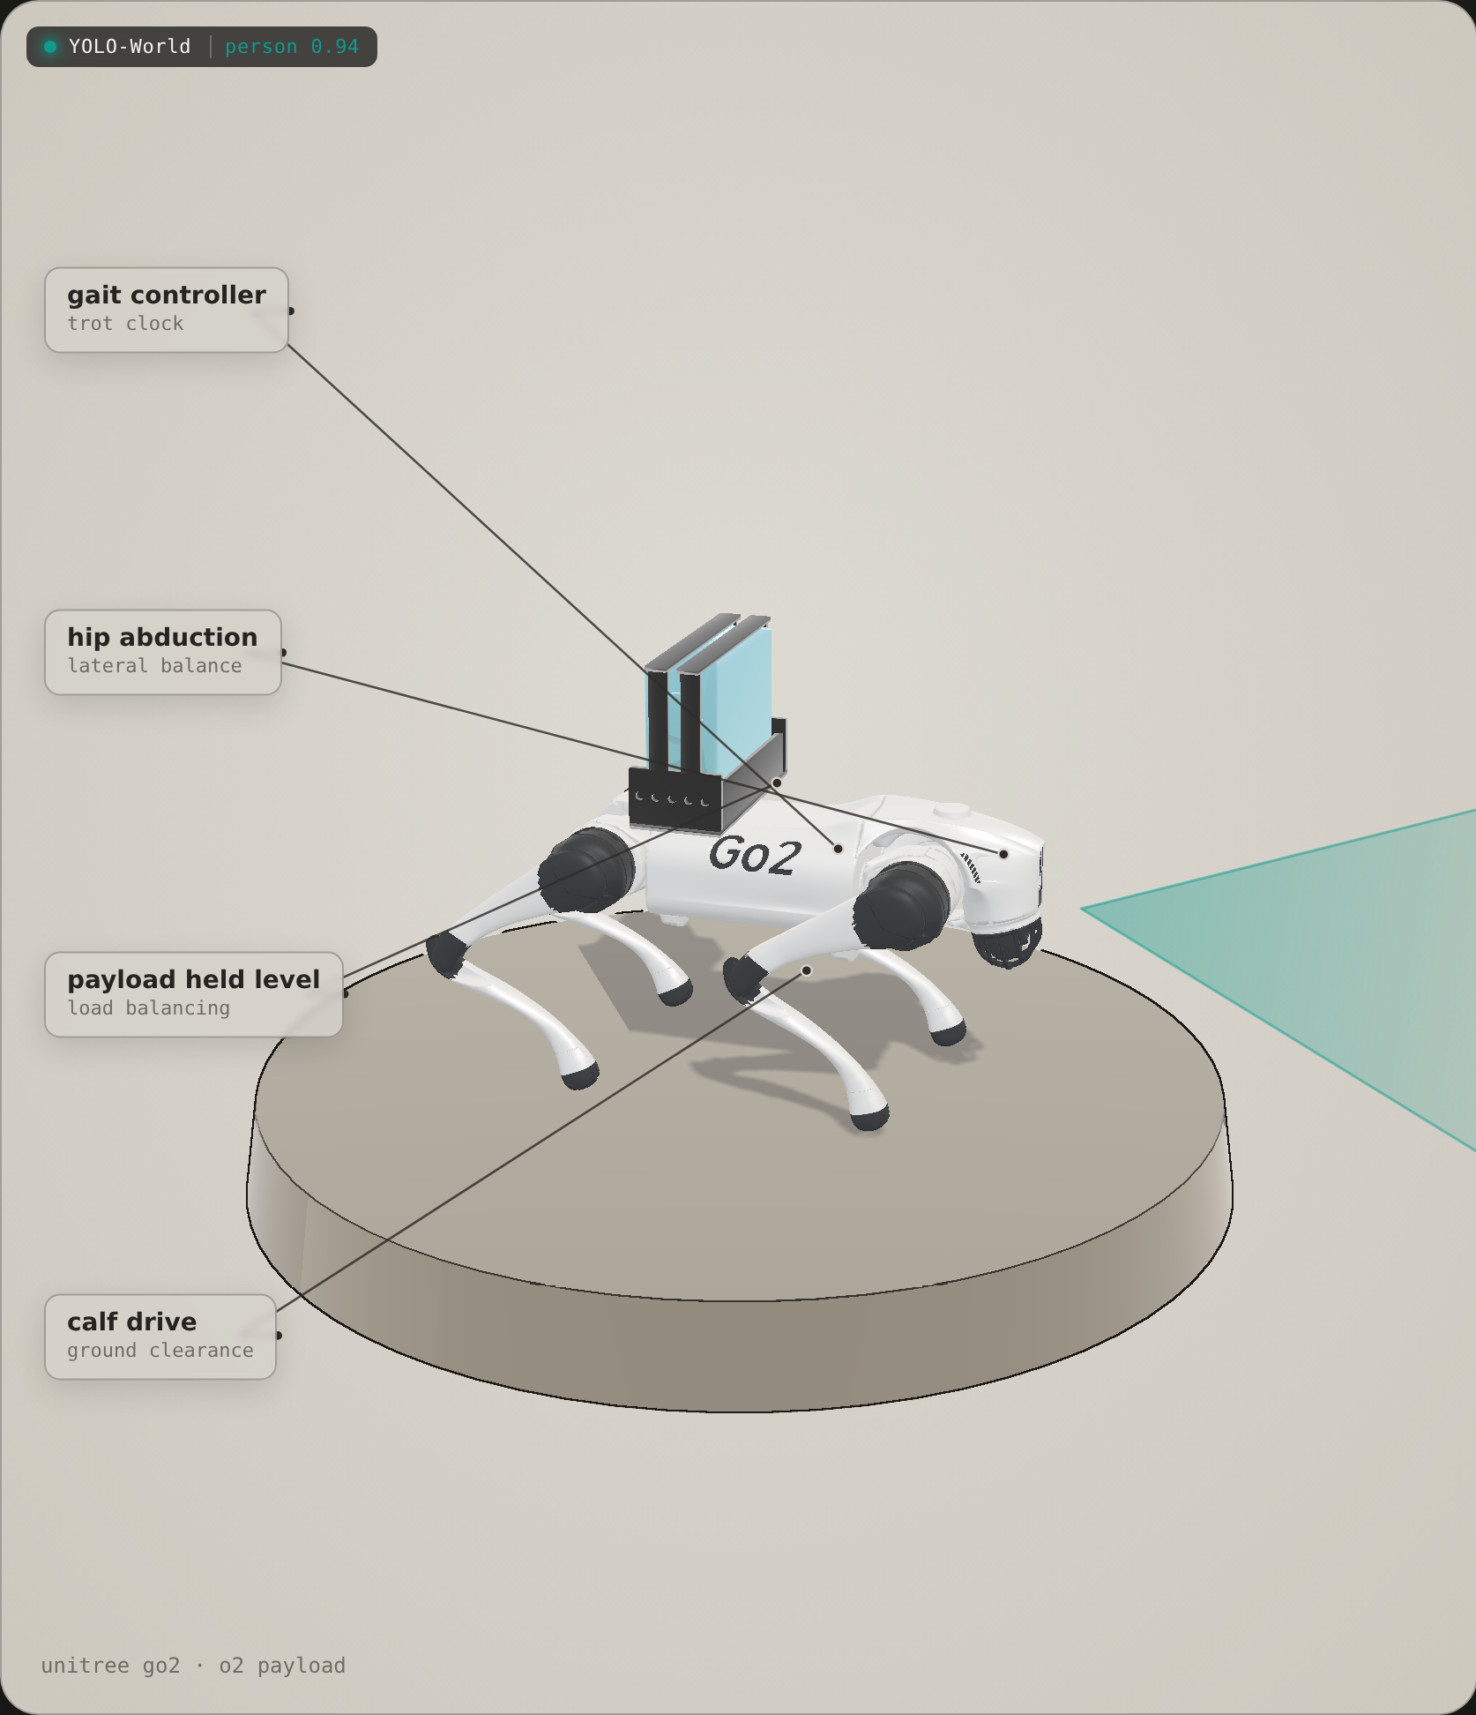
STAIR-CLIMBING ROBOTIC OXYGEN CARRIER
TASH
A robot dog that carries the oxygen and climbs the stairs alongside therapy patients — so they don’t have to.
Unitree Go2 · 2.22 kg O₂ payload · blind-RL climb · Isaac Sim ⇄ Jetson Orin

Slide 2
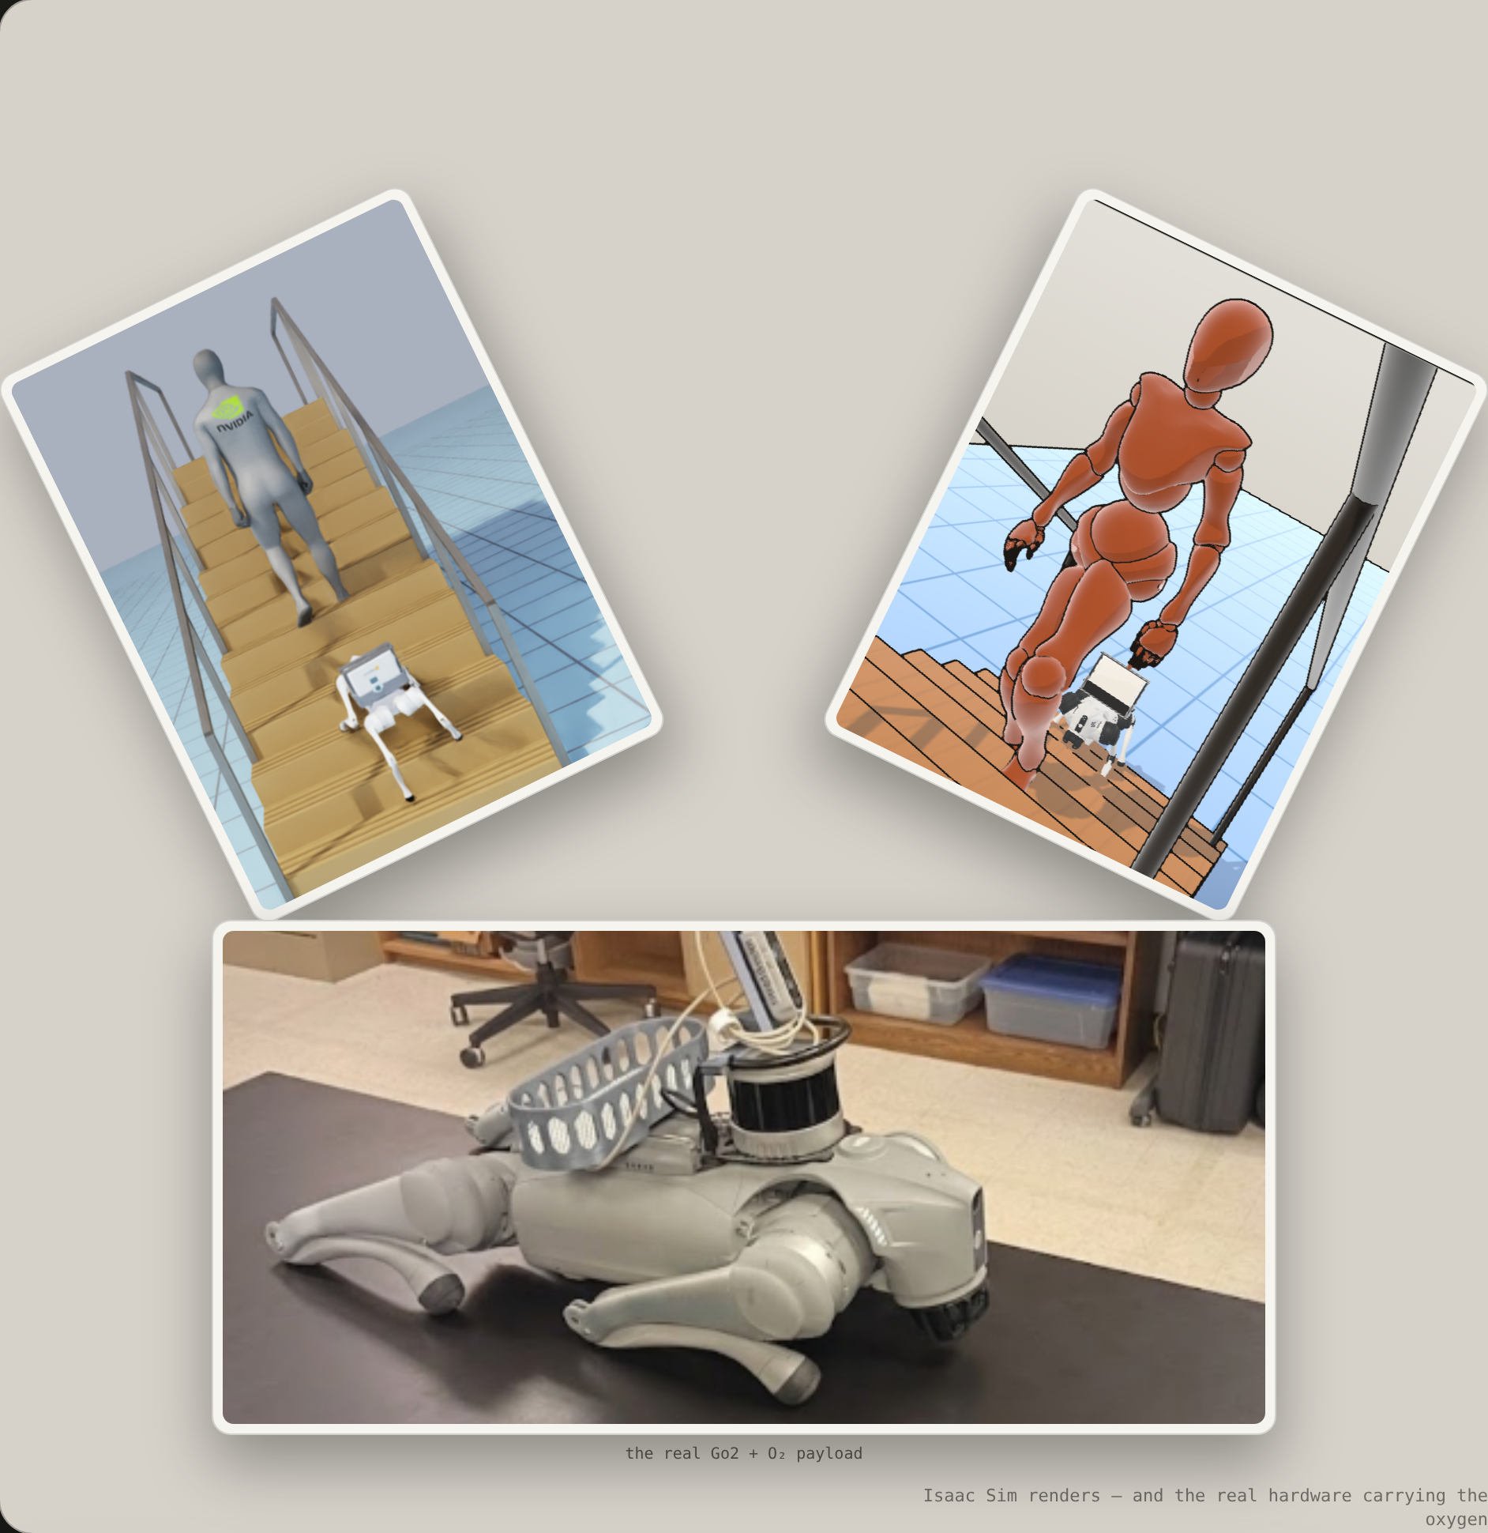
PROBLEM
TASH — Stair-Climbing Robotic Oxygen Carrier
Oxygen-therapy patients are tethered to their supply — wherever they go, the concentrator goes too.
Millions of people with COPD, pulmonary fibrosis and other chronic lung disease are prescribed long-term oxygen for everyday life at home. The equipment is heavy and awkward, and a staircase turns an ordinary trip into a two-hands-full balancing act. Many simply stop using the stairs — and lose a whole floor of their own home. Our idea is simple: let a robot dog carry the oxygen and climb alongside them, so they don’t have to.
~1.5 M
Americans on home oxygen (est.)
2–3 kg
portable unit to carry
Leading
injury cause, age 65+
independence
fall risk
daily burden

Slide 3
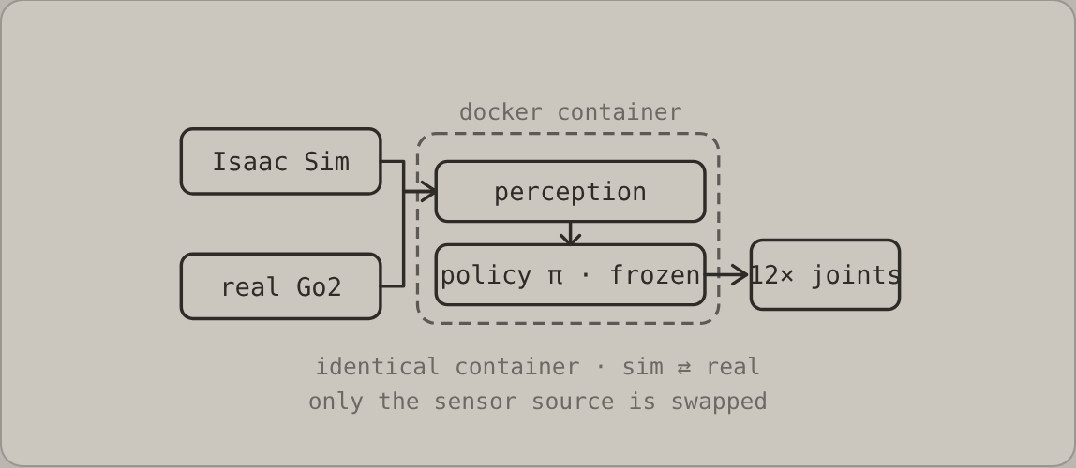
SOLUTION & TECHNOLOGY
System architecture
A Unitree Go2 carries the patient’s oxygen concentrator on a shock-isolated cradle. The whole control stack — perception plus the learned policy — runs inside one Docker container on a Jetson Orin: the same container whether Isaac Sim or the real robot feeds it. Only the sensor source is swapped, so a policy proven in simulation is expected to hold on hardware.

Slide 4
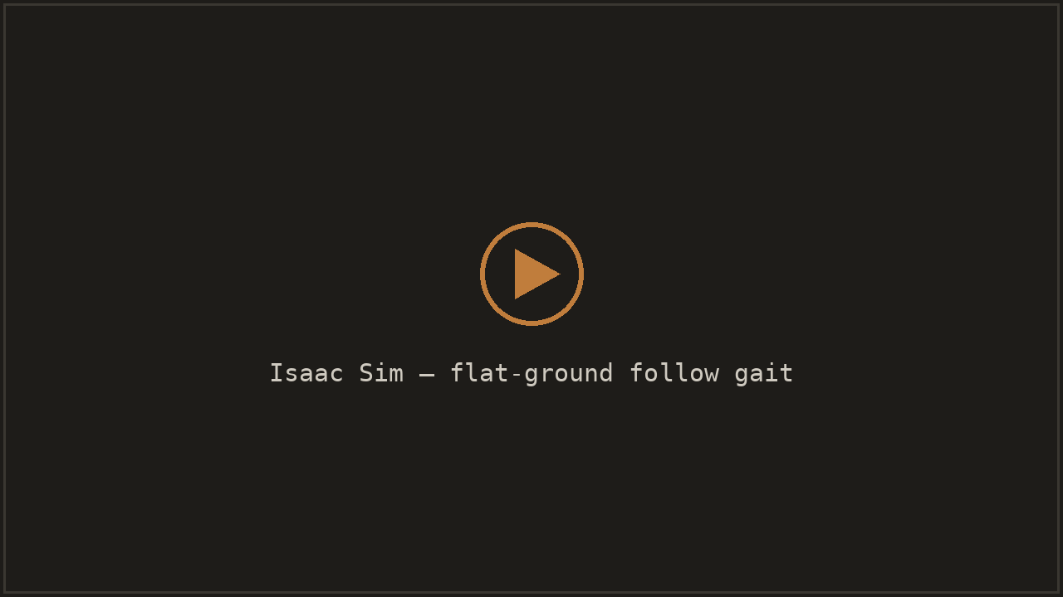
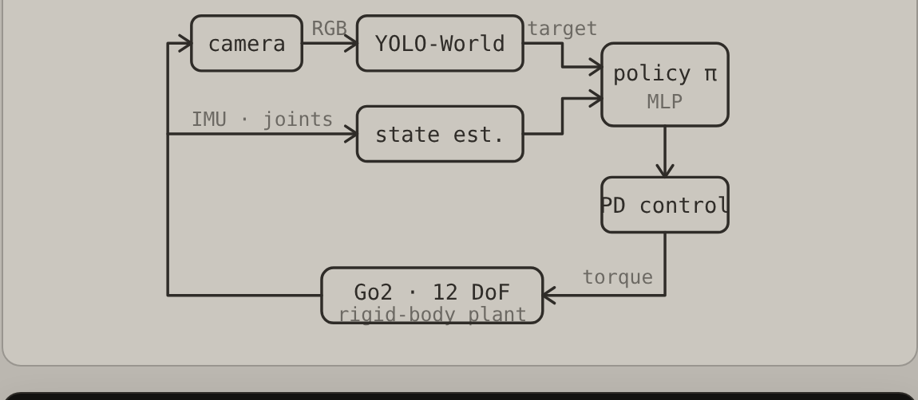
SOLUTION & TECHNOLOGY
Walking policy — it follows you
On flat ground the robot follows the patient by sight: a YOLO-World detector locates the person in every camera frame, and a learned trot gait steers to keep pace while holding the oxygen payload level — rejecting the disturbances of a shifting load and an uneven floor at each step.

Slide 5
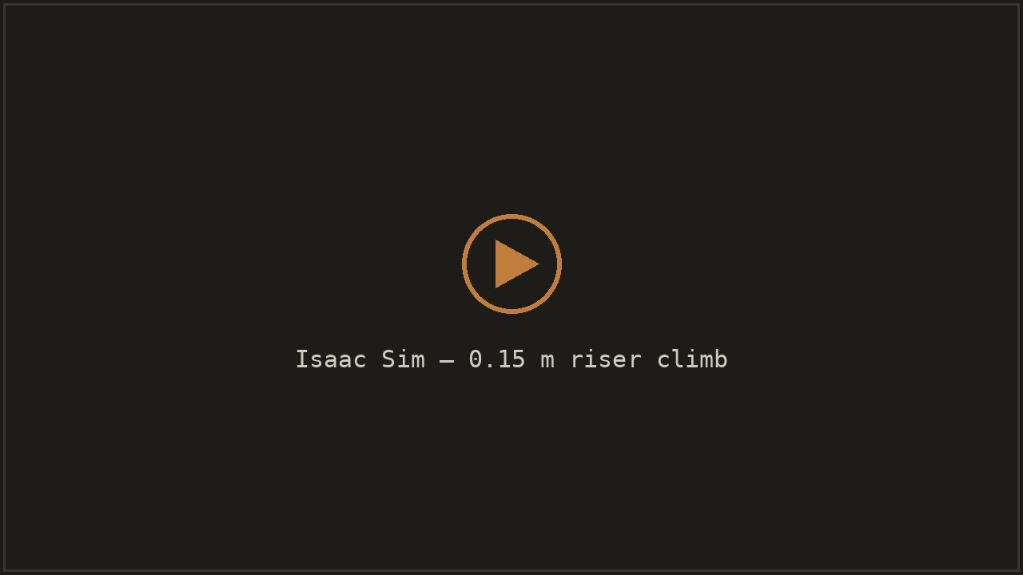
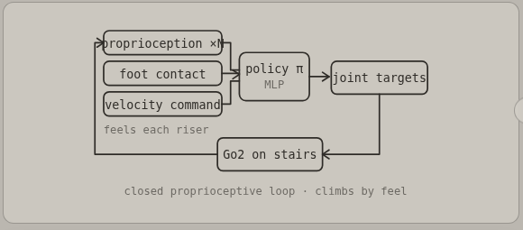
SOLUTION & TECHNOLOGY
Blind-RL policy — it climbs by feel
The staircase is climbed on feel alone. Cameras can’t see the steps underfoot, so a reinforcement-learning policy leans entirely on proprioception and foot contact — sensing each riser as a paw lands — to place its feet and drive the payload upward, step after step, while keeping the concentrator upright on the incline.

Slide 6
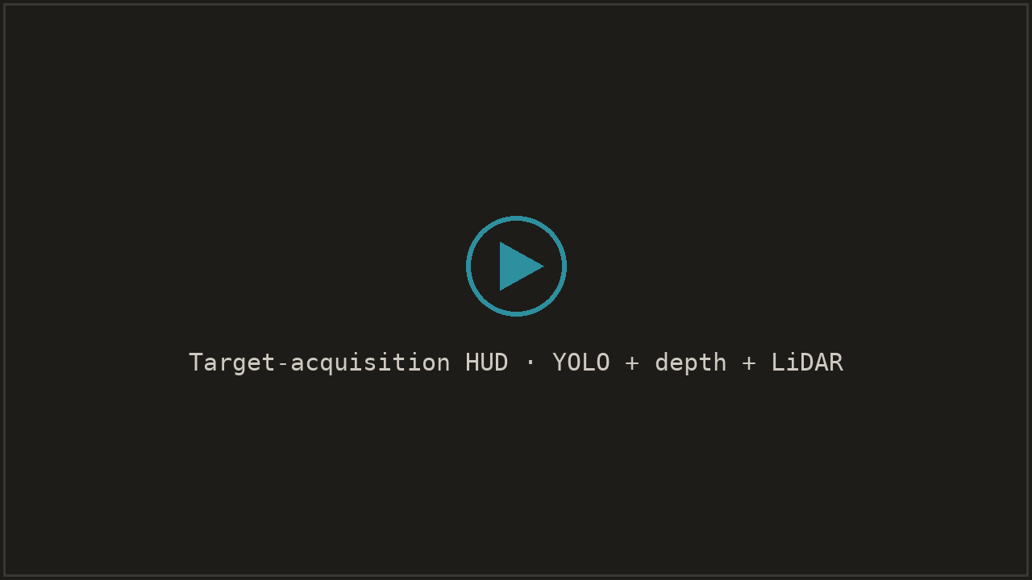




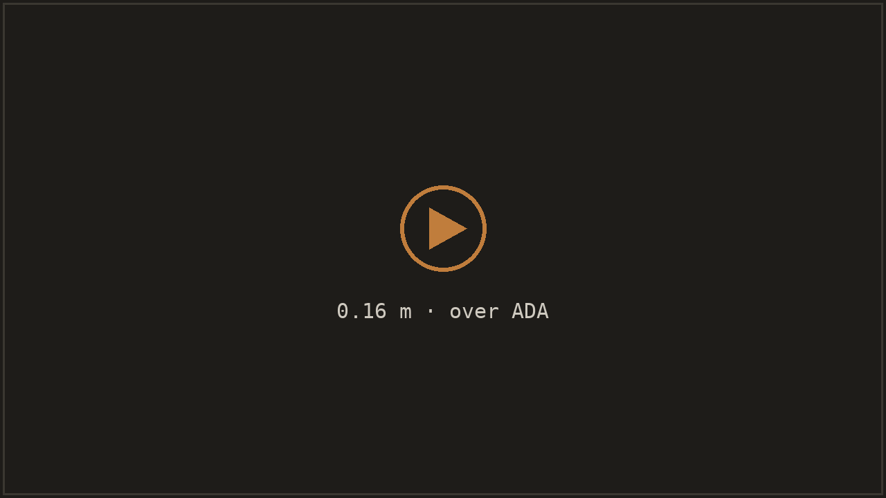
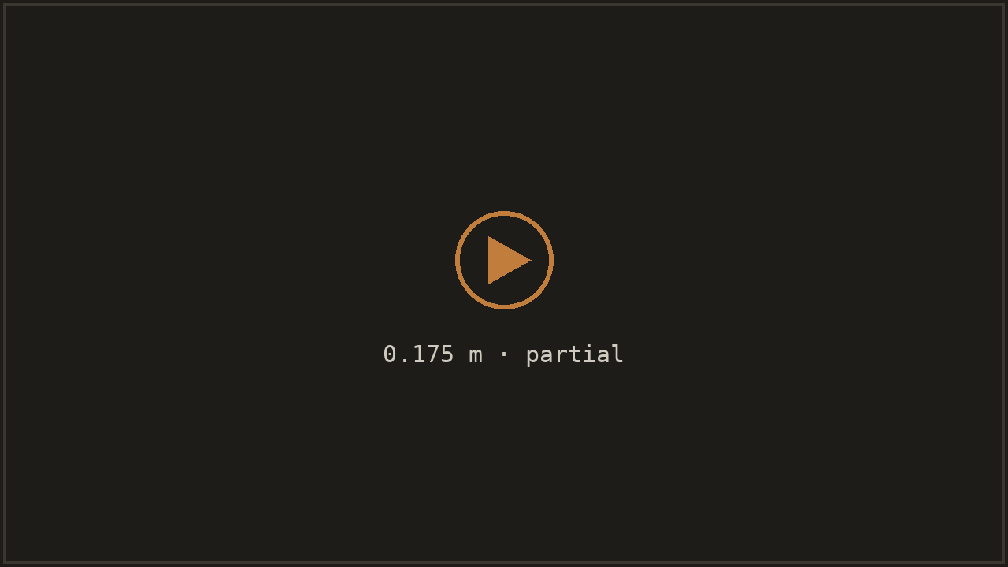
LIVE DEMO · REAL ISAAC ROLLOUT
It sees the patient and follows — and climbs rising stair heights
Nothing here is scripted. YOLO-World locks onto the patient in every frame; depth + LiDAR read the scene; the learned gait steers to keep pace — all from the dog’s own camera.

Slide 7

PROGRESS & RESULTS
We trained it to climb — 6,000 iterations
A blind reinforcement-learning policy learned to drive the payload upstairs on feel alone.
Across 6,000 training iterations the mean episode reward climbed to 95.7 and held. A difficulty curriculum pushed the stairs steeper over time, settling at a 138 mm riser — right at the real-world target height. Along the way the policy learned to stop falling — topples collapsed from 92% of episodes to about 3% — and to survive longer, carrying the payload the full climb instead of tipping in the first couple of seconds. The gait it found is cautious, not graceful — it noses down and leans into each riser rather than stepping cleanly — but inside that trained envelope it ends upright almost every time, keeping the payload level.
95.7
mean reward at plateau
138 mm
riser the curriculum settled at
≈100%
episodes end upright, not a fall
blind RL
Go2 + 2.22 kg O₂
Isaac Sim

Slide 8
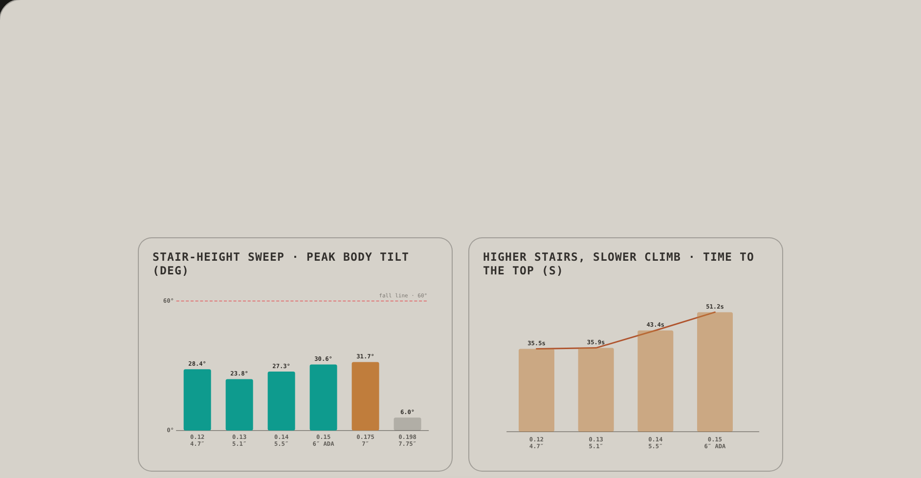
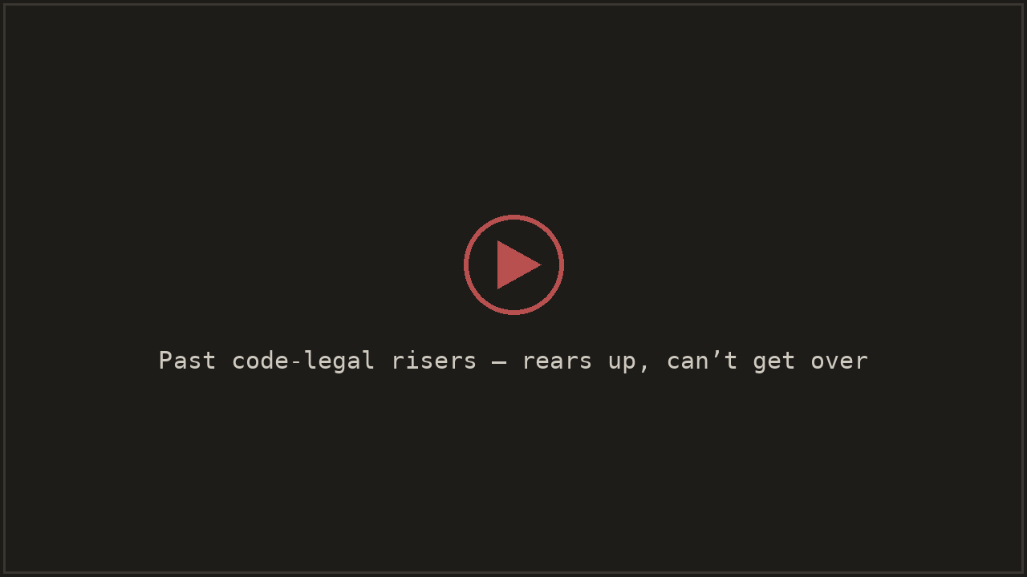
PROGRESS & RESULTS
How high it climbs — and where it stops
We swept real staircase heights from 4.7″ up past the code maximum — carrying the oxygen tank the whole way, and pushing until it fails.
Up to the ADA-legal 6-inch riser it climbs the full 14-step staircase and follows the patient to the top — but not for free: every extra inch of riser slows it down, from 35 s at 4.7″ to 51 s at 6″. Push past code-legal stairs and it runs out of reach — a 7-inch riser gets it barely a third of the way up — and steeper still it rears up against the step and can’t get over it at all. That limit sits right about where a person would want a stair-lift too.
6″ ADA
highest riser it fully tops out
+44%
slower climb from 4.7″ to 6″
7″ +
too steep — stalls out, can’t climb
ADA 6″ ✓
higher = slower
past code-max = stalls out

Slide 9
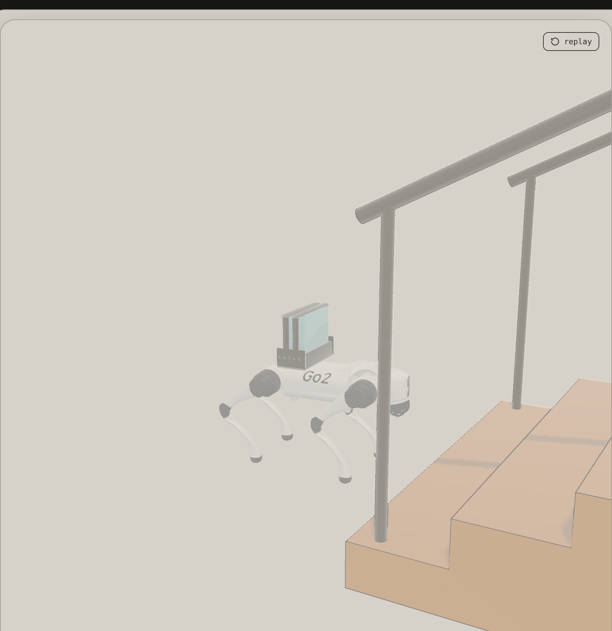
ENGINEERING CHALLENGES
Everything that broke — and the fix
Getting a blind dog to climb stairs — carrying a payload, beside a person — broke in every way you’d expect. Each failure sent us back to the sim with a fix.
× The first policy was reckless — it lunged at the steps and crashed.
→ Retrained from a stronger checkpoint until the gait commits to each step cautiously and stays upright.
× It couldn’t see the stairs underfoot.
→ A blind RL policy that climbs by feel — proprioception + foot contact, no camera needed on the steps.
× It mistook the patient for a staircase.
→ Mask the person out of the depth view and require a real stair detection before ever committing to climb mode.
× It crowded the patient on the incline.
→ Gap-aware pacing so the dog trails the person up the stairs instead of closing in on them.
sim-in-the-loop
fail, fix, repeat
safety first

Slide 10
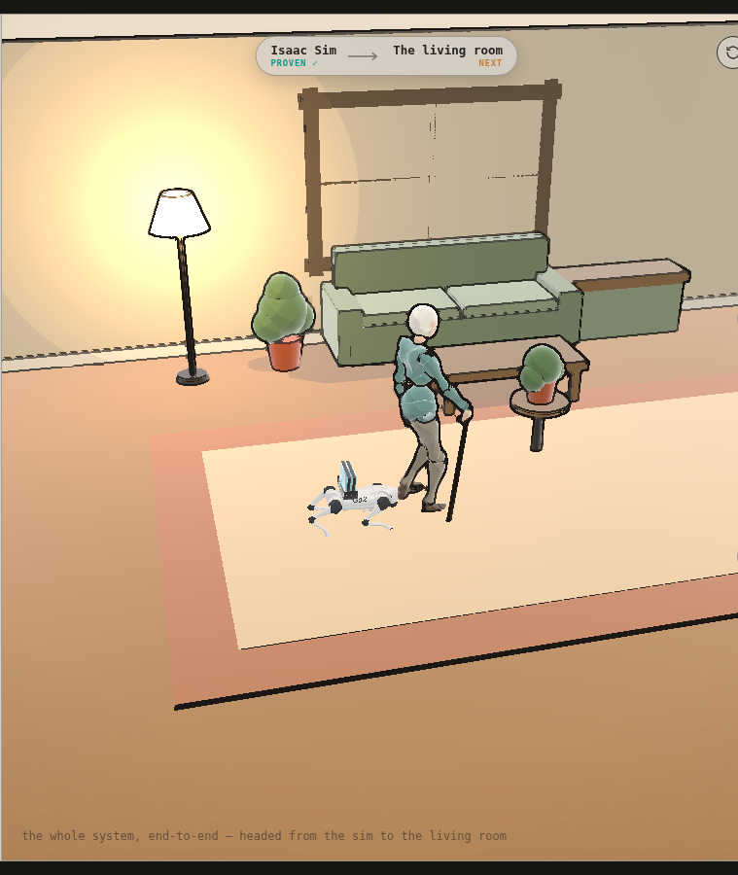
REAL-WORLD POTENTIAL
From a proven sim to the living room
The same control container runs in simulation and on the robot — only the sensor source changes.
That is the whole deployment bet: a policy proven in Isaac Sim is expected to hold on an NVIDIA Jetson Orin carried by a real Go2, because it runs the identical Docker stack. The payoff is a floor of the house given back — patients keep their stairs, caregivers get a hand, and clinics and rehab facilities get an assistant that never tires. Next up: hardware bring-up, gait polish, and a supervised home pilot.
Sim ✓
full climb, proven
1 stack
identical sim ⇄ robot
Jetson
Orin edge compute
home pilot
care facilities
aging in place

