Slide 1
Exceptions Handling
Anthony Wayman

Slide 2
Python
Exceptions (Errors)

Slide 3
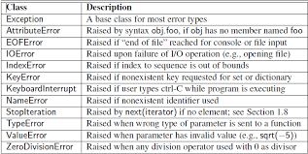

Slide 4
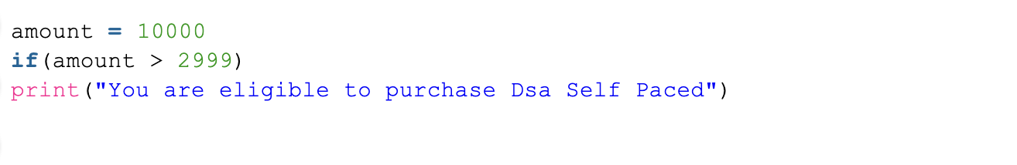
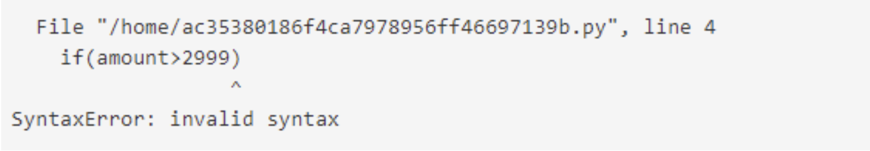
Python Exceptions
Input:
Output:

Slide 5
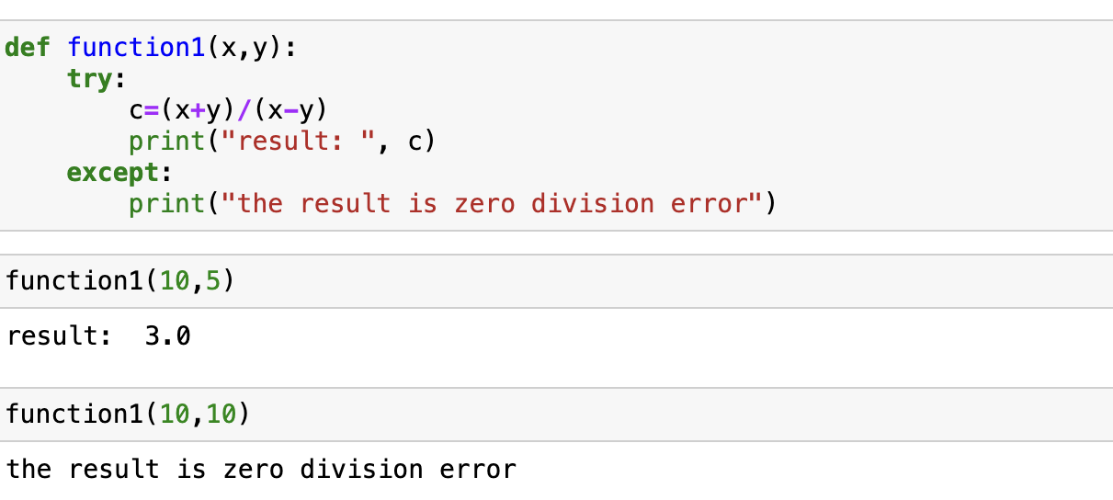
Uses

Slide 6
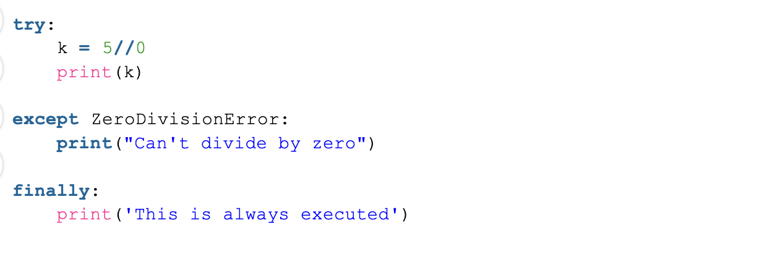
Other example

Slide 7
Conclusion
Anthony Wayman

