Slide 1

INFITEX Empowerment Hub

Slide 2
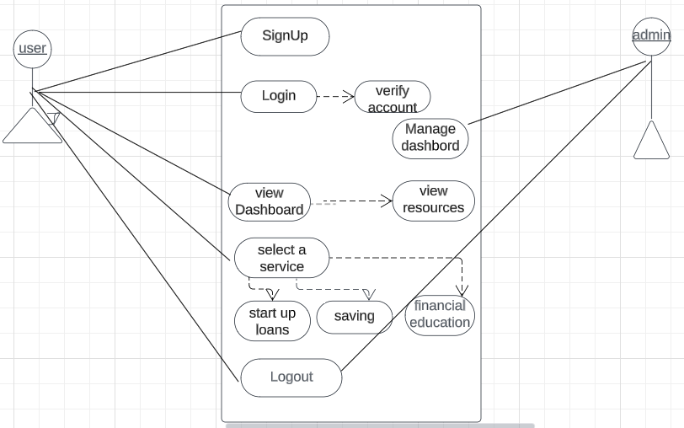
Use case diagram

Slide 3
Use case diagram

Slide 4
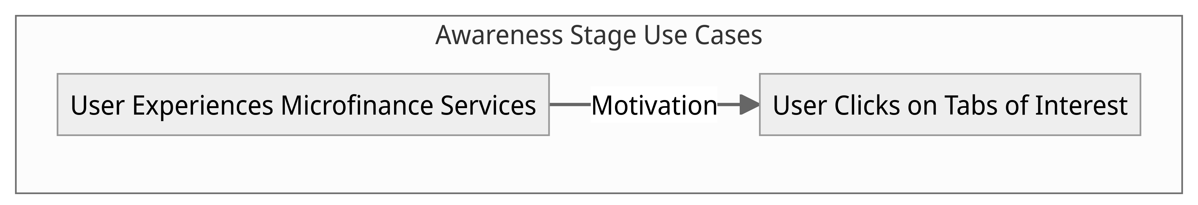

Awareness Stage Use Cases
User Experiences Microfinance Services: At the awareness stage, users encounter microfinance services, sparking interest.
User Clicks on Tabs of Interest: They explore further by clicking on tabs relevant to their needs.

Slide 5
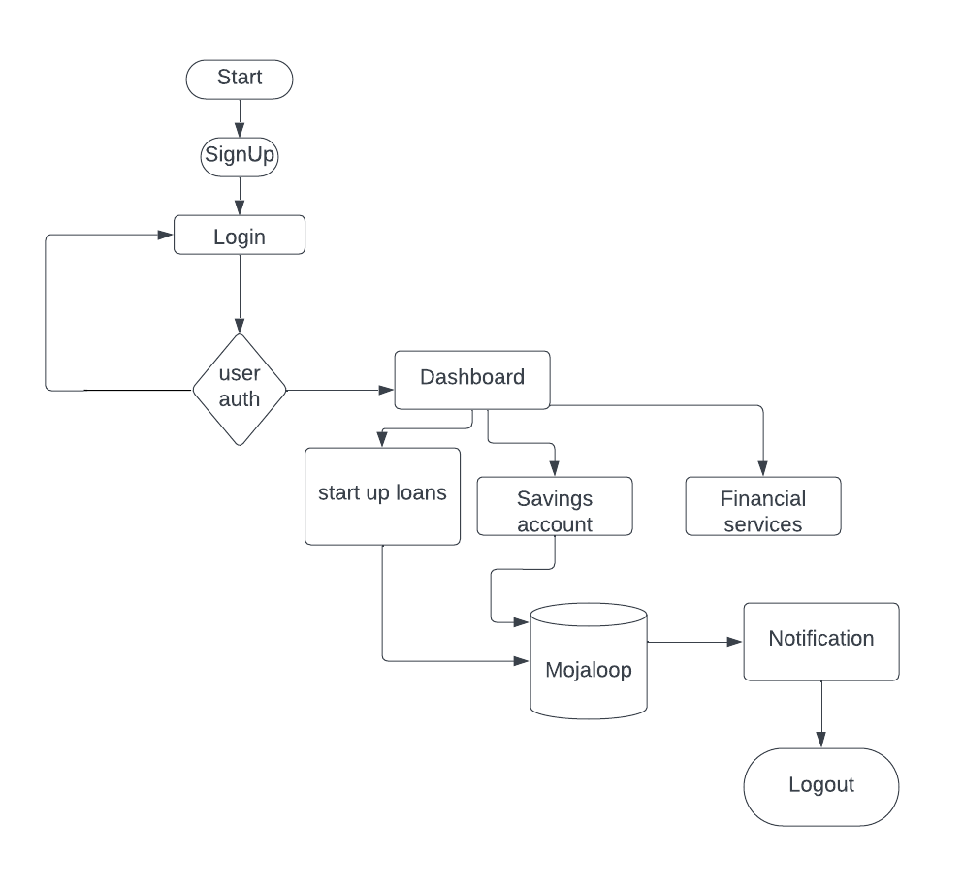
User Flow Diagram.

Slide 6
Data Model
The data model defines the relationships between these data elements, their attributes, and the rules for data integrity and validation.
It ensures that the hub's operations are well-structured and efficient, enabling accurate tracking of women's journeys, effective provision of services, and meaningful analysis of the hub's impact over time.

Slide 7
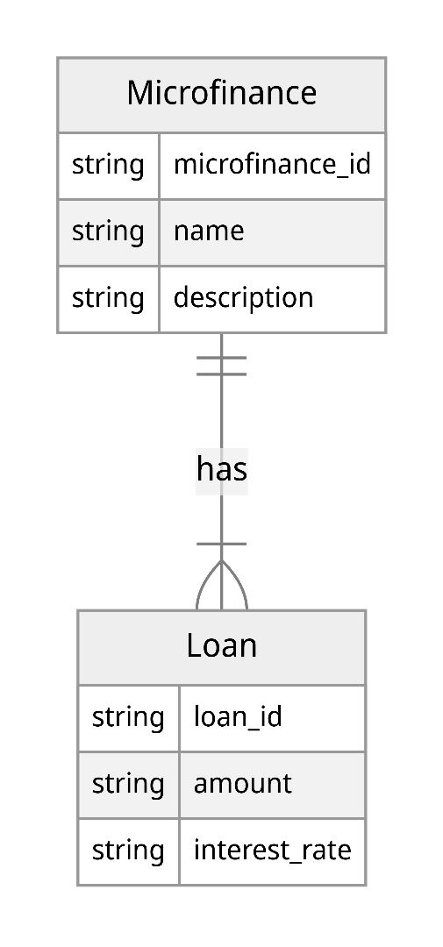
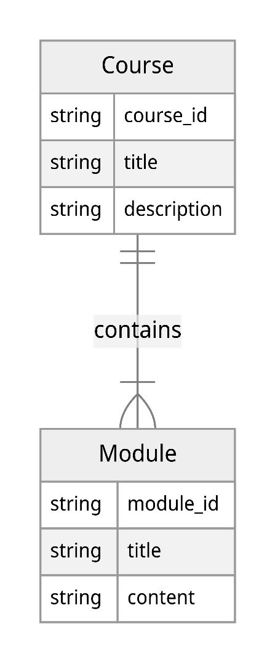
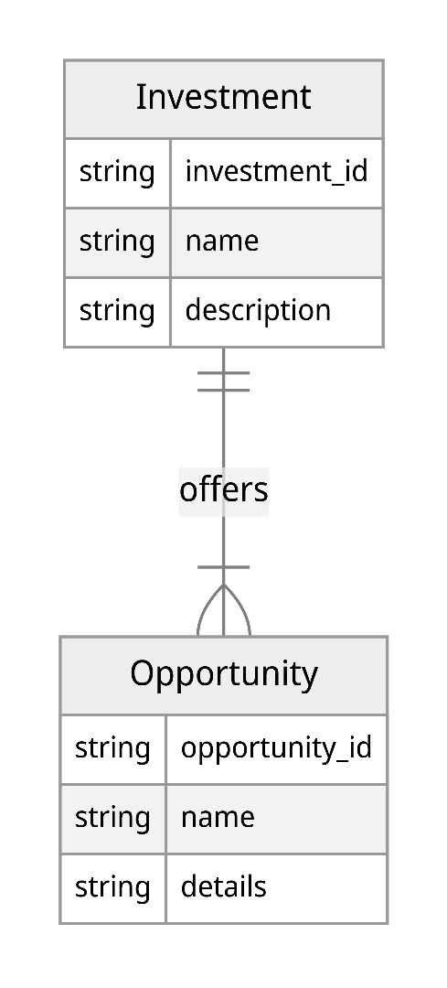
Continuation

Slide 8
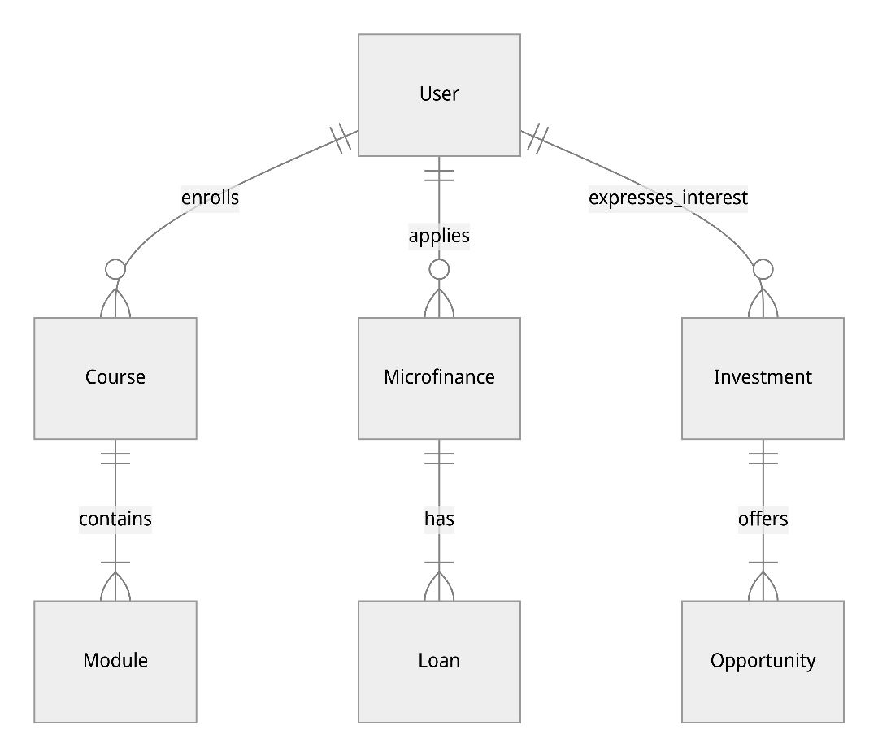
Continuation

Slide 9

Customer Journey Map

Slide 10
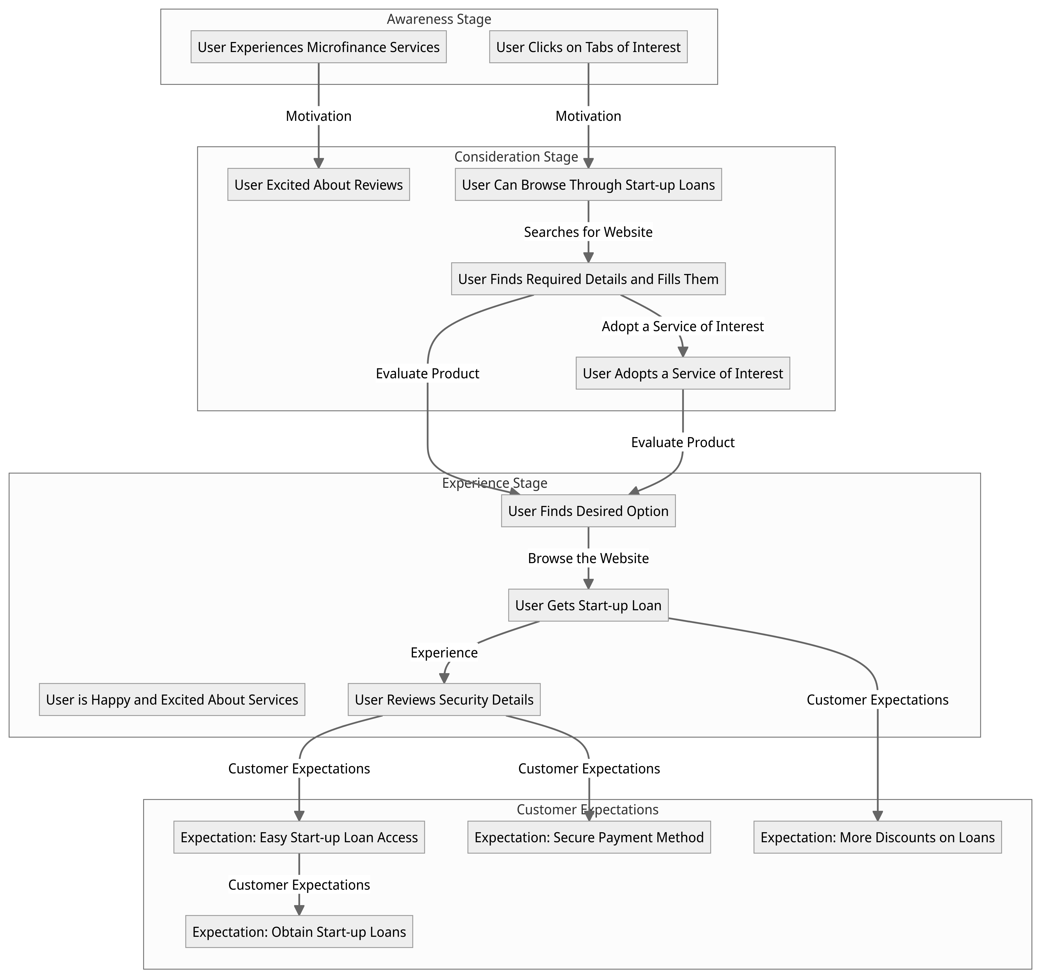
Customer Journey map

Slide 12
Customer Roadmap
1. Awareness Stage
User Experiences Microfinance Services: The journey begins as the user becomes aware of the platform's microfinance services.
User Clicks on Tabs of Interest: Intrigued, the user clicks on tabs of interest to explore further.

Slide 13

2. Consideration Stage
User Excited About Reviews: The user's excitement grows as they read positive reviews from other customers.
User Can Browse Through Start-up Loans: They start browsing through start-up loan options, seeking the right fit.
User Finds Required Details and Fills Them: The user locates required details and fills in necessary information.
User Adopts a Service of Interest: Ultimately, the user decides to adopt a service that aligns with their goals.

Slide 14
3. Experience Stage
User is Happy and Excited About Services: As they engage, the user feels happy and excited about the platform's offerings.
User Finds Desired Option: They navigate to find their desired option among the choices.
User Gets Start-up Loan: The user successfully secures a start-up loan, progressing their goals.
User Reviews Security Details: They carefully review security details to ensure a safe experience.

Slide 15

4. Customer Expectations
Expectation: Easy Start-up Loan Access: The user expects seamless access to start-up loans.
Expectation: Obtain Start-up Loans: They anticipate obtaining the needed start-up loans effortlessly.
Expectation: More Discounts on Loans: Their expectations include the possibility of more discounts on loans.
Expectation: Secure Payment Method: Lastly, they desire a secure payment method for their transactions.

