Slide 1
//World’s Best Palindrome Checker
String Lab = “Lab1”;
If ( Lab.equals( “Lab1”)){
System.out.println ( “Made by Anthony R” );
}

Slide 2
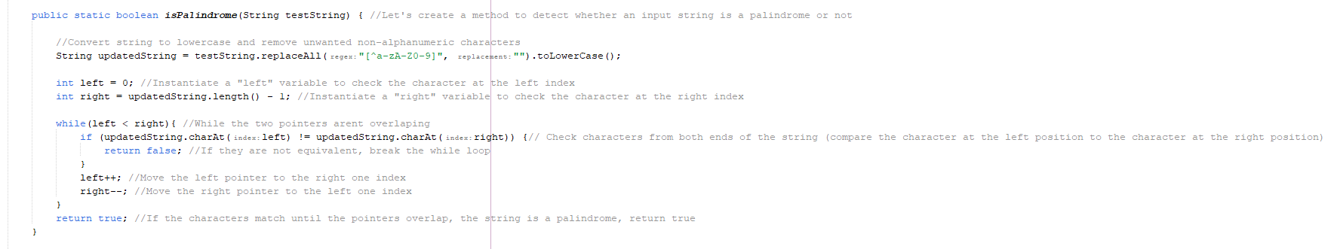
Part I: Implementation
The method created above essentially replaces any non-alphanumeric characters with a blank placeholder and converts the entirety of the string to lowercase letters. Following that, we initialize two integers labelled “left” and “right”. These act as pointers that will then iterate throughout the string. If the character on the left is not the same as the character on the right, the loop will end and the boolean expression will return false (meaning that the string is NOT a palindrome). If the characters of the string are both the same on the left and the right, the loop will iterate and compare until the middle of the string is met and return true (meaning the string IS a palindrome). The pointers will increment and decrement for every character as long as they are the same on both ends until they both reach the midpoint.

Slide 3
Part II: Theoretical Time Complexity Analysis
Best Case Scenario:
When the inputs character on both ends of it are not equivalent to one another (not a palindrome)
In this case, the loop will only have to iterate once and stop as soon as the first mismatch is discovered
The computation complexity for the best case scenario would be O(1) because the algorithm would be completed after just the first iteration in the instance that the first and last character are not the same
Worst Case Scenario:
When the string is a palindrome
This is because the loop would have to iterate through the entire string of ‘n’ characters
The computational complexity in the worst case is O(n/2), essentially O(n), because the time taken to execute the algorithm is dependent on the length of the input string

Slide 4
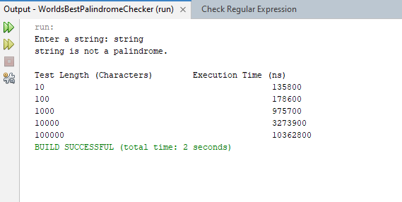
Part III: Experimental Time Complexity
After the generateRandomString()method created strings of {10, 100, 1000, 10000, 10000} length, we passed them through the isPalindrome method and recorded our findings of the algorithms execution in terms of nanoseconds

Slide 5
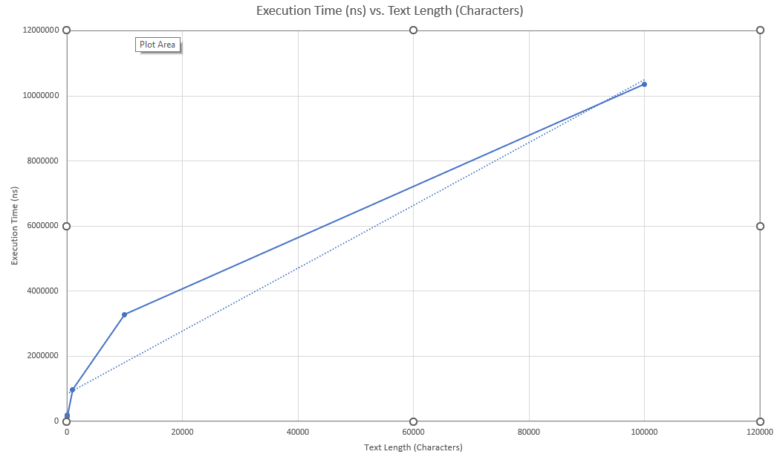
Result

Slide 6
Part IV: Conclusion
In our theoretical analysis we determined that our algorithms computational complexity is O(n). The ‘n’ being the length of characters in the input string. The reason behind our thought process was that the algorithm will iterate with two pointers (one on each end), through half of the string (n/2 characters) to specify whether a string is a palindrome. After experimenting and developing a method that generates random strings throughout multiple trials, we found that the execution time with respect to the length of the string, increases linearly. This is consistent with our theoretical analysis and this can be seen on the previous slide based on the trendline incorporated in the graph. A possible potential improvement could be to optimize the algorithms code in order to execute more swiftly. Overall, the algorithm seems to perform efficiently for most practical use cases.

