Slide 1
Sentiment Analysis of Reddit Data

Slide 2
Research Question

Slide 3
Sentiment Analysis

Slide 4
Dataset

Slide 5
Data Cleaning

Slide 6
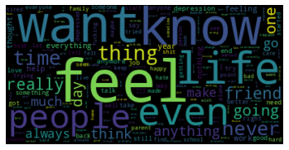
Word cloud

Slide 7
Sentiment Analysis

Slide 8
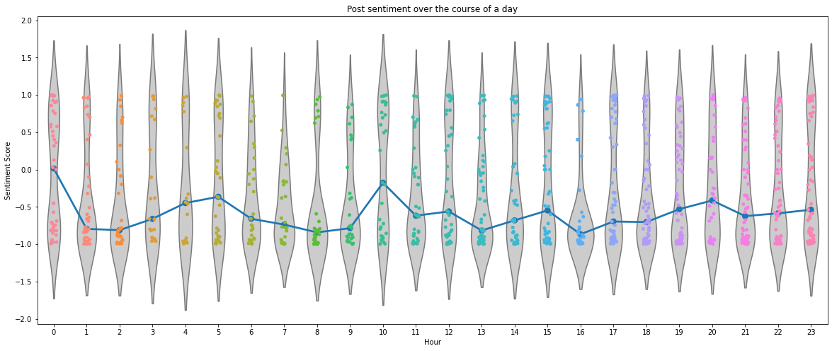
Results

Slide 9
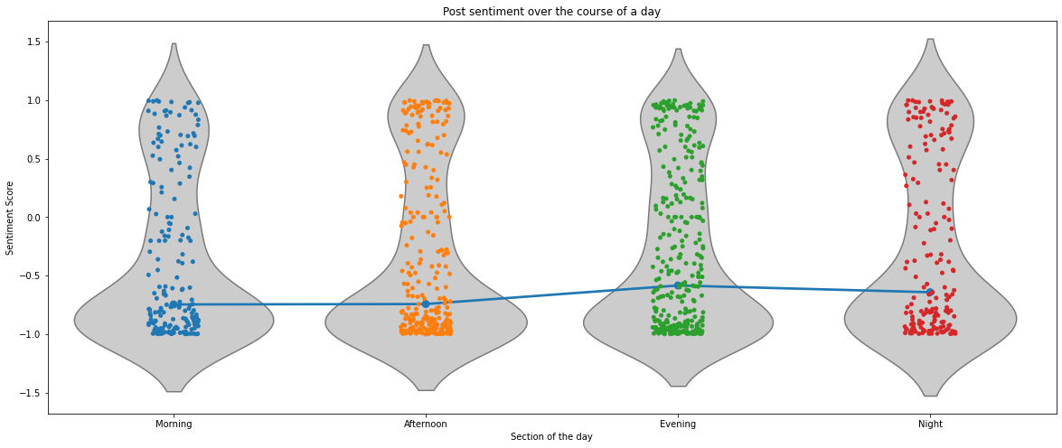

Slide 10
Statistical Analysis

Slide 11
Conclusion

Slide 12
Questions?

