Slide 1

Sentiment Analysis of Reddit Data

Slide 2

Research Question
Does mood fluctuate throughout the day?
Business Case
If you can pinpoint which part of the day consumers are most positive than you could reasonably assume they would respond more favorably to ads

Slide 3
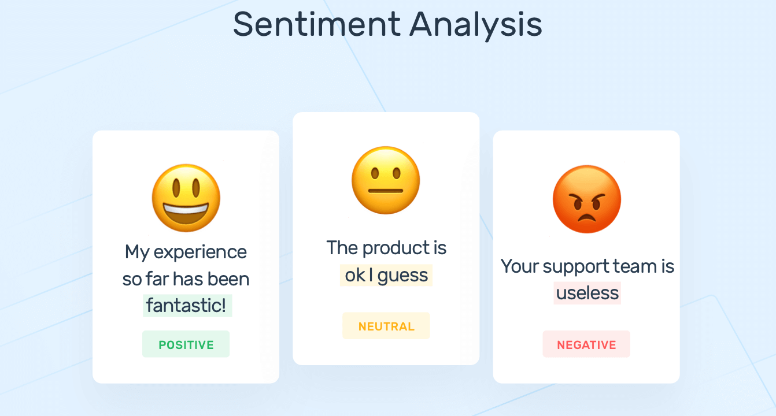
Sentiment Analysis
Sentiment analysis is an NLP (Natural Language Processing) technique used generally to determine if human speech is positive, negative, or neutral.
https://monkeylearn.com/sentiment-analysis/

Slide 4
Dataset
Connect to reddit API
Specify the subreddit and pull the most recent 1000 posts
Extract only headers needed for analysis
Very similar to other API’s with the use of authentication keys etc.
I extracted posts from “r/Depression” thinking this would have the most dramatic differences in sentiment
Reddit gathers many metadata values for each post, I only pulled data relevant to the project

Slide 5
Data Cleaning
Cleaning text for word cloud
Removed stop words
Lemmatization
Converting time
Reddit API outputs seconds since unix epoch
Converted to US central time
Cleaning text data for sentiment analysis
Remove non ascii characters
Remove emojis

Slide 6
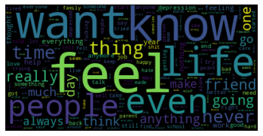
Word cloud

Slide 7
Sentiment Analysis implementation

Slide 8
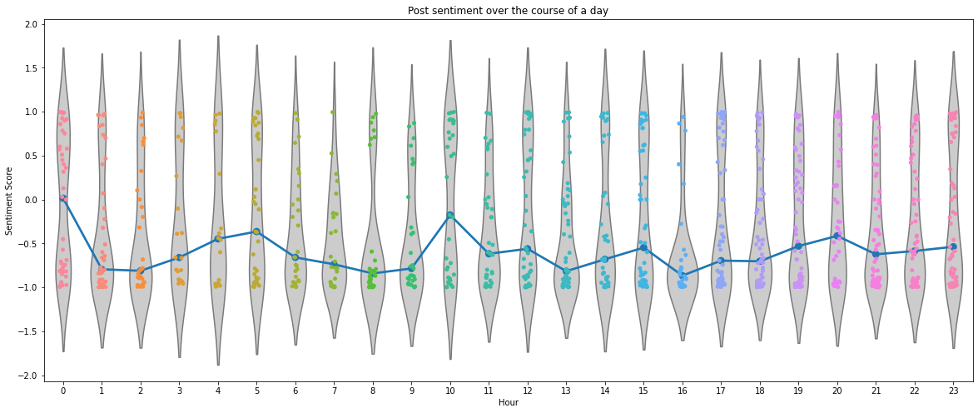
Results

Slide 9
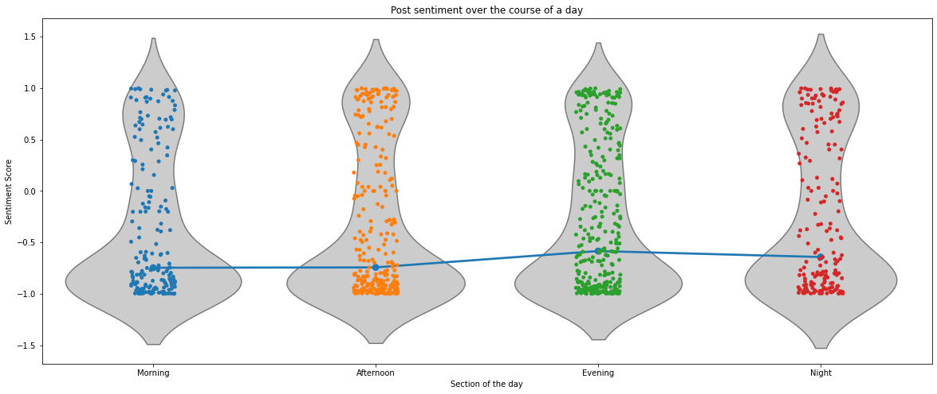

Slide 10
Statistical Analysis

Slide 11
Conclusion

Slide 12
Questions?

