Slide 1
Title
Team Member Names
Faculty Advisor(s): (their name/s), Dept. of ____, Florida Institute of Technology
INSTRUCTIONS
Do not use a color background
Keep all content within the gold lines and blue and crimson bars (other than title block and icons)
Do not change the size of the poster
Please keep the text readable. The only font allowed is “Calibri”. It is available on all Microsoft products . Minimum font size is 48 pts.
The size is already set to exactly the print size. Please arrange and size all the images and text properly.
Ensure that all images are at least 300 dpi
The name of any faculty should be put in as “Dr. [First Name] [Middle Initial]. [Last Name], Dept. Of [name of department], [name of institution]
Names of any sponsors, mentors, volunteers, helpers, etc. can be put in the acknowledgements section. Put in text only. Do not put in any additional logos in the poster other than the ones already in the template.
Your Poster file should be named as follows:
SHOWCASE_SPRING2024_POSTER_CAPSTONE MAJOR_YOURTEAMNAME*
(Example: SHOWCASE_SPRING2024_POSTER_ME_SUNNUCLEAR)
Note: The project name should be exactly as the registered project name.
*If this is an individual project, please place the title of your project instead of the team name
Please follow all instructions above.
The submission may be rejected if the formatting guidelines are violated or the file is not properly named.
**delete this text box**

Slide 2
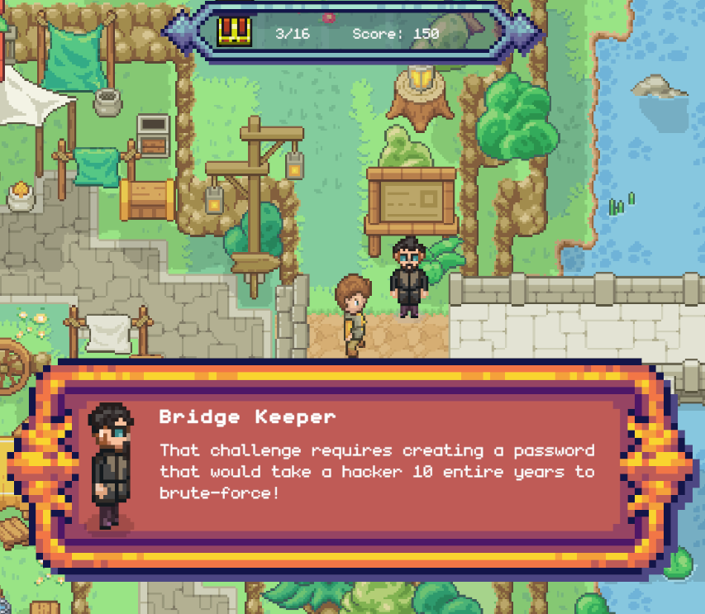
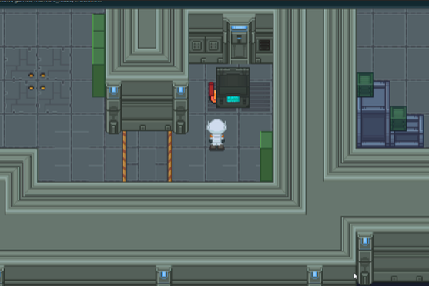
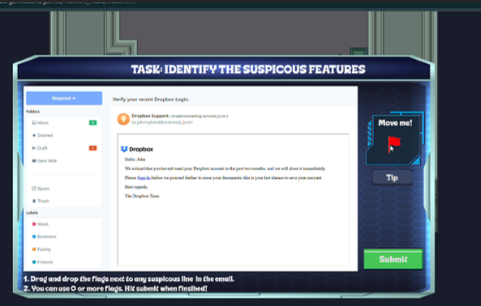
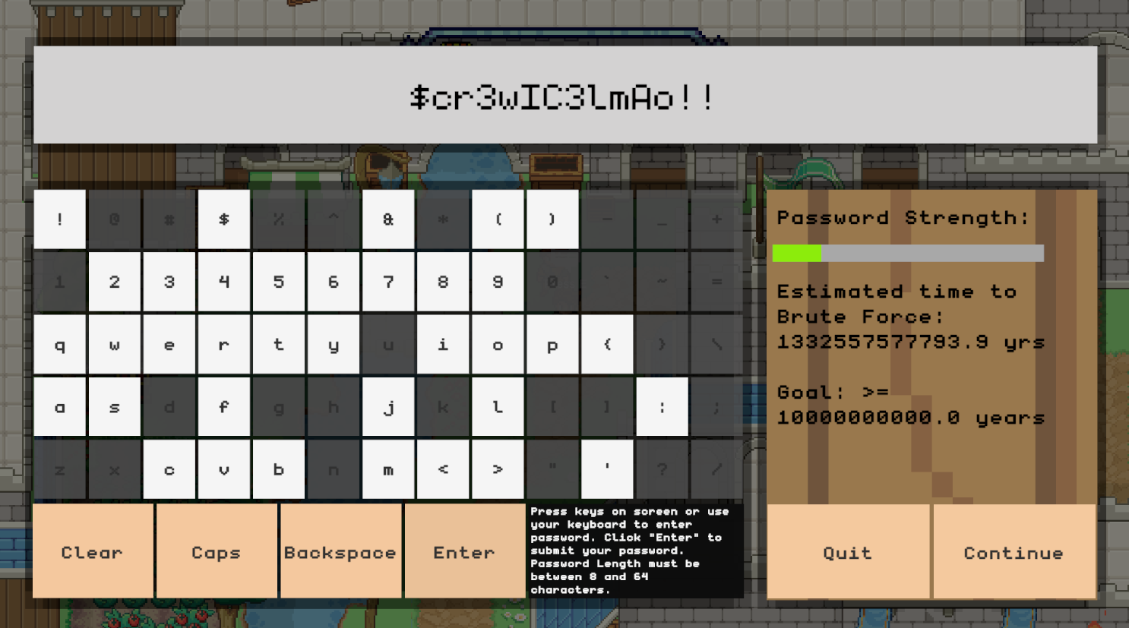

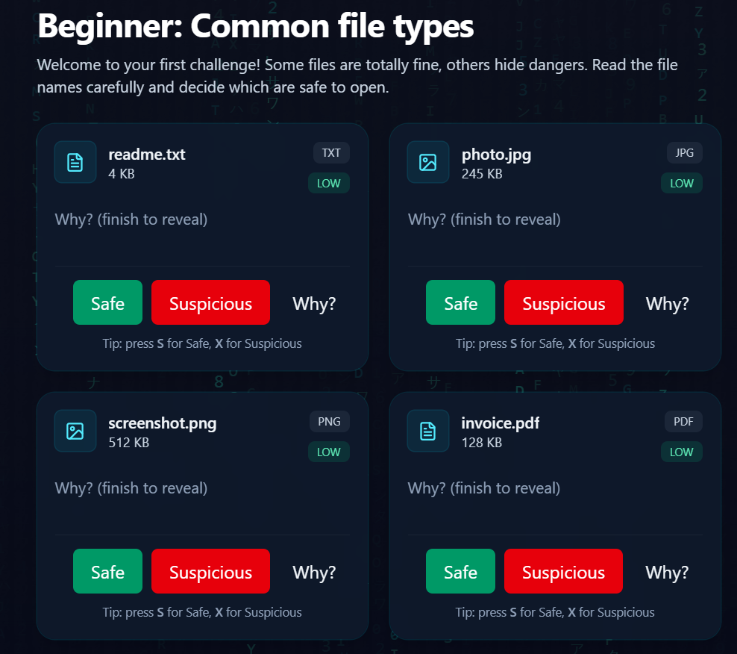
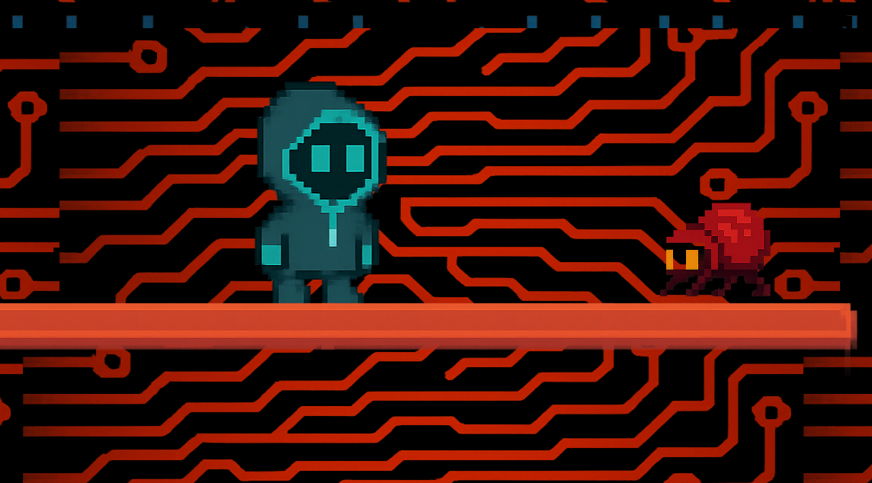
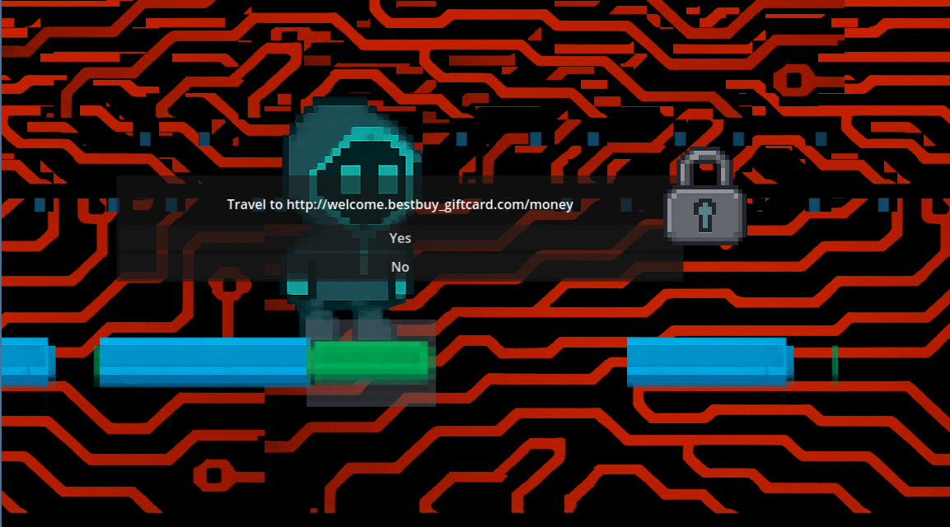
Cool Cyber Games
Cyber Security learning platform
Matthew Goembel, Anthony Clayton, Benjamin Allerton, Ludendorff Brice
Faculty Advisor(s): Dr. Sneha Sudhakaran, Dept. of Electrical Engineering and Computer Science, Florida Institute of Technology
Games & Development
Project Summary
Cool Cyber Games is an interactive cybersecurity learning platform that teaches players real-world digital safety skills through fun, gamified experiences. Each game focuses on a core cybersecurity topic—such as phishing, password security, and file safety—allowing users to learn, apply, and test their knowledge in engaging, story-driven challenges.
Malware Maze
Description: Navigate a digital maze while learning to recognize and avoid phishing and malware threats.
Objective: Identify safe paths and “neutralize” malware monsters to unlock the next challenge.
Estimated Time: 15 minutes
Skills: Phishing detection, Malware avoidance
Tools: Godot Engine, Figma, Piskel, Itch.io, GenAI, Custom assets
Master the Password
Description: Learn and apply password security techniques as you explore this top-down 2D game.
Objective: Collect chests to earn characters to use in password challenges.
Estimated Time: 20 minutes
Skills: Password Security, Cyber Defense Awareness
Tools: Unity Engine, Itch.io, GenAI, Custom assets, bosca ceoil.
Impact & Future Directions
Major impact stems from being able to teach all generations a wide range of beginner friendly Cyber-Security topics through video games. Moving forward we hope to create more diverse games and delve into deeper and more niche concepts to help people truly understand all cybersecurity concepts.
File Inspector
Description: Learn and identify the different file types you may come across on the internet and their properties.
Objective: Pick out and determine safe file types and potentially dangerous ones
Estimated Time: 10-15 min
Skills: Malware avoidance, General
Computer knowledge
Tools: React + Vite + Tailwind +
Zustand + Framer Motion
Web Quest:
Description: Learn how to read web links to keep you and your data safe in this Mario-esque learning game.
Objective: Traverse levels and determine safe web links while avoiding pesky popups.
Estimated time: 10-15 minutes
Skills: Web security, observation awareness
Tools: Godot, GenAI, Custom Assets, Bandlab
Backend & Website
Architecture Overview:
Frontend: HTML5-exported Godot games embedded on coolcybergames.com
Backend: Node.js + Express API managing authentication, score tracking, and achievements
Database: MongoDB storing user profiles, game progress, and leaderboard stats
Hosting: Render (server) + Git LFS for large WASM game files
Key Features:
Secure login with Google OAuth
Real-time leaderboard updates via API calls
Automatic score syncing after each game
Admin dashboard for monitoring player metrics

