Slide 1

MINI PROJECT · COMPUTER SCIENCE & ENGINEERING:DATA SCIENCE· 2023–2027
Auto Suggestion System Using Trie Data Structure
This mini project presents an intelligent auto-suggestion engine built on the Trie (Prefix Tree) data structure. It delivers real-time word completions as users type, dramatically reducing keystrokes and improving search efficiency across large datasets.
Team Members: S. Yogasaikumar · M. Chethan Kumar Reddy · A. Cypriyan

Slide 2

Problem Statement & Project Objectives
The Challenge
Project Objectives
Traditional linear search methods scale poorly with large datasets, causing noticeable delays as data grows. Users today expect instant, context-aware suggestions while typing — a demand that brute-force string matching simply cannot meet. In high-traffic systems, this latency directly impacts user experience and system performance.
Efficient Prefix Search
Implement a Trie-based structure that retrieves all words sharing a given prefix in O(k) time, where k is the prefix length.
Real-Time Suggestions
Slow prefix matching in large dictionaries
No intelligent prediction during typing
High computational cost per keystroke
Poor scalability with millions of words
Generate and display word completions dynamically as the user types, with zero perceptible delay.
Scalable Architecture
Design a system capable of handling large word corpora without performance degradation.

Slide 3
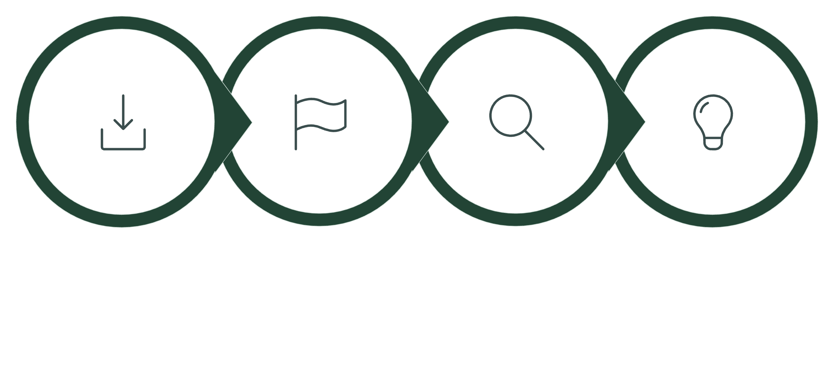
Methodology: Trie Data Structure in Action
The Trie (pronounced "try"), also known as a Prefix Tree, is a tree-like data structure where each node represents a single character. Words sharing common prefixes share the same path from the root, enabling extremely fast prefix-based retrieval.
Insert
Mark
Search
Suggest
The diagram above illustrates the complete lifecycle of the auto-suggestion system — from word insertion through prefix traversal to final suggestion generation.
Trie Structure — Visual Example
Core Operations
For the words "app", "apple", and "application", the Trie shares the common prefix "app" in a single path, then branches out:
Insert(word)
(root) | a | p | p ← "app" (end-of-word) / \ l l | | e i | | apple c | a | t | i | o | n → "application"
Traverse character by character; create new nodes only when a path does not exist. Mark the final node as end-of-word.
Search(prefix)
Navigate the Trie using prefix characters. If the path exists, perform DFS from that node to collect all suggestions.
Suggest(prefix)
Return up to N completions sorted alphabetically. Time complexity: O(k + m), where k = prefix length, m = output size.

Slide 4
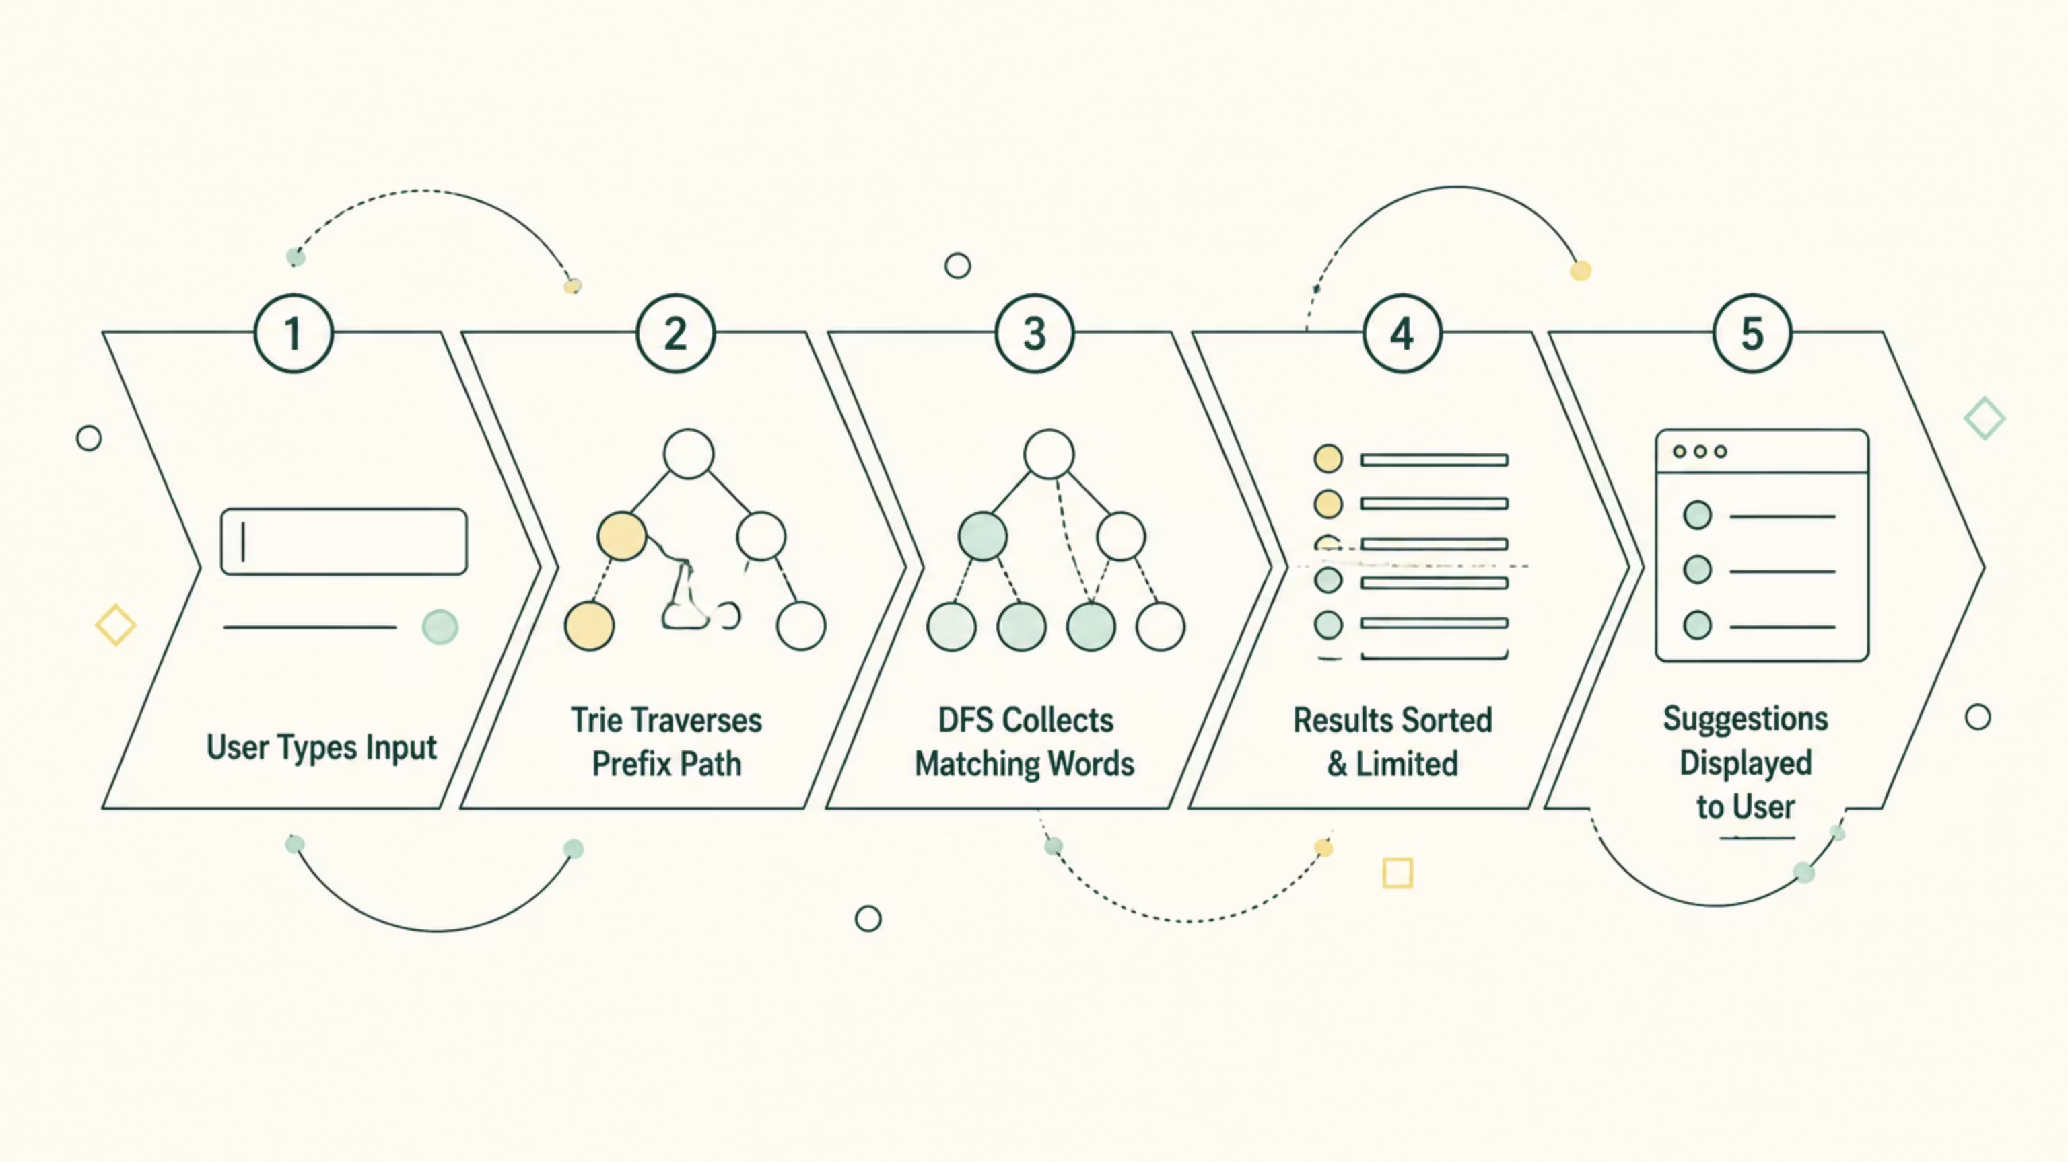
Results & System Output
Sample Execution
Performance Metrics
Input Prefix: app
Output Suggestions:
O(k)
app
apple
application
apply
appointment
Search Complexity
Prefix lookup time depends only on prefix length, not dictionary size.
All suggestions are returned in under 1 millisecond for a dictionary of 10,000+ words.
~1ms
Avg. Response Time
Measured across 10,000-word dictionary on standard hardware.
10K+
Word Capacity
System tested with a comprehensive English word corpus.
System Workflow
The workflow above demonstrates how each keystroke triggers an efficient Trie traversal, collects all matching completions via depth-first search, and presents ranked suggestions to the user in real time.

Slide 5



Conclusion & Future Scope
✅ Achieved
🌐 Real-World Applications
🔭 Future Enhancements
The Trie-based auto-suggestion system successfully delivers fast, accurate, and scalable word completions. It outperforms traditional linear search methods and provides a seamless real-time user experience.
This architecture directly mirrors systems used in Google Search, mobile keyboard apps (Gboard, SwiftKey), e-commerce product search (Amazon, Flipkart), and code IDE auto-completion tools.
Planned extensions include fuzzy search for spell correction, AI-powered ranking based on user history, multi-language support, and voice-input integration for accessibility.
Speed & Efficiency
Scalable by Design
Enhanced UX
Trie reduces search complexity from O(n) to O(k), making it ideal for high-frequency, low-latency applications.
Adding new words requires only O(k) insertion — no re-indexing or full dataset scans needed.
Instant suggestions reduce typing effort, minimise errors, and significantly improve overall search experience.

