Slide 1
Java: A Language for the Ages
Exploring Java’s Features and Global Impact
Anthony Duran
Programming Languages

Slide 2
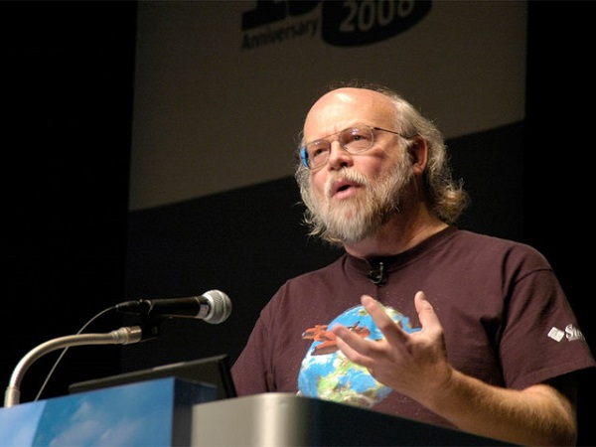
What is Java
Java was developed in 1995 by James Gosling at Sun Microsystems and was originally designed for embedded systems and appliances but then grew to become a global standard
“Write Once, Run Anywhere” (WORA), meaning Java programs could be run on any device with a JVM or Java Virtual Machine
This Photo by Unknown Author is licensed under CC BY-SA-NC

Slide 3
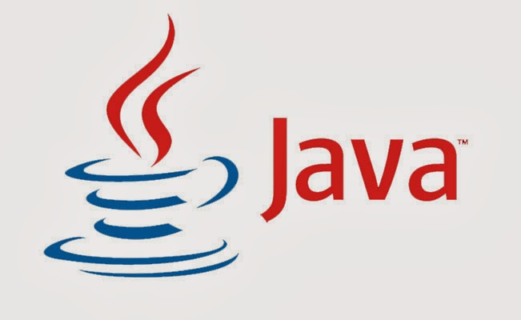
Why is java popular
Platform Independence - WORA
Object-Oriented – Code reusability and modular design
Multithreading – handle multiple tasks at once
Secure and Robust – Automatic garbage collection and memory management
Extensive Ecosystem – Frameworks like Spring and Hibernate
This Photo by Unknown Author is licensed under CC BY-SA
Notes:
The demonstration will go over Object orietnted design, multi thrading and file handling

Slide 4
Global Applications of Java
Java powers 90% of Fortune 500 companies
Used for simulations and computational tools
Big Data – Runs tools like Hadoop and Spark
Web Applications: Frameworks like Spring power e-commerce platforms

Slide 5
Strengths and Challenges of Java Strengths:
Portability and reliability for enterprise-scale systems.
Backward compatibility: Old applications still work on modern JVMs
Multithreading for efficiency
Thread Safety: Has a built in synchronization tool ( synchronized keyword ) which ensures thread safety in multithreaded programs
Error-handling Mechanisms: Java has a robust system , try-catch-finally, that makes it easy to manage errors
Notes:
Javas multithreading strength ensures the file search demo is fast even with large datasets

Slide 6
Strengths and Challenges of Java Challenges:
Verbose syntax compared to modern languages like python
Slower than C++ for performance-critical applications
Memory Overhead: The JVM adds a slight delay to the execution of java programs
Complexity in Multithreading: Managing thread pools and avoiding deadlocks can be challenging for larger, more complex systems

Slide 7
Java Project : File Search demo
The purpose is to search for words across multiple files in a directory.
Key Features
Object-Oriented Design: Modular classes
Multithreading: speeds up processing multiple files
Whole-word Search: Ensures precise matches
Robust Error Handling: handles invalid directories gracefully

Slide 8
Conclusion Java’s relevance today:
Legacy: Over 25 years of powering enterprise systems
Versatility: From Android apps to scientific computing
Future plans to expand into cloud computing and machine learning
Impact
Java remains critical for industries like finance, healthcare, and e-commerce, where reliability and scalability are essential
Its widespread adoption ensures a strong developer community and long term support for applications

Slide 9
references
Oracle Java Documentation: https://docs.oracle.com/en/java/index.html
Java use by Coursea: https://www.coursera.org/articles/what-is-java-used-for
Features by StackOverflow: https://stackoverflow.blog/2020/07/30/java-at-25-features-that-made-an-impact-and-a-look-to-the-future/
Code from the project itself

