Slide 1
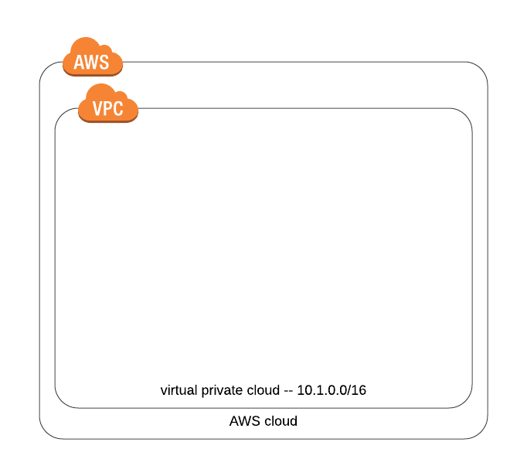
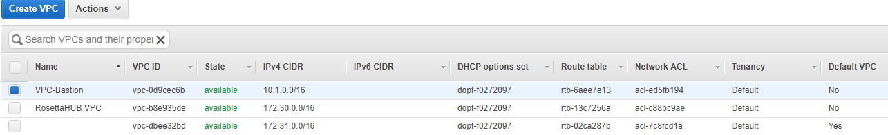
VPC creation
VPC name: VPC-Bastion
Ipv4: 10.1.0.0/16

Slide 2
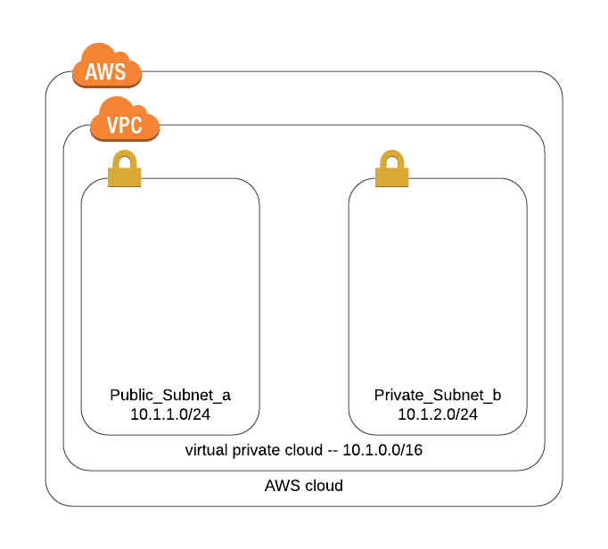
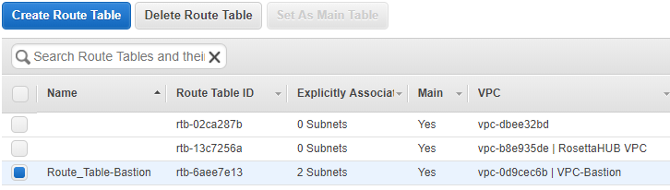
Subnets creation
Public subnet name: Public_Subnet_a
Ipv4: 10.1.1.0/24
Private subnet name: Private_Subnet_b
Ipv4: 10.1.2.0/24
Associating these subnets to the implicit VPC-Bastion Route Table

Slide 3
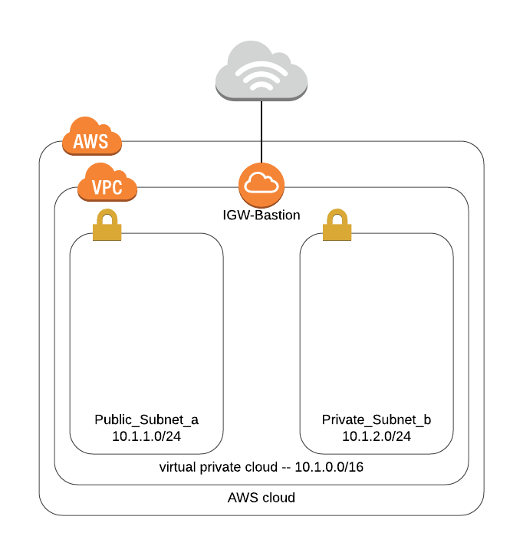
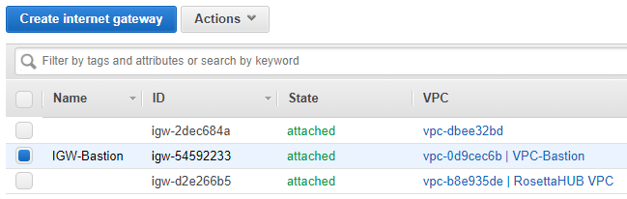
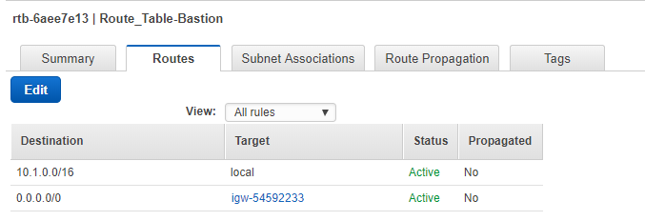
Internet Gateway creation
Internet gateway name: IGW-Bastion .Attached to the VPC-Bastion
Adding a route to the Route Table for IPv4 Internet traffic (0.0.0.0/0), pointing to IGW-Bastion.

Slide 4
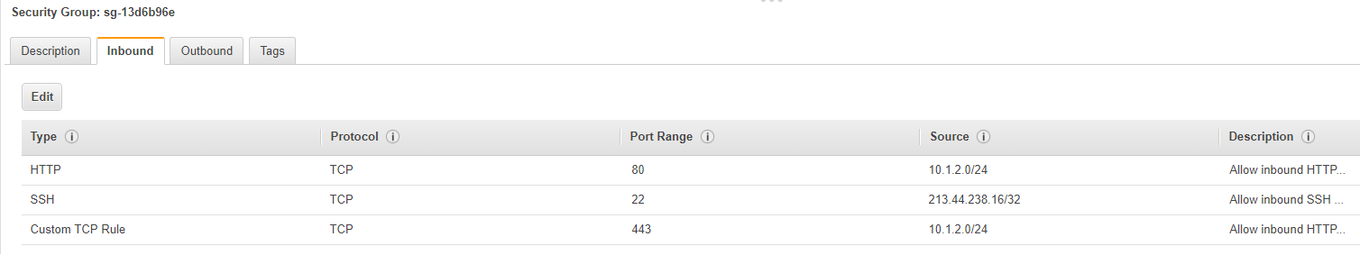
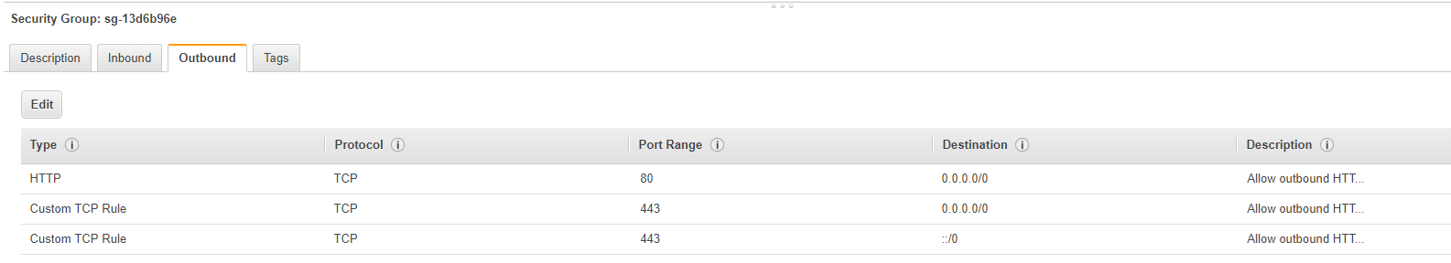
Network Address Translation creation 1/2
NAT security group name: NAT-SG. Adding inbound and outbound (HTTP,HTTPS, SSH)

Slide 5
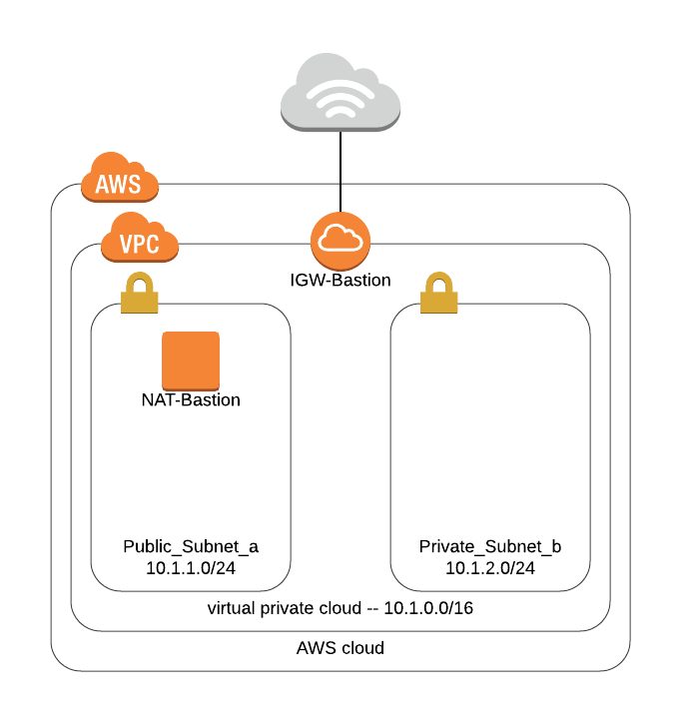
Network Address Translation creation 2/2
NAT instance name : NAT
Created from an AMI:amzn-ami-vpc-nat
Configuring to be attached to the public subnet, and security group NAT-SG
Creating an elastic IP and associating it to the NAT.

Slide 6
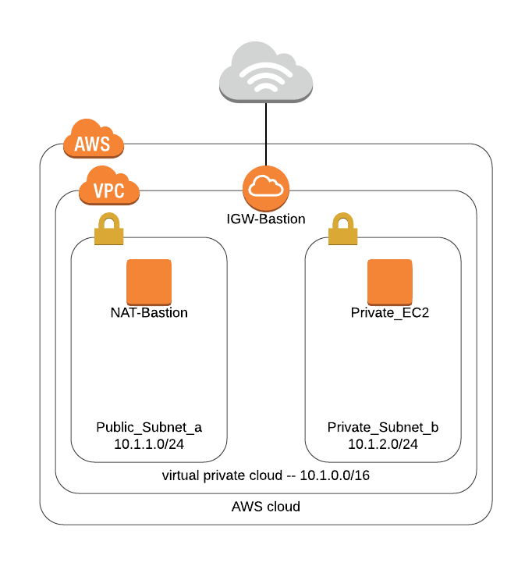
Private EC2 creation

Slide 7
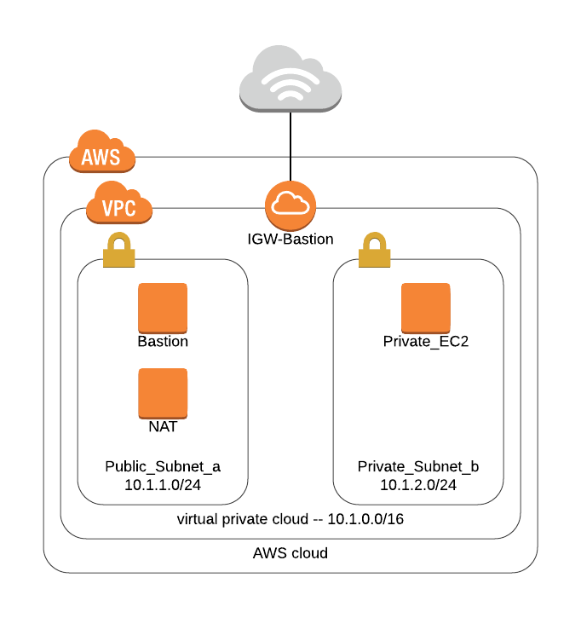
Public NAT instance creation

Slide 8
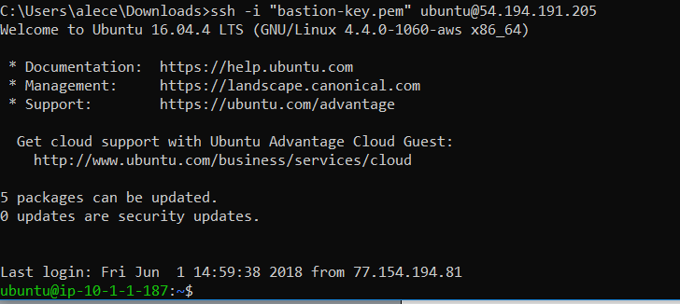
Connection to Bastion
First, go to directory containing the key pairs (“Downloads” here)

Slide 9
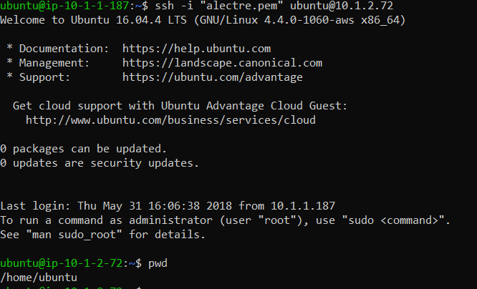
Connection to private instance

